Slide 1
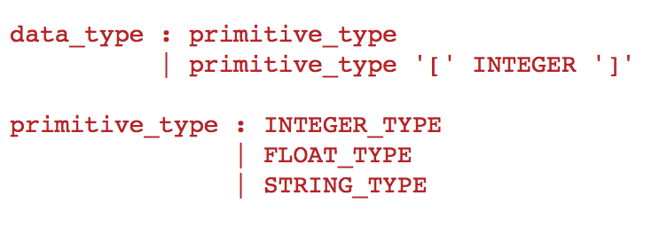
Array Implementation
The key insight here is that arrays can be viewed as modifiers to some primitive type such as int or float, e.g. int[10]
This is expressed with the grammar rules:

Slide 2
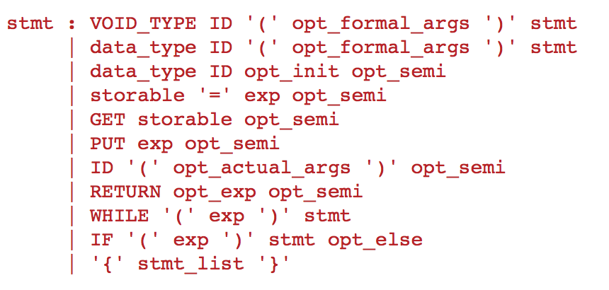
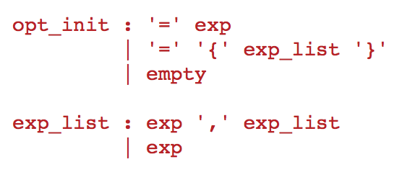
Array Implementation
We also need to allow for array initializers of the form int[2] a = {1,2} in addition to the scalar initializers

Slide 3
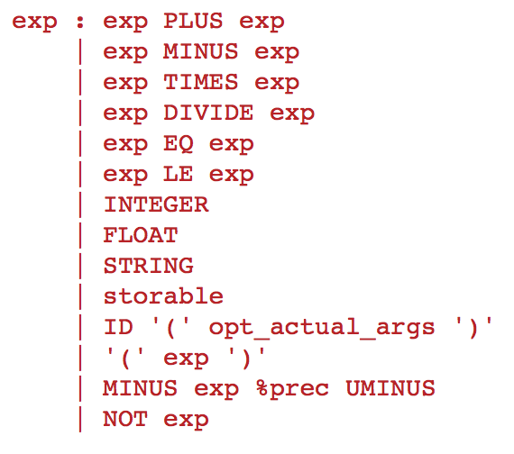

Array Implementation
The last thing we need to address are the contexts array expression can appear in:
Left hand side of an assignment statement
Within an expression
We do this with the idea of a storable:

Slide 4
Type Descriptors
Up to now we were able to describe our types with tokens such as INTEGER or FLOAT
With the introduction of arrays this is no longer true, the type int[10] is different from the type int[20] and is certainly different from the type int
In order to describe structured types in our AST we need type descriptors, that is, structural descriptions of the type at hand.

Slide 5
Type Descriptors
In our implementation type descriptors are tuples
For the primitive types the type descriptors are one tuples,
(‘integer’,)
(‘float’,)
(‘string’,)
For arrays we have the ‘array-type’ tuple,
(‘array-type’, <size>, <elem-type>)

Slide 6
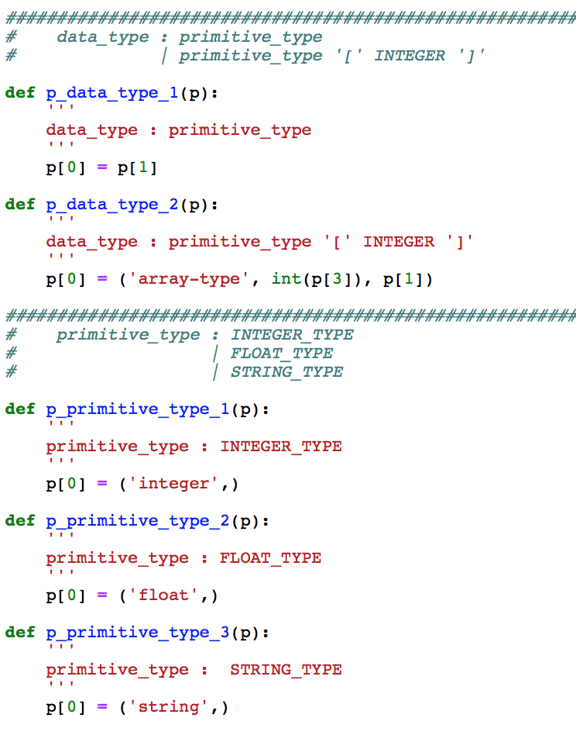
Type Descriptors
These type descriptors show up in the front end

Slide 7
Type Descriptors
Going from a token based type system to type descriptors has ramification for the type checker:
Checking for compatible types is more complicated because we have to do a structural comparison
Type promotions (widening conversions) should only be applied to scalar types
This is a design decision, we could also allow for code like this if we so choose:
int[3] a = {1,2,3};
float[3] b;
b = a; // element by element type promotion
put b;
Output: {1.0, 2.0, 3.0}

Slide 8
Type Descriptors vs. Values
Type descriptors are structural descriptions of types in the AST
The type descriptions are used in variable declarations
stmt returns [Stmt ast]
: …
| dt=dataType VAR '=' initializer ';' { $ast = new VarDeclStmt($dt.type,$VAR.text,$initializer.ast); }
| …
;

Slide 9
Type Descriptors vs. Values
Values are objects that we associate with variables in the symbol table
Values represent actual values such as integer values that can be copied and with which we can compute.
In our language values are represented by the following class hierarchy
Value
IntValue
FloatValue
StringValue
ArrayValue
FunctionValue

Slide 10
Type Descriptors vs. Values
Type Descriptors are just structural descriptions of the type in the AST
Values are object that can hold values that we can compute with:
IntValue - holds an integer value
FloatValue - holds a real value
StringValue - holds a string value
ArrayValue - holds the values of its elements with the appropriate element type
FunctionValue - holds a function value

Slide 11
Type Descriptors vs Values
Symbol Table
Global Scope
int[3] a = { 3,-2,10 };
a → Array int 3 {3,-2,10}
Current Scope Pointer
Value
Type Descriptor: ArrayType(Type.INTEGER, 3)

