Slide 1
Compiling for Real Machines
We have seen compilers that compile high-level code to virtual machine code
Here we take a look at compilers that generate actual machine code
The difference between the two approaches is the fact that real machines impose many more constraints on the generated code.
Consider the ‘mov’ command in the i386 instruction set.
Mov a,b means moving the value stored in b to the entity a.
Constraint: only one of the operands is allowed to be a memory address, the other one has to be a register, e.g., mov eax,x or mov x,eax, but not mov x,y where both x and y are labels.

Slide 2
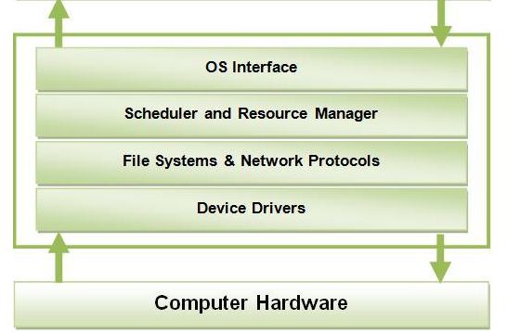
The Virtual Address Space
0
Compiled code,
RTS,
Library code
Heap Manager
static
Global data
Stack Pointer
Heap
dynamic
Runtime stack
FF..FF

Slide 3
The Virtual Address Space
The virtual address space for an application is managed on the OS side by the scheduler and resource manager
Once the virtual address space is created, the scheduler will hand control off to the program
However, if something goes wrong (exceptions) or if the program exits, the scheduler resumes control.

Slide 4
Compiling for Real Machines
Classical Tool Sequence
Library
Code
Assembly
Language
File
Editor
Source File
Compiler
Assembler
Object
Code
Linker
Executable
Code
Loader
In our Case:
Simple3 Compiler
Link
Part of the OS,
Scheduler
MASM32

Slide 5
i386 Machine Code
Before looking at translation, let take a look at i386 machine code and the MASM32 assembler
Different from the gas x86 syntax we looked at previously, here:
mov eax,x means eax ← x

Slide 6
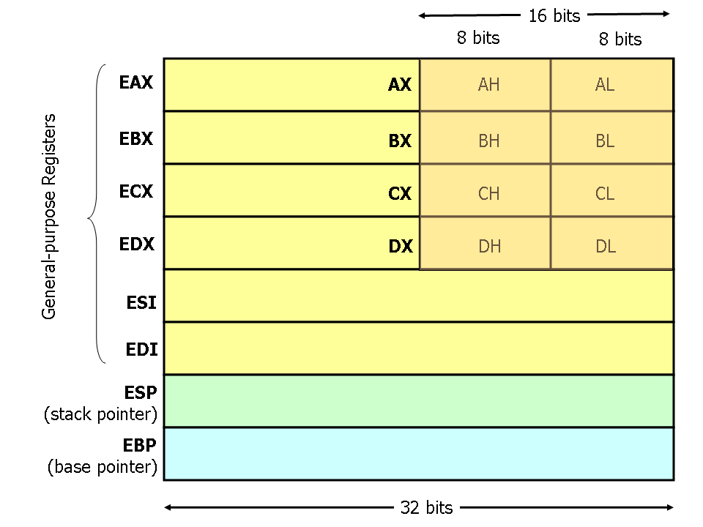
The Machine Registers
Some examples of mov instructions using the registers:
mov eax, ebx ; Move the contents of EBX into EAX
mov x, ebx ; Move the contents of EBX into the 4 bytes at memory address x, x is a label.
mov eax, [ebp-4] ; Move 4 bytes at memory address EBP + (-4) into EAX

Slide 7
i386 Machine Code
;;; add.asm - this program asks the user for two integer values,
;;; adds them together, and then prints out the result
;;; include everything that is necessary to run this program
include tinyrts.asm
;;; data section: 3 DWORDs (4 bytes) initialized to 0.
;;; 'dd' stands for 'Data Dword'.
.data
X dd 0
y dd 0
z dd 0
;;; code section: all programs have to start with the
;;; label 'start:' and end with end start'
.code
start:
invoke get ;ask for the first int and store it into x
mov x,eax
invoke get ;ask for the second int and store it into y
mov y,eax
mov eax,x ;load x into eax
mov ebx,y ;load y into ebx
add eax,ebx ;eax=eax+ebx
mov z,eax ;store eax into z
invoke put,z ;print z to the screen
invoke exit ;exit program
end start

Slide 8
Our RTS
;;; tinyrts.asm - version 1.0
;;; define the process model for MASM
.386
;;; define the memory model MASM
.model flat,stdcall
;;; labels and names are case sensitive
option casemap:none
;;; include the necessary procedure prototypes and
;;; library code to support this minimal RTS
;;; NOTE: here we use the microsoft C runtime lib.
include \masm32\include\msvcrt.inc
includelib \masm32\lib\msvcrt.lib
;;;;;;;;;;;;;;;;;;;;;;;;;;;;;;;;;;;;;;;;;;;;;;;;;;;;;;;;;;;;;;;;
;;; RTS procedure definitions
.code
;;; define the get procedure
;;; call: invoke get
;;; return value in eax
get proc
.data
get_buffer dd 0
get_text db "Enter a value: ",0
get_format db "%d",0
.code
invoke crt_printf,ADDR get_text
invoke crt_scanf,ADDR get_format,ADDR get_buffer
mov eax,get_buffer
ret
get endp
;;; define the put procedure
;;; call: invoke put, <arg>
;;; return value: none
put proc v
.data
put_format db "Value: %d",13,10,0
.code
invoke crt_printf, ADDR put_format,v
ret
put endp
;;; define the exit procedure
;;; call: invoke exit
;;; return value: none
exit proc
.code
invoke crt__exit,0
ret
exit endp

Slide 9
Using jump Instructions
;;; seq.asm
;;; generate the sequence 1...10 and print it to the screen.
include tinyrts.asm
.data
cnt dd 0
.code
start:
mov cnt,1
top:
cmp cnt,10
jg bottom
invoke put,cnt
inc cnt
jmp top
bottom:
invoke exit
end start

Slide 10
Recursive Functions
;;; factrec.asm - compute the factorial of a number recursively
include tinyrts.asm
;;; ;;;;;;;;;;;;;;;;;;;;;;;;
.data
x dd 0 ;input value
z dd 0 ;factorial result
;;; ;;;;;;;;;;;;;;;;;;;;;;;;;
;;; our recursive factorial procedure - returns the result in eax
.code
fact proc i
cmp i,0
jne cont
mov eax,1 ;if i==0 return 1
ret
cont:
mov eax,i
dec eax
invoke fact,eax
imul eax,i ;mult the i and result of fact
ret
fact endp
;;; ;;;;;;;;;;;;;;;;;;;;;;;;;
.code
start:
invoke get ;get input value
mov x,eax
invoke fact,x ;compute fact into z
mov z,eax
invoke put,z ;pint out result
invoke exit ;done!
end start
Note: you cannot keep intermediate values in registers across function calls, the call will destroy these values.

Slide 11
Recursive Functions with local Variables
;;; factrec.asm - compute the factorial of a number recursively
include tinyrts.asm
;;; ;;;;;;;;;;;;;;;;;;;;;;;;
.data
x dd 0 ;input value
z dd 0 ;factorial result
;;; ;;;;;;;;;;;;;;;;;;;;;;;;;
;;; our recursive factorial procedure - returns the result in eax
.code
fact proc i
LOCAL result:DWORD ;reserve space on the stack for 'result'
acmp i,0
jne cont
mov result,1 ;if i==0 return 1
jmp done
cont:
mov eax,i
dec eax
invoke fact,eax
imul eax,i ;mult the i and result of fact
mov result,eax
done:
mov eax,result
ret
fact endp
;;; ;;;;;;;;;;;;;;;;;;;;;;;;;
.code
start:
invoke get ;get input value
mov x,eax
invoke fact,x ;compute fact into z
mov z,eax
invoke put,z ;pint out result
invoke exit ;done!
end start

Slide 12
Recursive Functions with local Variables
A different style of writing functions with local variables - explicit manipulation of the stack frame.
Advantage: our Simple3 compiler is easily adapted to this approach.

Slide 13
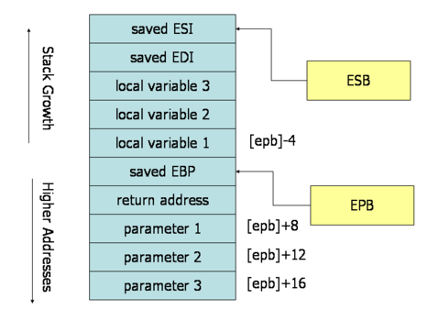
Recursive Functions with local Variables
;;; factrec.asm - compute the factorial of a number recursively
include tinyrts.asm
;;; ;;;;;;;;;;;;;;;;;;;;;;;;
.data
x dd 0 ;input value
z dd 0 ;factorial result
;;; ;;;;;;;;;;;;;;;;;;;;;;;;;
;;; our recursive factorial procedure - returns the result in eax
.code
fact proc i
sub esp,4 ;push our stack frame
cmp i,0
jne cont
;; esp points to the top of the stack frame
;; ebp points to the bottom of the stack frame
mov eax,1
mov [ebp-4],eax ;if i==0 return 1
jmp done
cont:
mov eax,i
dec eax
invoke fact,eax
imul eax,i ;mult the i and result of fact
mov [ebp-4],eax
done:
mov eax,[ebp-4]
add esp,4 ; pop stack frame
ret
fact endp
;;; ;;;;;;;;;;;;;;;;;;;;;;;;;
.code
start:
invoke get ;get input value
mov x,eax
invoke fact,x ;compute fact into z
mov z,eax
invoke put,z ;pint out result
invoke exit ;done!
end start
Stack Frame
local variable 5
local variable 4
ESP
[ebp-8]
[ebp-4]
EBP
[ebp+8]
[ebp+12]
[ebp+16]
ESP - stack pointer register
EBP - base pointer register

