Slide 1
Processing ASTs: Tree Walking
The recursive structure of trees gives rise to an elegant way of processing trees: tree walking.
A tree walker typically starts at the root node and traverses the tree in a depth first manner.

Slide 2
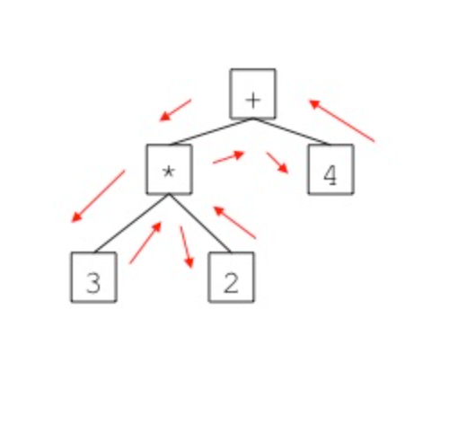
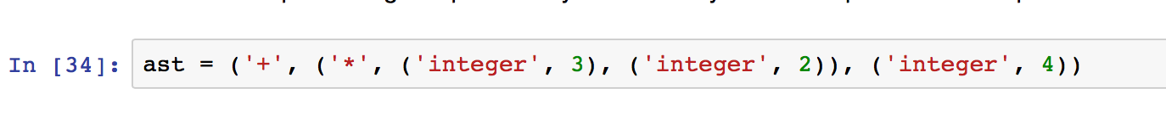
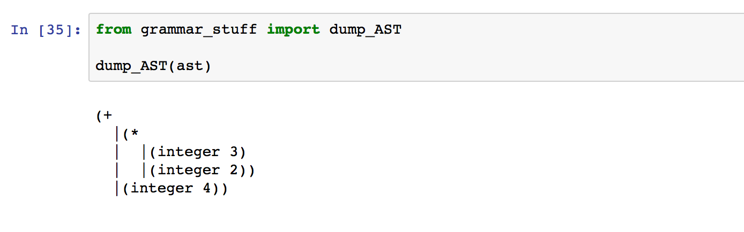
Processing ASTs: Tree Walking
Consider the following:
3*2+4

Slide 3
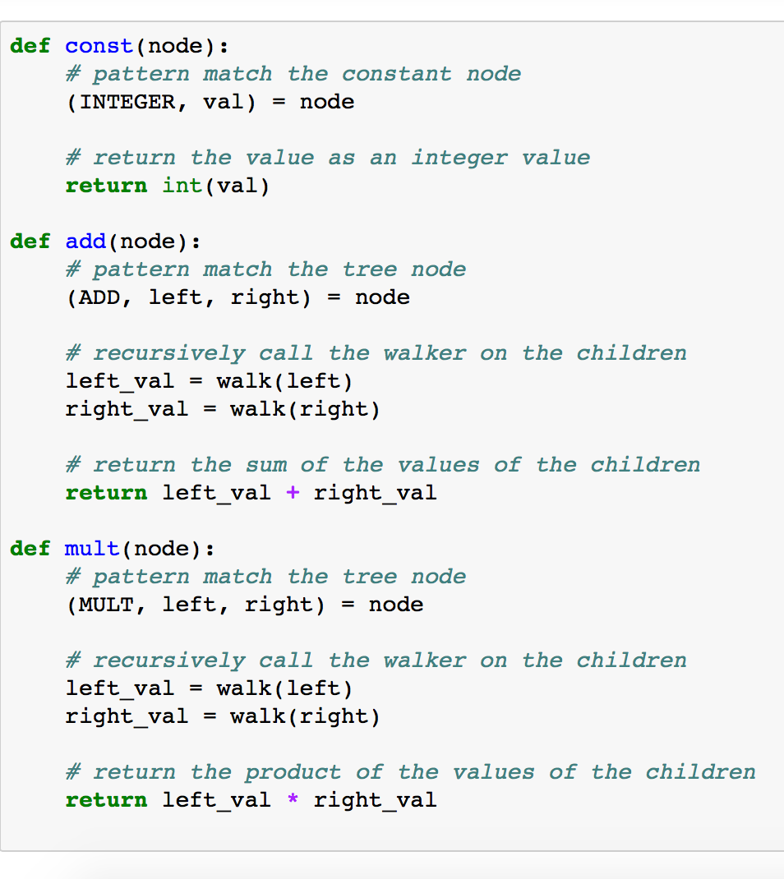
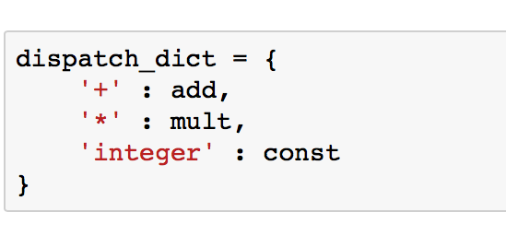
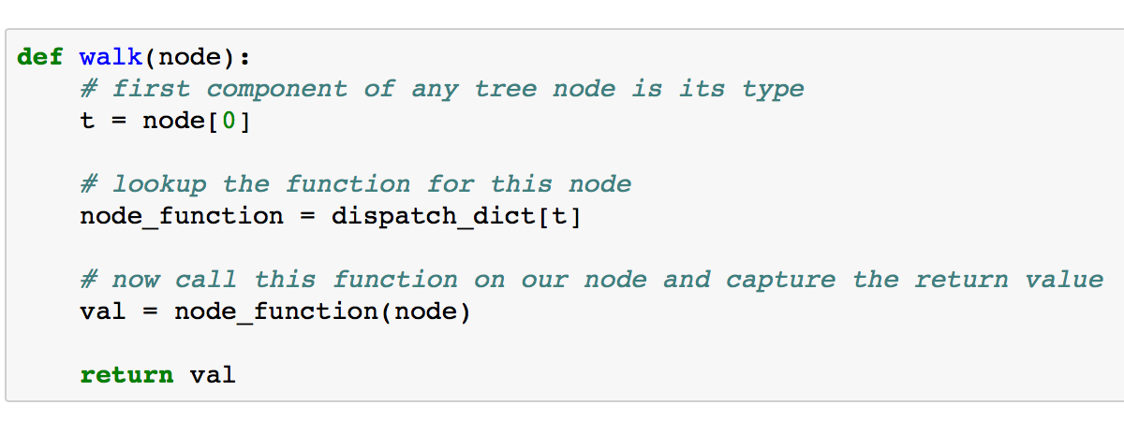
Processing ASTs: Tree Walking
A simple tree walker for our expression tree

Slide 4
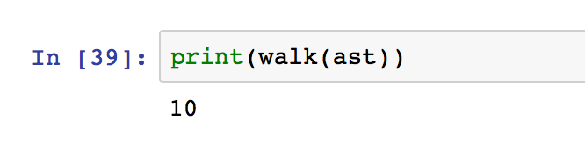
Processing ASTs: Tree Walking
A simple tree walker for our expression tree
We just interpreted the expression tree!!!

Slide 5
Processing ASTs: Tree Walking
A simple tree walker for our expression tree
Notice that this scheme mimics what we did in the syntax directed interpretation schema,
But now we interpret an expression tree rather than the implicit tree constructed by the parser.

Slide 6
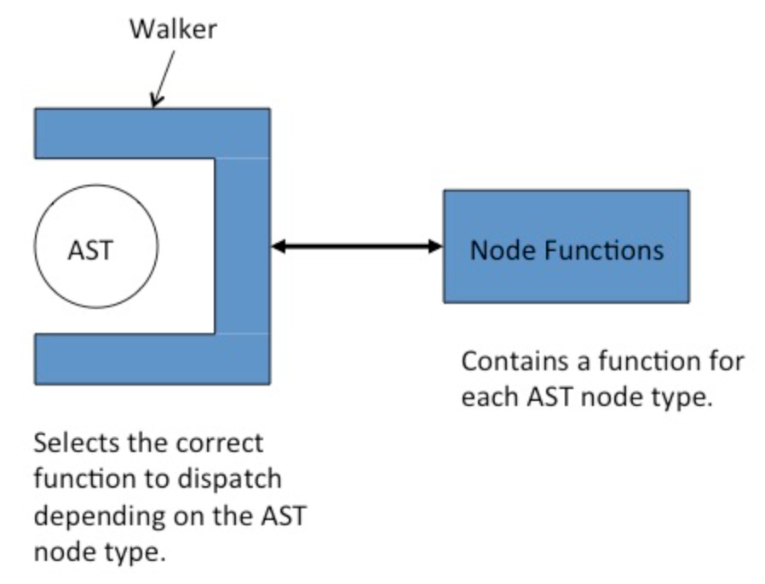
Tree Walkers are Plug'n Play
Tree walkers exist completely separately from the AST.
Tree walkers plug into the AST and process it using their node functions.

Slide 7
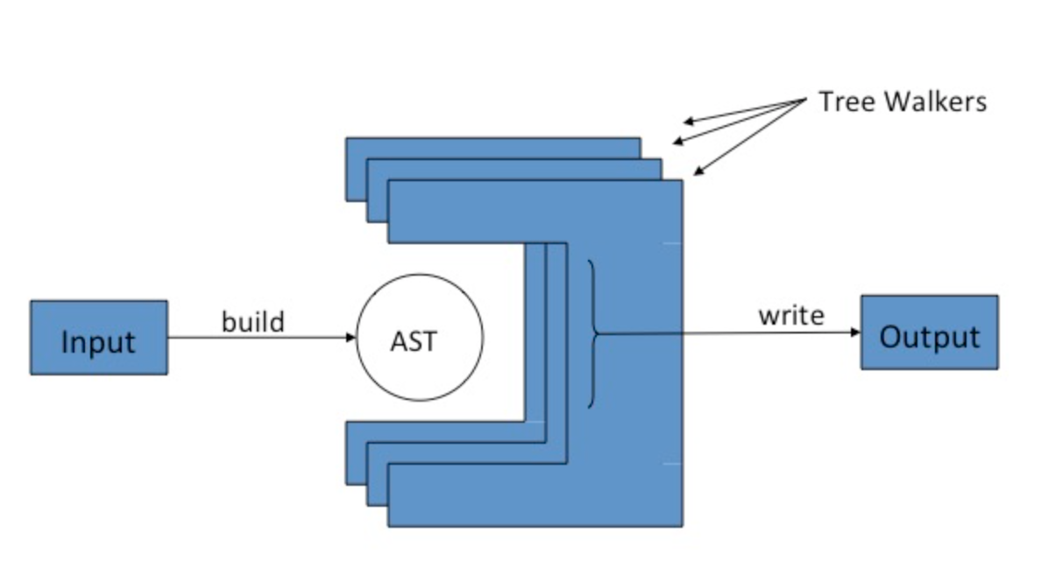
Tree Walkers are Plug'n Play
There is nothing to prevent us from plugging in multiple walkers during the processing of an AST, each performing a distinct phase of the processing.

Slide 8
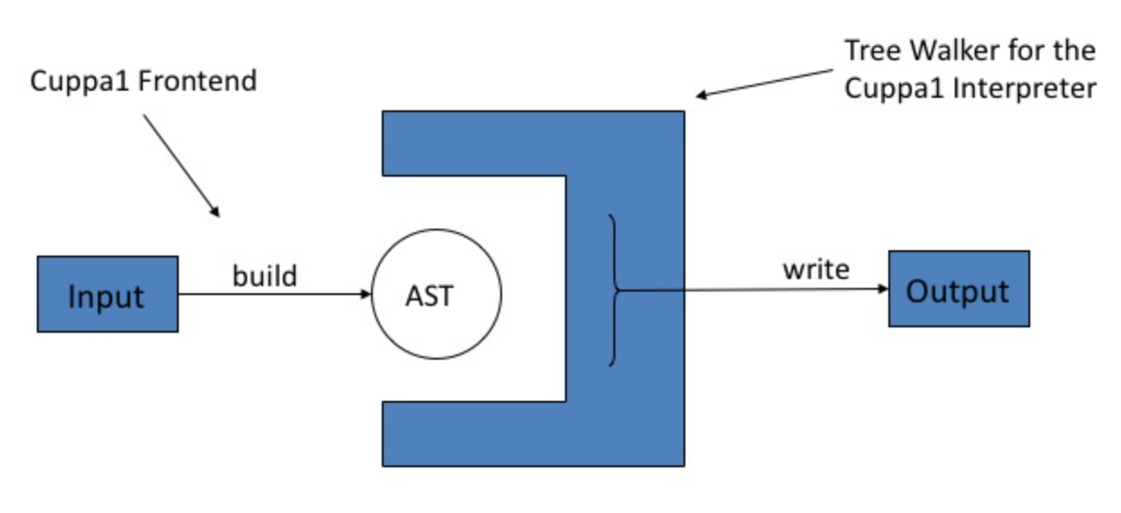
An Interpreter for Cuppa1

Slide 9
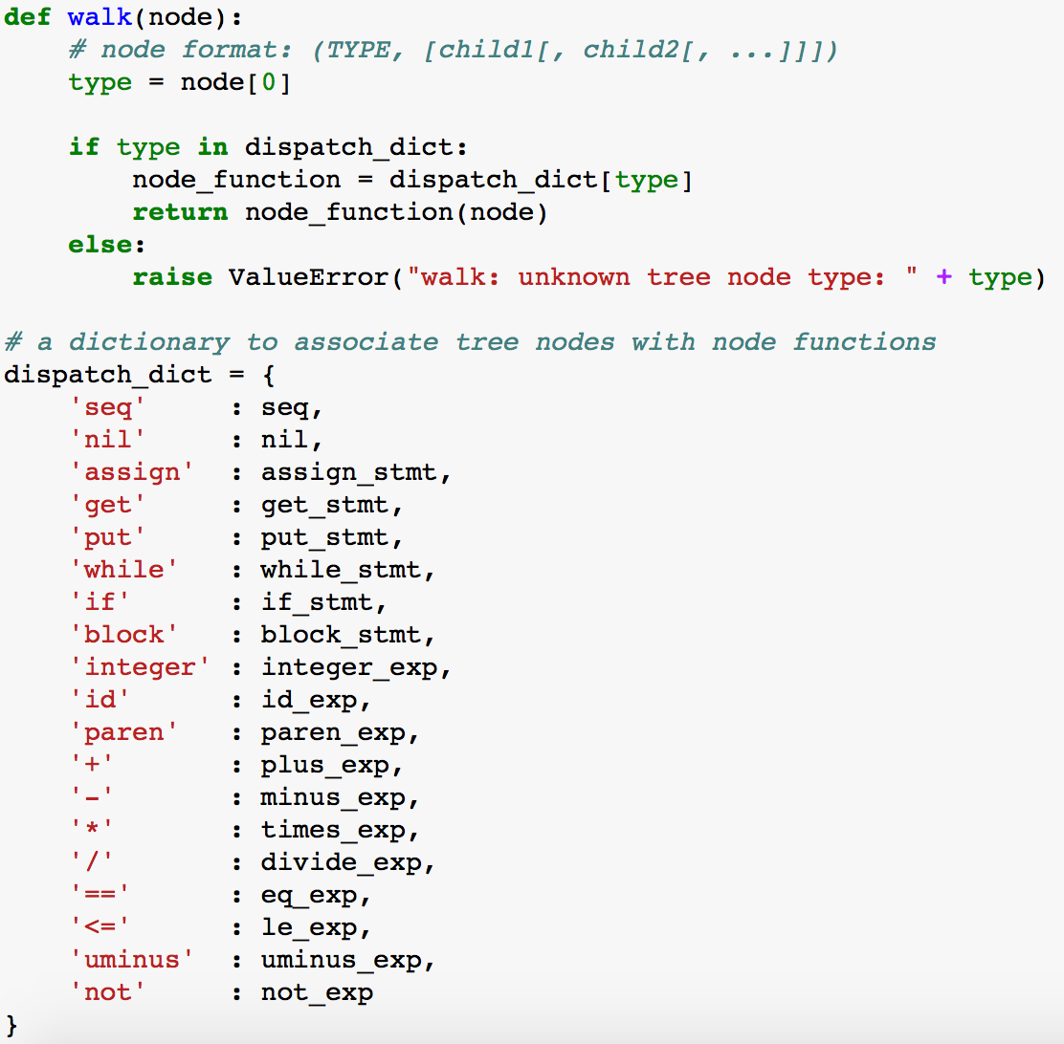
An Interpreter for Cuppa1
cuppa1_interp_walk.py

Slide 10
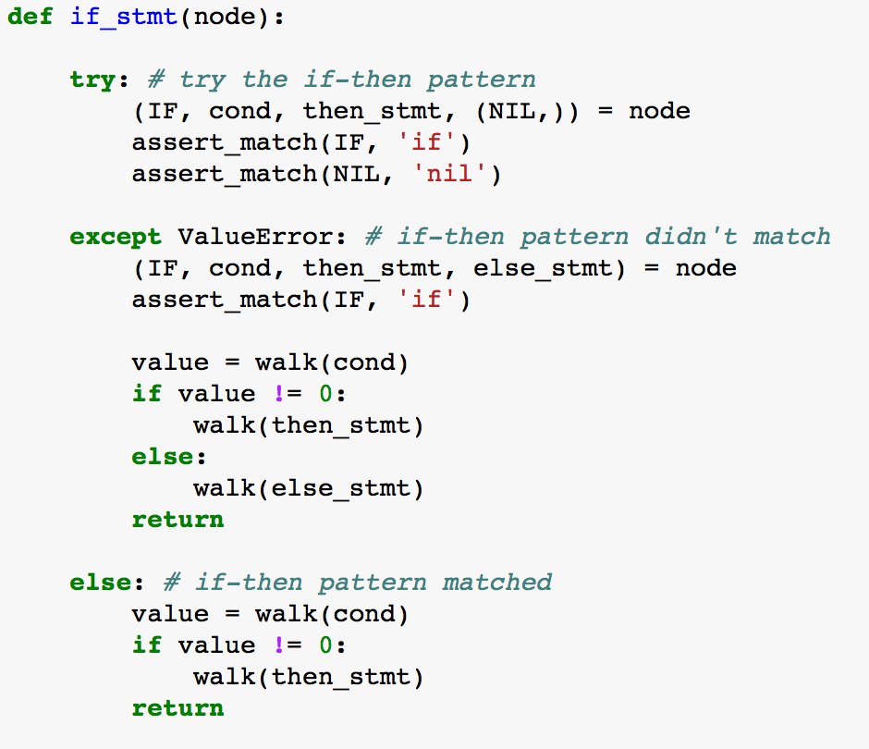
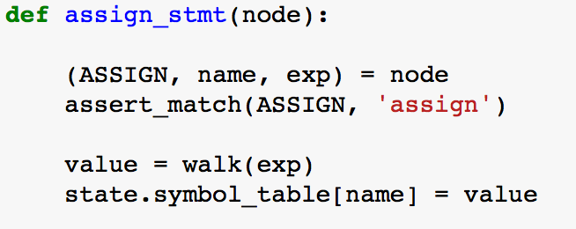
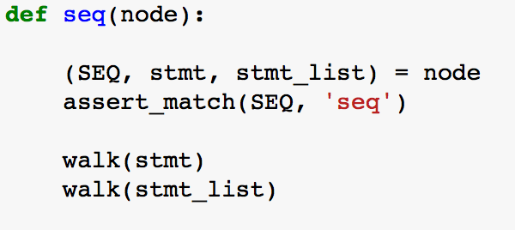
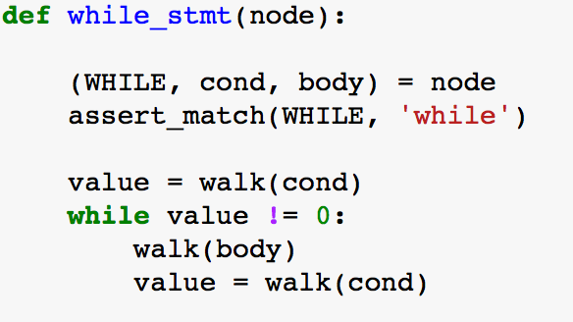
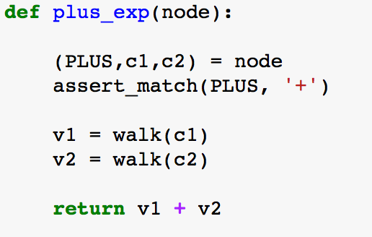
An Interpreter for Cuppa1
cuppa1_interp_walk.py

Slide 11
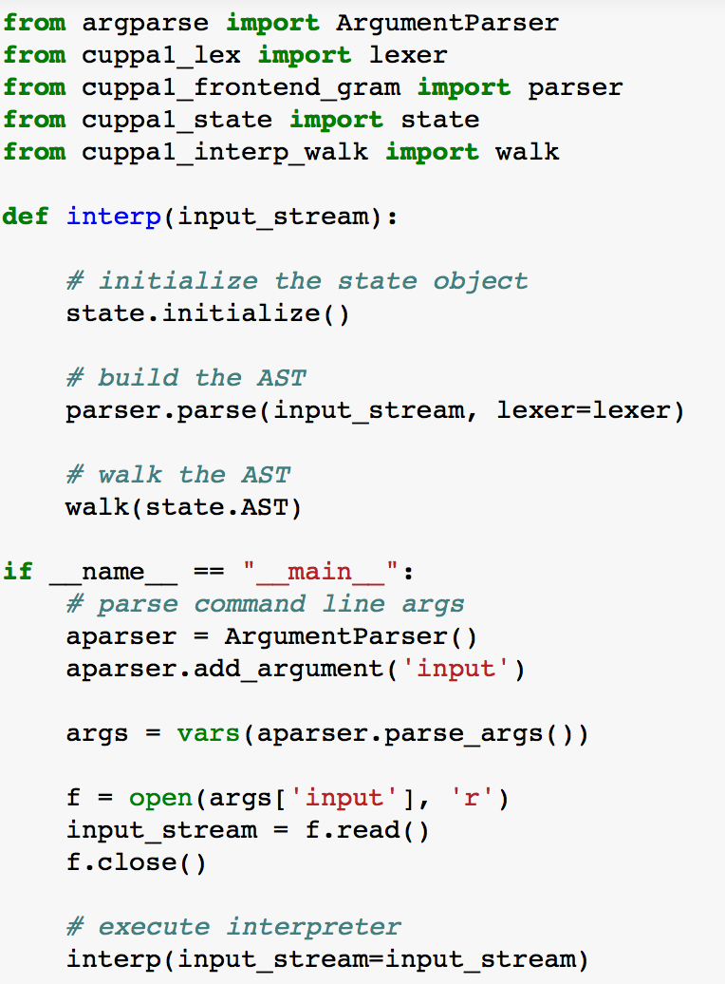
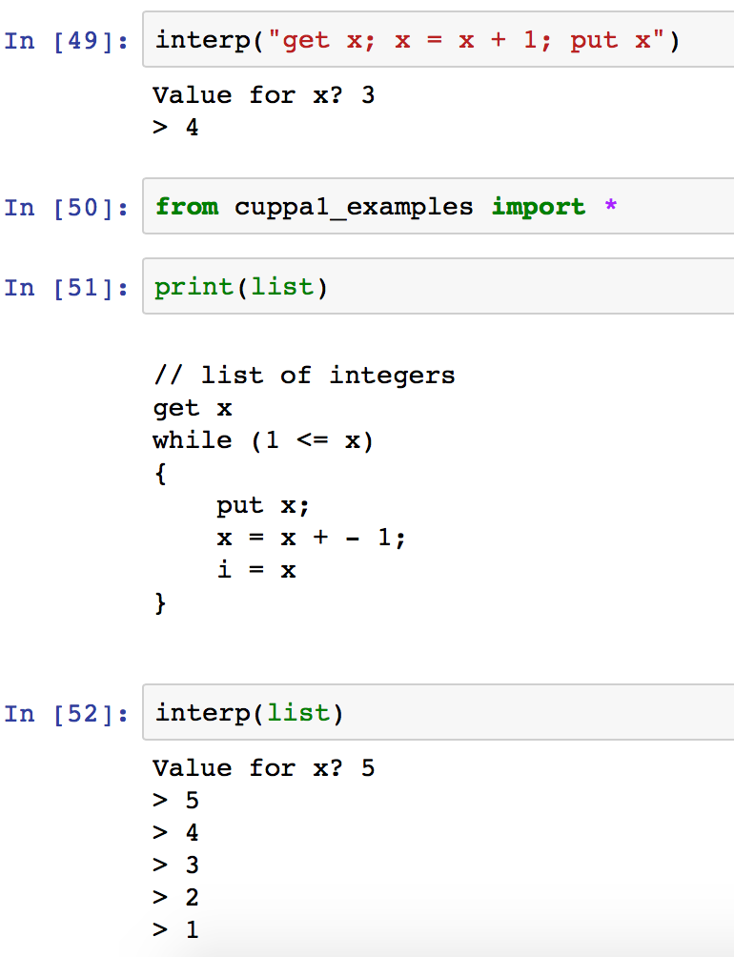
An Interpreter for Cuppa1
cuppa1_interp.py

Slide 12
A Pretty Printer with a Twist
Our pretty printer will do the following things:
It will read the Cuppa1 programs and construct an AST
It will compute whether a particular variable is used in the program
It will output a pretty printed version of the input script but will flag assignment/get statements to variables which are not used in the program
➔This cannot be accomplished in a syntax directed manner – therefore we need the AST

Slide 13
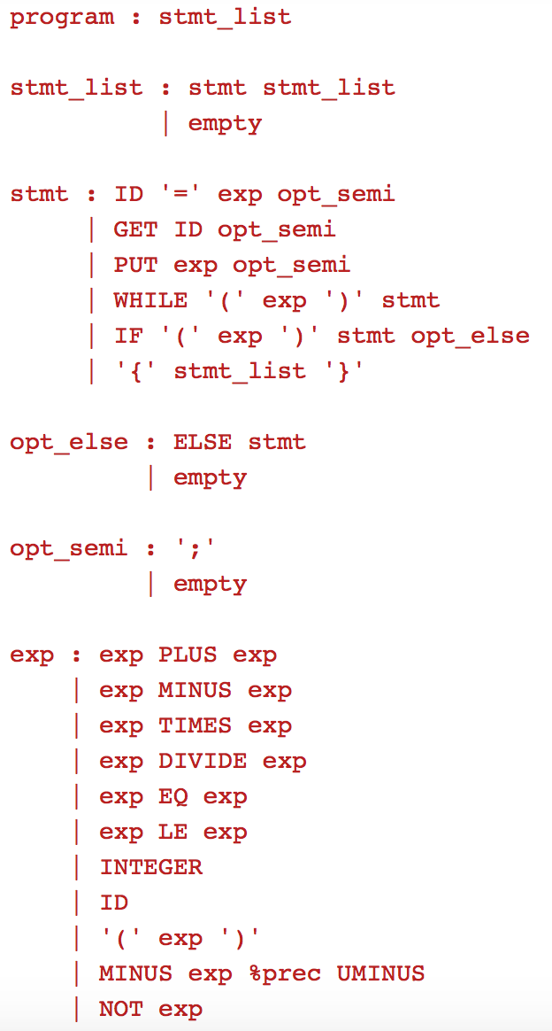
PrettyPrinting the Language
// list of integers
get x;
i = x;
while (1 <= x) {
put x;
x = x - 1;
}
get x
i = x // -- var i unused --
while ( 1 <= x )
{
put x
x = x - 1
}
 We need an IR because usage will always occur after definition – cannot be handled by a syntax directed pretty printer.

Slide 14
The Pretty Printer is a Translator!
The Pretty Printer with a Twist fits neatly into our translator class
Read input file and construct AST/Collect info
Generate output code, flagging unused assignments
IR
IR
Syntax
Analysis
Semantic
Analysis
Code
Generation
Target Language
Program Text
Variable definition/usage analysis

Slide 15
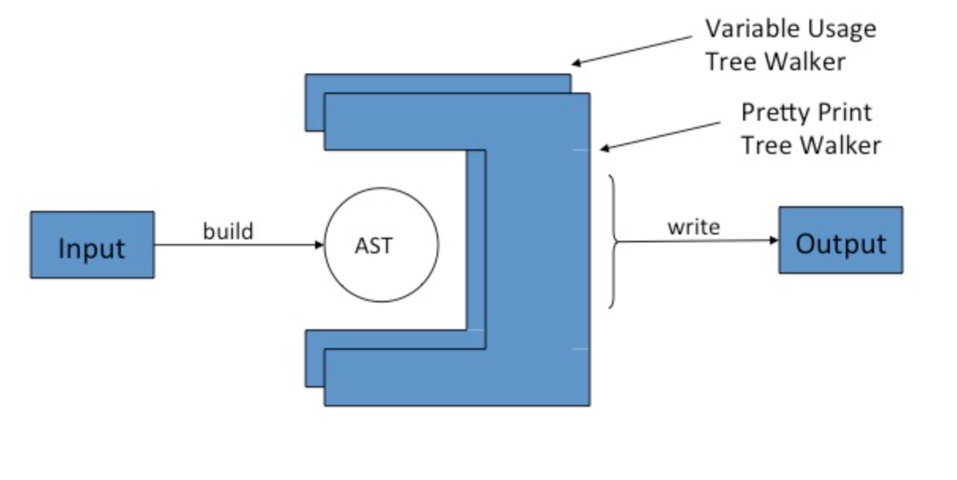
Pretty Printer Architecture
Frontend + 2 Tree Walkers

Slide 16
PP1: Variable Usage
The first pass of the pretty printer walks the AST and looks for variables in expressions
only those count as usage points.
A peek at the tree walker for the first pass, cuppa1_pp1_walk.py shows that it literally just walks the tree doing nothing until it finds a variable in an expression.
If it finds a variable in an expression then the node function for id_exp marks the variable in the symbol table as used,

Slide 17
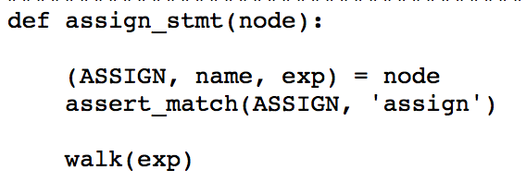
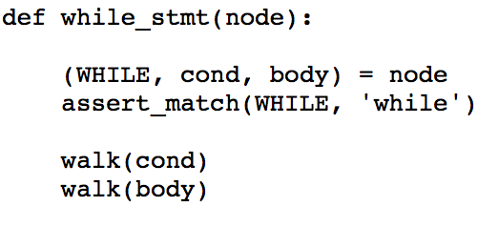
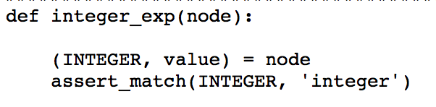
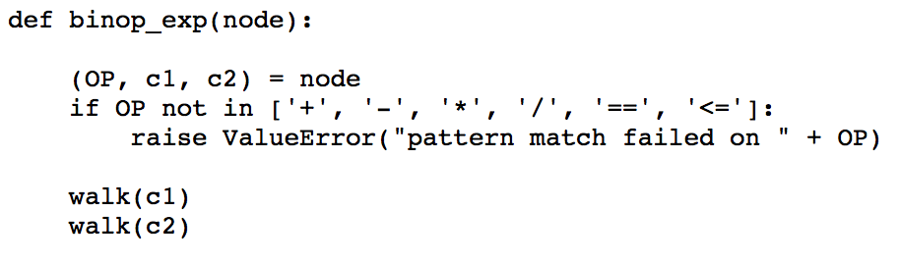
PP1: Variable Usage
Just Walking the Tree!

Slide 18
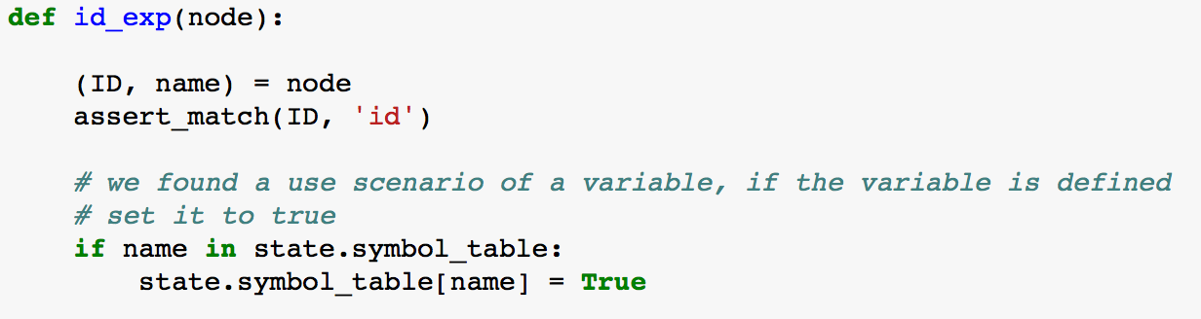
PP1: Variable Usage
But…

Slide 19
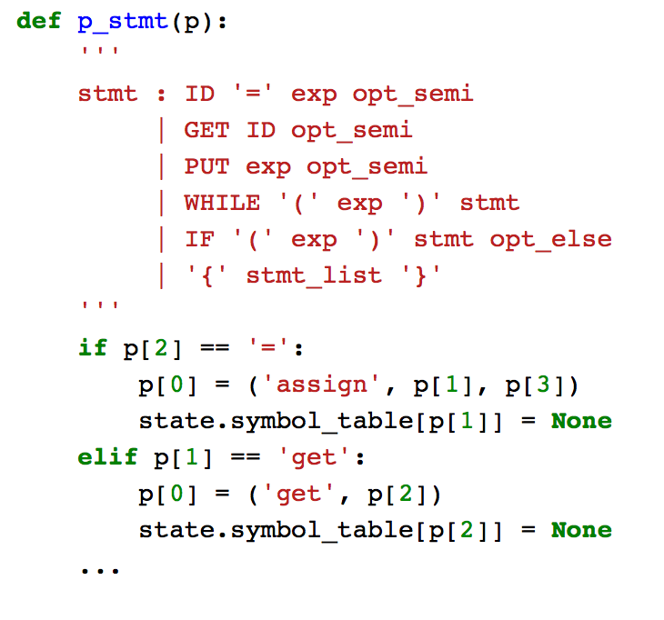
PP1: Variable Usage
Recall that when the frontend finds a definition of a variable as an
assignment statement or a
get statement
it enters the variable into the symbol table and initializes it with None.

Slide 20
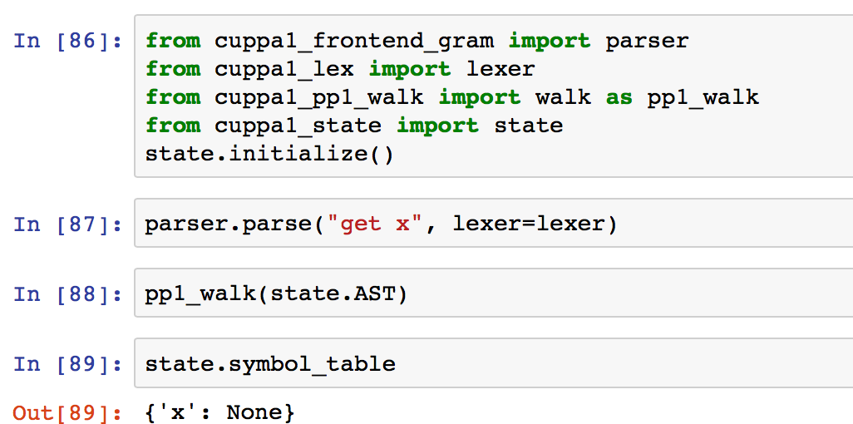
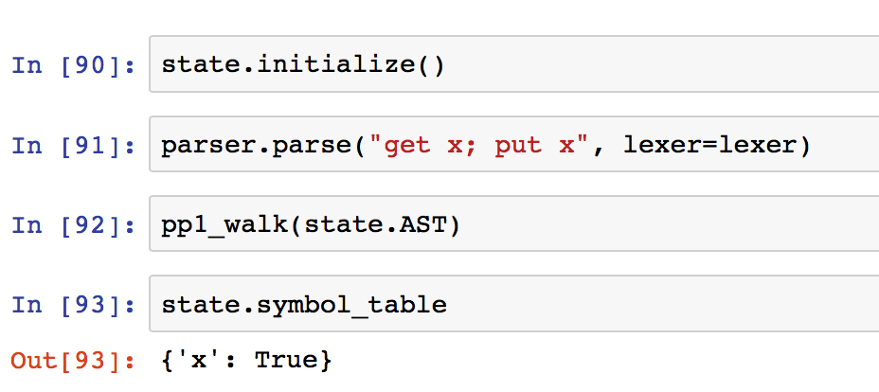
PP1: Variable Usage
Testing the tree walker

Slide 21
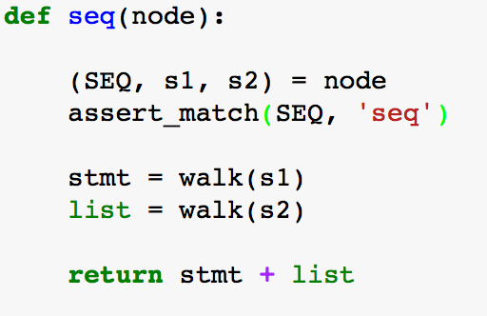
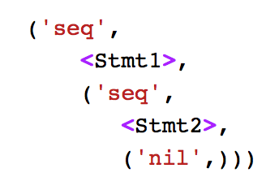
PP2: Pretty Print Tree Walker
The tree walker for the second pass walks the AST and compiles a formatted string that represents the pretty printed program.
Recall that programs are nil terminated Seq lists of statements:
Concatenate the string
for stmt with the string from the rest of the Seq list.

Slide 22
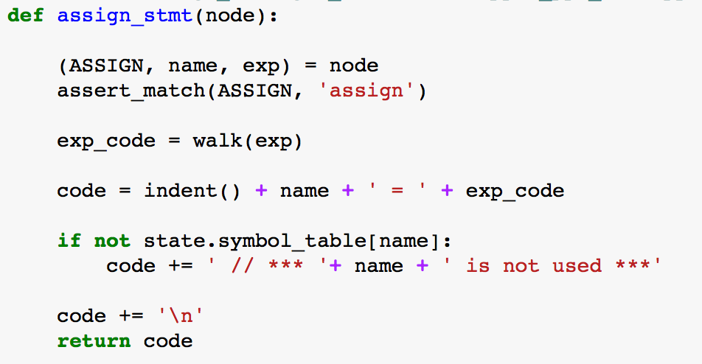
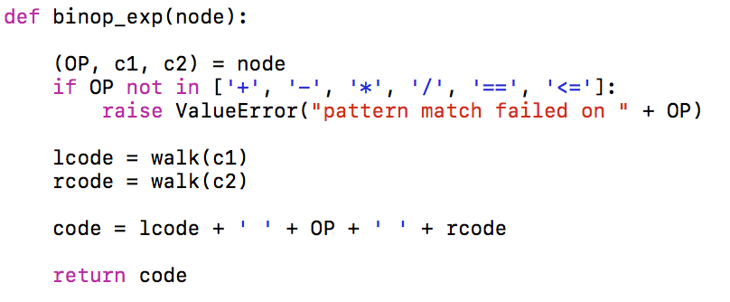
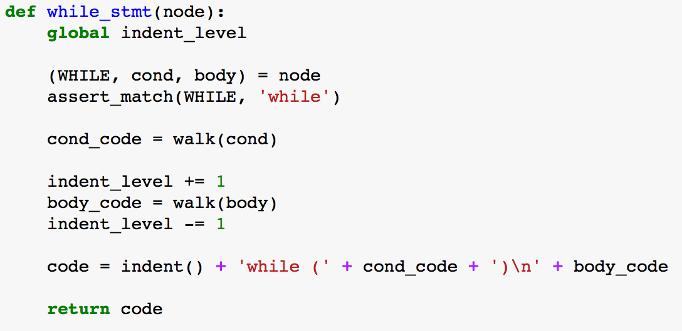
PP2: Pretty Print Tree Walker
Indent() and indent_level keep track of the code indentation for formatting purposes.

Slide 23
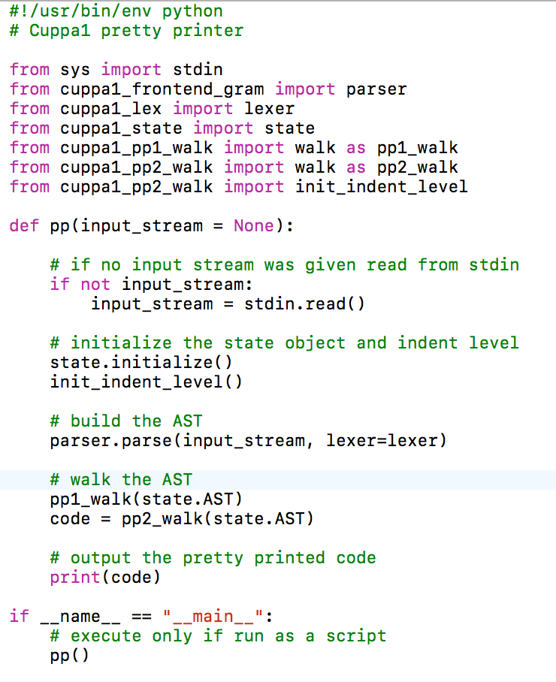
Top Level Function of PP
Top level function

Slide 24
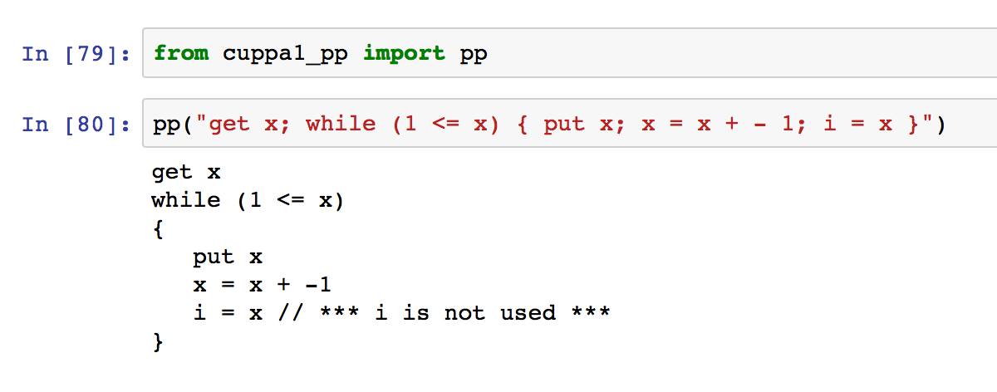
The Cuppa1 PP
Testing the pretty printer

Slide 25
Assignment
Chap 5
Midterm – see webpage.

