Slide 1
Multi-Symbol Words - Lexical Analysis
In our exp0 programming language we only had words of length one
However, most programming languages have words of lengths more than one
The lexical structure of a programming language specifies how symbols are combined to form words
Not to be confused with the phrase structure which tells us how words are combined to form phrases and sentences
The lexical structure of a programming language can be specified with regular expressions
whereas the phrase structure is specified with CFGs.
The “parser” for the lexical structure of a programming language is called a lexical analyzer or lexer

Slide 2
Reading
Chap 3

Slide 3
Multi-Symbol Words - Lexical Analysis
This gives us the following hierarchy:
symbol
Lexical structure (regular expressions)
word
phrase
Phrase structure (grammars)
sentence

Slide 4
Ply & Regular Expressions
The lexer in Ply uses the Python regular expression syntax
https://docs.python.org/3.6/library/re.html
Documentation on the Ply lexer can be found here:
http://www.dabeaz.com/ply/ply.html#ply_nn3

Slide 5
Regular Expressions (RE)
‘a’ … ‘a’+ = ‘a’’a’*
REs can be defined inductively as follows:
Each letter ‘a’ through ‘z’ and ‘A’ through ‘Z’ constitutes a RE and matches that letter
Each number ‘0’ through ‘9’ constitutes a RE and matches that number
Each printable character ‘(‘, ‘)’,’+’, etc. constitutes a RE and matches that character.
If A is a RE, then (A) is also a RE and matches A
‘(A)’ vs. ‘\(A\)’
If A and B are REs, then AB is also a RE and matches the concatenation of A and B.
If A and B are REs, then A|B is also an RE and matches A or B
If A is a RE, then A? is also a RE and matches zero or one instances of A
If A is a RE, then A* is also a RE and matches zero or more instances of A
If A is a RE, then A+ is also a RE and matches one or more instances of A
NOTE: Python regular expressions are written as strings, in particular as raw strings
such as: r’\(a|b\)+’

Slide 6
Regular Expressions (RE)
‘//.*’
‘[a-z]’=‘a’|’b’|’c’….
Useful RE Notations:
‘[a – z]’ - any single character between ‘a’ and ‘z’
‘[A – Z]’ - any single character between ‘A’ and ‘Z’
‘[0 – 9]’ - any single digit between ‘0’ and ‘9’
. - the dot matches any character
Also, any other character can be considered a RE. You need to distinguish between RE commands and syntax of the language to be defined:
i.e., ‘a+’ vs. ‘a\+’
Examples
‘p’ ‘r’ ‘i’ ‘n’ ‘t’ is the same as ‘print’ (why)
‘-?[0-9]+’ [0-9]+|-[1-9][0-9]*
‘([a – z] | [A – Z])+[0 – 9]*’

Slide 7
Regular Expressions (RE)
Exercises:
Write a RE for character strings that start and end with a single digit.
E.g. 3abc5
Write a RE for numbers that have at least two digits and a dot separates the first two digits
E.g. 3.14, 2.5, 3.0, 0.125
Write a RE for numbers where the dot can appear anywhere
E.g. 12.5, .10, 125.0, 125.678, 15.
Write a RE for words that start with a single capital letter followed by lowercase letters and numbers, neither of which has to appear in the word.
E.g. Version10a, A

Slide 8
The Exp1 Language
We extend the Exp0 language to create Exp1:
keywords that are longer than a single character
Variable names that conform to the normal variable names found in other programming languages: a single alpha character followed by zero or more alpha-numerical characters
Numbers that consist of more than one digit.
Ply allows you to specify both the lexer (lex) and the parser (yacc)
It is common practice to convert words of the language longer than one character into tokens

Slide 9
Tokens
The definition of Tokens usually has two parts:
A token type
A token value
For example, in Exp1 we have
a token type PRINT with a token value of ‘print’
a token type NUMBER with an integer token value.
That means lexers turn character/symbols streams into token streams
Token streams is what is read by parsers.

Slide 10
Exp1 Lexer
# %load code/exp1_lex.py
# Lexer for Exp1
from ply import lex
reserved = {
'store' : 'STORE',
'print' : 'PRINT'
}
literals = [';','+','-','(',')']
tokens = ['NAME','NUMBER'] + list(reserved.values())
t_ignore = ' \t'
def t_NAME(t):
r'[a-zA-Z_][a-zA-Z_0-9]*'
t.type = reserved.get(t.value,'NAME') # Check for reserved words
return t
def t_NUMBER(t):
r'[0-9]+'
t.value = int(t.value)
return t
def t_NEWLINE(t):
r’\n'
pass
def t_error(t):
raise SyntaxError("Illegal character {}".format(t.value[0]))
# build the lexer
lexer = lex.lex()
Single-character words
Multi-character words

Slide 11
Exp1 Grammar
# %load code/exp1_gram.py
from ply import yacc
from exp1_lex import tokens, lexer
def p_grammar(_):
"""
prog : stmt_list
stmt_list : stmt stmt_list
| empty
stmt : PRINT exp ';'
| STORE var exp ';'
exp : '+' exp exp
| '-' exp exp
| '(' exp ')'
| var
| num
var : NAME
num : NUMBER
"""
pass
def p_empty(p):
'empty :'
pass
def p_error(t):
print("Syntax error at '%s'" % t.value)
parser = yacc.yacc()

Slide 12
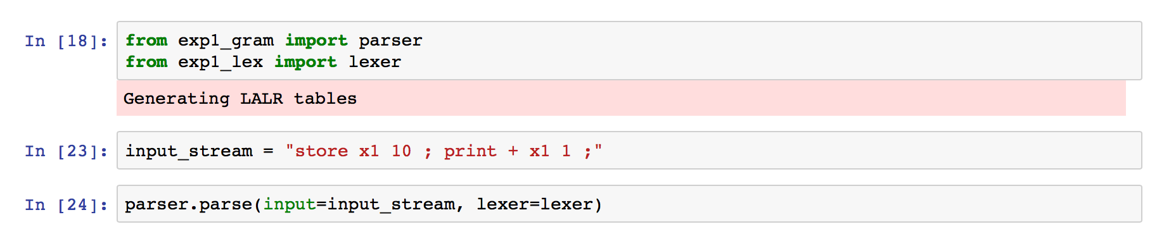
Testing the Specification

Slide 13
Writing an Interpreter for Exp1
Writing an interpreter for Exp1
We add actions to the grammar rules that interpret the values within the phrase structure of a program.
Observation: we need access to the token values during parsing in order to evaluate things like the values of numbers or the value of an addition.
Observation: interpretation always starts at the leaves.

Slide 14
Writing an Interpreter for Exp1
Consider the following Exp1 program: store y + 2 x ;
Where x has the value 3.

Slide 15
Symbol Table
x | 3
y | ???
Action: start
stmt
STORE
var
exp
SEMI
NAME(y)
PLUS
exp
exp
INTVAL(2)
var
NAME(x)

Slide 16
Symbol Table
x | 3
y | ???
Action: interpret INTVAL
stmt
STORE
var
exp
SEMI
NAME(y)
PLUS
exp
exp
INTVAL(2)
var
NAME(x)

Slide 17
Symbol Table
x | 3
y | ???
Action: propagate
stmt
STORE
var
exp
SEMI
NAME(y)
PLUS
exp
exp
2
INTVAL(2)
var
NAME(x)

Slide 18
Symbol Table
x | 3
y | ???
Action: propagate
stmt
STORE
var
exp
SEMI
2
NAME(y)
PLUS
exp
exp
INTVAL(2)
var
NAME(x)

Slide 19
Symbol Table
x | 3
y | ???
Action: interpret NAME
stmt
STORE
var
exp
SEMI
2
NAME(y)
PLUS
exp
exp
INTVAL(2)
var
NAME(x)

Slide 20
Symbol Table
x | 3
y | ???
Action: read symbol table
stmt
STORE
var
exp
SEMI
2
NAME(y)
PLUS
exp
exp
INTVAL(2)
var
NAME(x)

Slide 21
Symbol Table
x | 3
y | ???
Action: propagate
stmt
STORE
var
exp
SEMI
2
NAME(y)
PLUS
exp
exp
INTVAL(2)
var
3
NAME(x)

Slide 22
Symbol Table
x | 3
y | ???
Action: propagate
stmt
STORE
var
exp
SEMI
2
NAME(y)
PLUS
exp
exp
3
INTVAL(2)
var
NAME(x)

Slide 23
Symbol Table
x | 3
y | ???
Action: add
stmt
STORE
var
exp
SEMI
3
2
NAME(y)
PLUS
exp
exp
INTVAL(2)
var
NAME(x)

Slide 24
Symbol Table
x | 3
y | ???
Action: propagate
stmt
5
STORE
var
exp
SEMI
NAME(y)
PLUS
exp
exp
INTVAL(2)
var
NAME(x)

Slide 25
Symbol Table
x | 3
y | ???
Action: propagate
stmt
5
STORE
var
exp
SEMI
NAME(y)
PLUS
exp
exp
INTVAL(2)
var
NAME(x)

Slide 26
Symbol Table
x | 3
y | ???
Action: interpret NAME
stmt
STORE
var
exp
SEMI
5
NAME(y)
PLUS
exp
exp
INTVAL(2)
var
NAME(x)

Slide 27
Symbol Table
x | 3
y | 5
Action: write to symbol table
stmt
STORE
var
exp
SEMI
5
NAME(y)
PLUS
exp
exp
INTVAL(2)
var
NAME(x)

Slide 28
Symbol Table
x | 3
y | 5
Action: done
stmt
STORE
var
exp
SEMI
NAME(y)
PLUS
exp
exp
INTVAL(2)
var
NAME(x)

Slide 29
Interpretation
Consider the Exp1 expression: + 1 2
exp : '+' exp exp
| '-' exp exp
| '(' exp ')'
| var
| num
;
exp
+
exp
exp
Interpretation means, computing the value
of the root node.
We have to start at the leaves of the tree,
that is where the primitive values are and
proceed upwards…
What is the value at the root node?
num
num
1
2

Slide 30
Interpretation
We can rewrite the grammar to add the appropriate actions that have this bottom-up behavior.
exp
exp : '+' exp exp
…
| num
;
+
exp
exp
num
num
def p_plus_exp(p):
"""
exp : '+' exp exp
"""
p[0] = p[2] + p[3]
1
2
Observation: the p list holds the values of all the symbols of the right side of a production. p[0] represents the value of the left side of the production:
exp : '+' exp exp
0 1 2 3
Note: p[1] == '+'
def p_num_exp(p):
"exp : num"
p[0] = p[1]
def p_num(p):
"num : NUMBER"
p[0] = p[1]

Slide 31
Extended Exp1 Grammar
…
def p_plus_exp(p):
"""
exp : '+' exp exp
"""
p[0] = p[2] + p[3]
def p_minus_exp(p):
"""
exp : '-' exp exp
"""
p[0] = p[2] - p[3]
def p_paren_exp(p):
"""
exp : '(' exp ')'
"""
p[0] = p[2]
def p_var_exp(p):
"exp : var"
p[0] = p[1]
def p_num_exp(p):
"exp : num"
p[0] = p[1]
def p_var(p):
"var : NAME"
p[0] = symbol_table.get(p[1], 0)
def p_num(p):
"num : NUMBER"
p[0] = p[1]
def p_empty(p):
"empty :"
pass
def p_error(t):
print("Syntax error at '%s'" % t.value)
parser = yacc.yacc(debug=False, tabmodule='exp1parsetab')
# %load code/exp1_lrinterp_gram.py
from ply import yacc
from exp1_lex import tokens, lexer
symbol_table = dict()
def p_prog(_):
"prog : stmt_list"
pass
def p_stmt_list(_):
"""
stmt_list : stmt stmt_list
| empty
"""
pass
def p_print_stmt(p):
"stmt : PRINT exp ';'"
print("> {}".format(p[2]))
def p_store_stmt(p):
"stmt : STORE NAME exp ';'"
symbol_table[p[2]] = p[3]
…
Note: the lexer has not changed, only the grammar was extended with actions

Slide 32
Exp1 Lexer
# %load code/exp1_lex.py
# Lexer for Exp1
from ply import lex
reserved = {
'store' : 'STORE',
'print' : 'PRINT'
}
literals = [';','+','-','(',')']
tokens = ['NAME','NUMBER'] + list(reserved.values())
t_ignore = ' \t'
def t_NAME(t):
r'[a-zA-Z_][a-zA-Z_0-9]*'
t.type = reserved.get(t.value,'NAME') # Check for reserved words
return t
def t_NUMBER(t):
r'[0-9]+'
t.value = int(t.value)
return t
def t_NEWLINE(t):
r’\n'
pass
def t_error(t):
raise SyntaxError("Illegal character {}".format(t.value[0]))
# build the lexer
lexer = lex.lex()

Slide 33
Putting this all together
To finish the interpreter…
We have to create a top-level driving function that finds and connects the input file to the lexer/parser.
from exp1_lrinterp_gram import parser
def exp1_lrinterp(input_stream = None):
'A driver for our LR Exp1 interpreter.'
if not input_stream:
input_stream = input("exp1 > ")
parser.parse(input_stream)

Slide 34
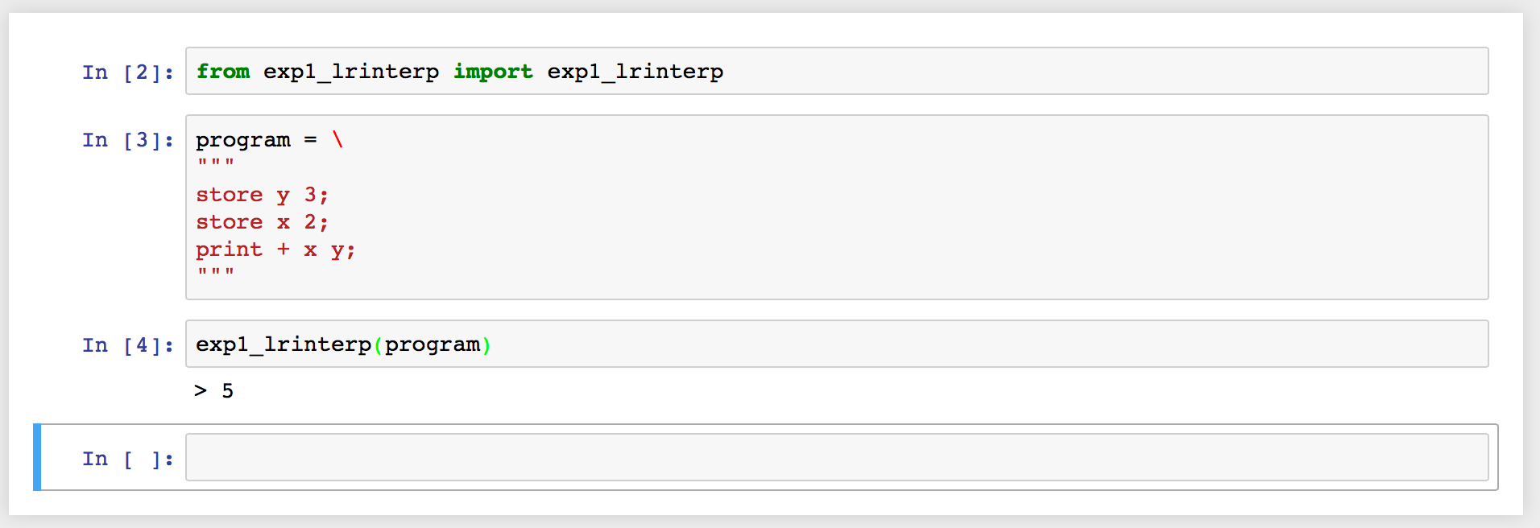
Putting this all together
We now have an interpreter that can run programs such as: store y 3; store x 2; print + x y;

Slide 35
Reading
Chapter 3
Assignment #3 – please see website

