Slide 1
Compiling Scoped Code
Compiling scoped code raises a set of issues because most low-level languages do not support scoping.
Also, our low-level programming languages do not support declarations, you simply start using a variable name, therefore, all declarations need to be resolved in the source language processor.
Declarations in the source language usually just become assignment statements in our low-level target language.

Slide 2
Compiling Scoped Code
As long as all variables of the source program are declared globally there is no problem:
// computes the factorial of x
declare x = 3;
declare y = 1;
while (1 <= x) {
y = y * x;
x = x - 1;
}
put y;
store R$x 3;
store R$y 1;
L0:
jumpF (<= 1 R$x) L1;
store R$y (* R$y R$x);
store R$x (- R$x 1);
jump L0;
L1:
noop
print R$y;
stop;
Here R$ is just a variable name prefix…it could be any string…it will become
significant when considering scoping.

Slide 3
Compiling Scoped Code
Now consider the following program:
declare x = 1;
{
declare x = 2;
put x;
}
put x;
store R$x 1;
store R$x 2;
print R$x;
print R$x;
stop;
Expected output: 2 1
Actual output: 2 2
If we are not careful in our translation our target programs will be incorrect.

Slide 4
Compiling Scoped Code
Now consider the following program:
declare x = 1;
{
declare x = 2;
put x;
}
put x;
store R$x 1;
store R$$x 2;
print R$$x;
print R$x;
stop;
Expected output: 2 1
Actual output: 2 1
In the target language we simulate scoping by adding a distinct variable prefix for each scope: R$ - global scope, R$$ first nested scope, R$$$ second nested scope, etc.

Slide 5
Compiling Scoped Code
Now consider the following program:
declare x = 1;
{
declare x = 2;
put x;
}
{
declare x = 3;
put x;
}
put x;
store R$x 1;
store R$$x 2;
print R$$x;
store R$$x 3;
print R$$x;
print R$x;
stop;
Expected output: 2 3 1
Actual output: 2 3 1
This still works because two nested scopes at the same level
can never be active at the same time.
You have to be careful that the variable is properly initialized if you use it for the second scope.

Slide 6
Compiler: Cuppa2 → Exp1bytecode
The compiler follows the Cuppa1 architecture.
Uses the same symbol table as the interpreter, but computes the variable prefix instead of storing values
CodeGen
Walker
Frontend
Input
build
write
Output
AST

Slide 7
Observations on Compilers
Compilers do not compute values (as interpreters do)
Compilers validate the source program, making sure that the intended behavior is correct but do not execute it
Compilers generate code for the target machine that then executes the intended behavior

Slide 8
Observations on the Symbol Table
The fact that compilers do not compute values but validate the source program has an effect on the symbol table:
rather than storing variable-value pairs the symbol table act merely as a record holder for variables seen/declared
in our case, the symbol table stores the variable-’target name’ (scoped name) pairs

Slide 9
Observations on the Symbol Table
class SymTab:
#-------
def __init__(self):
…
#-------
def push_scope(self):
# push a new dictionary onto the stack - stack grows to the left
…
#-------
def pop_scope(self):
# pop the left most dictionary off the stack
…
#-------
def declare_sym(self, sym):
# declare the symbol in the current scope: dict @ position 0
# first we need to check whether the symbol was already declared
# at this scope
if sym in self.scoped_symtab[CURR_SCOPE]:
raise ValueError("symbol {} already declared".format(sym))
# enter the symbol in the current scope
n_scopes = len(self.scoped_symtab)
prefix = create_prefix(n_scopes-1)
scope_dict = self.scoped_symtab[CURR_SCOPE]
scope_dict[sym] = prefix + sym # value is the prefixed name
#-------
def lookup_sym(self, sym):
# find the first occurence of sym in the symtab stack
# and return the associated value
…
#-------
def update_sym(self, sym):
# for the compiler version updating is the same as looking up
# in order to check if sym is updateable.
self.lookup_sym(sym)
return

Slide 10
Cuppa2 Compiler
We reuse the Cuppa2 interpreter frontend but we need to include the new symbol table therefore we need to rename it
cuppa2_cc_frontend.py
Because the compiler is based on the Cuppa1 compiler we can use most of that code generator but need to modify it for:
Declarations
Get
Assignments
Variables in expressions
cuppa2_cc_codegen.py
The output phase is the same as the Cuppa1 output phase, but to keep things simple we deleted the peephole optimization
to make your compiler more sophisticated you can add this back in ☺
cuppa2_cc_output.py

Slide 11
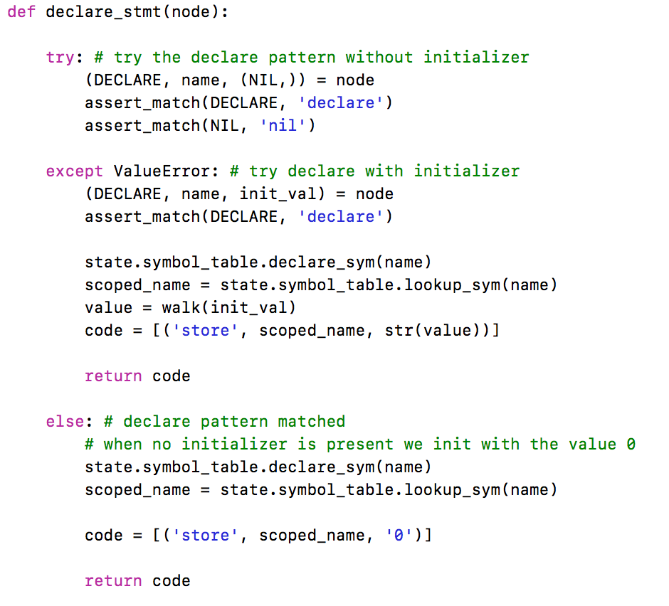
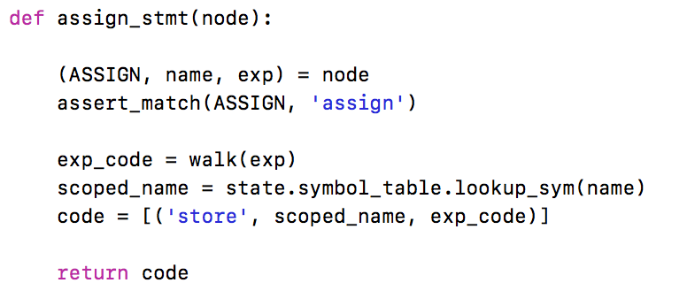
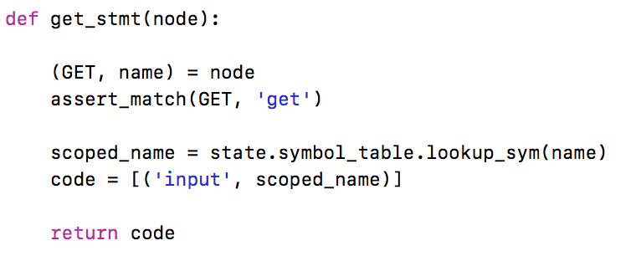
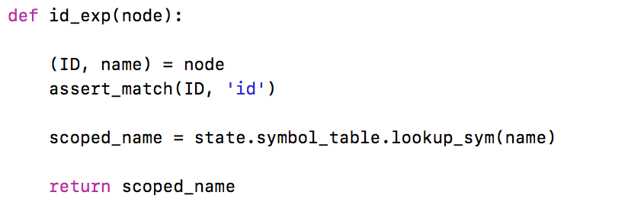
Cuppa2 Codegen
cuppa2_cc_codegen.py

Slide 12
Cuppa2 Compiler
Observation:
The difference between the Cuppa1 and Cuppa2 language is the introduction of scope and declarations
These are purely high-level language constructs and we see this manifested in that the only thing that really changed in the Cuppa2 compiler compared to the Cuppa1 compiler is how variables are named!
That means the Cuppa2 compiler is completely responsible for enforcing scope it cannot pass that through to the underlying abstract machine.

Slide 13
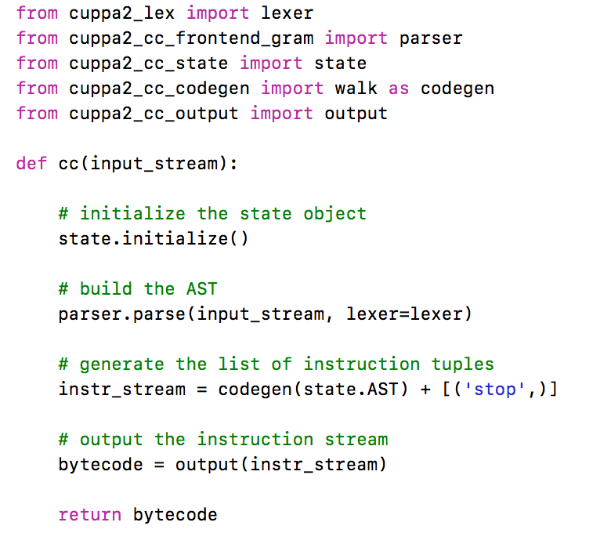
Cuppa2 Driver Function
cuppa2_cc.py

Slide 14
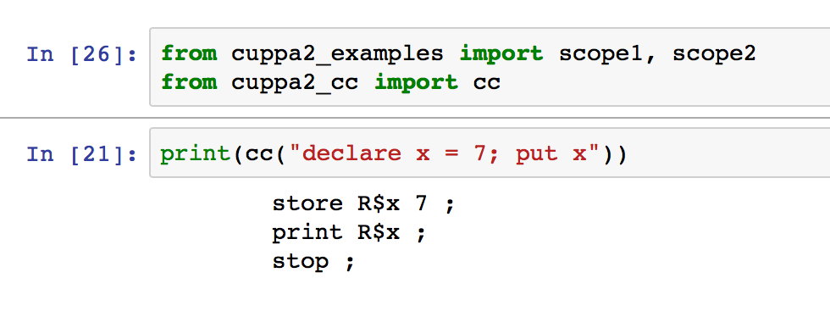
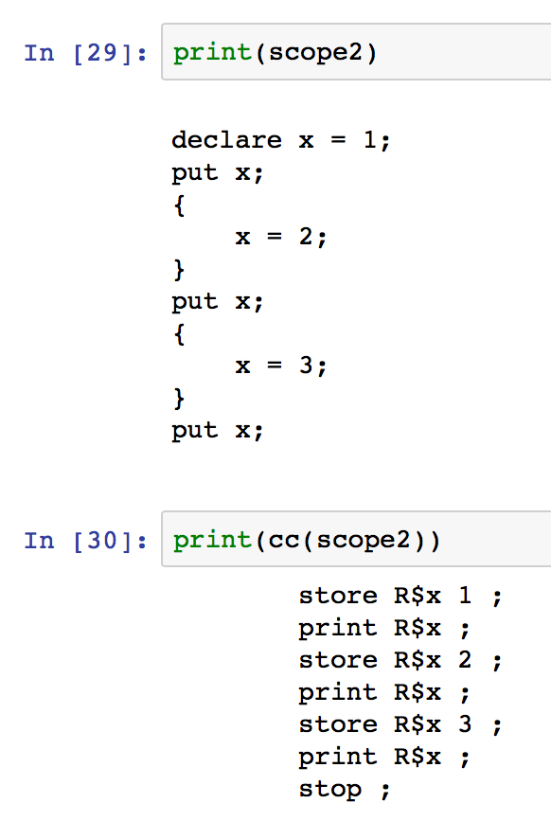
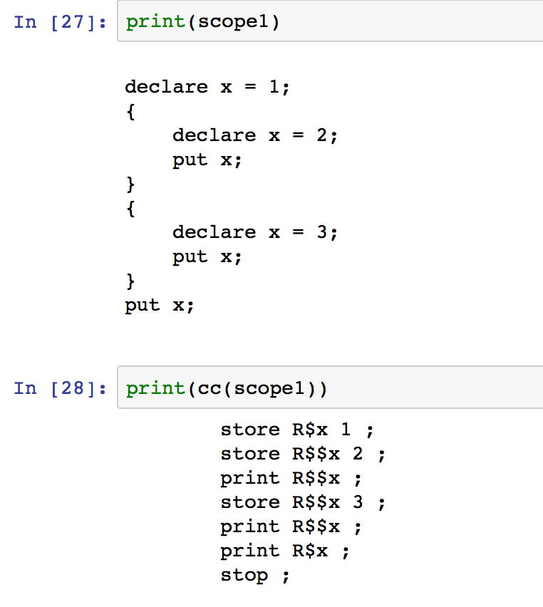
Testing the Compiler

