Slide 1
Higher Order Programming
Let’s play a syntactic trick…
We already decided that function names really have no influence on the actual function definition, i.e., the behavior of the function does not depend on its name. That is ‘declare inc(x) return x+1’ is the same function as ‘declare icecream(x) return x+1’.
We took advantage of this in our implementation by using the name as a handle to retrieve the actual function value from the symbol table during interpretation of a program.
The idea then is to make this separation of name and behavior visible at the syntactic level

Slide 2
Higher Order Programming
That is the function declaration declare inc(x) return x+1; becomes declare inc = function (x) return x+1;
Notice, that all we have done is to make the separation of function name and function behavior explicit at the syntactic level.

Slide 3
Higher Order Programming
However, this simple trick has huge ramifications in terms of expressive power of the programming language.
First consider that the function declaration now looks like any variable declaration statement:
declare inc = function (x) return x+1;
Init value
Variable name
 The function behavior is the value assigned to the variable ‘inc’

Slide 4
Higher Order Programming
Now, consider the ramifications…if the function behavior is just a value then there is nothing to prevent us from assigning that value to another variable.
But that means that the new variable name is now also a handle to access the function behavior
declare inc = function (x) return x+1;
declare icecream = inc;
put inc(1);
put icecream(1);

Slide 5
Interpreting Functions
Symbol Table
Global Scope
declare inc = function (x) return x+1;
declare icecream = inc;
put inc(1);
put icecream(1);
Current Scope Pointer
Function Scope

Slide 6
Interpreting Functions
Symbol Table
Global Scope
declare inc = function (x) return x+1;
declare icecream = inc;
put inc(1);
put icecream(1);
inc → function (x) return x+1
Current Scope Pointer
Function Scope

Slide 7
Interpreting Functions
Symbol Table
Global Scope
declare inc = function (x) return x+1;
declare icecream = inc;
put inc(1);
put icecream(1);
inc → function (x) return x+1
Current Scope Pointer
icecream → function (x) return x+1
Function Scope

Slide 8
Interpreting Functions
Symbol Table
Global Scope
declare inc = function (x) return x+1;
declare icecream = inc;
put inc(1);
put icecream(1);
inc → function (x) return x+1
Current Scope Pointer
icecream → function (x) return x+1
Function Scope
function (x) return x+1
x → 1

Slide 9
Interpreting Functions
Symbol Table
Global Scope
declare inc = function (x) return x+1;
declare icecream = inc;
put inc(1);
put icecream(1);
inc → function (x) return x+1
Current Scope Pointer
icecream → function (x) return x+1
Function Scope
function (x) return x+1
x → 1

Slide 10
Interpreting Functions
2
Symbol Table
Global Scope
declare inc = function (x) return x+1;
declare icecream = inc;
put inc(1);
put icecream(1);
inc → function (x) return x+1
Current Scope Pointer
icecream → function (x) return x+1
Function Scope
x → 1

Slide 11
Interpreting Functions
2
Symbol Table
Global Scope
declare inc = function (x) return x+1;
declare icecream = inc;
put inc(1);
put icecream(1);
inc → function (x) return x+1
Current Scope Pointer
icecream → function (x) return x+1
Function Scope
function (x) return x+1
x → 1

Slide 12
Interpreting Functions
2
Symbol Table
Global Scope
declare inc = function (x) return x+1;
declare icecream = inc;
put inc(1);
put icecream(1);
inc → function (x) return x+1
Current Scope Pointer
icecream → function (x) return x+1
Function Scope
function (x) return x+1
x → 1

Slide 13
Interpreting Functions
2
2
Symbol Table
Global Scope
declare inc = function (x) return x+1;
declare icecream = inc;
put inc(1);
put icecream(1);
inc → function (x) return x+1
Current Scope Pointer
icecream → function (x) return x+1
Function Scope
x → 1

Slide 14
Interpreting Functions
2
2
Symbol Table
Global Scope
declare inc = function (x) return x+1;
declare icecream = inc;
put inc(1);
put icecream(1);
inc → function (x) return x+1
Current Scope Pointer
icecream → function (x) return x+1
Function Scope
x → 1

Slide 15
Higher Order Programming
Now consider, formal function parameters are also variables, that means we can assign function values to the formal parameters of functions
That is, we can pass functions to functions!
declare inc = function (x) return x+1;
declare apply = function(f,x) return f(x);
put apply(inc,1);

Slide 16
Interpreting Functions
Symbol Table
Global Scope
declare inc = function (x) return x+1;
declare apply = function(f,y) return f(y);
put apply(inc,1);
Current Scope Pointer
Function Scope
Function Scope

Slide 17
Interpreting Functions
Symbol Table
Global Scope
declare inc = function (x) return x+1;
declare apply = function(f,y) return f(y);
put apply(inc,1);
inc → function (x) return x+1
Current Scope Pointer
Function Scope
Function Scope

Slide 18
Interpreting Functions
Symbol Table
Global Scope
declare inc = function (x) return x+1;
declare apply = function(f,y) return f(y);
put apply(inc,1);
inc → function (x) return x+1
Current Scope Pointer
apply = function(f,y) return f(y)
Function Scope
Function Scope

Slide 19
Interpreting Functions
Symbol Table
Global Scope
declare inc = function (x) return x+1;
declare apply = function(f,y) return f(y);
put apply(inc,1);
inc → function (x) return x+1
Current Scope Pointer
apply = function(f,y) return f(y)
Function Scope
function(f,y) return f(y);
f → function (x) return x+1
y → 1
Function Scope

Slide 20
Interpreting Functions
Symbol Table
Global Scope
declare inc = function (x) return x+1;
declare apply = function(f,y) return f(y);
put apply(inc,1);
inc → function (x) return x+1
Current Scope Pointer
apply = function(f,y) return f(y)
Function Scope
function(f,y) return f(y);
f → function (x) return x+1
y → 1
Function Scope

Slide 21
Interpreting Functions
Symbol Table
Global Scope
declare inc = function (x) return x+1;
declare apply = function(f,y) return f(y);
put apply(inc,1);
inc → function (x) return x+1
Current Scope Pointer
apply = function(f,y) return f(y)
Function Scope
function(f,y) return f(y);
f → function (x) return x+1
y → 1
function(x) return x+1;
Function Scope
x → 1

Slide 22
Interpreting Functions
Symbol Table
Global Scope
declare inc = function (x) return x+1;
declare apply = function(f,y) return f(y);
put apply(inc,1);
inc → function (x) return x+1
Current Scope Pointer
apply = function(f,y) return f(y)
Function Scope
function(f,y) return f(y);
f → function (x) return x+1
y → 1
function(x) return x+1;
Function Scope
x → 1

Slide 23
Interpreting Functions
Symbol Table
Global Scope
declare inc = function (x) return x+1;
declare apply = function(f,y) return f(y);
put apply(inc,1);
inc → function (x) return x+1
Current Scope Pointer
apply = function(f,x) return f(x)
Function Scope
function(f,y) return f(y);
f → function (x) return x+1
y → 1
Function Scope
x → 1

Slide 24
Interpreting Functions
2
Symbol Table
Global Scope
declare inc = function (x) return x+1;
declare apply = function(f,y) return f(y);
put apply(inc,1);
inc → function (x) return x+1
Current Scope Pointer
apply = function(f,x) return f(x)
Function Scope
f → function (x) return x+1
y → 1
Function Scope
x → 1

Slide 25
Interpreting Functions
2
Symbol Table
Global Scope
declare inc = function (x) return x+1;
declare apply = function(f,y) return f(y);
put apply(inc,1);
inc → function (x) return x+1
Current Scope Pointer
apply = function(f,x) return f(x)
Function Scope
f → function (x) return x+1
y → 1
Function Scope
x → 1

Slide 26
Higher Order Programming
This is the hallmark of higher order programming
Definition: In higher order programming we can pass functions to other functions or return functions as return values from functions.
declare inc = function (x) return x+1;
declare dec = function (x) return x-1;
declare select = function (f,g,q) {
if (q == 0)
return f;
else
return g;
}
put select(inc,dec,1) (3);

Slide 27
Interpreting Functions
Symbol Table
Global Scope
declare inc = function (x) return x+1;
declare dec = function (x) return x-1;
declare select = function (f,g,q) {
if (q == 0)
return f;
else
return g;
}
put select(inc,dec,1) (3);
Current Scope Pointer
Function Scope

Slide 28
Interpreting Functions
Symbol Table
Global Scope
declare inc = function (x) return x+1;
declare dec = function (x) return x-1;
declare select = function (f,g,q) {
if (q == 0)
return f;
else
return g;
}
put select(inc,dec,1) (3);
inc → function (x) return x+1
Current Scope Pointer
Function Scope

Slide 29
Interpreting Functions
Symbol Table
Global Scope
declare inc = function (x) return x+1;
declare dec = function (x) return x-1;
declare select = function (f,g,q) {
if (q == 0)
return f;
else
return g;
}
put select(inc,dec,1) (3);
inc → function (x) return x+1
Current Scope Pointer
dec → function (x) return x-1
Function Scope

Slide 30
Interpreting Functions
Symbol Table
Global Scope
declare inc = function (x) return x+1;
declare dec = function (x) return x-1;
declare select = function (f,g,q) {
if (q == 0)
return f;
else
return g;
}
put select(inc,dec,1) (3);
inc → function (x) return x+1
Current Scope Pointer
dec → function (x) return x-1
select → function (f,g,q) {
if (q == 0)
return f;
else
return g;
}
Function Scope

Slide 31
Interpreting Functions
Symbol Table
Global Scope
declare inc = function (x) return x+1;
declare dec = function (x) return x-1;
declare select = function (f,g,q) {
if (q == 0)
return f;
else
return g;
}
put select(inc,dec,1) (3);
inc → function (x) return x+1
Current Scope Pointer
dec → function (x) return x-1
select → function (f,g,q) {
if (q == 0)
return f;
else
return g;
}
Function Scope
function (f,g,q) {
if (q == 0)
return f;
else
return g;
}
f → function (x) return x+1
g → function (x) return x-1
q → 1

Slide 32
Interpreting Functions
Symbol Table
Global Scope
declare inc = function (x) return x+1;
declare dec = function (x) return x-1;
declare select = function (f,g,q) {
if (q == 0)
return f;
else
return g;
}
put select(inc,dec,1) (3);
inc → function (x) return x+1
Current Scope Pointer
dec → function (x) return x-1
select → function (f,g,q) {
if (q == 0)
return f;
else
return g;
}
Function Scope
function (f,g,q) {
if (q == 0)
return f;
else
return g;
}
f → function (x) return x+1
g → function (x) return x-1
q → 1

Slide 33
Interpreting Functions
Symbol Table
Global Scope
declare inc = function (x) return x+1;
declare dec = function (x) return x-1;
declare select = function (f,g,q) {
if (q == 0)
return f;
else
return g;
}
put select(inc,dec,1) (3);
inc → function (x) return x+1
Current Scope Pointer
dec → function (x) return x-1
select → function (f,g,q) {
if (q == 0)
return f;
else
return g;
}
Function Scope
function (f,g,q) {
if (q == 0)
return f;
else
return g;
}
f → function (x) return x+1
g → function (x) return x-1
q → 1

Slide 34
Interpreting Functions
Symbol Table
Global Scope
declare inc = function (x) return x+1;
declare dec = function (x) return x-1;
declare select = function (f,g,q) {
if (q == 0)
return f;
else
return g;
}
put select(inc,dec,1) (3);
inc → function (x) return x+1
Current Scope Pointer
dec → function (x) return x-1
select → function (f,g,q) {
if (q == 0)
return f;
else
return g;
}
Function Scope
f → function (x) return x+1
(Return value)
function (x) return x-1;
g → function (x) return x-1
q → 1

Slide 35
Interpreting Functions
Symbol Table
Global Scope
declare inc = function (x) return x+1;
declare dec = function (x) return x-1;
declare select = function (f,g,q) {
if (q == 0)
return f;
else
return g;
}
put select(inc,dec,1) (3);
inc → function (x) return x+1
Current Scope Pointer
dec → function (x) return x-1
select → function (f,g,q) {
if (q == 0)
return f;
else
return g;
}
Function Scope
x → 3
function (x) return x-1;

Slide 36
Interpreting Functions
Symbol Table
Global Scope
declare inc = function (x) return x+1;
declare dec = function (x) return x-1;
declare select = function (f,g,q) {
if (q == 0)
return f;
else
return g;
}
put select(inc,dec,1) (3);
inc → function (x) return x+1
Current Scope Pointer
dec → function (x) return x-1
select → function (f,g,q) {
if (q == 0)
return f;
else
return g;
}
Function Scope
x → 3
function (x) return x-1;

Slide 37
Interpreting Functions
2
Symbol Table
Global Scope
declare inc = function (x) return x+1;
declare dec = function (x) return x-1;
declare select = function (f,g,q) {
if (q == 0)
return f;
else
return g;
}
put select(inc,dec,1) (3);
inc → function (x) return x+1
Current Scope Pointer
dec → function (x) return x-1
select → function (f,g,q) {
if (q == 0)
return f;
else
return g;
}
Function Scope
x → 3

Slide 38
Interpreting Functions
2
Symbol Table
Global Scope
declare inc = function (x) return x+1;
declare dec = function (x) return x-1;
declare select = function (f,g,q) {
if (q == 0)
return f;
else
return g;
}
put select(inc,dec,1) (3);
inc → function (x) return x+1
Current Scope Pointer
dec → function (x) return x-1
select → function (f,g,q) {
if (q == 0)
return f;
else
return g;
}
Function Scope
x → 3

Slide 39
Higher Order Programming
Why is this interesting?
It is interesting because higher order programming lets us construct generic functions whose behavior can be specialized by passing them more specific functions.
Consider the function ‘select’ from the previous slide.
We could use ‘select’ in many different contexts
declare mul = function (x) return x*2;
declare div = function (x) return x/2;
declare select = function (f,g,q) {
if (q == 0)
return f;
else
return g;
}
put select(mul,div,1) (4);

Slide 40
Higher Order Programming
Observation: In higher order programming we can now have a cascade of function applications
Consider the last line of the program below: put select (mul,div,1) (4)
declare mul = function (x) return x*2;
declare div = function (x) return x/2;
declare select = function (f,g,q) {
if (q == 0)
return f;
else
return g;
}
put select(mul,div,1) (4);

Slide 41
Anonymous Functions
If variables are just handles to access function behavior why not just program with the function behavior directly?
Consider:
put (function (x) return x+1) (3);
Anonymous Function

Slide 42
Interpreting Functions
Symbol Table
Global Scope
Current Scope Pointer
put (function (x) return x+1) (3);
Function Scope

Slide 43
Interpreting Functions
Symbol Table
Global Scope
Current Scope Pointer
put (function (x) return x+1) (3);
function (x) return x+1
Function Scope
x → 3

Slide 44
Interpreting Functions
Symbol Table
Global Scope
Current Scope Pointer
put (function (x) return x+1) (3);
function (x) return x+1
Function Scope
x → 3

Slide 45
Interpreting Functions
4
Symbol Table
Global Scope
Current Scope Pointer
put (function (x) return x+1) (3);
Function Scope
x → 3

Slide 46
Interpreting Functions
4
Symbol Table
Global Scope
Current Scope Pointer
put (function (x) return x+1) (3);
Function Scope
x → 3

Slide 47
Anonymous Functions
What does the following program do?
declare select = function (f,g,q) {
if (q == 0)
return f;
else
return g;
}
put select((function (x) return x+1),(function (x) return x-1),1) (3);

Slide 48
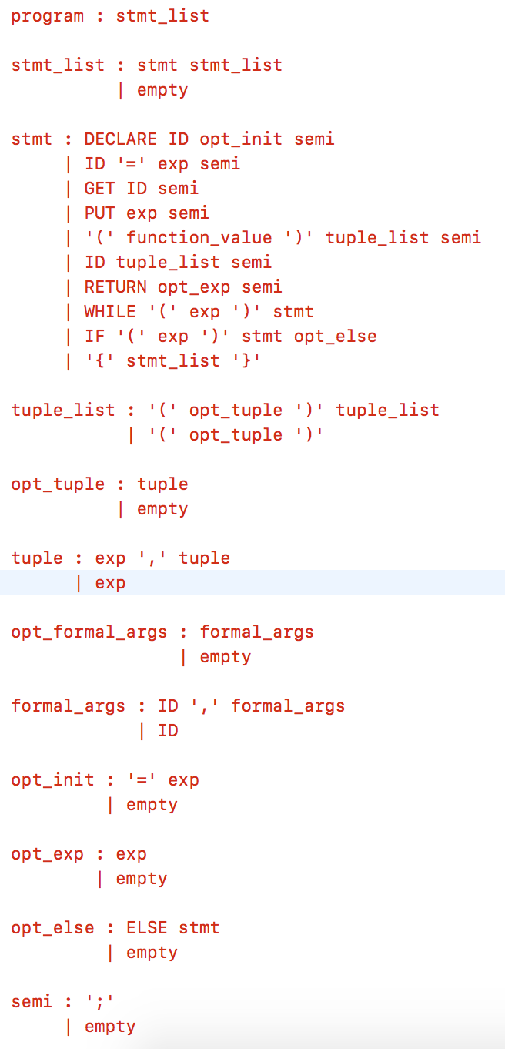
The Cuppa3h Language
Similar to Cuppa3 but higher-order.
Syntactic differences to deal with anonymous functions and function cascades - tuple lists

Slide 49
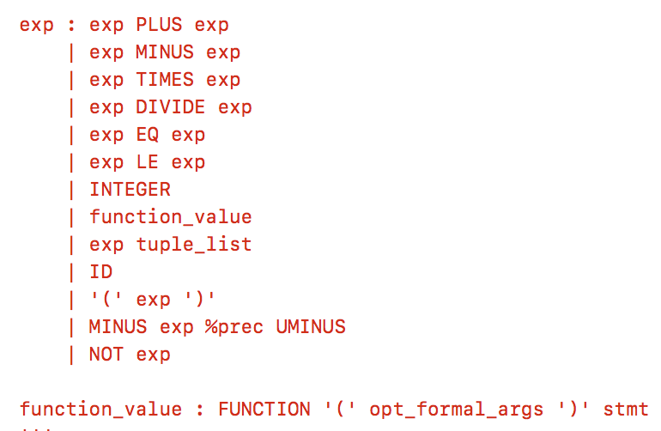
The Cuppa3h Language
Note: function values are just values appearing in expressions.

Slide 50
Cuppa3h
The addition of function values now raises the possibility to write syntactically correct programs that semantically do not make any sense.
Consider:
declare z = function (x) return x+1;
put z+1; // ???
At runtime we need to reject the expression ‘z+1’ since adding 1 to a function value does not make sense.
Problem: we need to wait until runtime to discover that that is an illegal expression (this is called dynamic type checking).
Alternative: introduce a type system and static type checking to discover these kind of illegal expressions before interpretation/compilation begins.

Slide 51
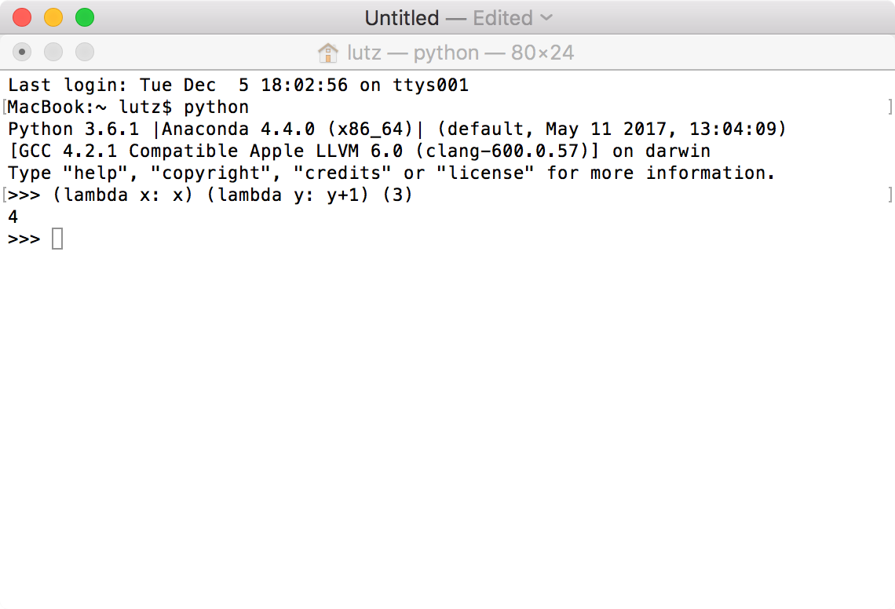
Python is Higher-Order

