Slide 1
Bottom-Up Parsing – LR(1)
Previously we have studied top-down or LL(1) parsing.
The idea here was to start with the start symbol and keep expanding it until the whole input was read and matched.
In bottom-up or LR(1) parsing we do exactly the opposite, we try to match the input to a rule and then keep reducing the input replacing it with the non-terminal of the rule. The last step is to replace the current input with the start-symbol.
Observation: in LR(1) parsing we apply the rules backwards – this is called reduction

Slide 2
Bottom-Up Parsing – LR(1)
In our LL(1) parsing example we replaced non-terminal symbols with functions that did the expansions and the matching for us.
In LR(1) parsing we use a stack to help us find the correct reductions.
Given a stack, an LR(1) parser has four available actions:
Shift – push an input token on the stack
Reduce – pop elements from the stack and replace by a non-terminal (apply a rule ‘backwards’)
Accept – accept the current program
Reject – reject the current program

Slide 3
Bottom-Up Parsing – LR(1)
Stack | Input | Action
<empty> | p + x 1 ; | Shift
p | + x 1 ; | Shift
p + | x 1 ; | Shift
p + x | 1 ; | Reduce
p + var | 1 ; | Reduce
p + exp | 1 ; | Shift
p + exp 1 | ; | Reduce
p + exp num | ; | Reduce
p + exp exp | ; | Reduce
p exp | ; | Shift
p exp ; | <empty> | Reduce
stmt | <empty> | Shift
stmt <empty> | <empty> | Reduce
stmt prog | <empty> | Reduce
prog | <empty> | Accept
p + x 1 ;
grammar exp0;
prog : stmt prog
| ””
;
stmt : 'p' exp ';'
| 's’ var exp ';'
;
exp : '+' exp exp
| '-' exp exp
| '(' exp ')'
| var
| num
;
var : 'x' | 'y' | 'z'
;
num : '0’ …'9'
;
Notes:
Add algorithm box

Slide 4
Bottom-Up Parsing – LR(1)
Stack
<empty>
p
p +
p + x
p + var
p + exp
p + exp 1
p + exp num
p + exp exp
p exp
p exp ;
stmt
stmt <empty>
stmt prog
prog
p + x 1 ;
prog
stmt
prog
p
exp
;
exp
“”
+
exp
var
num
x
1

Slide 5
Bottom-Up Parsing – LR(1)
Let’s try an illegal sentence
p + x s ;
Stack | Input | Action
<empty> | p + x s ; | Shift
p | + x s ; | Shift
p + | x s ; | Shift
p + x | s ; | Reduce
p + var | s ; | Reduce
p + exp | s ; | Shift
p + exp s | ; | Shift
p + exp s ; | <empty> | Reject
grammar exp0;
prog : stmt prog
| ””
;
stmt : 'p' exp ';'
| 's’ var exp ';'
;
exp : '+' exp exp
| '-' exp exp
| '(' exp ')'
| var
| num
;
var : 'x' | 'y' | 'z'
;
num : '0’ …'9'
;

Slide 6
Bottom-Up Parsing – LR(1)
Let’s try it with the a grammar where left-hand side and right-hand variables
are differentiated.
Stack | Input | Action
<empty> | p + x 1 ; | Shift
p | + x 1 ; | Shift
p + | x 1 ; | Shift
p + x | 1 ; | Reject
p + x 1 ;
prog : stmt prog
| ””
;
stmt : 'p' exp ';'
| 's’ lhsvar exp ';'
;
exp : '+' exp exp
| '-' exp exp
| '(' exp ')'
| rhsvar
| num
;
lhsvar : 'x' | 'y' | 'z'
;
rhsvar : 'x' | 'y' | 'z'
;
num : '0’ …'9'
;
There is a conflict between the lhsvar rule and rhsvar rule here, we do not have enough information to select one rule over the other. This is called a reduce/reduce conflict in bottom-up parsing terminology. That means, even though our grammar is a perfectly legal context-free grammar, it is not a grammar that can be used by a bottom-up parser, we say that the grammar is not LR(1). We didn’t point this out but there are also grammars which
are perfectly legal CFG’s that are not LL(1).
Notes:
In what other way could we make this grammar LR(1)?

Slide 7
Bottom-Up Parsing – LR(1)
LR(1) parsers are implemented in such tools as Yacc (Unix) and Bison (Linux)
The tool we will be using, Ply, also implements LR(1) parsing.
Other tools such as ANTLR implement LL(1) parsing*

Slide 8
Parser Generators
Writing parsers by hand if difficult and time consuming
The resulting parsers are difficult to maintain and extend
Ideally we would like a tool that reads a grammar definition and generates a parser from that description
Note: This is only true for relatively small languages. Turns out that the parsers for large languages such as Python or Java are written by hand and are typically sLL(1) with many hand coded exceptions built in.

Slide 9
Parser Generators
Grammar File
Parser
Generator
Parser Code (e.g. Python)
That looks very much like a translator!

Slide 10
Parser Generators
IR
IR
Grammar File
Syntax
Analysis
Semantic
Analysis
Code
Generation
Parser Code
Parser generators are an example of a domain specific language translator!
Ply is a parser generator, it translates a grammar specification
into parser code written in Python.

Slide 11
Using Ply
Recall:
The examples assume that you have cloned or downloaded the Plipy book and have access to the ‘code’ folder on your local machine
For notebook demos it is assumed that you navigated Jupyter to the ‘code’ folder and started a new notebook
Documentation on Ply can be found here:
http://www.dabeaz.com/ply/ply.html
Documentation on Ply grammar specifications can be found here:
http://www.dabeaz.com/ply/ply.html#ply_nn23

Slide 12
Using Ply
from ply import yacc
from exp0_lex import tokens, lexer
def p_grammar(_):
"""
prog : stmt prog
| empty
stmt : 'p' exp ';'
| 's' var exp ';'
exp : '+' exp exp
| '-' exp exp
| '(' exp ')'
| var
| num
var : 'x'
| 'y'
| 'z'
num : '0'
| '1'
| '2'
| '3'
| '4'
| '5'
| '6'
| '7'
| '8'
| '9'
"""
pass
def p_empty(p):
'empty :'
pass
def p_error(t):
print("Syntax error at '%s'" % t.value)
parser = yacc.yacc(debug=False,tabmodule='exp0parsetab')
This is our ‘exp0_gram.py’ file
In Ply the grammar is specified in the docstring of the grammar functions
Don’t worry about the lex stuff – it simply sets up a character input stream for the parser to read
Goal is to generate a parser from this specification

Slide 13
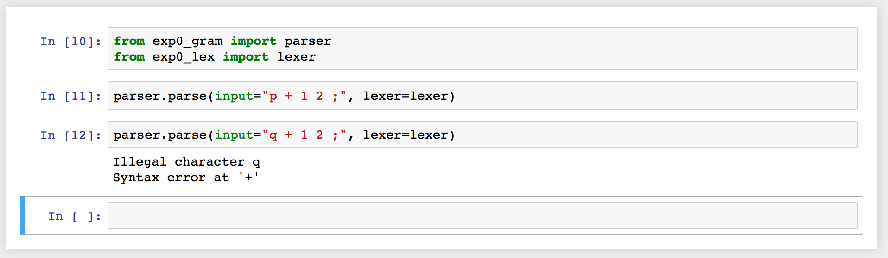
Using Ply

Slide 14
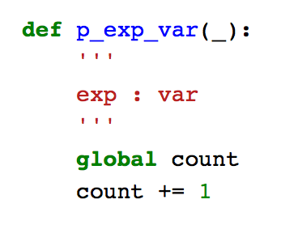
Actions
Making the generated parser do something useful.
In the hand-coded parser you can add code anywhere in order to make the parser do something useful…like counting ‘p’ statements.
In parsers generated by parser generators we use something called ‘actions’ we insert into the grammar.
In Ply actions are inserted into the grammar specification as Python code:
Actions

Slide 15
Actions
In order to insert actions we need to break the Ply grammar into smaller functions
Let’s try something:
The idea of our language processor is to count the number of right-hand side variables in a program
def p_prog(_):
'''
prog : stmt prog
'''
pass
def p_prog_empty(_):
'''
prog : empty
'''
print("count = {}".format(count))
def p_grammar(_):
"""
prog : stmt prog
| empty
…
Actions

Slide 16
Actions
def p_exp(_):
'''
exp : '+' exp exp
| '-' exp exp
| '(' exp ')'
| num
'''
pass
def p_exp_var(_):
'''
exp : var
'''
global count
count += 1
def p_grammar(_):
""”
…
exp : '+' exp exp
| '-' exp exp
| '(' exp ')'
| var
| num
…
"""
Actions

Slide 17
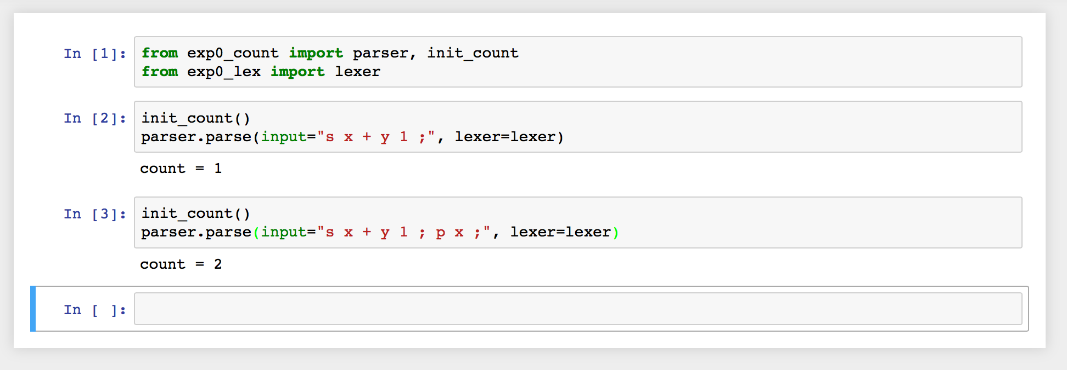
Actions

Slide 18
Assignment
Assignment #2 – see website

