Slide 1
Interpreter Implementation
The crucial insight to implementing functions is that function names act just like variable names - they are the key into a symbol lookup table.
During function declaration we enter the function name into the symbol table
During a function call we search for the function name in the symbol table
The second important insight is that the function body is the value that we store with the function name in the symbol table.
During a function call we lookup the function name in the symbol table and return the function body for interpretation.
The symbol table is extended to distinguish between scalar values and function values

Slide 2
Interpreting Functions
Symbol Table
Global Scope
declare inc(i) {
return i+1;
}
declare x = 10;
declare y;
y = inc(x);
put y;
Current Scope Pointer
Function Scope

Slide 3
Interpreting Functions
Symbol Table
Global Scope
declare inc(i) {
return i+1;
}
declare x = 10;
declare y;
y = inc(x);
put y;
inc → Function (i) {
return i+1;
}
Current Scope Pointer
Function Scope

Slide 4
Interpreting Functions
Symbol Table
Global Scope
declare inc(i) {
return i+1;
}
declare x = 10;
declare y;
y = inc(x);
put y;
inc → Function (i) {
return i+1;
}
Current Scope Pointer
x → 10
Function Scope

Slide 5
Interpreting Functions
Symbol Table
Global Scope
declare inc(i) {
return i+1;
}
declare x = 10;
declare y;
y = inc(x);
put y;
inc → Function (i) {
return i+1;
}
Current Scope Pointer
x → 10
y → 0
Function Scope

Slide 6
Interpreting Functions
Symbol Table
Global Scope
declare inc(i) {
return i+1;
}
declare x = 10;
declare y;
y = inc(x);
put y;
inc → Function (i) {
return i+1;
}
Current Scope Pointer
x → 10
y → 0
Function Scope
Function (i) {
return i+1;
}
i → 10
Setup the function call:
lookup function name
retrieve function body
push new function scope
init formal parameters with actual parameters

Slide 7
Interpreting Functions
Symbol Table
Global Scope
declare inc(i) {
return i+1;
}
declare x = 10;
declare y;
y = inc(x);
put y;
inc → Function (i) {
return i+1;
}
Current Scope Pointer
x → 10
y → 0
Function Scope
Function (i) {
return i+1;
}
i → 10
Execute the called function and compute return value.

Slide 8
Interpreting Functions
Symbol Table
Global Scope
declare inc(i) {
return i+1;
}
declare x = 10;
declare y;
y = inc(x);
put y;
inc → Function (i) {
return i+1;
}
Current Scope Pointer
x → 10
y → 11
Function Scope
i → 10
Exit the called function:
pop the function scope
store the return value in y

Slide 9
Interpreting Functions
Symbol Table
Global Scope
declare inc(i) {
return i+1;
}
declare x = 10;
declare y;
y = inc(x);
put y;
inc → Function (i) {
return i+1;
}
Current Scope Pointer
x → 10
y → 11
Function Scope
i → 10
Execute the put statement ⇒ 11

Slide 10
Interpreting Functions
Symbol Table
Global Scope
declare inc(i) {
return i+1;
}
declare x = 10;
declare y;
y = inc(x);
put y;
inc → Function (i) {
return i+1;
}
Current Scope Pointer
x → 10
y → 11
Function Scope
i → 10

Slide 11
Interpreting Functions
Note that we use the function value just like we would use the value of a variable, but instead of using it in some arithmetic expression we simply interpret the body of the function in order to compute a return value.

Slide 12
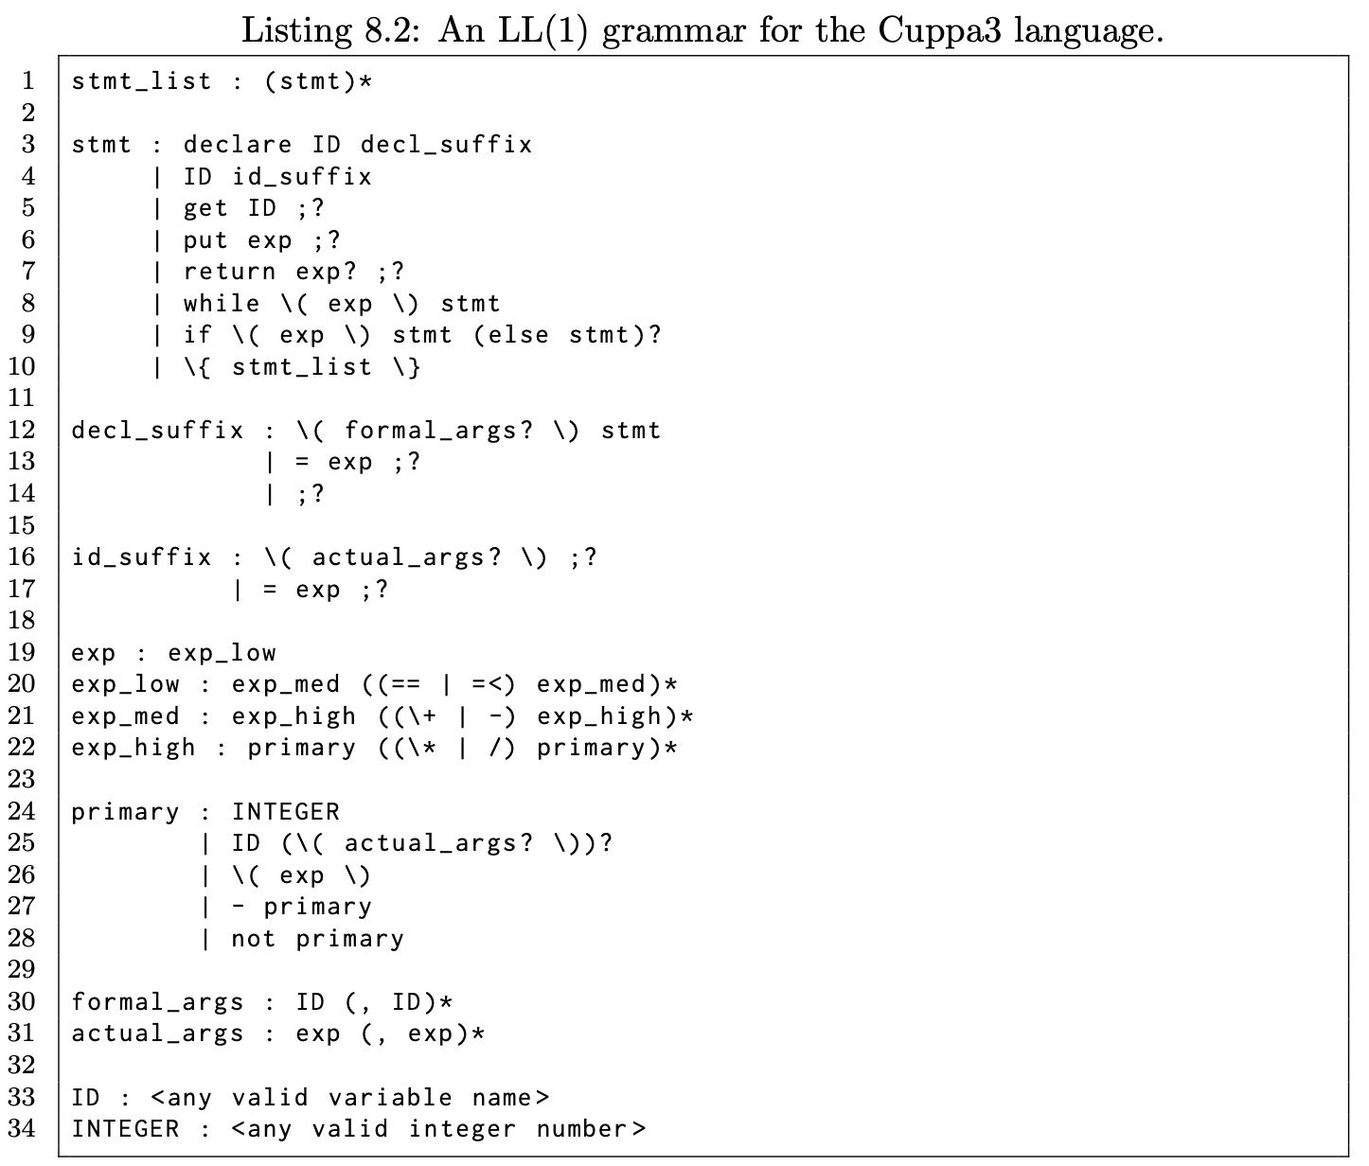
Cuppa3 Frontend

Slide 13
Cuppa3 Frontend
The frontend is like all of our other Cuppa LL(1) frontends
we construct an AST using a parser constructed from an LL(1) grammar.
We will concentrate on the three new features outlined in the previous slide.

Slide 14
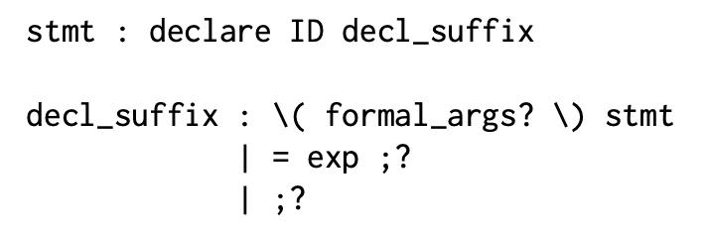
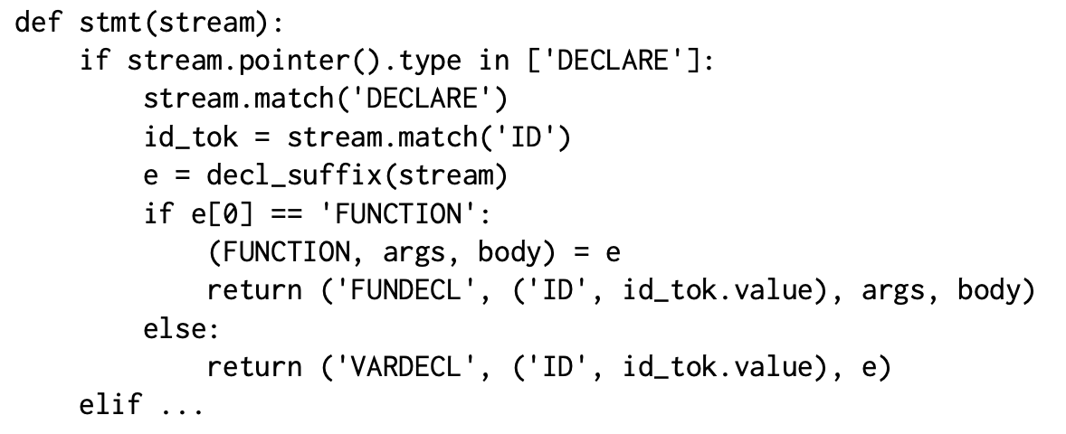
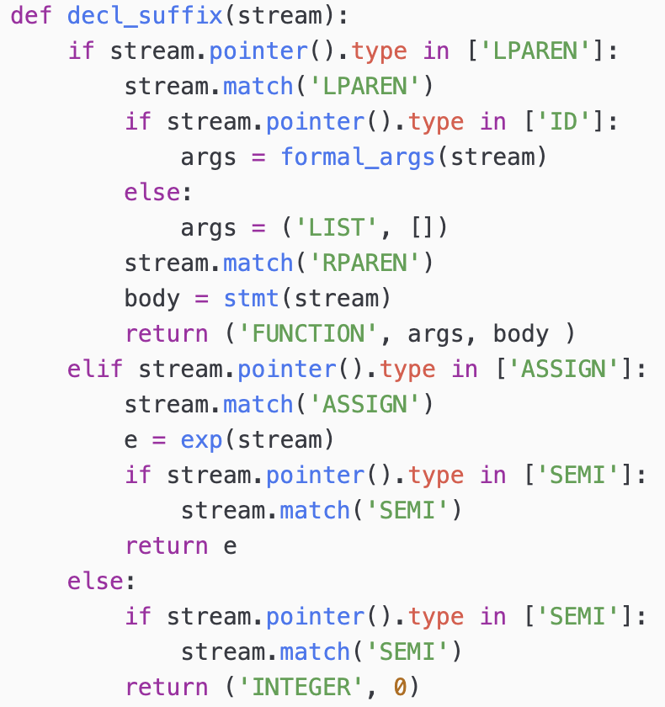
Cuppa3 Frontend

Slide 15
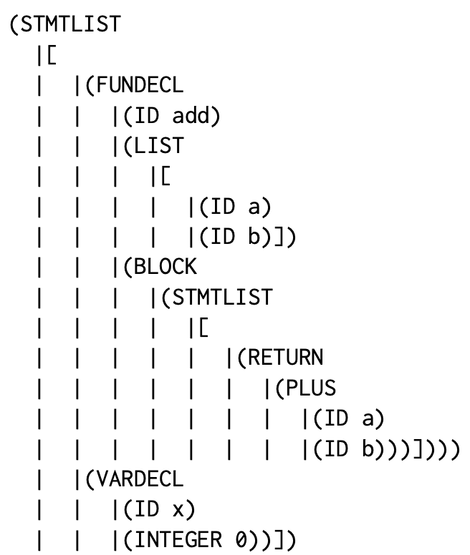
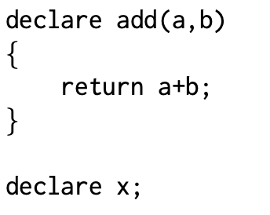
Cuppa3 Frontend

Slide 16
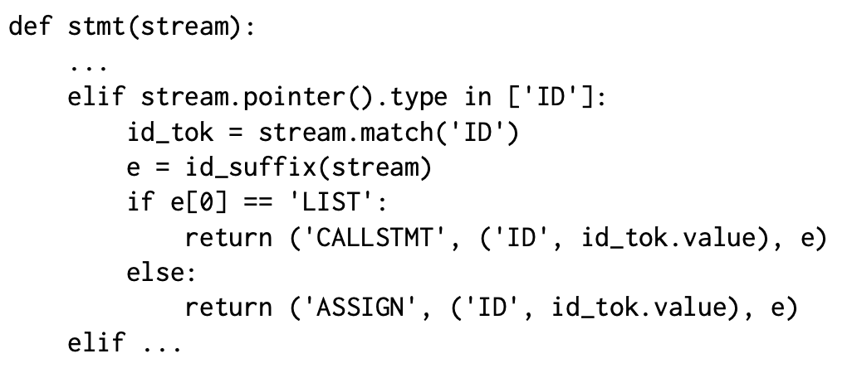
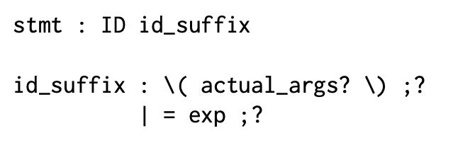
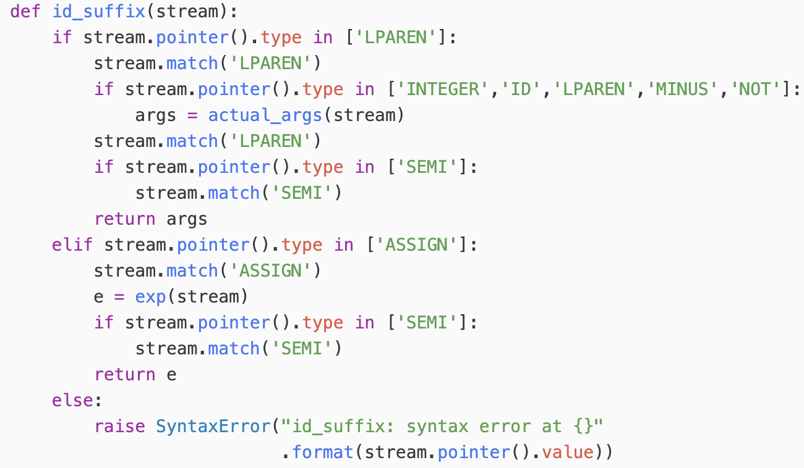
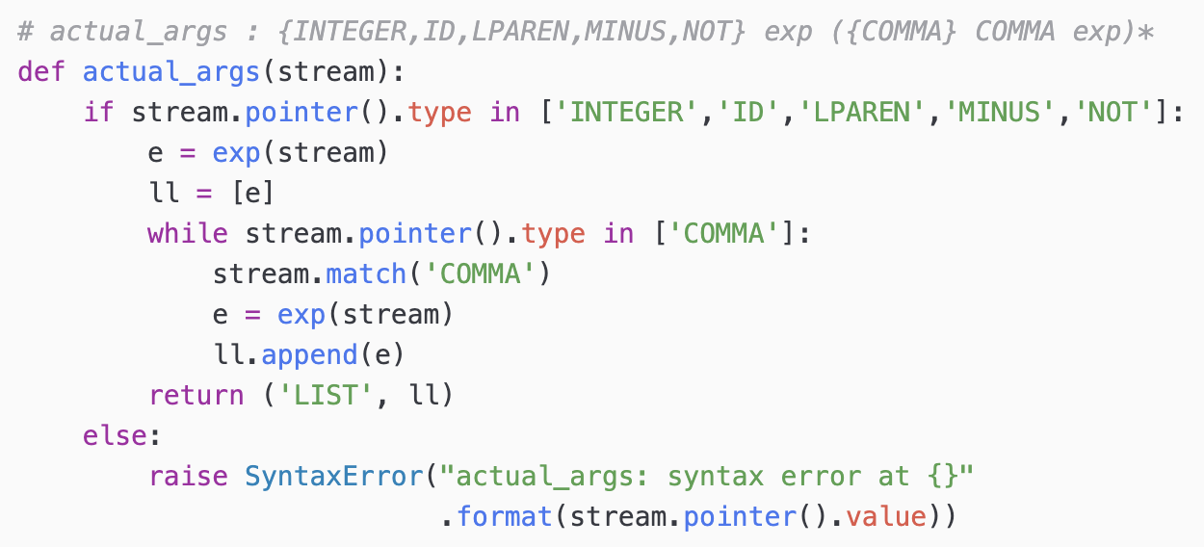
Cuppa3 Frontend

Slide 17
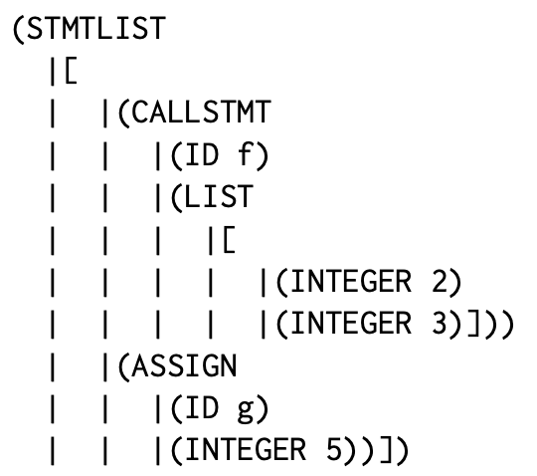

Cuppa3 Frontend

Slide 18

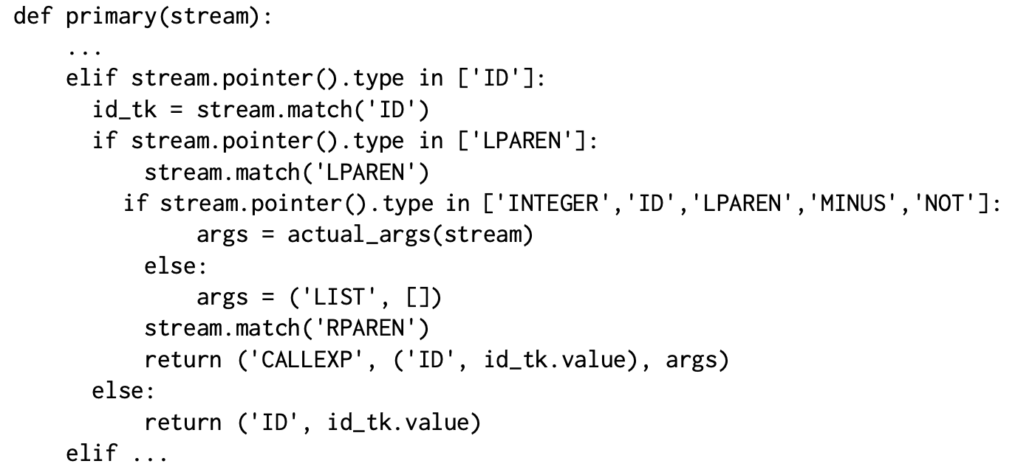
Cuppa3 Frontend

Slide 19
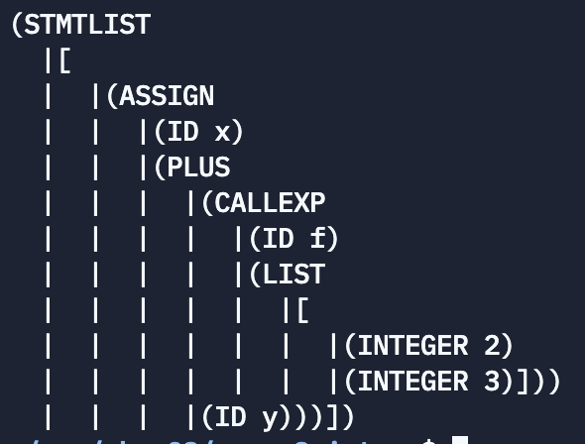

Cuppa3 Frontend

Slide 20
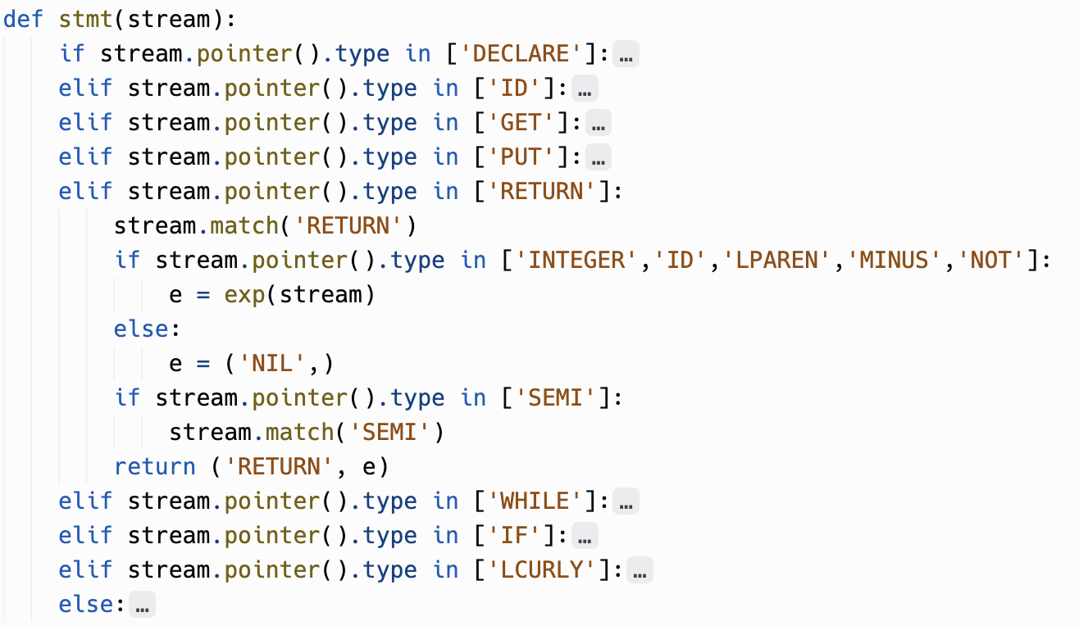
Cuppa3 Frontend
stmt : return exp? ;?

Slide 21
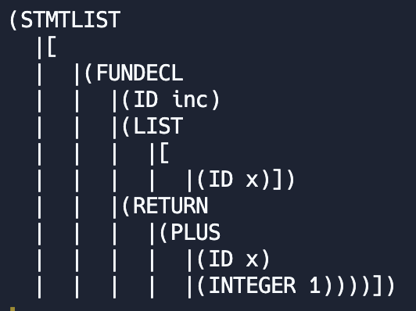
Cuppa3 Frontend
declare inc(x) return x+1;

Slide 22
Symbol Table
The symbol table is extended so that we can manipulate scopes in order to implement static scoping

Slide 23
Symbol Table
class SymTab:
def __init__(self):
self.scoped_symtab = [{}]
def get_config(self):
# we make a shallow copy of the symbol table
return list(self.scoped_symtab)
def set_config(self, c):
self.scoped_symtab = c
def push_scope(self):
…
def pop_scope(self):
…
def declare_sym(self, sym, init):
…
def declare_fun(self, sym, init):
…
def lookup_sym(self, sym):
…
def update_sym(self, sym, val):
…
cuppa3_symtab.py

Slide 24
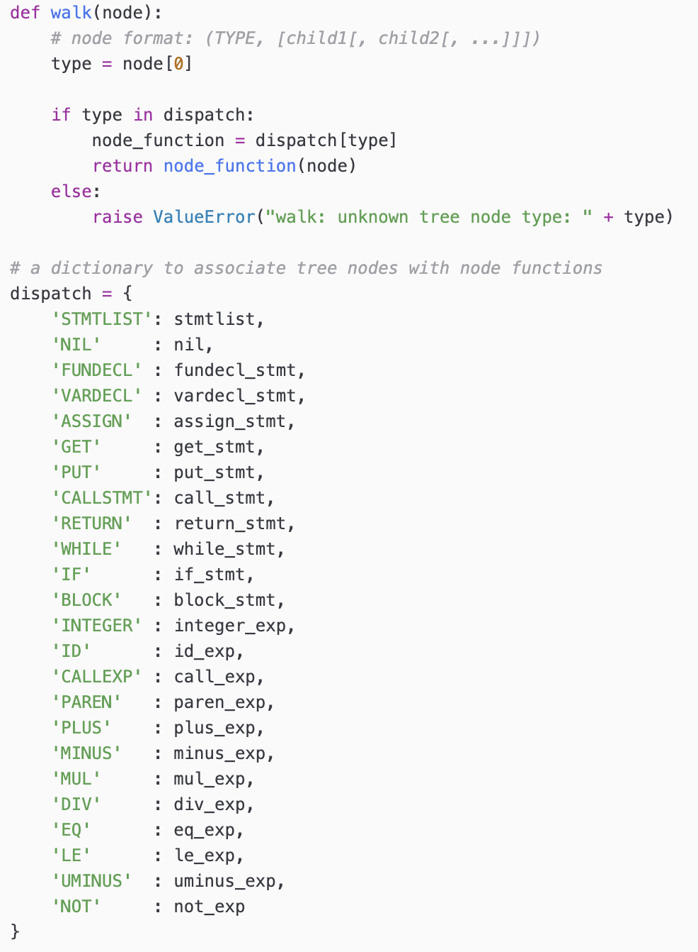
Interp Walker
Good News: the interpretation of the AST is the same as for Cuppa2 except for the nodes shown with the red arrow.
cuppa3_interp_walk.py

Slide 25
Interpreting Declarations
We now have two types of values that we need to store in the symbol table
Integer values
Function values
We tag the values that we store in the symbol table with appropriate type tags
Traditionally this is called a ‘symbol table record’
For us it is just a tuple of type tag and value

Slide 26
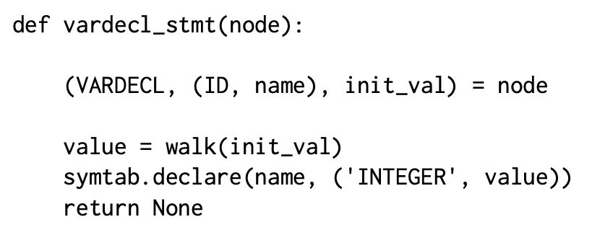
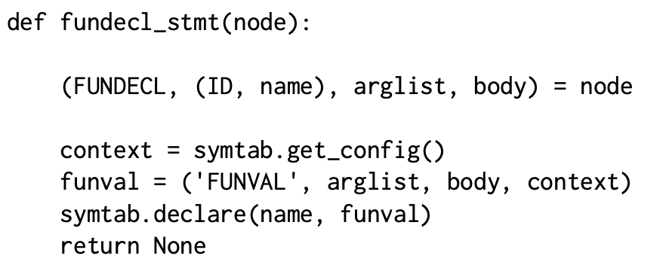
Interpreting Declarations
Function context needed for static scoping

Slide 27
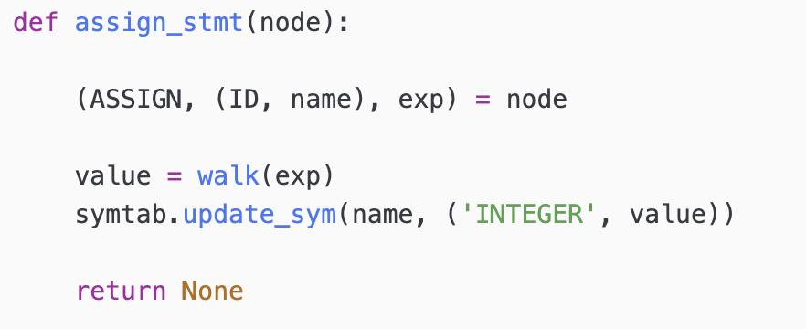
Interpreting Assignments
The fact that we are binding tuples into the symbol table affects assignment statements
We have to bind tuples into the symbol table for assigned values.

Slide 28
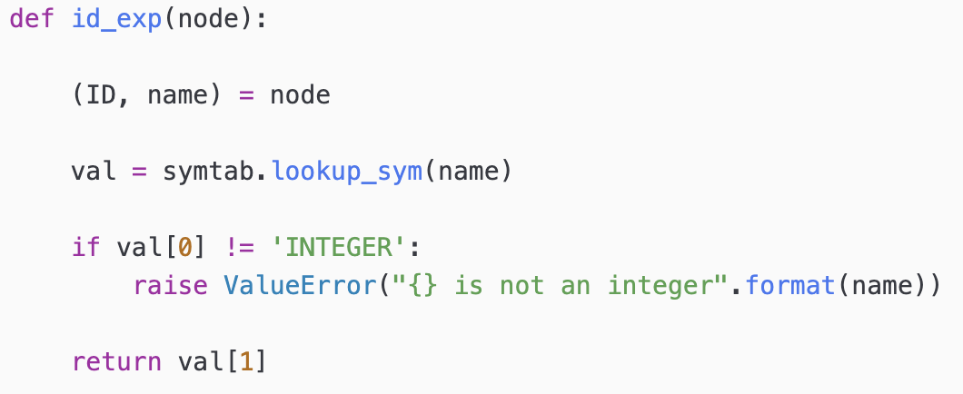
Interpreting Identifier Expressions
Variables that appear in expressions return values
Before we can return a value, we need to unpack the structure bound into the symbol table

Slide 29
Interpreting Function Calls
The difference between call statements and call expressions:
Call statements – return value of a function is ignored
Call expressions – function has to provide a return value
Note: the return value of functions
called as statement is ignored.
Consider:
declare f () {
put(1001);
return 1001;
}
f();
declare inc(i)
{
return i+1;
}
declare x = 10;
declare y;
y = inc(x);
put y;

Slide 30
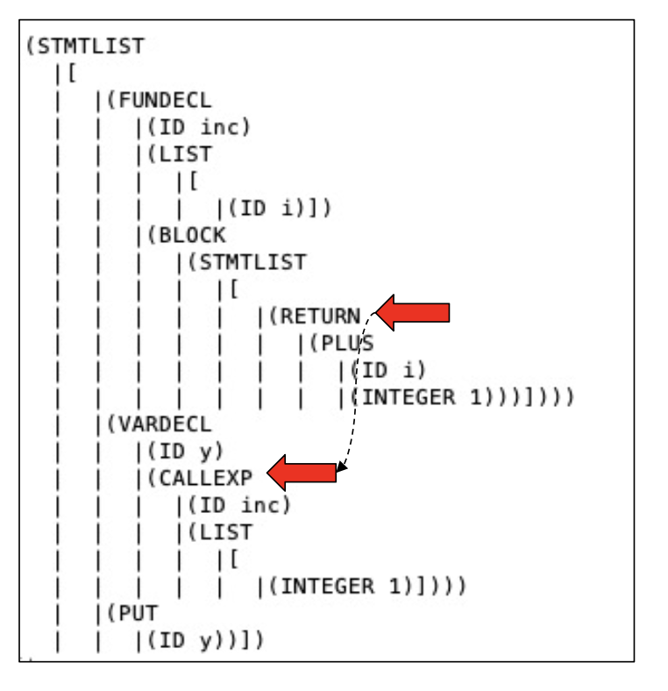
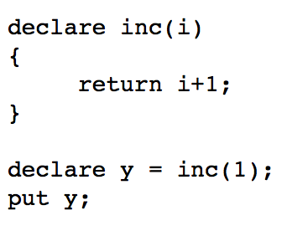
Interpreting Function Calls
How do we get function return values to the call site?
We throw them!

Slide 31
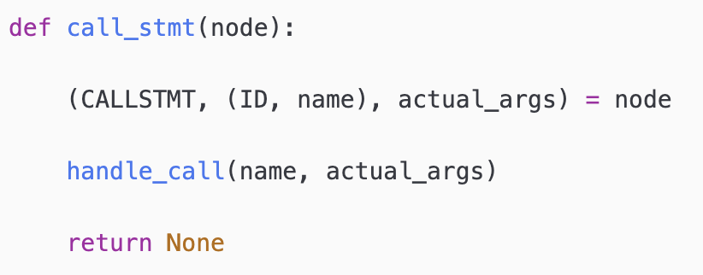
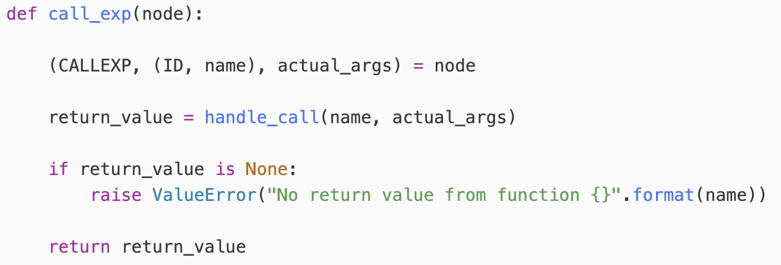
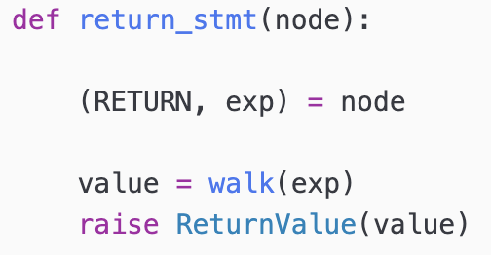
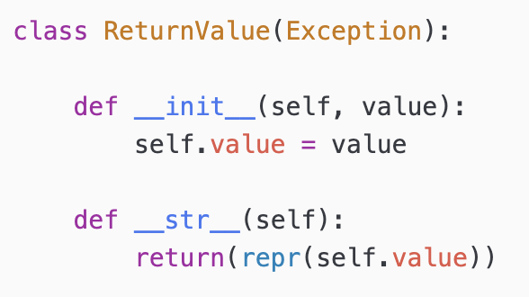
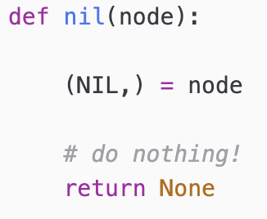
Interpreting Function Calls

Slide 32
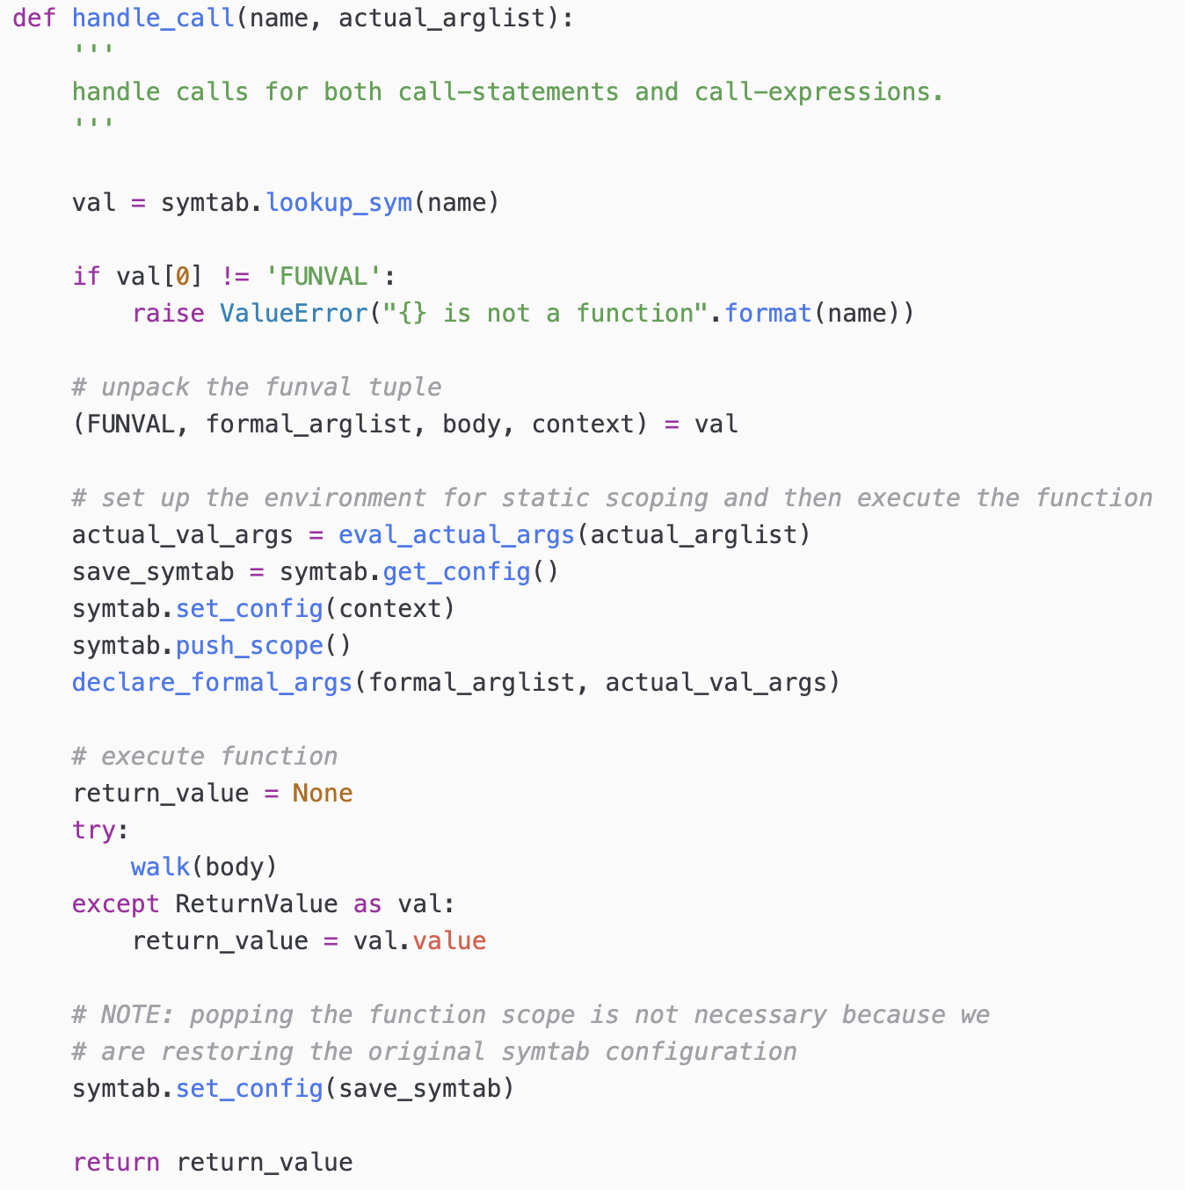
Interpreting Function Calls
‘handle_call’ our function call work horse

Slide 33
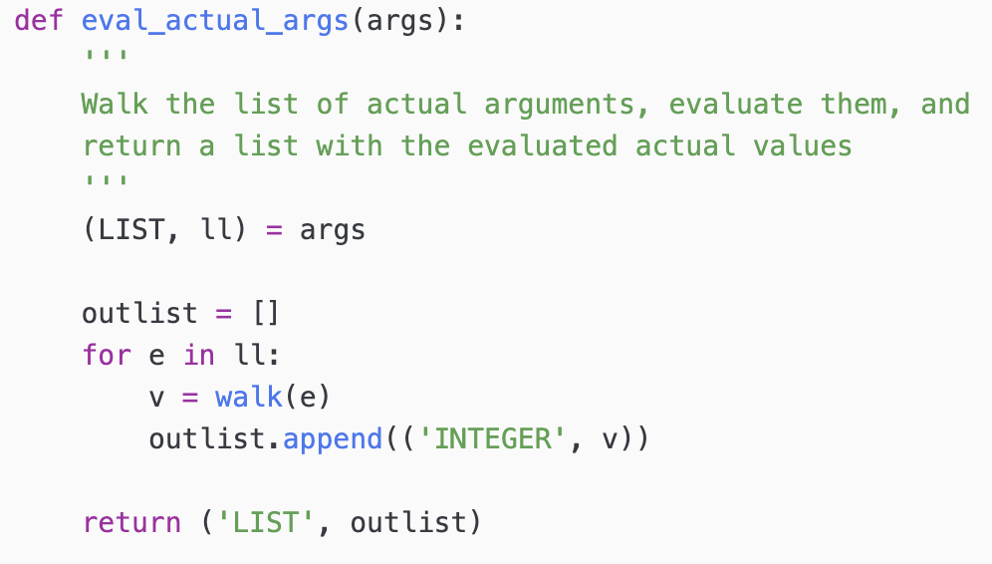
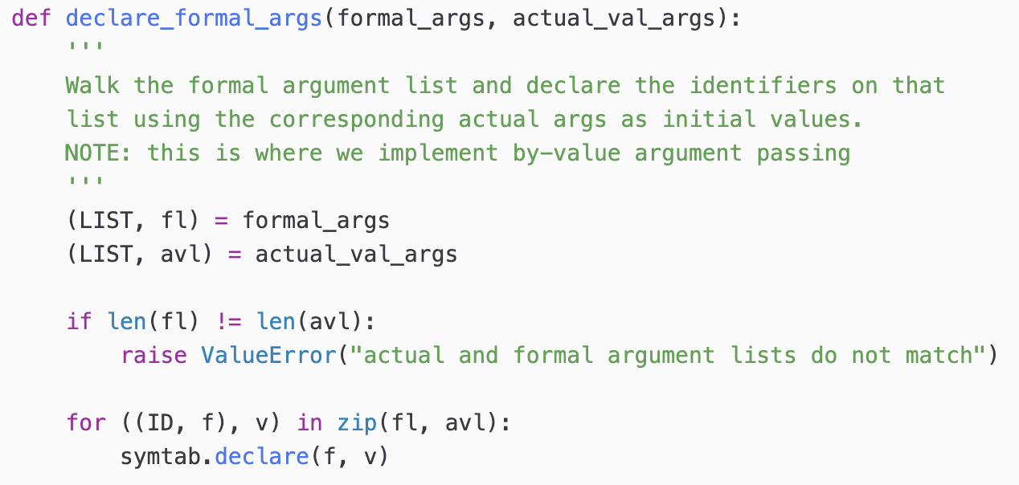
Interpreting Function Calls

Slide 34
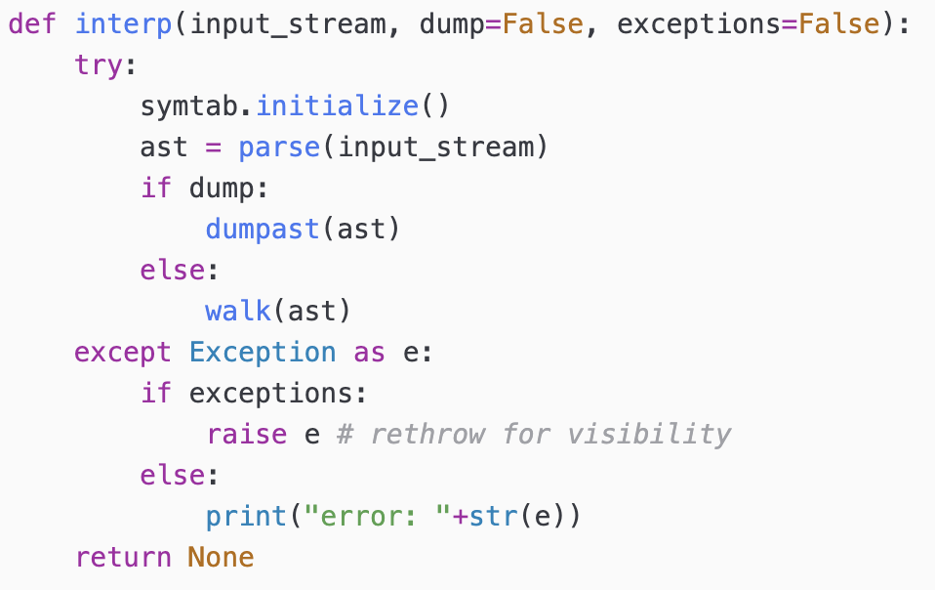
Driver Function

Slide 35
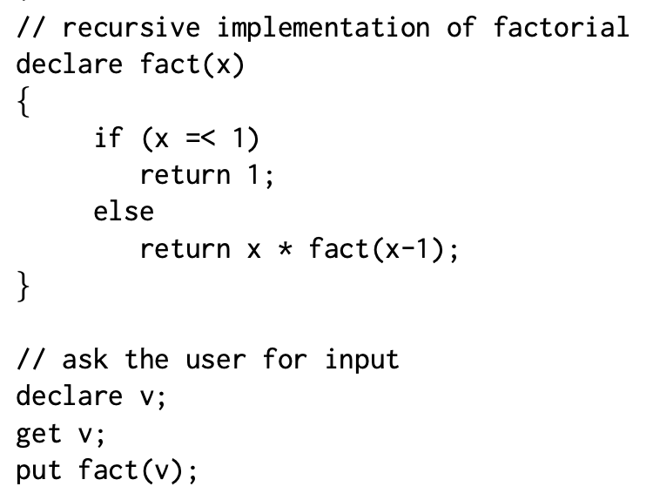
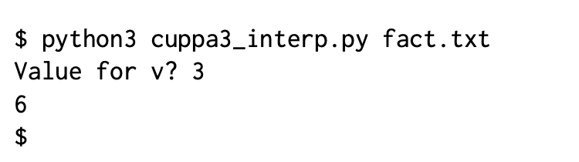
Testing the Interpreter

Slide 36
Assignment
Assignment #5 – see BrightSpace

