Slide 1
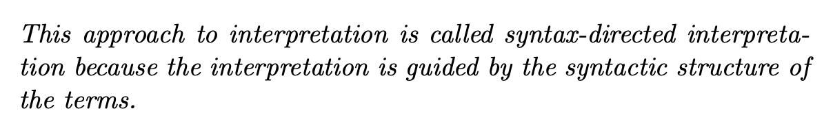
Syntax-Directed Interpretation
We now have all the tools to build our first interpreter.
We will extend Exp0 to Exp1 by allowing multi-symbol words
We will build an interpreter for Exp1 using a technique called syntax-directed interpretation.

Slide 2
Reading
Chap 3

Slide 3
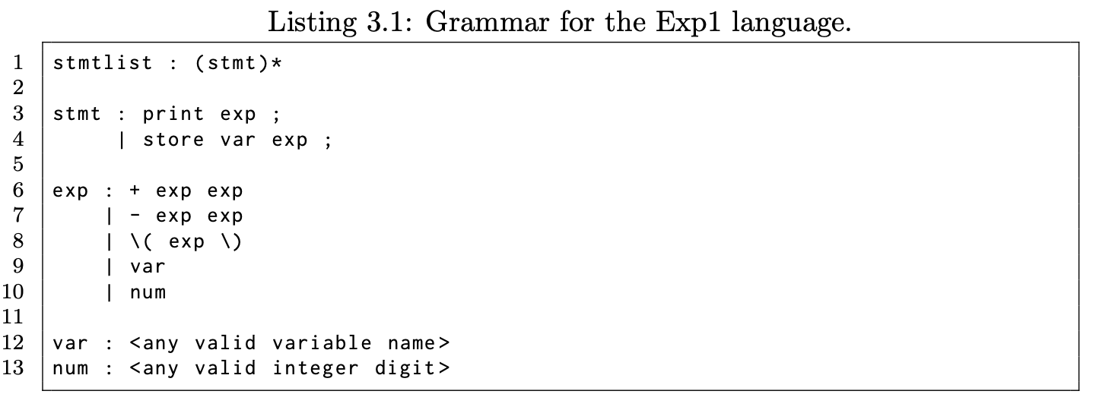
The Exp1 Language
We extend the Exp0 language to create Exp1:
keywords that are longer than a single character
Variable names that conform to the normal variable names found in other programming languages: a single alpha character followed by zero or more alpha-numerical characters
Numbers that consist of more than one digit.

Slide 4
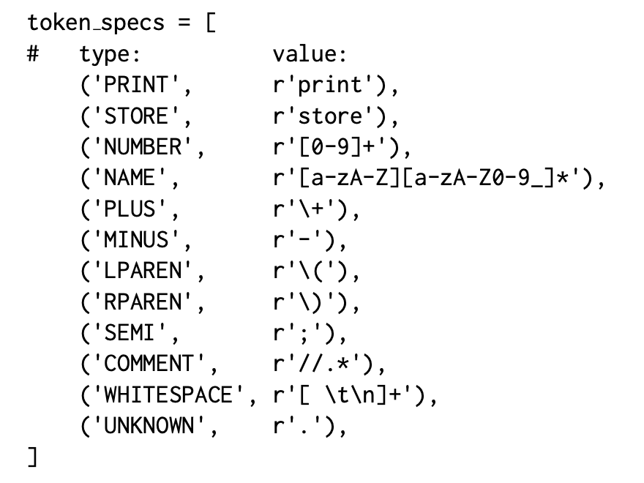
Exp1 Lexer
The only thing that changes in the lexer between the Calc lexer and the Exp1 lexer is the token specification

Slide 5
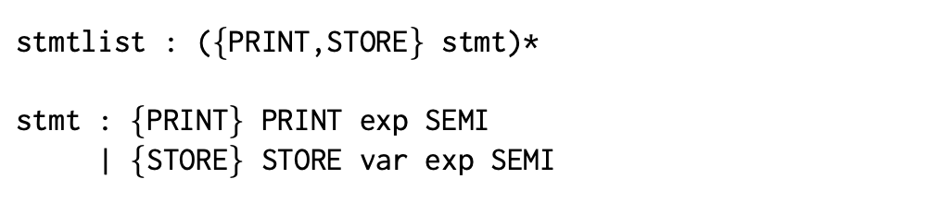
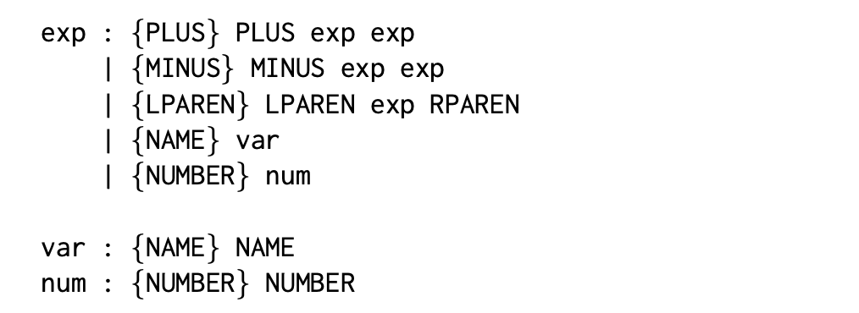
Exp1 Grammar
Rewriting the grammar in terms of tokens and lookahead sets.

Slide 6
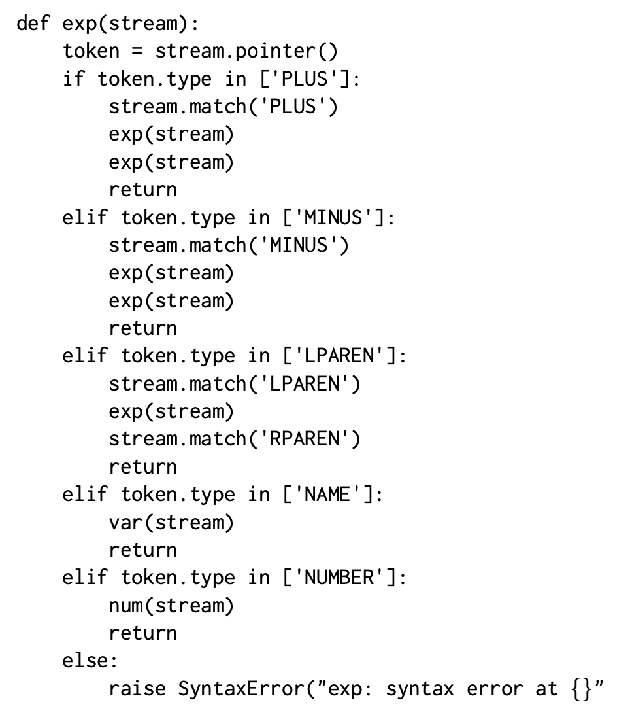
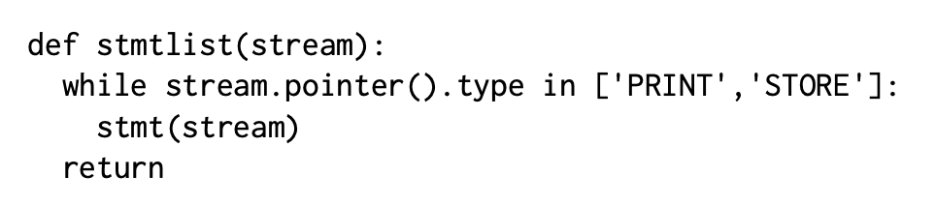
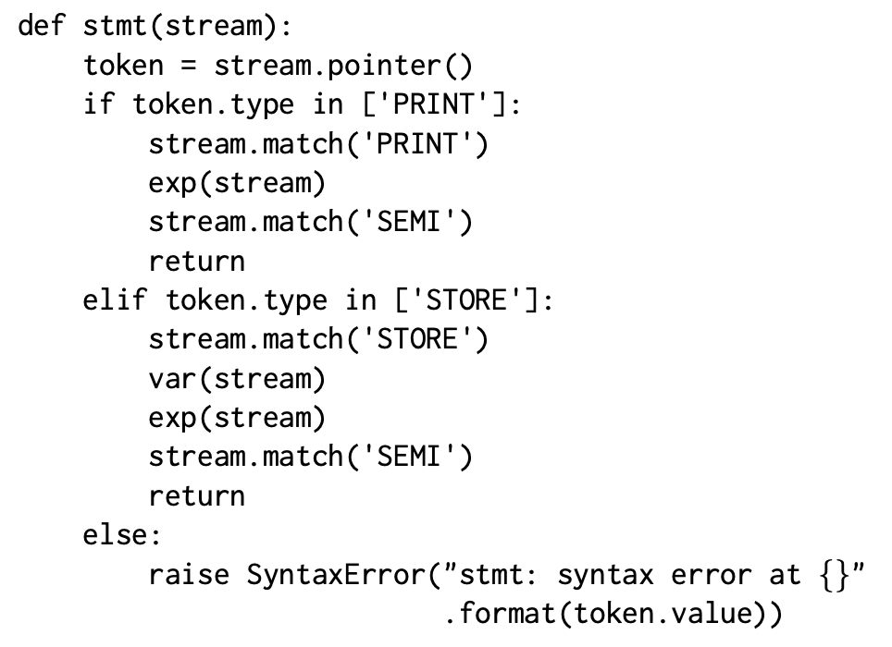
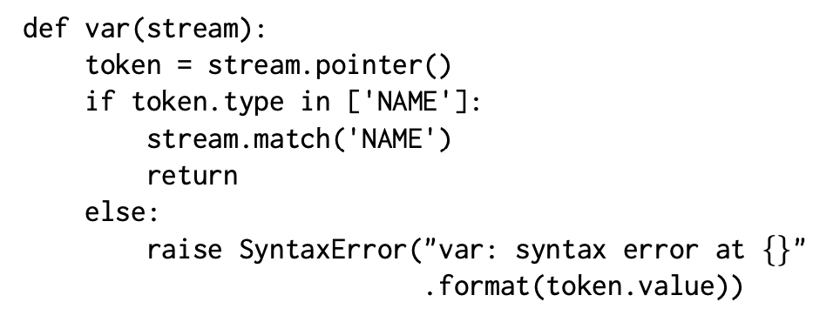
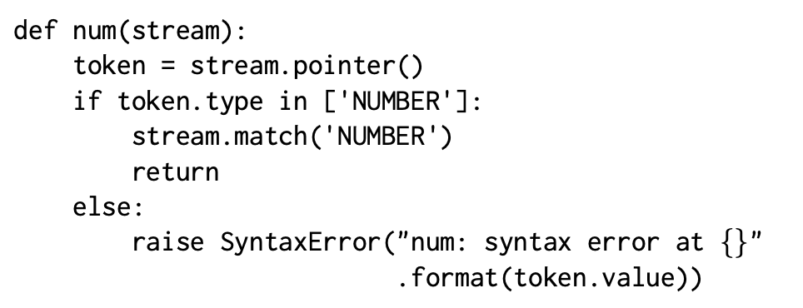
The Parser

Slide 7
Testing the Parser
$ python3 exp1_parser.py
store x 1; print + x 1;
^D
parse successful
$
$ python3 exp1_parser.py
print 1 + 1;
^D
error: unexpected token PLUS while parsing, expected SEMI
$

Slide 8
Writing an Interpreter for Exp1
Syntax-directed interpretation – we pass values along the parse tree in a bottom-up fashion
Writing an interpreter for Exp1
We add code to the parser that interprets the values within the phrase structure of a program.
Observation: we need access to the token values during parsing in order to evaluate things like the values of numbers or the value of an addition.
Observation: interpretation always starts at the leaves.

Slide 9
Writing an Interpreter for Exp1
Consider the following Exp1 program: store y + 2 x ;
Assumption: x has the value 3.

Slide 10
Symbol Table
x | 3
y | ???
Action: start
stmt
STORE
var
exp
SEMI
NAME(y)
PLUS
exp
exp
INTVAL(2)
var
NAME(x)

Slide 11
Symbol Table
x | 3
y | ???
Action: interpret INTVAL
stmt
STORE
var
exp
SEMI
NAME(y)
PLUS
exp
exp
INTVAL(2)
var
NAME(x)

Slide 12
Symbol Table
x | 3
y | ???
Action: propagate
stmt
STORE
var
exp
SEMI
NAME(y)
PLUS
exp
exp
2
INTVAL(2)
var
NAME(x)

Slide 13
Symbol Table
x | 3
y | ???
Action: propagate
stmt
STORE
var
exp
SEMI
2
NAME(y)
PLUS
exp
exp
INTVAL(2)
var
NAME(x)

Slide 14
Symbol Table
x | 3
y | ???
Action: interpret NAME
stmt
STORE
var
exp
SEMI
2
NAME(y)
PLUS
exp
exp
INTVAL(2)
var
NAME(x)

Slide 15
Symbol Table
x | 3
y | ???
Action: read symbol table
stmt
STORE
var
exp
SEMI
2
NAME(y)
PLUS
exp
exp
INTVAL(2)
var
NAME(x)

Slide 16
Symbol Table
x | 3
y | ???
Action: propagate
stmt
STORE
var
exp
SEMI
2
NAME(y)
PLUS
exp
exp
INTVAL(2)
var
3
NAME(x)

Slide 17
Symbol Table
x | 3
y | ???
Action: propagate
stmt
STORE
var
exp
SEMI
2
NAME(y)
PLUS
exp
exp
3
INTVAL(2)
var
NAME(x)

Slide 18
Symbol Table
x | 3
y | ???
Action: add
stmt
STORE
var
exp
SEMI
3
2
NAME(y)
PLUS
exp
exp
INTVAL(2)
var
NAME(x)

Slide 19
Symbol Table
x | 3
y | ???
Action: propagate
stmt
5
STORE
var
exp
SEMI
NAME(y)
PLUS
exp
exp
INTVAL(2)
var
NAME(x)

Slide 20
Symbol Table
x | 3
y | ???
Action: eval name
stmt
5
STORE
var
exp
SEMI
Y
NAME(y)
PLUS
exp
exp
INTVAL(2)
var
NAME(x)

Slide 21
Symbol Table
x | 3
y | ???
Action: propagate
stmt
Y
5
STORE
var
exp
SEMI
NAME(y)
PLUS
exp
exp
INTVAL(2)
var
NAME(x)

Slide 22
Symbol Table
x | 3
y | 5
Action: write to symtab
stmt
Y
5
STORE
var
exp
SEMI
NAME(y)
PLUS
exp
exp
INTVAL(2)
var
NAME(x)

Slide 23
Symbol Table
x | 3
y | 5
Action: done
stmt
STORE
var
exp
SEMI
NAME(y)
PLUS
exp
exp
INTVAL(2)
var
NAME(x)

Slide 24
Interpretation
Consider the Exp1 expression: + 1 2
exp : + exp exp
| - exp exp
| \( exp \)
| var
| num
;
exp
+
exp
exp
Interpretation means, computing the value
of the root node.
We have to start at the leaves of the tree,
that is where the primitive values are and
proceed upwards…
What is the value at the root node?
num
num
1
2

Slide 25
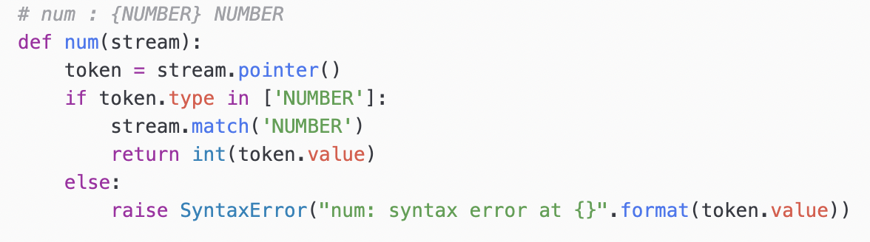
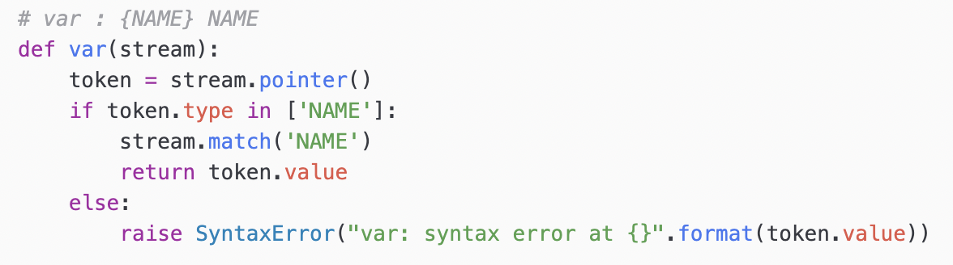
Interpretation & the Parser

Slide 26
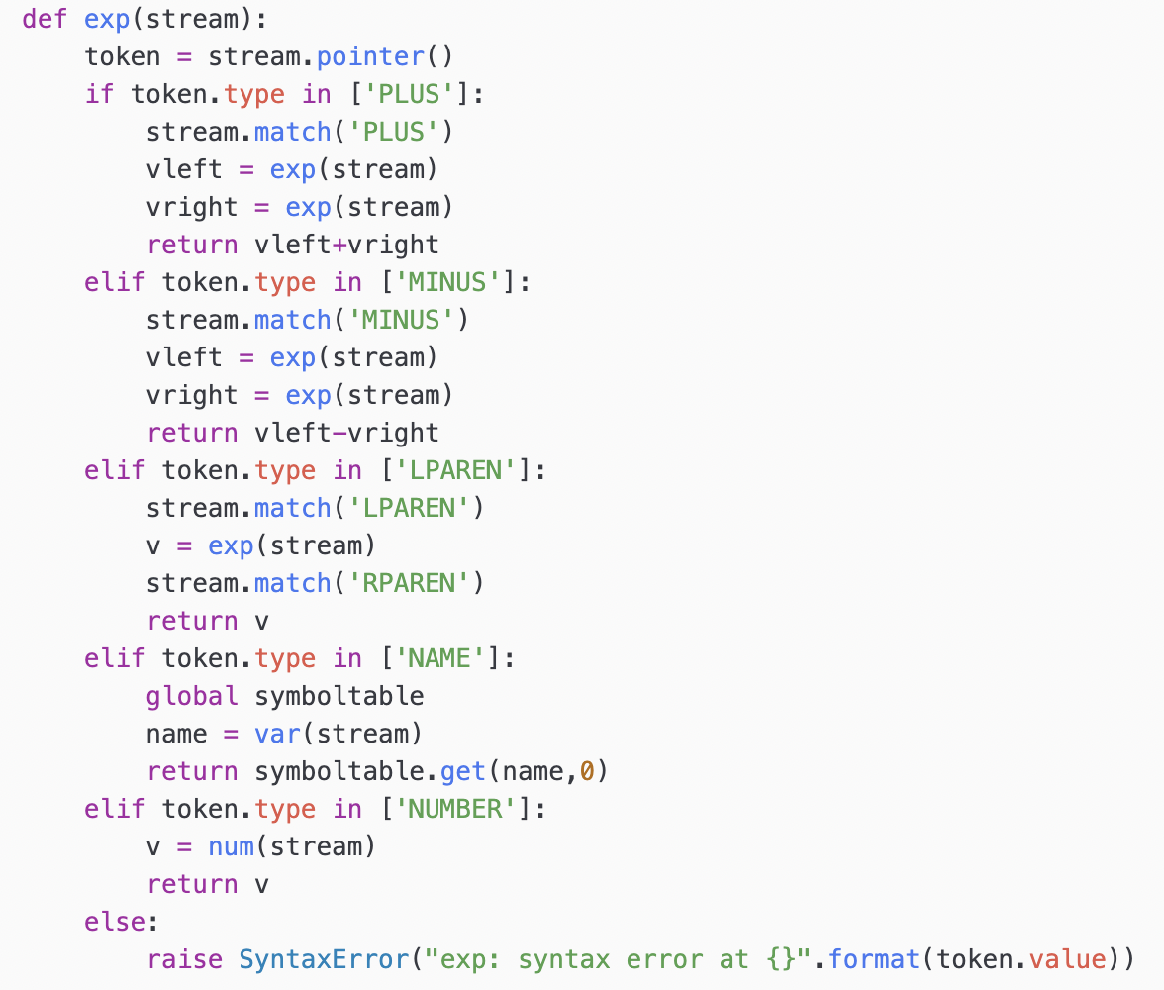
Interpretation & the Parser
Recursion lets the values percolate up.

Slide 27
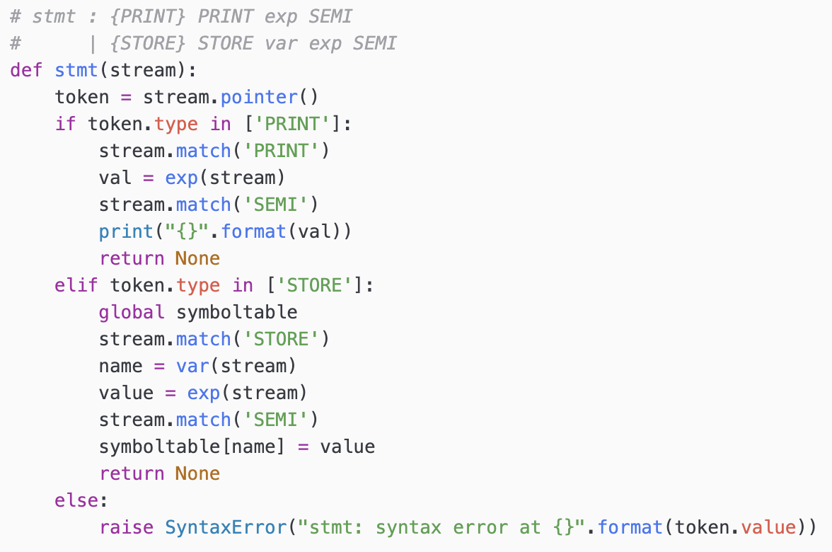
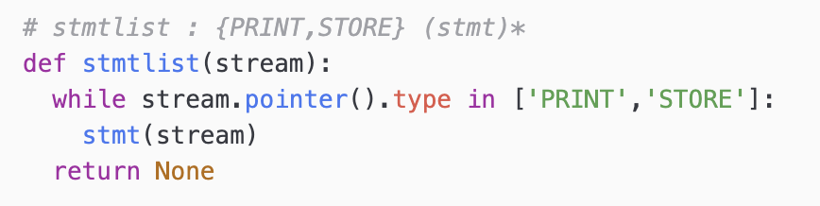
Interpretation & the Parser
Recursion lets the values percolate up.

Slide 28
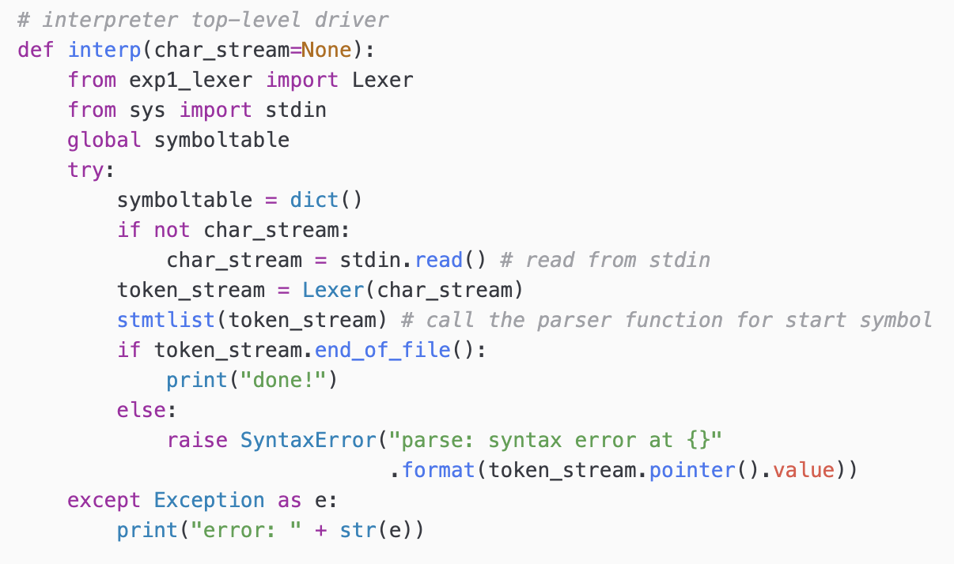
Interpretation & the Parser

Slide 29
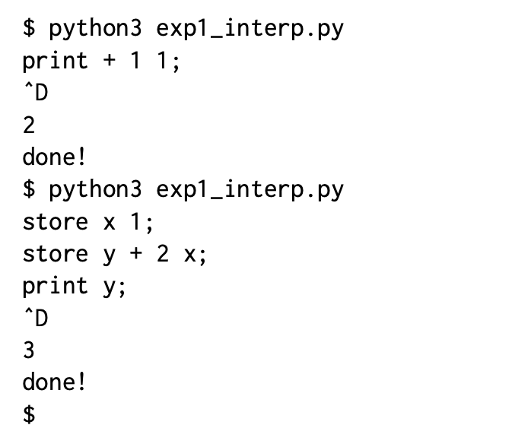
Testing the Interpreter

Slide 30
Reading
Chapter 3
Assignment #2 – please see website

