Slide 1
Parser Generators
Chap 13
Up till now we have constructed parsers by hand for our language implementations.
Given some of the repetitive work involved you probably have asked yourself if some of that can be automated.
The answer is: Yes!
Parser generators will process a grammar specification and generate code that implements a parser.

Slide 2
Lex/YACC
The most well-known parser generator tool set is Lex/YACC
Lex – LEXical analyzer
YACC – Yet Another Compiler Compiler
These tools were developed by the original Unix creators in order to be able to create “little languages” very fast.
Lex is a regular expression based lexical analyzer (very similar to our lexer)
YACC creates bottom-up parsers.
We will be using an implementation of Lex/YACC in Python called PLY.

Slide 3
Bottom-Up Parsing – LR(1)
Previously we have studied top-down or LL(1) parsing.
The idea here was to start with the start symbol and keep expanding it until the whole input was read and matched.
In bottom-up or LR(1) parsing we do exactly the opposite, we try to match the input to a rule and then keep reducing the input replacing it with the non-terminal of the rule. The last step is to replace the current input with the start-symbol.
Observation: in LR(1) parsing we apply the rules backwards – this is called reduction

Slide 4
Bottom-Up Parsing – LR(1)
In our LL(1) parsing example we replaced non-terminal symbols with functions that did the expansions and the matching for us.
In LR(1) parsing we use a stack to help us find the correct reductions.
Given a stack, an LR(1) parser has four available actions:
Shift – push an input token on the stack
Reduce – pop elements from the stack and replace by a non-terminal (apply a rule ‘backwards’)
Accept – accept the current program
Reject – reject the current program

Slide 5
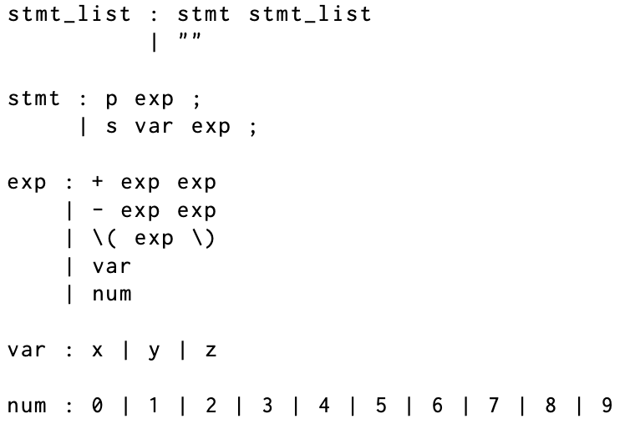
Bottom-Up Parsing – LR(1)
Stack | Input | Action
<empty> | p + x 1 ; | Shift
p | + x 1 ; | Shift
p + | x 1 ; | Shift
p + x | 1 ; | Reduce
p + var | 1 ; | Reduce
p + exp | 1 ; | Shift
p + exp 1 | ; | Reduce
p + exp num | ; | Reduce
p + exp exp | ; | Reduce
p exp | ; | Shift
p exp ; | <empty> | Reduce
stmt | <empty> | Shift
stmt <empty> | <empty> | Reduce
stmt stmt_list | <empty> | Reduce
stmt_list | <empty> | Accept
p + x 1 ;
Notes:
Add algorithm box

Slide 6
Bottom-Up Parsing – LR(1)
Stack
<empty>
p
p +
p + x
p + var
p + exp
p + exp 1
p + exp num
p + exp exp
p exp
p exp ;
stmt
stmt <empty>
stmt stmt_list
stmt_list
p + x 1 ;
stmt_list
stmt
stmt_list
p
exp
;
exp
“”
+
exp
var
num
x
1

Slide 7
Bottom-Up Parsing – LR(1)
Let’s try an illegal sentence
p + x s ;
Stack | Input | Action
<empty> | p + x s ; | Shift
p | + x s ; | Shift
p + | x s ; | Shift
p + x | s ; | Reduce
p + var | s ; | Reduce
p + exp | s ; | Shift
p + exp s | ; | Shift
p + exp s ; | <empty> | Reject

Slide 8
Parser Generators
Grammar File
Parser
Generator
Parser Code (e.g. Python)
That looks very much like a translator!

Slide 9
Parser Generators
IR
IR
Grammar File
Syntax
Analysis
Semantic
Analysis
Code
Generation
Parser Code
Parser generators are an example of a domain specific language translator!
Ply is a parser generator, it translates a grammar specification
into parser code written in Python.

Slide 10
Using Ply
Documentation on Ply can be found here:
http://www.dabeaz.com/ply/ply.html
Documentation on Ply grammar specifications can be found here:
http://www.dabeaz.com/ply/ply.html#ply_nn23

Slide 11
YACC Specification of Exp0
We will use Exp0 as our example language using Ply.

Slide 12
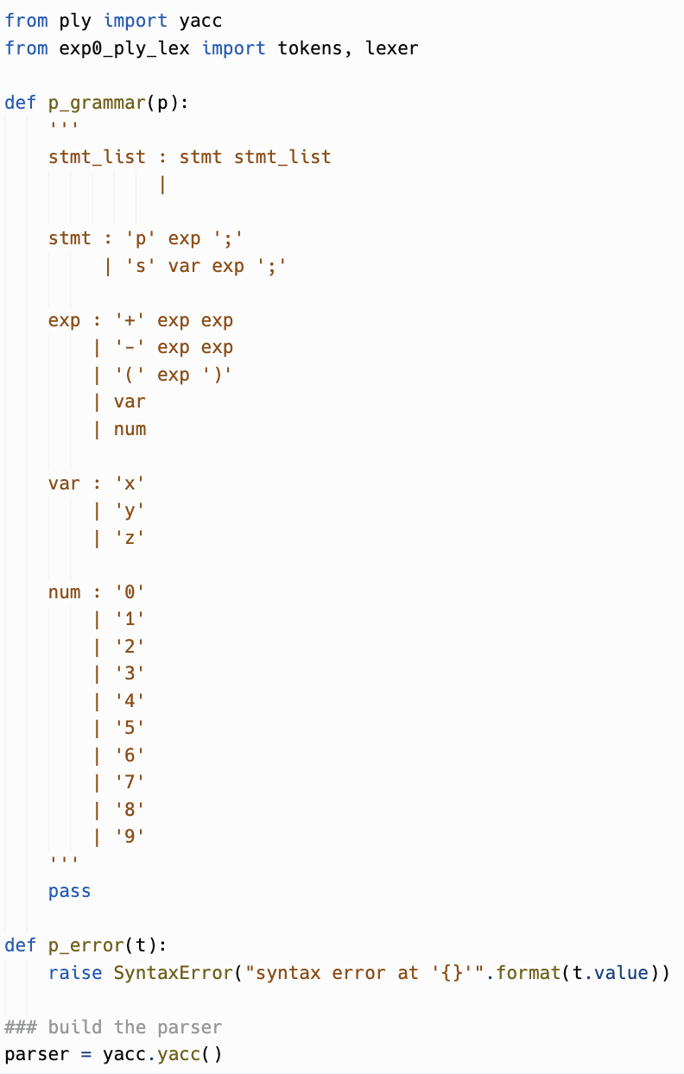
Using Ply
This is the ‘exp0_gram.py’ file
In Ply the grammar is specified in the docstring of the grammar functions
Goal is to generate a parser from this specification
The lex part is specified in a separate file ‘exp0_lex.py’

Slide 13
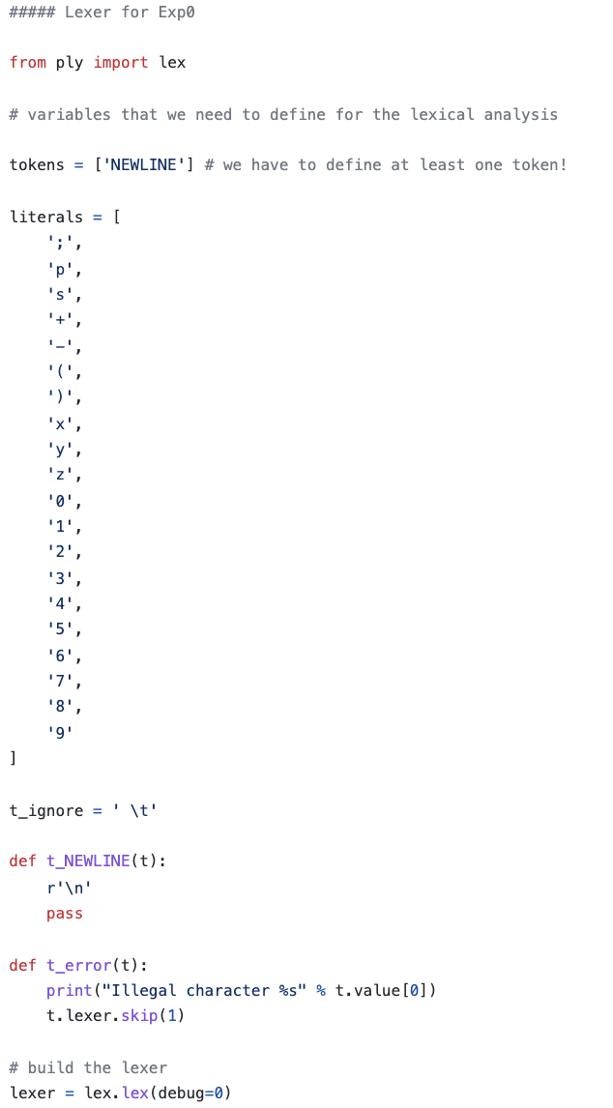
Lex
The ‘exp0_lex.py’ file

Slide 14
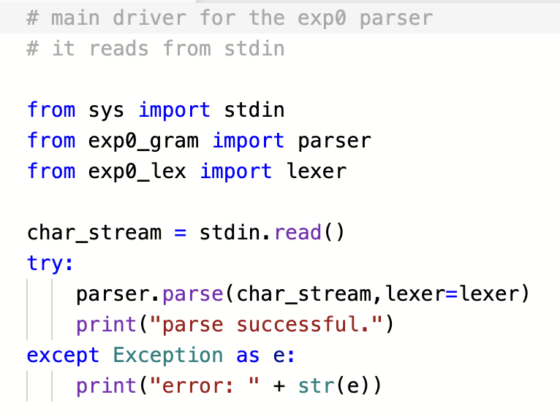
Driver

Slide 15
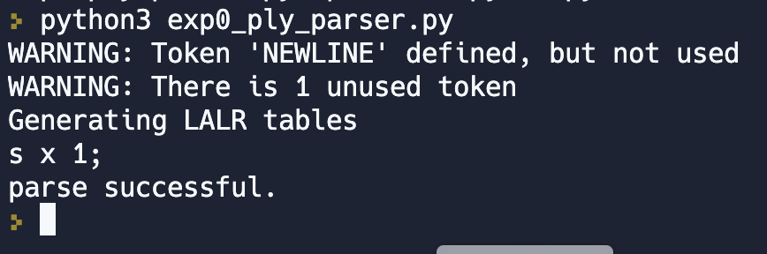
Running the Parser
Look at ‘parser.out’

Slide 16
YACC Grammars
For SMALL languages YACC grammars tend to be very natural
e.g. Cuppa1 grammar
However, bottom-up parsing breaks down for large, production-level languages

Slide 17
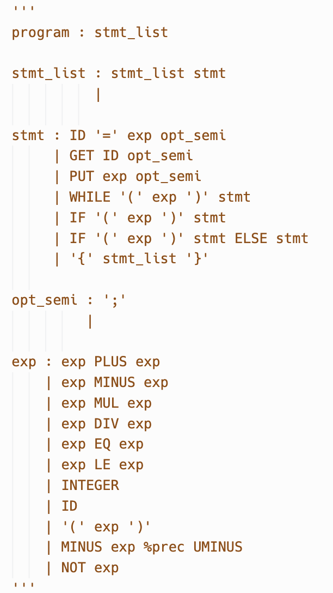
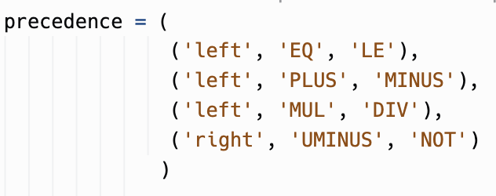
Cuppa1 Grammar
Words in capital letters are tokens!

Slide 18
Actions
Making the generated parser do something useful.
In the hand-coded parser you can add code anywhere in order to make the parser do something useful…
In parsers generated by parser generators we use something called ‘actions’ we insert into the grammar.
In Ply actions are inserted into the grammar specification as Python code.
Details in the PLY documentation and the book.

Slide 19
Conflicts
Bottom-up parsers take a global view of the grammar – they search the right sides of all rules to find a reduction.
Top-down parsers take a local view of the grammar – they only search for applicable rules within the appropriate non-terminal.

Slide 20
Conflicts
The global view of grammars in bottom-up parsers leads to a phenomenon called conflicts.
There are two type of conflicts:
Shift/reduce conflicts
Reduce/reduce conflicts

Slide 21
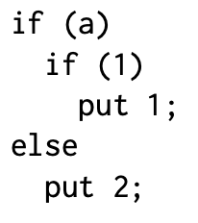
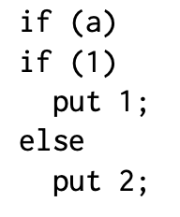
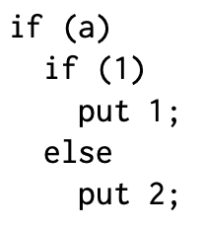
Shift/Reduce Conflicts
The classical example of a shift/reduce conflict is the if-then-else statement.
In most programming languages the if-then-else statement is inherently ambiguous. Consider the two nested if-statements which can be interpreted in two distinct ways:
Here we use indentation to illustrated association

Slide 22
Shift/Reduce Conflicts
This ambiguity shows up as a shift/reduce conflict in YACC
YACC has a default mechanism to deal with this conflict: always shift
In this case, that means that the ‘else’ part with always be associated with the closest ‘if’ statement:

Slide 23
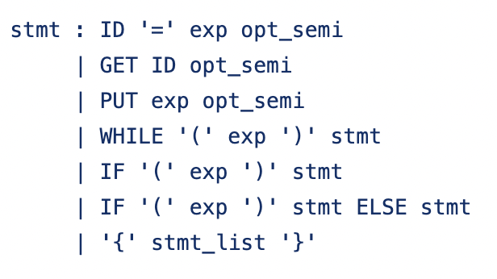
Cuppa1
The shift/reduce conflict in Cuppa1 is due to the if-then-else.
Here is the YACC grammar snippet of the Cuppa1 statements:

Slide 24
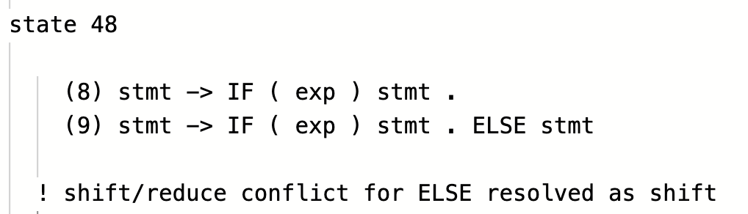
Cuppa1
We can look at the generated ‘parser.out’ file to see what YACC has to say about this conflict:

Slide 25
Reduce/Reduce Conflicts
Reduce/reduce conflicts are dreaded in the language implementation community
Usually that means that you have two syntactic entities that look very similar but appear in different contexts
Because YACC takes a global view of the rules it cannot detect the context and therefore it cannot decide which rule to use to provide a reduce action.

Slide 26
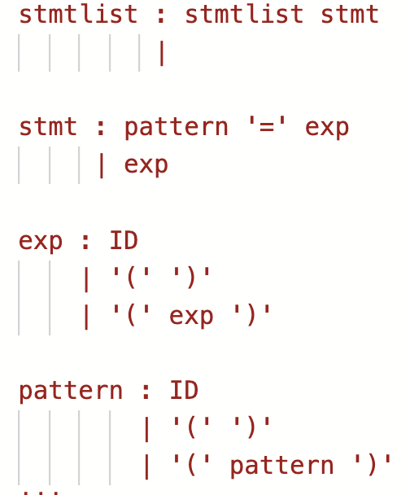
Reduce/Reduce Conflict Example
Consider the grammar snippet of a very simple language that does pattern matching in nested parentheses
Notice that expressions and patterns look exactly the same
the difference is that patterns appear on the left side of an assignment and expressions on the right side.
Right hand sides look Identical!
-> ID
-> ‘(‘ ‘)’)

Slide 27
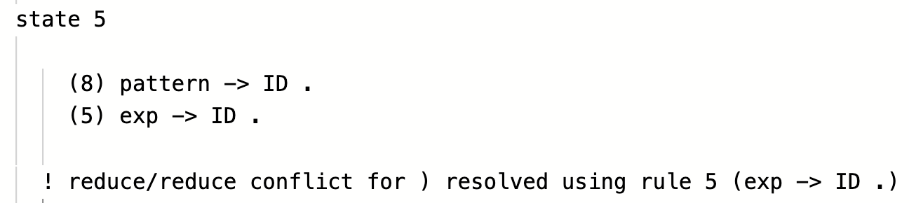
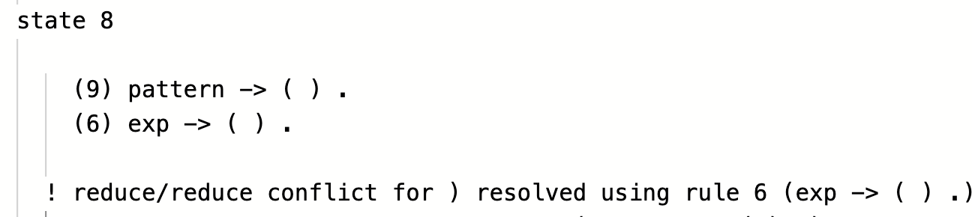
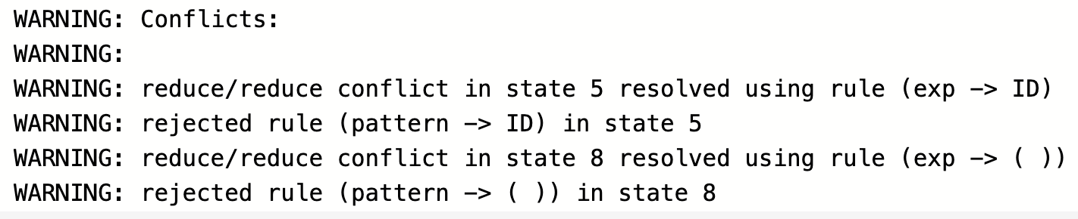
Reduce/Reduce Conflict Example
We would expect that YACC will get confused by the fact that ID and ‘(‘ ‘)’ are right sides for two sets of rules.

Slide 28
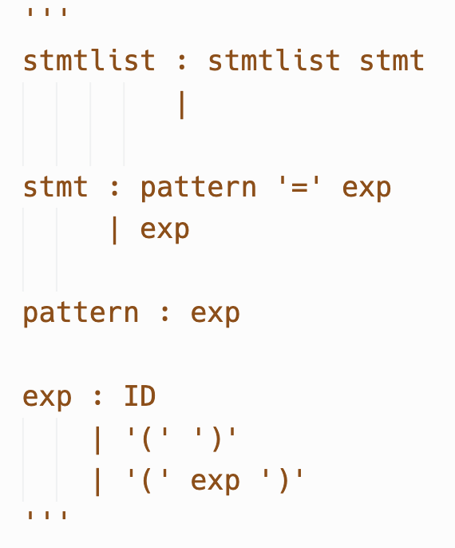
Reduce/Reduce Conflict Example
The fact that YACC outright rejected a set of rules means that the generated parser will not work correctly
One way to fix this is to acknowledge that these two syntactic entities look the same and therefore we make them the same syntactic entity and deal with differences between them at the semantic level.

