Slide 1
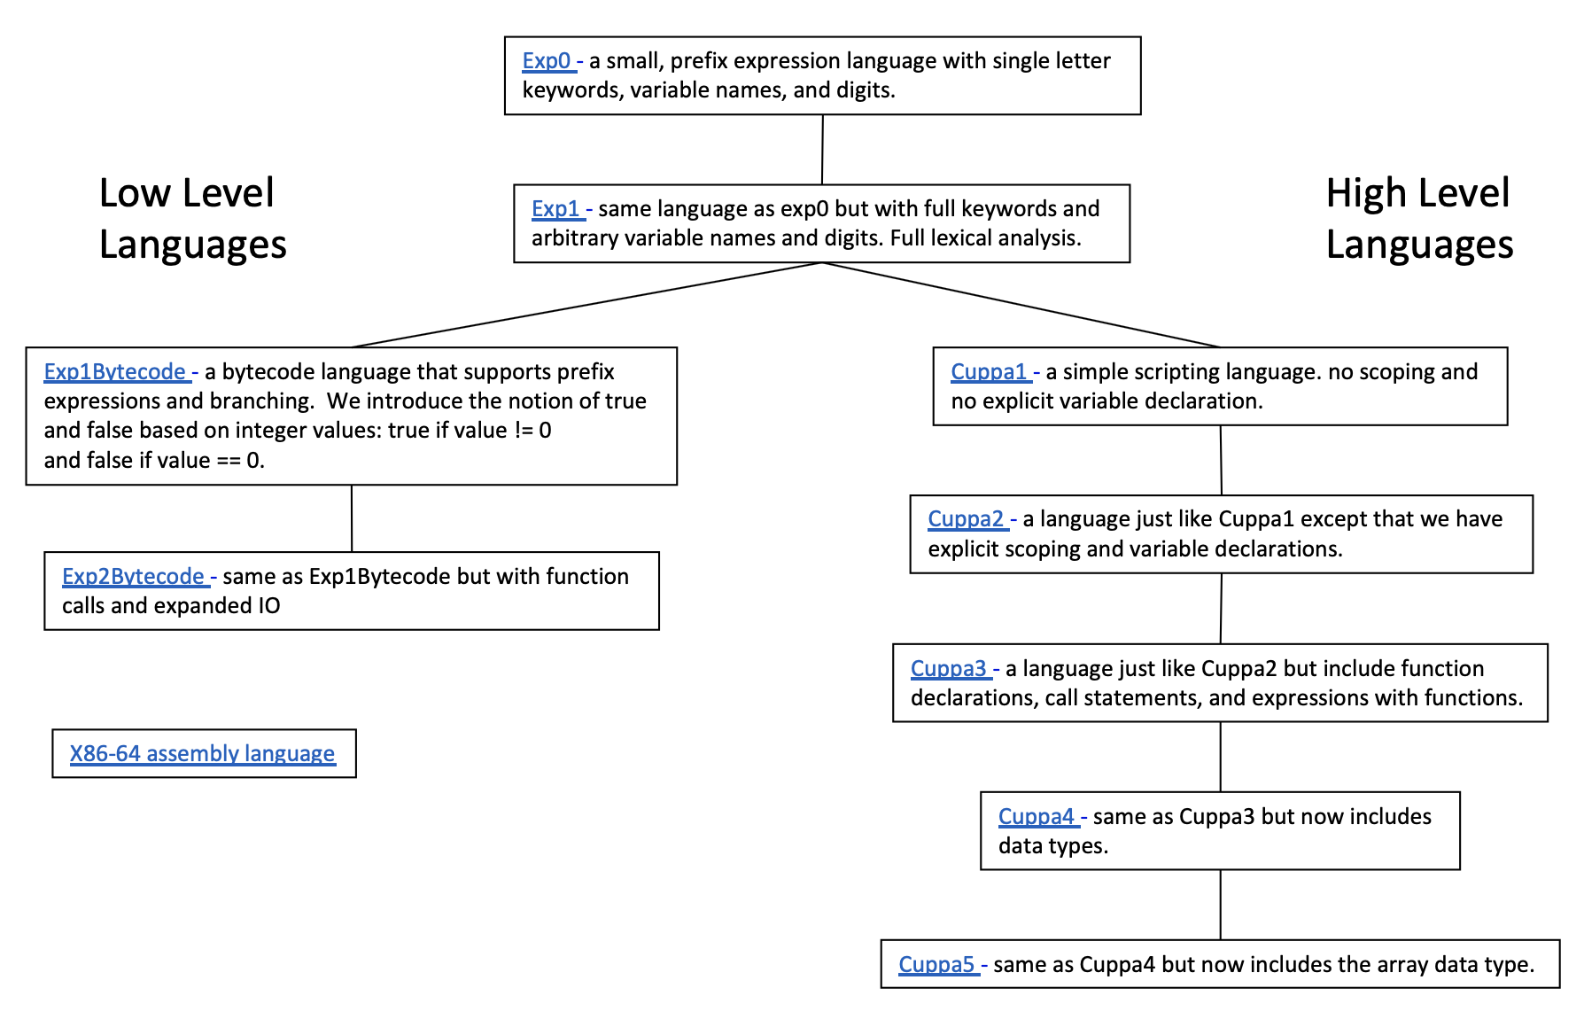
An Ontology of Languages

