Slide 1
A Basic Compiler
At a fundamental level compilers can be understood as processors that match AST patterns of the source language and translate them into patterns in the target language.
Here we will look at a basic compiler that translates Cuppa1 programs into exp1bytecode.
Chap 6

Slide 2
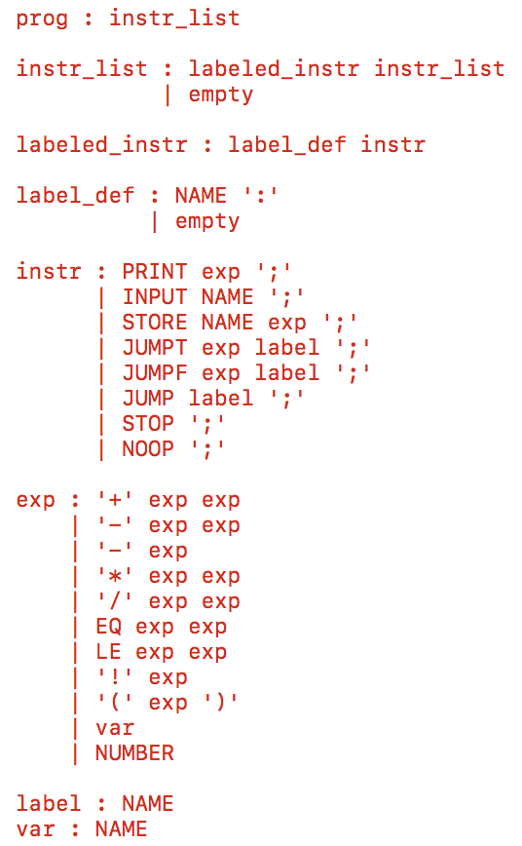
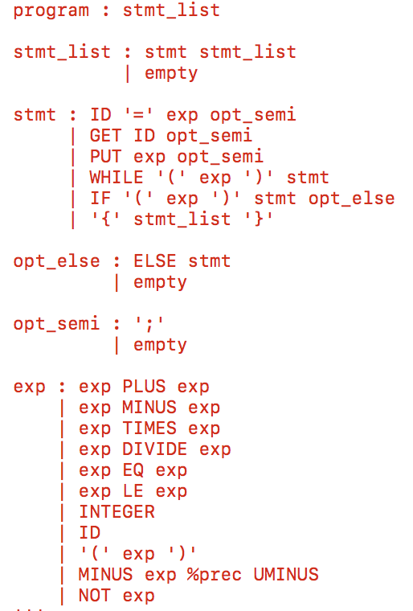
A Basic Compiler
Cuppa1
Exp1bytecode

Slide 3
A Basic Compiler
Consider for example the AST pattern for the assignment statement in Cuppa1,
('assign', name, exp)
We could easily envision translating this AST pattern into a pattern in Exp1bytecode as follows,
store <name> <exp>;
where <name> and <exp> are the appropriate translations of the variable name and the assignment expression from Cuppa1 into Exp1bytecode.

Slide 4
A Basic Compiler
In our case it is not that difficult to come up with pattern translations for all the non-structured statements and expressions in Cuppa1.
For all the non-structured statements we have the pattern translations,
('assign', name, exp) => store <name> <exp>;
('put', exp) => print <exp>;
('get', name) => input <name>;

Slide 5
A Basic Compiler
And for the expressions we have,
('+', c1, c2) => ('+' <c1> <c2>)
('-', c1, c2) => ('-' <c1> <c2>)
('*', c1, c2) => ('*' <c1> <c2>)
('/', c1, c2) => ('/' <c1> <c2>)
('==', c1, c2) => ('==' <c1> <c2>)
('<=', c1, c2) => ('<=' <c1> <c2>)
('id', name) => <name>
('integer', value) => <value>
('uminus', value) => - <value>
('not', value) => ! <value>

Slide 6
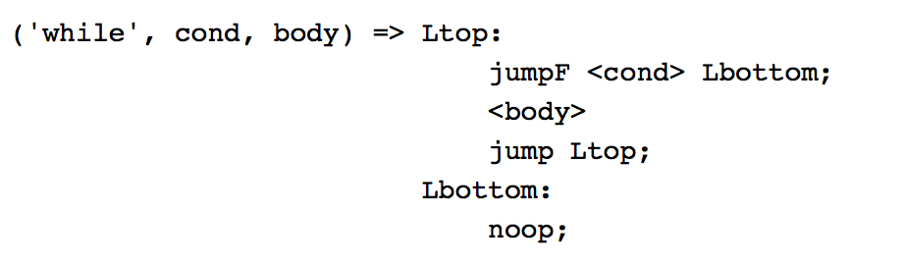
A Basic Compiler
We have to “simulate” the behavior of the Cuppa1 “while” loop with jump statements in Exp1bytecode.
One way to translate the AST pattern for the while loop into a code pattern in Exp1bytecode is,

Slide 7
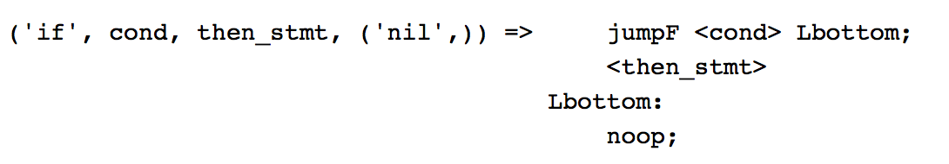
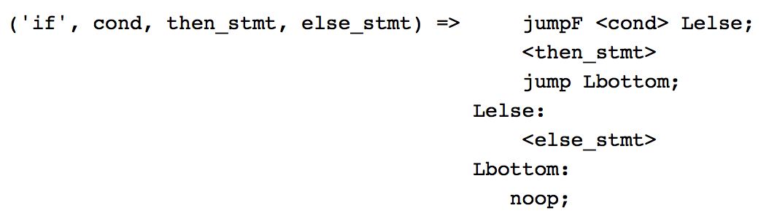
A Basic Compiler
We can do something similar with if-then statements,
Finally, adding the else-statement to the if-then statement we have,

Slide 8
A Basic Compiler
One thing to keep in mind is the notion of target pattern compositionality.
By that we mean that any target language patterns generated from the same class of AST patterns should be able to be composed,
Any one of the Exp1bytecode patterns due to statements in Cuppa1 should be able to be composed with any other Exp1bytecode pattern due to a statement without ever generating incorrect target code.
The same thing is true for Exp1bycode patterns generated from Cuppa1 expressions
See the ‘noop’ instructions at the end of the target patterns for ‘while’, ’if-then’, and ‘if-then-else’.

Slide 9
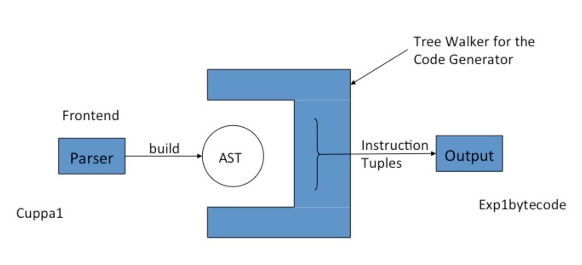
A Basic Compiler Architecture
Our basic compiler consists of:
The Cuppa1 frontend
A code generation tree walker

Slide 10
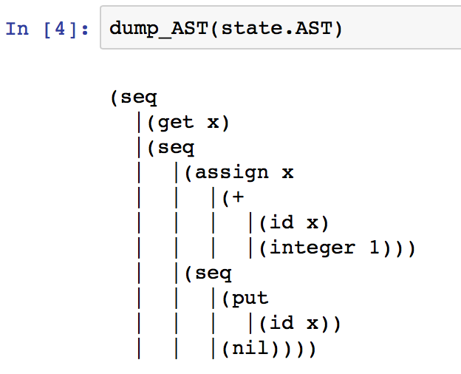
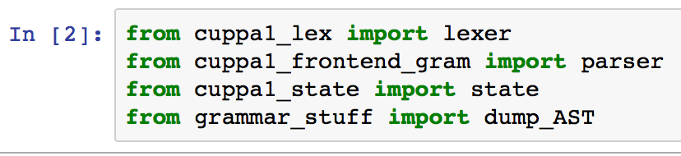
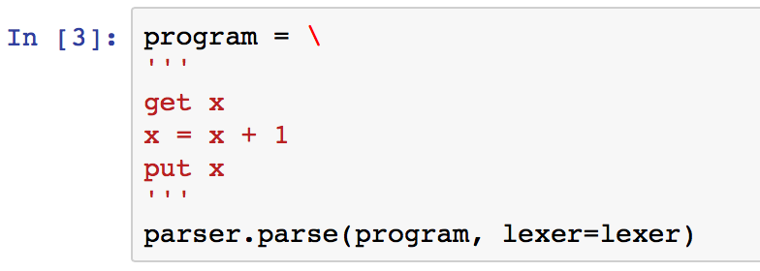
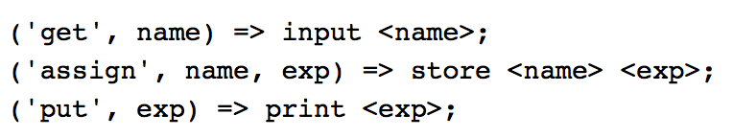
Frontend Pattern Translation
Recall that the Cuppa1 frontend generates an AST for a source program,
We can easily apply our pattern translations to generate Exp1bytecode:

Slide 11
Codegen Tree Walker
The code generator for our compiler is a tree walker that walks the Cuppa1 AST and for each AST pattern that appears in a pattern translation rule it will generate the corresponding target code.
Cuppa1 statement patterns will generate Exp1bytecode instructions on a list and Cuppa1 expression patterns will generate Exp1bytecode expressions returned as strings.
The reason for this will become clear later when we look at optimizations in this compiler.

Slide 12
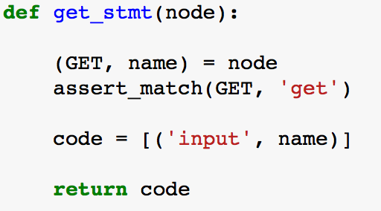
Codegen
cuppa1_cc_codegen.py
Recall the pattern translation,
('get', name) => input <name>;
The codegen tree walker has a function for that,
Even though the translation rule for the get
statement demands that we also generate the
semicolon as part of the translation,
we delay this until we generate the actual
machine instructions.
We use Python’s ability to do pattern matching on tuples!

Slide 13
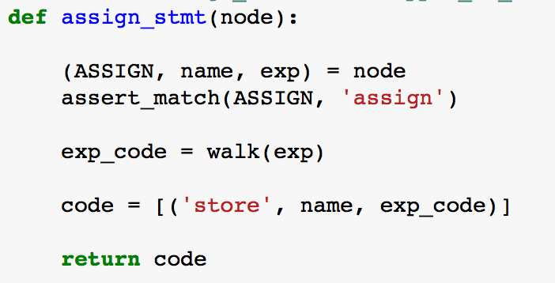
Codegen
cuppa1_cc_codegen.py
Recall the pattern translation,
('assign', name, exp) => store <name> <exp>;
The codegen tree walker has a function for that,

Slide 14
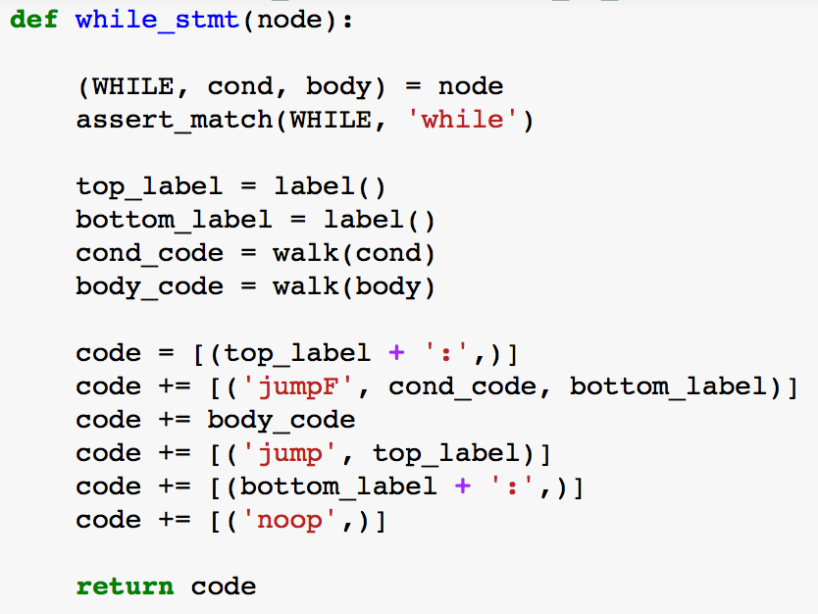
Codegen
cuppa1_cc_codegen.py
Recall the pattern translation,
The codegen tree walker has a function for that,

Slide 15
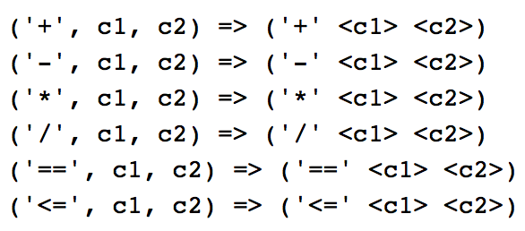
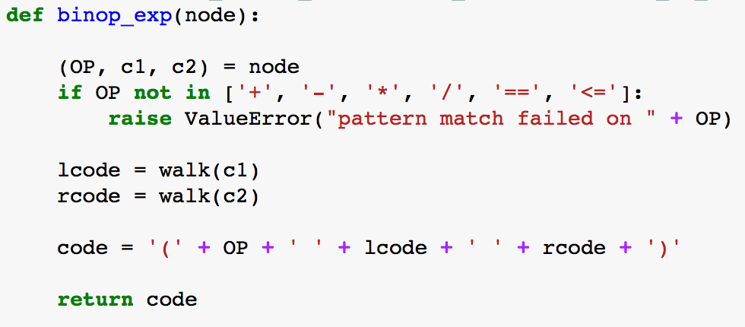
Codegen
cuppa1_cc_codegen.py
Recall the pattern translation for binops,
The codegen tree walker has a function for that,

Slide 16
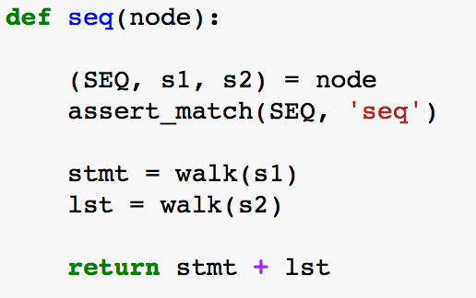
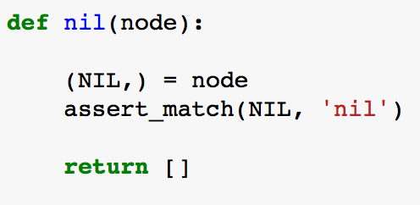
Codegen
cuppa1_cc_codegen.py
What remains to be looked at is how the tree walker deals with Seq nodes since they act as the glue between the statements in the AST we saw above.
Related to this is how the walker deals with Nil nodes in a statement sequence since Seq sequences are Nil terminated.

Slide 17
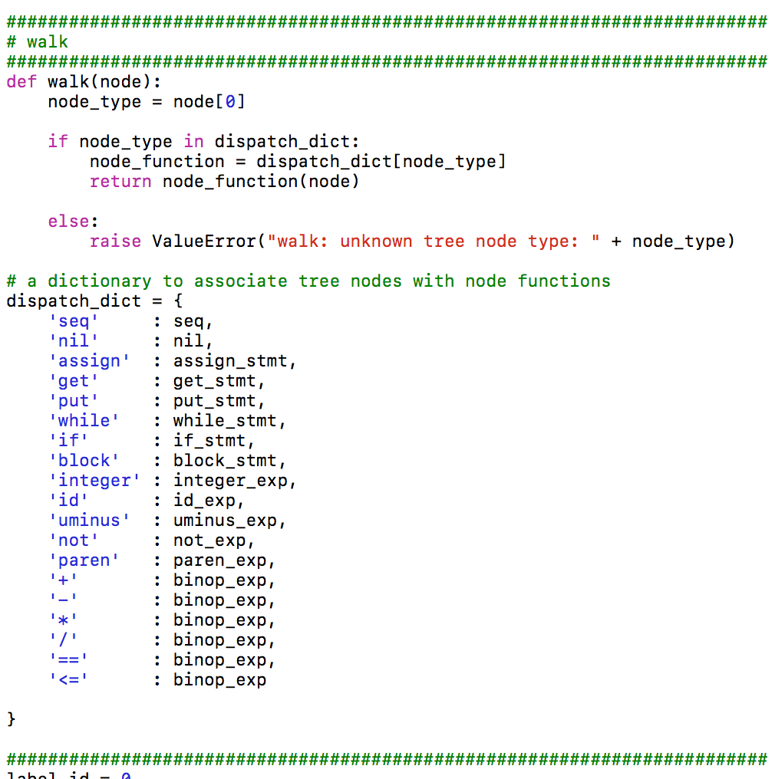
Codegen
cuppa1_cc_codegen.py

Slide 18
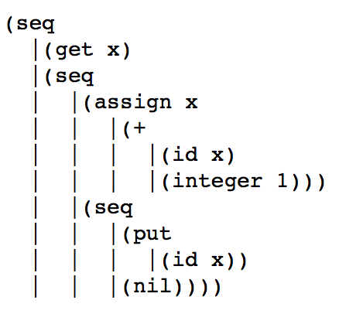
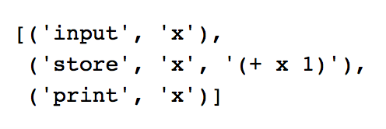
Running Codegen
Consider our AST:
Generated instruction list:

Slide 19
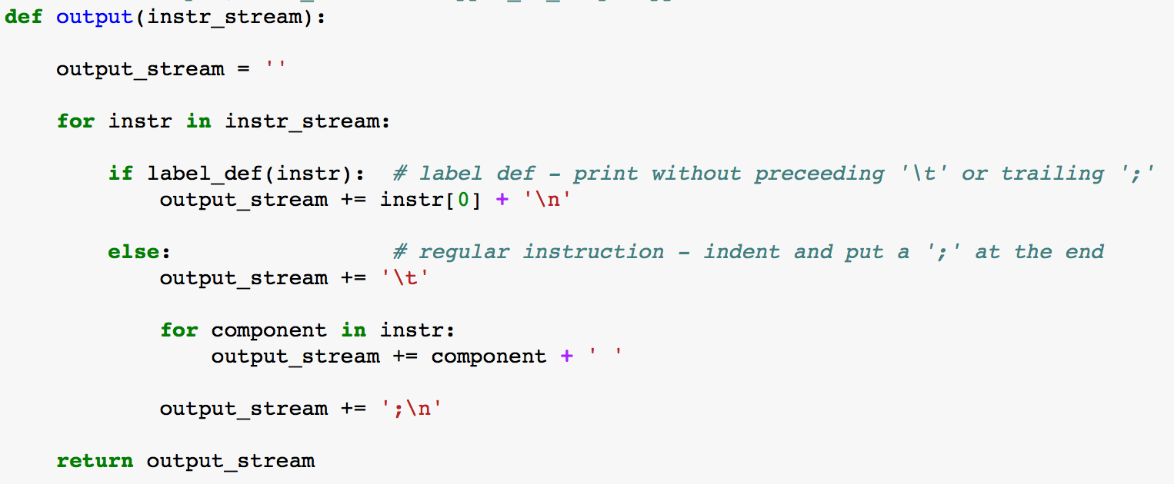
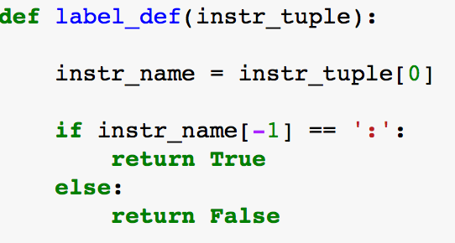
Formatting the Output
Convert the instruction tuple list into
a printable target program.

Slide 20
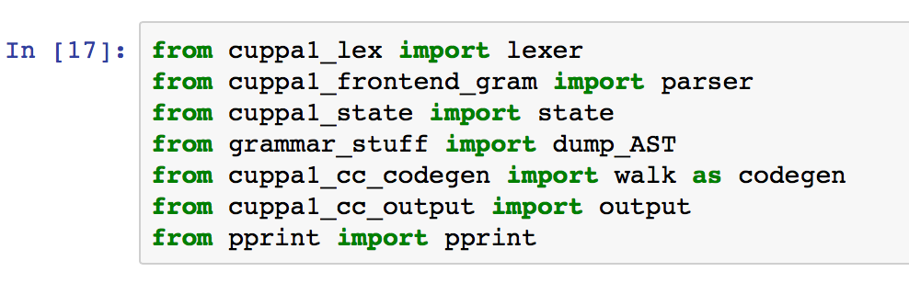
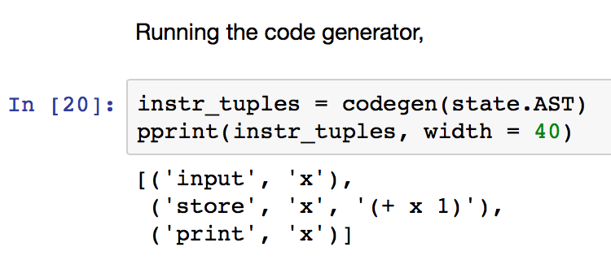
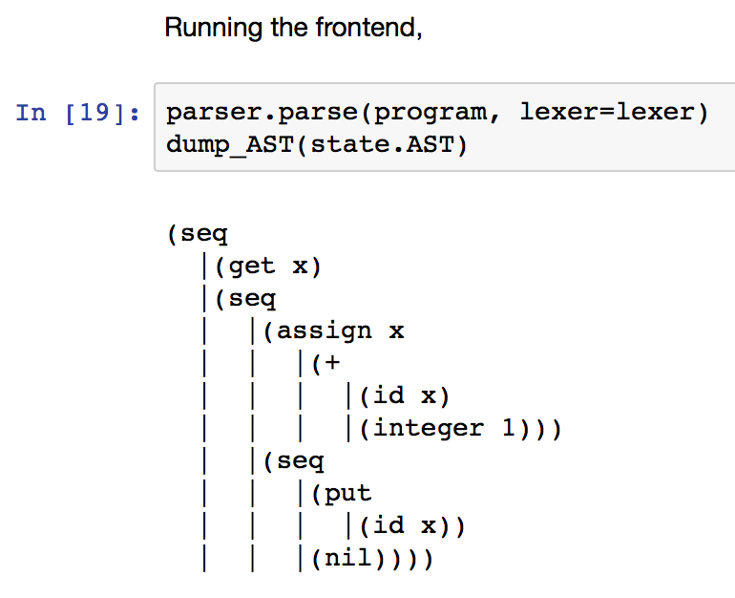
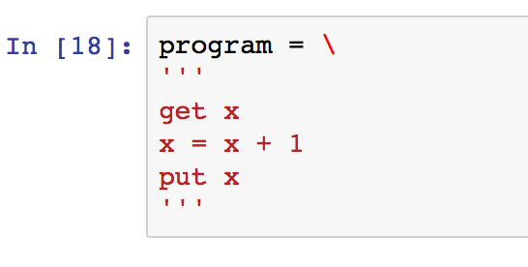
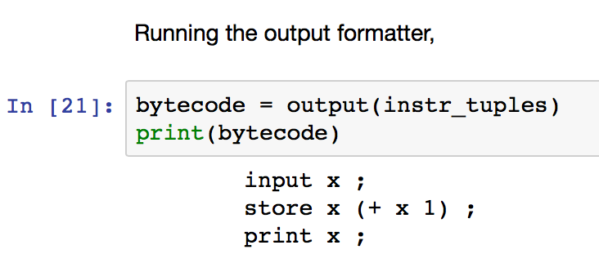
Running the Phases of the Compiler

Slide 21
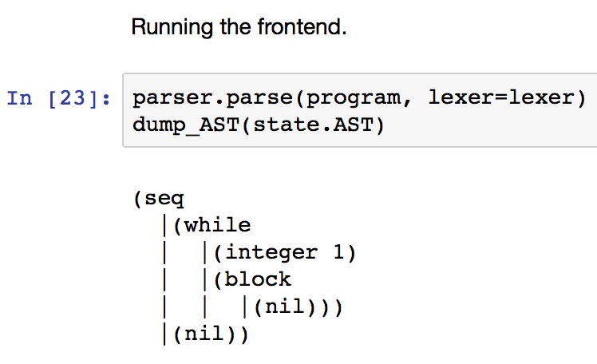
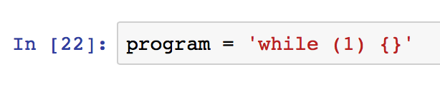
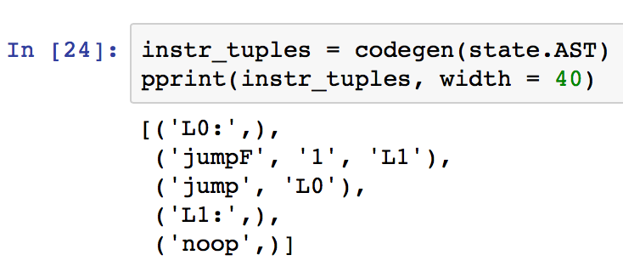
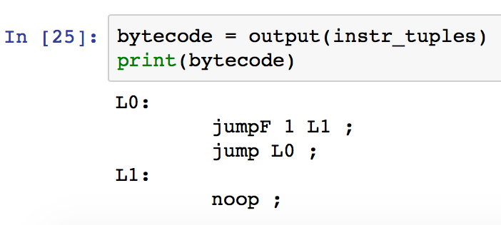
Running the Phases of the Compiler

Slide 22
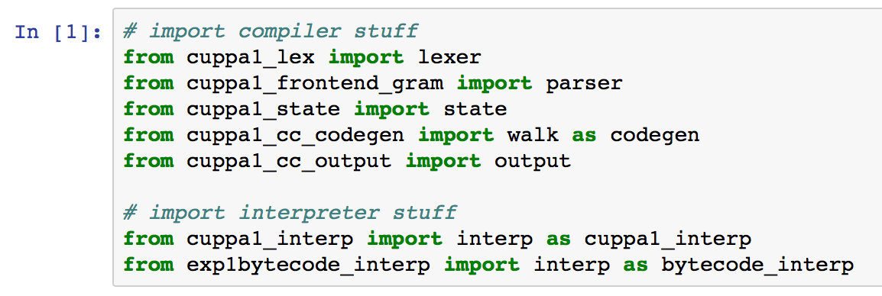
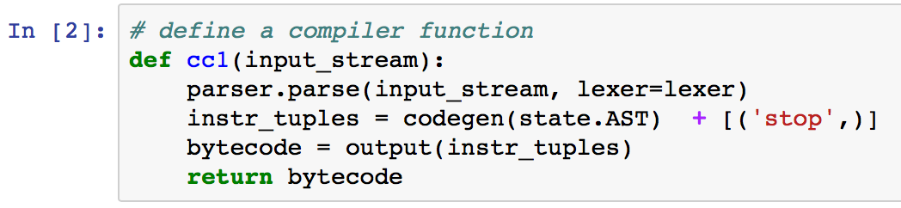
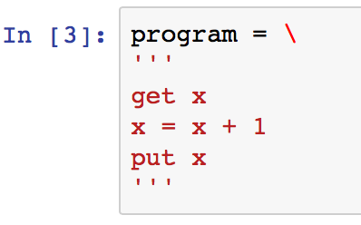
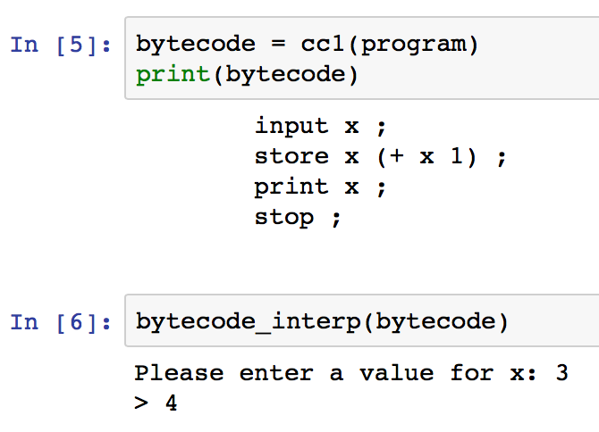
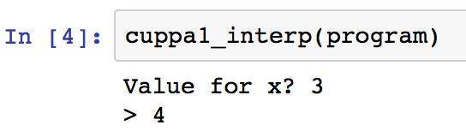
Compilation vs Interpretation
Compilation
Interpretation

Slide 23
Compiler Correctness
We now have two ways to execute a Cuppa1 program:
We can interpret the program directly with the Cuppa1 interpreter.
We can first translate the Cuppa1 program into Exp1bytecode and then execute the bytecode in the abstract bytecode machine.
A compiler is correct if the translated program, when executed,
gives the same results as the interpreted program.
👍

Slide 24
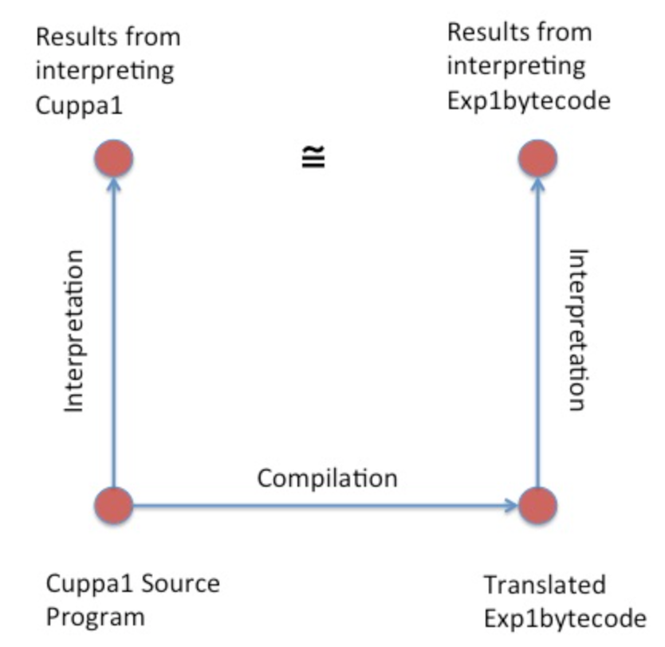
Compiler Correctness

Slide 25
Assignment
Assignment #6 – see webpage.

