Slide 1
Compiling Programs into our Bytecode
Our goal is to compile Cuppa3 programs into Exp2Bytecode
The big difference between the two languages is that Cuppa3 is a statically scoped language (supports nested scopes and statically scoped functions) and Exp2Bytecode has no notion of scope (all variables are global variables)
We saw that in order to make recursion work in Exp2Bytecode we resorted to allocating function local variables in a frame on the runtime stack.

Slide 2
Compiling Global Code
In terms of global code, nothing has changed from our strategy we developed when we compiled Cuppa2 programs into bytecode:
Every program variable that appears in the Cuppa3 program is compiled into a unique global variable in the bytecode
declare x = 1;
{
declare x = 2;
put x;
}
{
declare x = 3;
put x;
}
put x;
store t$0 1 ;
store t$1 2 ;
print t$1 ;
store t$2 3 ;
print t$2 ;
print t$0 ;
stop ;

Slide 3
Compiling Functions
For functions all local variables are stored on the stack
The actual parameters are pushed on the stack in reverse order, and this is done before the function frame is created.
Also, during a function call, the return address is pushed onto the stack before the stack frame is created

Slide 4
Compiling Functions
Here is what the stack looks like during a function call:
…
Actual Parameter_{n}
…
Actual Parameter₁
Return Address
Local Variable_{m}
…
Local Variable₁
Frame
Formal Parameter_{k}
…
Formal Parameter₁
Top of Stack

Slide 5
Compiling Functions
Consider the call add(3,2) to the function defined as
declare add(a,b) { declare temp = a+b; return temp; }
add:
pushf 3;
store %tsx[0] %tsx[-4]; # init a
store %tsx[-1] %tsx[-5]; # init b
store %tsx[-2] (+ %tsx[0] %tsx[-1]); # store temp
store %rvx %tsx[-2];
popf 3;
return;
…
2
3
Return Address
temp
Frame
b
a
Top of Stack

Slide 6
Compiling Functions
Now consider the following function:
// a program with nested functions that makes
// use of static scoping and generates a sequence
// of numbers according to the step variable.
declare seq(n) {
declare step = 2;
declare inc(k) return k+step;
declare i = 1;
// generate the sequence
while(i<=n) {
put(i);
i = inc(i)
}
}
// main program
seq(10);
Nested function
Declarations!
Our interpreter handles this correctly! Try it.

Slide 7
Compiling Functions
To see the problem with nested function declarations for compilation, let’s take a look at the compiled declare inc(k) return k+step; function
…
inc:
pushf 2;
store %tsx[0] %tsx[-3] ; # init k
store %tsx[-1] (+ %tsx[0] %tsx[???] ); # inc value into temp
store %rvx %tsx[-1];
popf 2;
return;
Frame of Calling Function
…
…
3
Return Address
temp
Frame
k
Top of Stack
Note: ‘step’ is inaccessible from the nested function, ‘step’ is in the frame of the calling function.

Slide 8
Compiling Functions
Compiling inc as a global function presents no problems as long as the function is statically scoped.
declare step = 2;
declare inc(k) return k+step;
declare seq(n) {
declare i = 1;
// generate the sequence
while(i<=n) {
put(i);
i = inc(i)
}
}
// main program
seq(10);
inc:
pushf 2;
store %tsx[0] %tsx[-3];
store %tsx[-1] (+ %tsx[0] step$0);
store %rvx %tsx[-1];
popf 2;
return;
Conclusion: we will disallow nested function declarations in our compiler.

Slide 9
Compiling Expressions with Functions
Compiling expressions that contain function calls presents a problem
Expressions are represented as terms
BUT function calls are statements in our bytecode
That means function calls cannot appear in expressions of the bytecode
Solution: convert the evaluation of expressions into three-address code statements.

Slide 10
Three-Address Code
Three-address code is an intermediate representation
The name refers to the fact that in a single statement we access at most three variables, constants, or functions.
Each statement in three-address code has the general form of: x = y op z where x, y and z are variables, constants or temporary variables generated by the compiler and op represents any operator, e.g. an arithmetic operator.
Source: Wikipedia

Slide 11
Three-Address Code
Expressions containing more than one fundamental operation, such as: w = x + y * z are not representable in three-address code.
Instead, they are decomposed into an equivalent series of three-address code statements, such as: t1 = y * z w = x + t1

Slide 12
Compiling Expressions with Functions
Consider the expression term: 3*2+6
We turn this into three-address code statements by doing only one operation at a time and store the result in a temporary variable: T$1 = 3*2 T$2 = T$1+6

Slide 13
Compiling Expressions with Functions
That is exactly what the compiler will do:
store t$0 (* 3 2) ;
store t$1 (+ t$0 4) ;
print t$1 ;
stop ;
put 3*2+4;

Slide 14
Compiling Expressions with Functions
Now compiling expressions with functions is straightforward
Calling a function is just another operation whose result will be stored in a temp
Consider: 3*2+inc(5)
We can rewrite the expression term as the following three-address code statements: T$1 = 3*2 T$2 = inc(5) T$3 = T$1+T$2

Slide 15
Compiling Expressions with Functions
As compiled code:
jump L32 ;
#
# Start of function inc
#
inc:
pushf 2 ;
store %tsx[0] %tsx[-3] ;
store %tsx[-1] (+ %tsx[0] 1) ;
store %rvx %tsx[-1] ;
popf 2 ;
return ;
#
# End of function inc
#
L32:
noop ;
store t$0 (* 3 2) ;
pushv 5 ;
call inc ;
popv ;
store t$1 %rvx ;
store t$2 (+ t$0 t$1) ;
print t$2 ;
stop ;
declare inc(k) return k+1;
put 3*2+inc(5);

Slide 16
Compiler: Cuppa3 → exp2bytecode
The compiler has three phases:
frontend,
semantic analysis/tree rewriting,
code generation.
The symbol table has the same structure as in the interpreter to enforce the semantics of Cuppa3
But the symbol table also has structures that support the generation of target code.
Tree Rewriting Walker
CodeGen
Walker
Frontend
Input
build
write
Output
AST

Slide 17
Putting it all together
We use the symbol table to associate source variable names with target names
If source variable is a function local variable then the target name will be a stack frame location
We use the tree rewriting phase to lower the abstraction level of the AST:
Insert target names
Generate three-address code
The lowered AST is already in a format that the codegen phase can understand
Overall codegen structure similar to Cuppa2 compiler
However, lots of details with regards to tracking three address-code result locations and stack manipulation
That said, most of the changes from the Cuppa2 to the Cuppa3 compiler are in the function declaration/code generation part and the expression handling part.

Slide 18
Putting it all together
The relevant code:
Cuppa3_cc_symtab.py
cuppa3_cc_tree_rewrite.py
cuppa3_cc_codegen.py

Slide 19
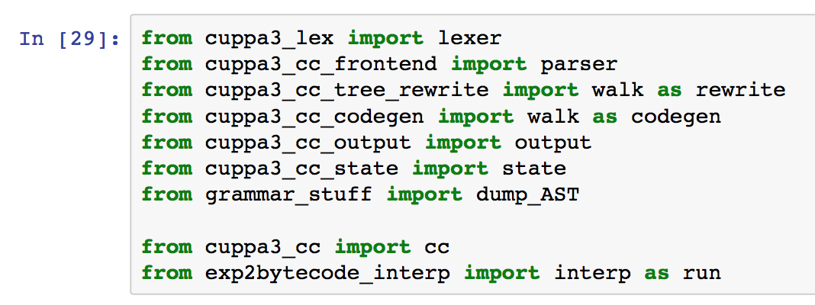
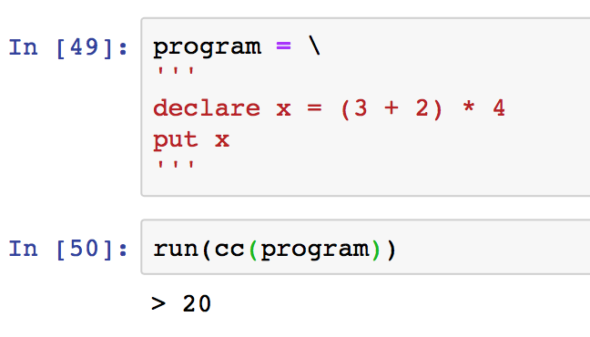
Putting it all together: three-address code generation
Let’s use this program to follow the translation process through the compiler

Slide 20
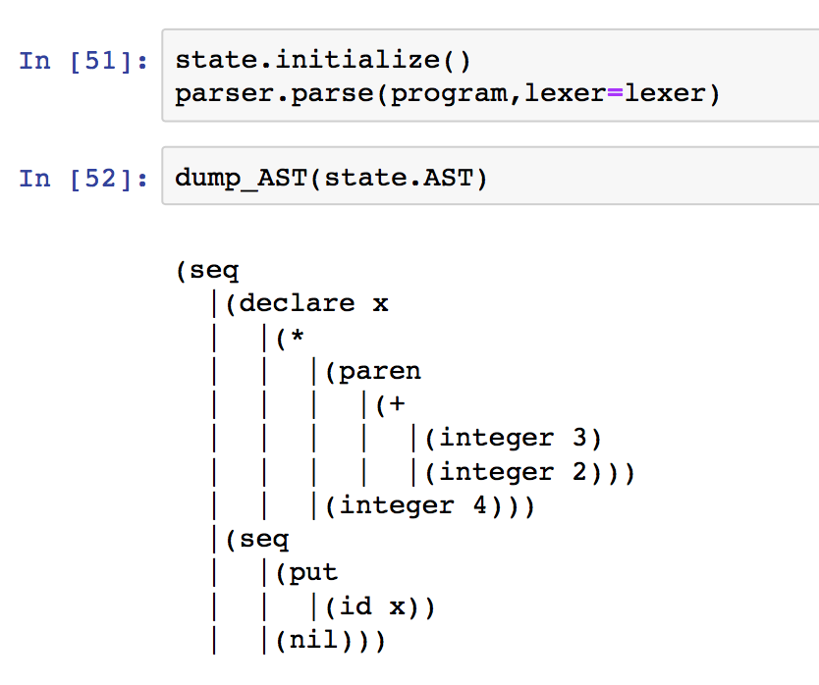
Putting it all together: three-address code generation
The AST right after the front end.

Slide 21
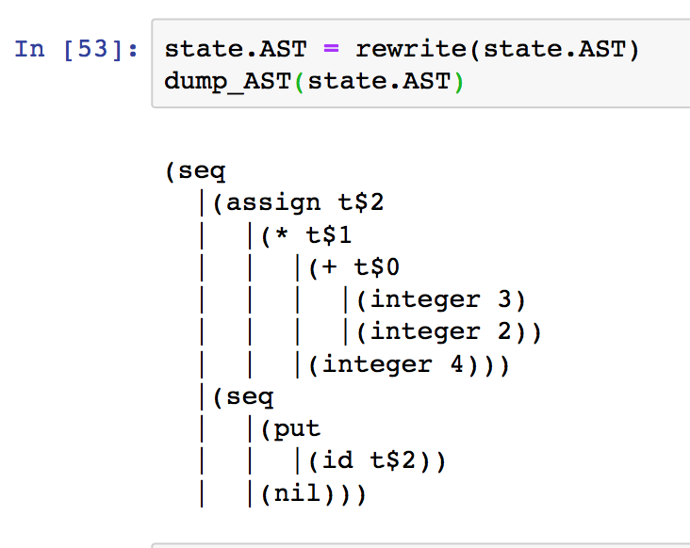
Putting it all together: three-address code generation
The AST right after tree rewriting.
Notice the additional variable name in the expression AST – third address!

Slide 22
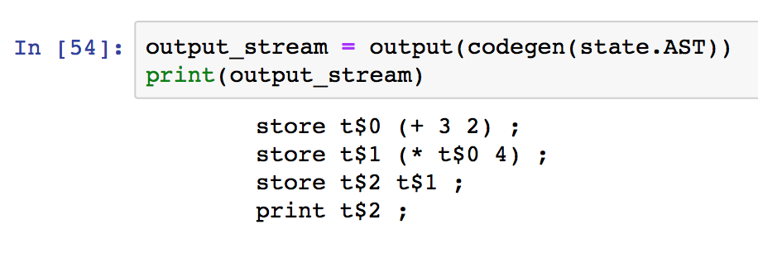
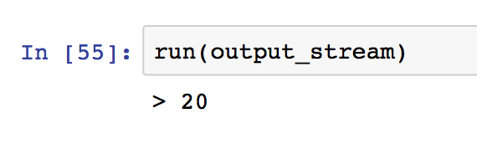
Putting it all together: three-address code generation
The code generated from the lowered AST
Notice the statements (arrows) due to three-address code generation

Slide 23
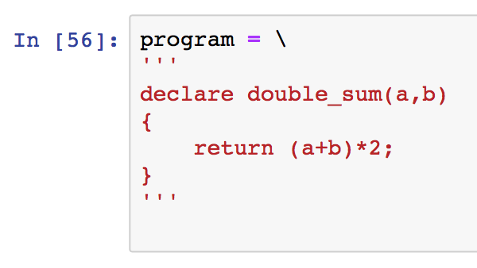
Putting it all together: Function local code
Let’s look at this function and trace the translation process with respect to function local variables

Slide 24
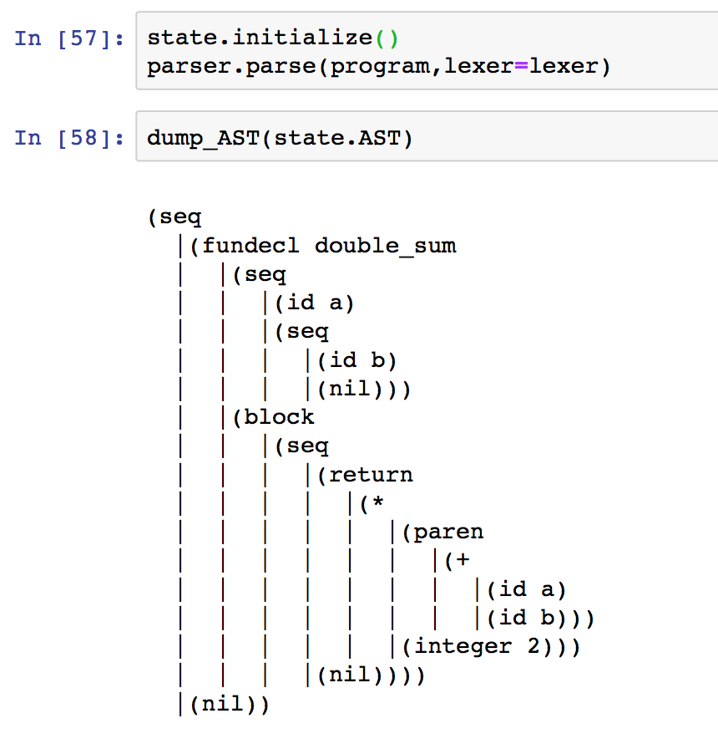
Putting it all together: Function local code
The AST right after the front end

Slide 25
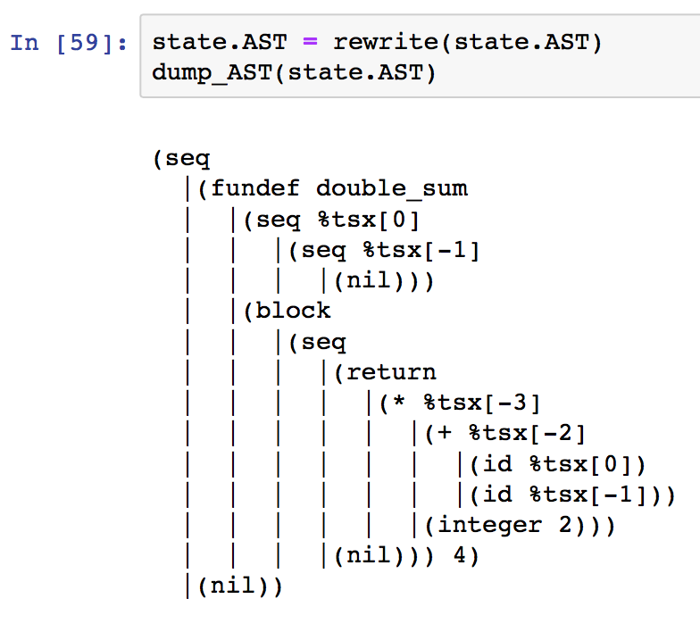
Putting it all together: Function local code
The AST after rewriting
Both function local variables and three address code generation are represented!
Formal arguments
3-addr code temps
Formal arguments

Slide 26
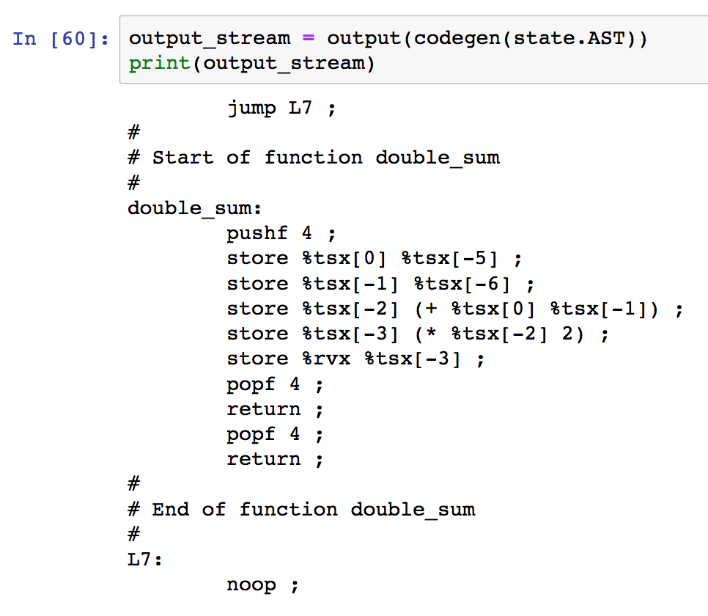
Putting it all together: Function local code
Generated code
Formal arguments
3-addr code temps

Slide 27
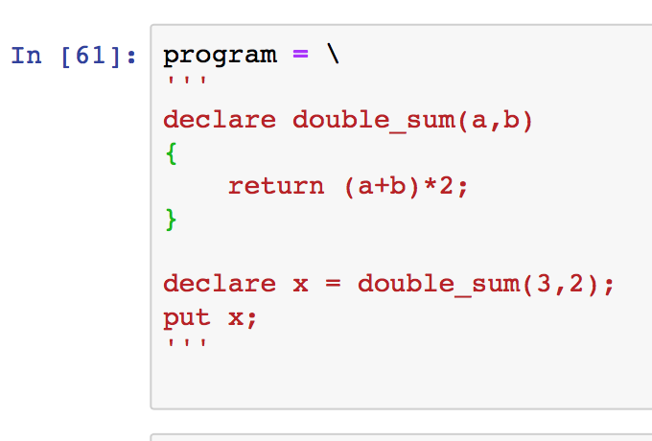
Putting it all together
The program

Slide 28
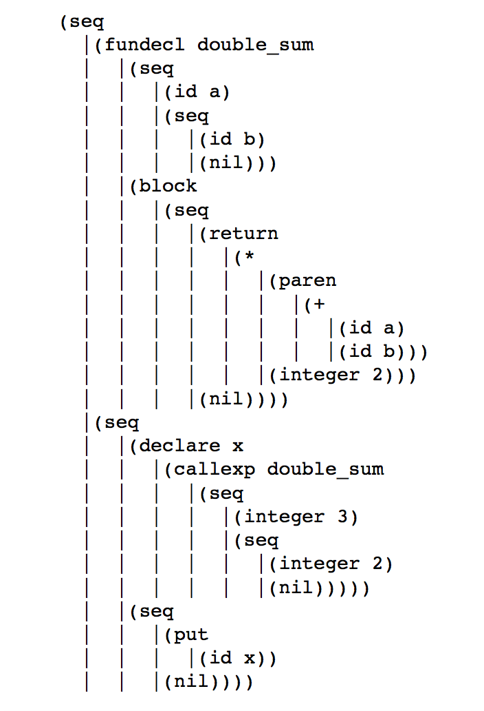
Putting it all together
The front end AST

Slide 29
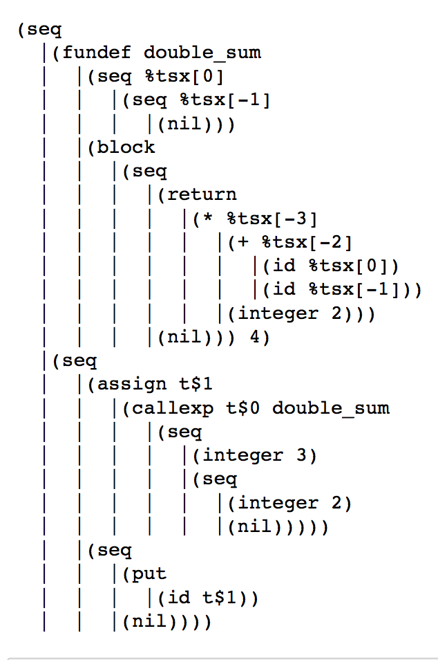
Putting it all together
The rewritten AST

Slide 30
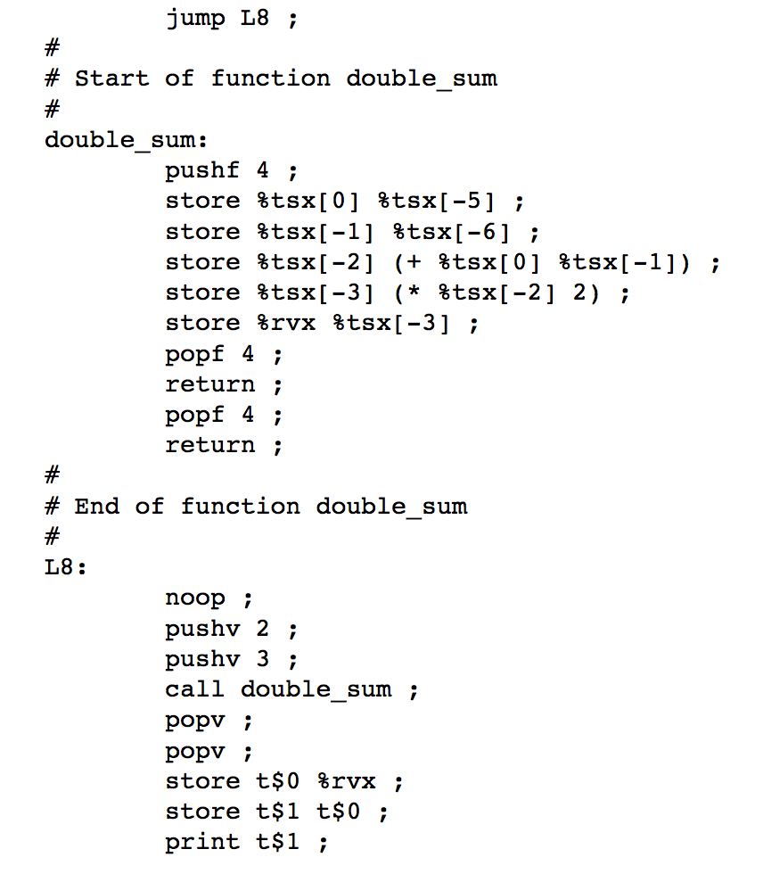
Putting it all together
The rewritten AST

Slide 31
The Symbol Table
The symbol table has additional functionality to deal with
The stack frame
Scalars vs functions
Function local vs global variables

Slide 32
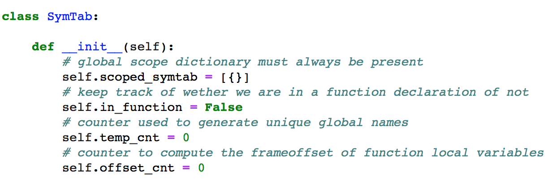
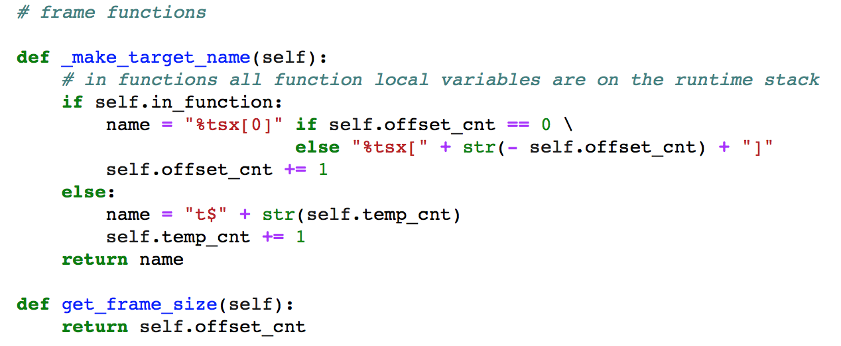
The Symbol Table

Slide 33
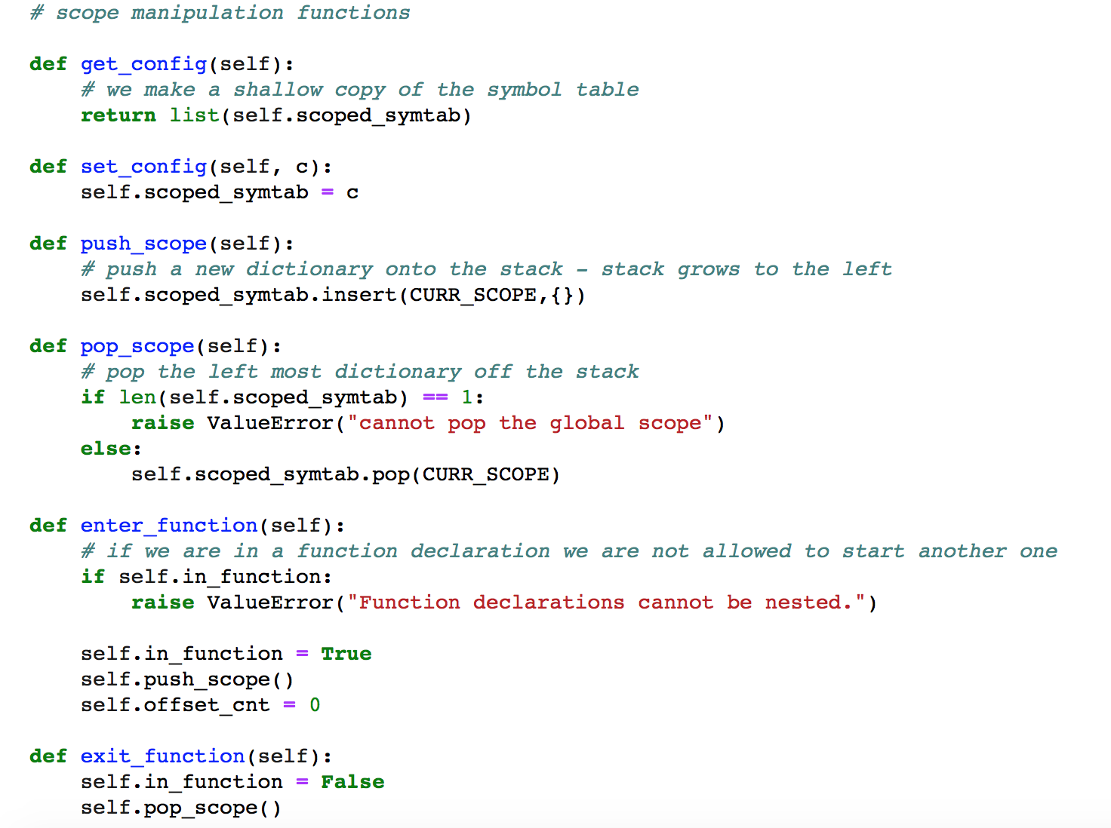
The Symbol Table

Slide 34
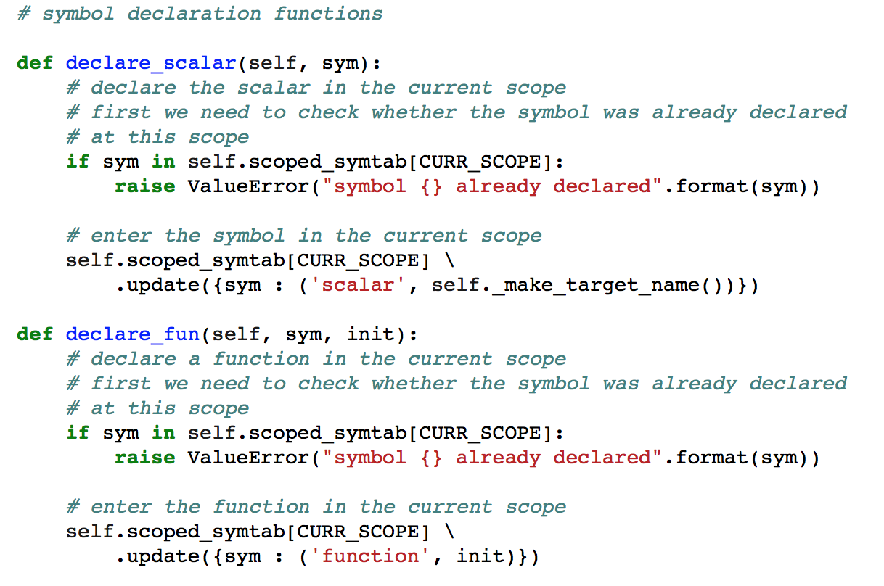
The Symbol Table

Slide 35
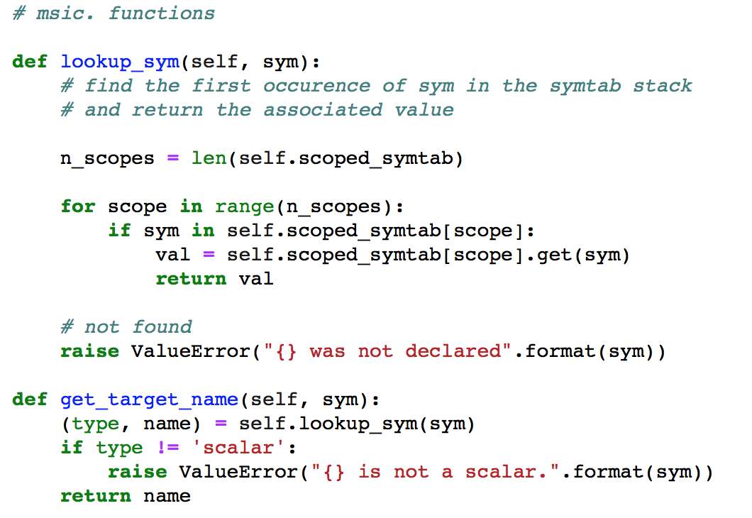
The Symbol Table

Slide 36
Tree Rewriting
Generate three address code
Replace original variable names with target names

Slide 37
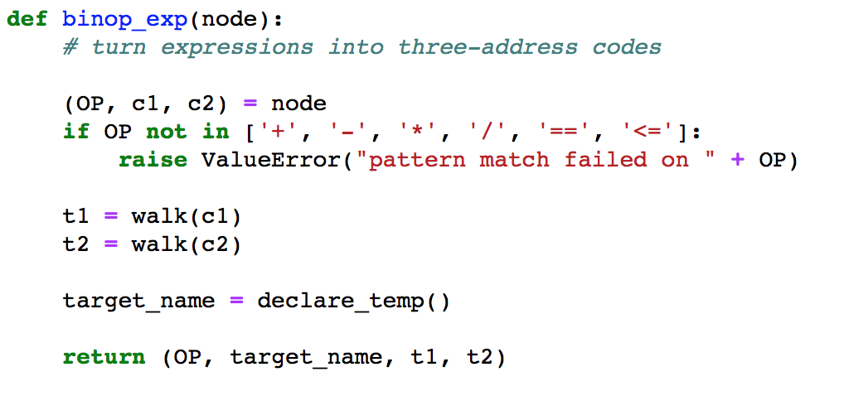
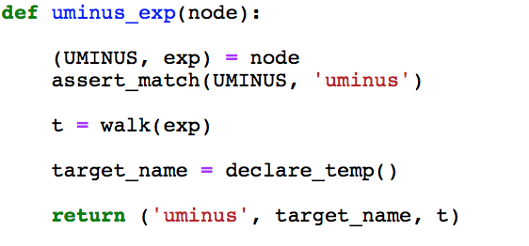
Tree Rewriting
Insert a temporary variable into expression as the “third address”

Slide 38
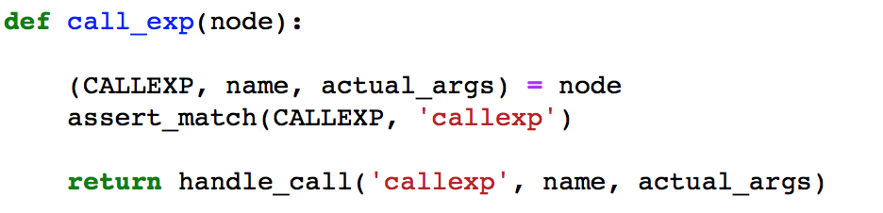
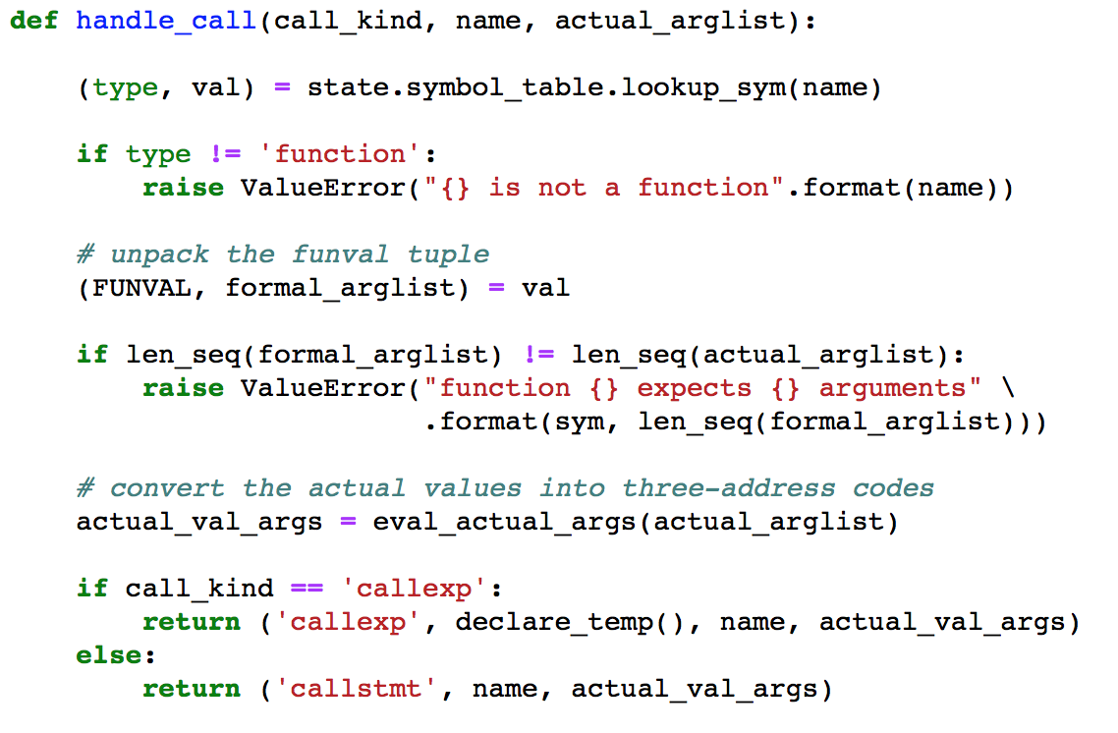
Tree Rewriting
Insert a temporary variable into call expression as the “third address”

Slide 39
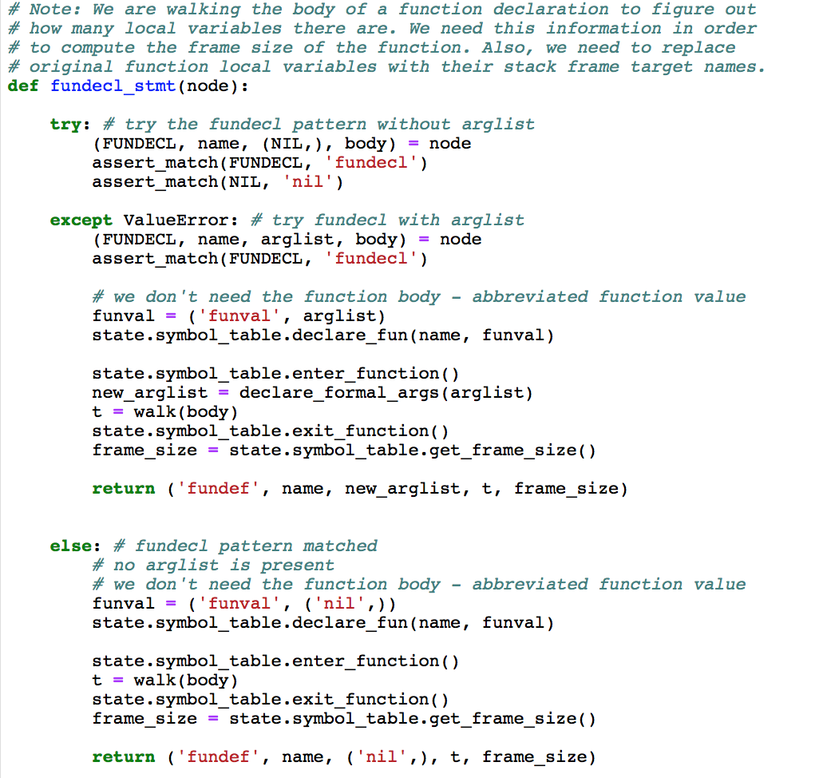
Tree Rewriting
Function declarations get rewritten into function definitions which contain the frame size.

Slide 40
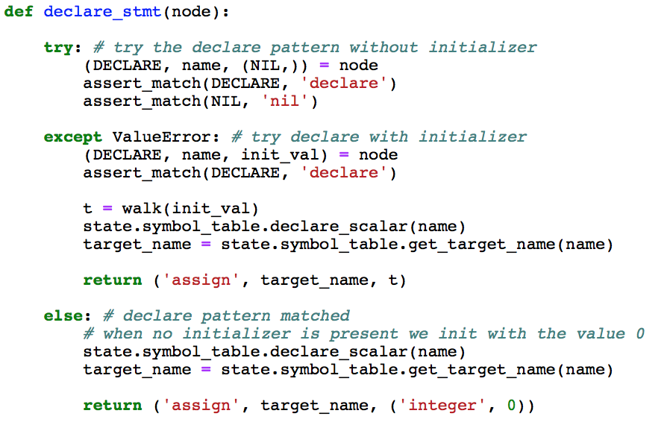
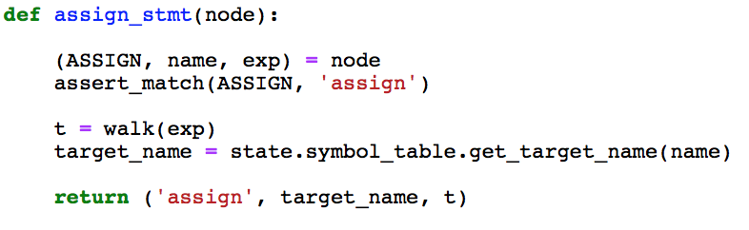
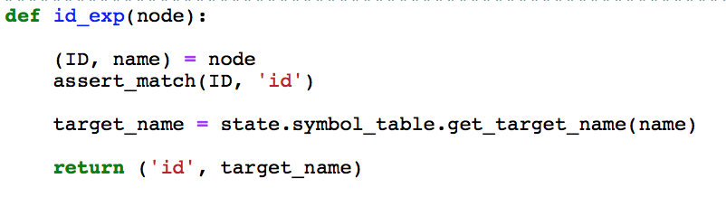
Tree Rewriting
Original variable names are replaced with target names.

Slide 41
Code Generation
Very similar to the Cuppa2 compiler
All statement level patterns carry over almost unmodified
Expressions need to keep track of the “third address” or “target address” of the three address code encoding.

Slide 42
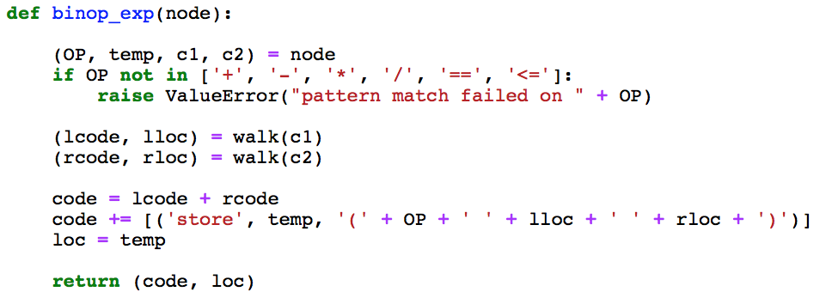
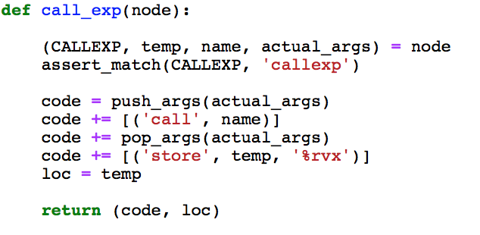
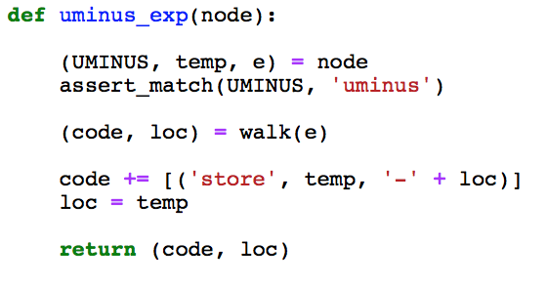
Code Generation
The code generator keeps track of the location where the value of an expression is stored
Returns a pair for an expression: (1) code (2) location

Slide 43
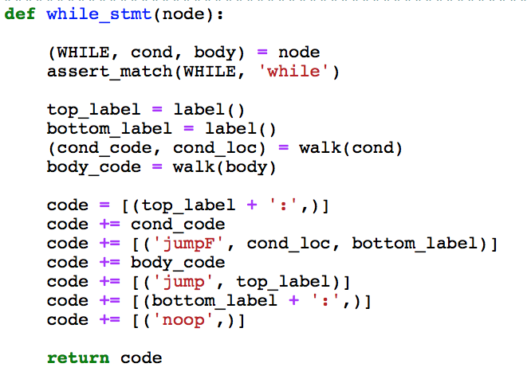
Code Generation
The while statement is probably the best example to see how the pair returned by generating code for an expression is used.
Note that we first put the code for the expression into the output stream
Then we use the location in the conditional jump instruction.

