Slide 1
Type system implementation
We extend our Cuppa3 language to Cuppa4 with the addition of a type system with four types:
int
float
string
void
We also assume that int is a subtype of float and float is a subtype of string, that is, a compiler/interpreter is allowed to insert widening conversions and should flag errors for narrowing conversions, int < float < string

Slide 2
Type system implementation
We want to be able to write programs such as these:
float pow(float b, int p) {
if (p == 0)
return 1.0;
else
return b*pow(b,p-1);
}
float v;
get v;
int p;
get p;
float result = pow(v,p);
put v + ” to the power of “ + p +” is “+result;
int inc(int x) return x+1;
int y = inc(3);
put "the result is” + y;

Slide 3
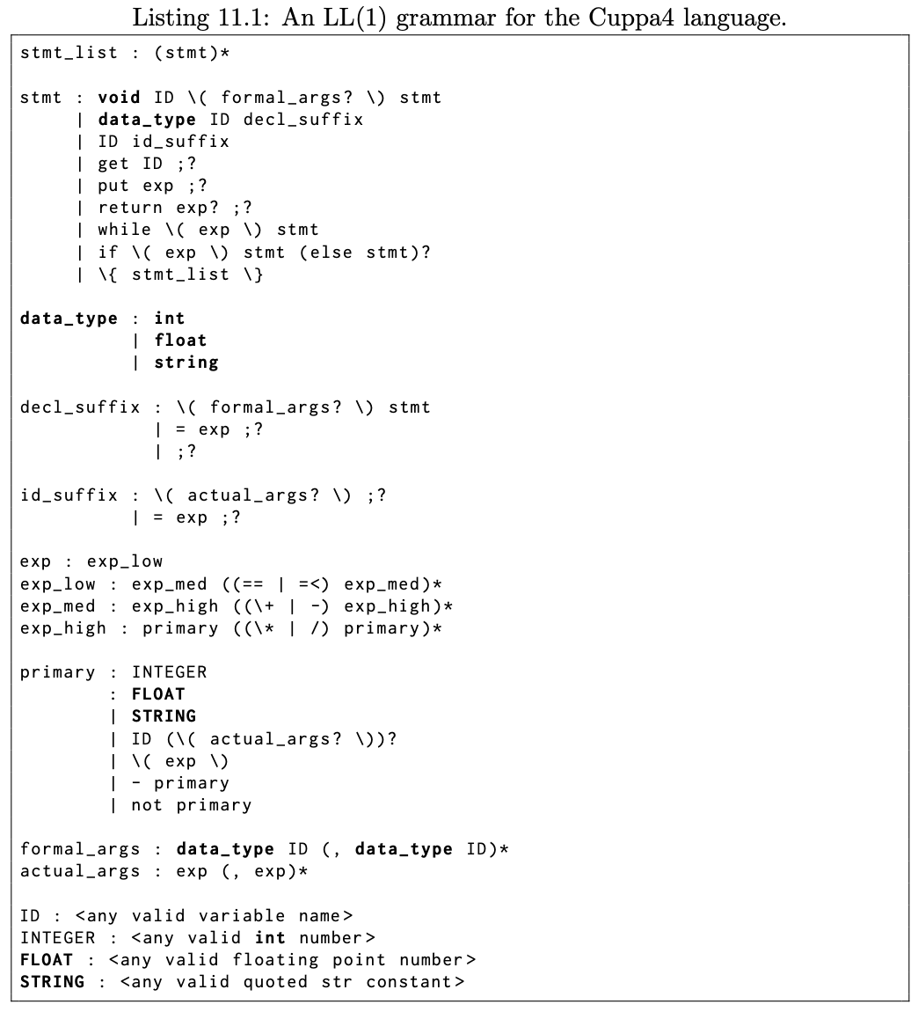
Type system implementation: Syntax
New additions to the language are shown in bold face.

Slide 4
Type system implementation: Semantics
At the semantic level we annotate all ASTs with type information
We use type propagation to check that expressions/statements are properly typed.
Type propagation is the systematic tagging of an AST from leafs up with type information.

Slide 5
Type system implementation: Semantics
Consider the simple example:
int y;
int x;
y = 3;
x = y + 1;
stmtlist
stmt
=
stmt
y
3
=
x
+
y
1

Slide 6
Type system implementation: Semantics
Consider the simple example:
int y;
int x;
y = 3;
x = y + 1;
stmtlist
stmt
=
stmt
y
3
=
x
+
{int}
y
1

Slide 7
Type system implementation: Semantics
Consider the simple example:
int y;
int x;
y = 3;
x = y + 1;
stmtlist
stmt
=
stmt
y
3
=
x
+
{int}
y
1
{int}

Slide 8
Type system implementation: Semantics
Consider the simple example:
int y;
int x;
y = 3;
x = y + 1;
stmtlist
stmt
=
stmt
y
3
=
x
+
{int}
{int}
y
1
{int}

Slide 9
Type system implementation: Semantics
Consider the simple example:
int y;
int x;
y = 3;
x = y + 1;
stmtlist
stmt
=
stmt
y
3
=

x
{int}
+
{int}
{int}
y
1
{int}

Slide 10
Type system implementation: Semantics
Consider the simple example:
int y;
int x;
y = 3;
x = y + 1;
stmtlist
stmt
=
stmt
y
{int}
3
=

x
{int}
+
{int}
{int}
y
1
{int}

Slide 11
Type system implementation: Semantics
Consider the simple example:
int y;
int x;
y = 3;
x = y + 1;
stmtlist
stmt
=

stmt
y
{int}
3
{int}
=

x
{int}
+
{int}
{int}
y
1
{int}

Slide 12
Type system implementation: Semantics
Consider this example which has a typecheck error:
float y;
int x;
y = 3.7;
x = y + 1;
stmtlist
stmt
=
stmt
y
3.7
=
x
+
y
1

Slide 13
Type system implementation: Semantics
Consider this example which has a typecheck error:
float y;
int x;
y = 3.7;
x = y + 1;
stmtlist
stmt
=
stmt
y
3.7
=
x
+
{float}
y
1

Slide 14
Type system implementation: Semantics
Consider this example which has a typecheck error:
float y;
int x;
y = 3.7;
x = y + 1;
stmtlist
stmt
=
stmt
y
3.7
=
Widening
conversion
x
+
{float}
y
1
{int → float}

Slide 15
Type system implementation: Semantics
Consider this example which has a typecheck error:
float y;
int x;
y = 3.7;
x = y + 1;
stmtlist
stmt
=
stmt
y
3.7
=
x
+
{float}
{float}
y
1
{int → float}

Slide 16
Type system implementation: Semantics
Consider this example which has a typecheck error:
float y;
int x;
y = 3.7;
x = y + 1;
stmtlist
stmt
=
stmt
y
3.7
=
❒
x
{int}
+
{float}
{float}
y
1
{int → float}

Slide 17
Type system implementation: Semantics
Consider this example which has a typecheck error:
float y;
int x;
y = 3.7;
x = y + 1;
stmtlist
stmt
=
stmt
{float}
y
3.7
=
❒
x
{int}
+
{float}
{float}
y
1
{int → float}

Slide 18
Type system implementation: Semantics
Consider this example which has a typecheck error:
float y;
int x;
y = 3.7;
x = y + 1;
stmtlist
stmt
=

stmt
{float}
y
3.7
{float}
=
❒
x
{int}
+
{float}
{float}
y
1
{int → float}

Slide 19
Type system implementation: Semantics
Here is an example with a function call:
int inc(int i) return i+1;
int x;
x = inc(1);
stmtlist
stmt
=
x
callexpr
inc
1

Slide 20
Type system implementation: Semantics
Here is an example with a function call:
int inc(int i) return i+1;
int x;
x = inc(1);
stmtlist
stmt
=
x
callexpr
{f:int→int}
inc
1
We have to track function symbols, both for their formal parameter types and return types.

Slide 21
Type system implementation: Semantics
Here is an example with a function call:
int inc(int i) return i+1;
int x;
x = inc(1);
stmtlist
stmt
=
x
callexpr
{f:int→int}
inc
1
{int}

Slide 22
Type system implementation: Semantics
Here is an example with a function call:
int inc(int i) return i+1;
int x;
x = inc(1);
stmtlist
stmt
=
x
callexpr
{int}
{f:int→int}
inc
1
{int}

Slide 23
Type system implementation: Semantics
Here is an example with a function call:
int inc(int i) return i+1;
int x;
x = inc(1);
stmtlist
stmt
=

{int}
x
callexpr
{int}
{f:int→int}
inc
1
{int}

Slide 24
Type system implementation: Semantics
Here is an example with a function call and a type error:
int inc(int i) return i+1;
int x;
x = inc(3.7);
stmtlist
stmt
=
x
callexpr
inc
3.7

Slide 25
Type system implementation: Semantics
Here is an example with a function call and a type error:
int inc(int i) return i+1;
int x;
x = inc(3.7);
stmtlist
stmt
=
x
callexpr
{f:int→int}
inc
3.7

Slide 26
Type system implementation: Semantics
Here is an example with a function call and a type error:
int inc(int i) return i+1;
int x;
x = inc(3.7);
stmtlist
stmt
=
x
callexpr
❒
{f:int→int}
inc
3.7
{float}

Slide 27
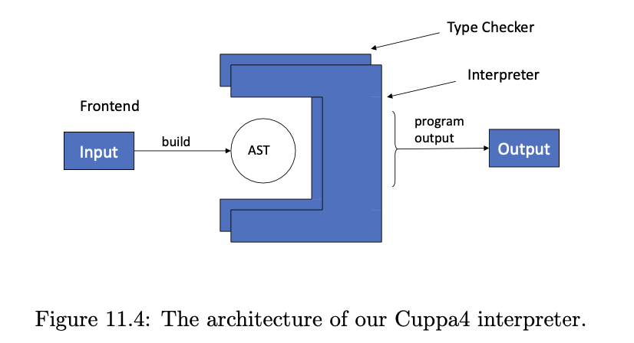
Type System Implementation
We will implement a static type checker

Slide 28
Frontend
The frontend is the Cuppa3 frontend with explicit type information.
The changes necessary are simple extensions to the Cuppa3 frontend.

Slide 29
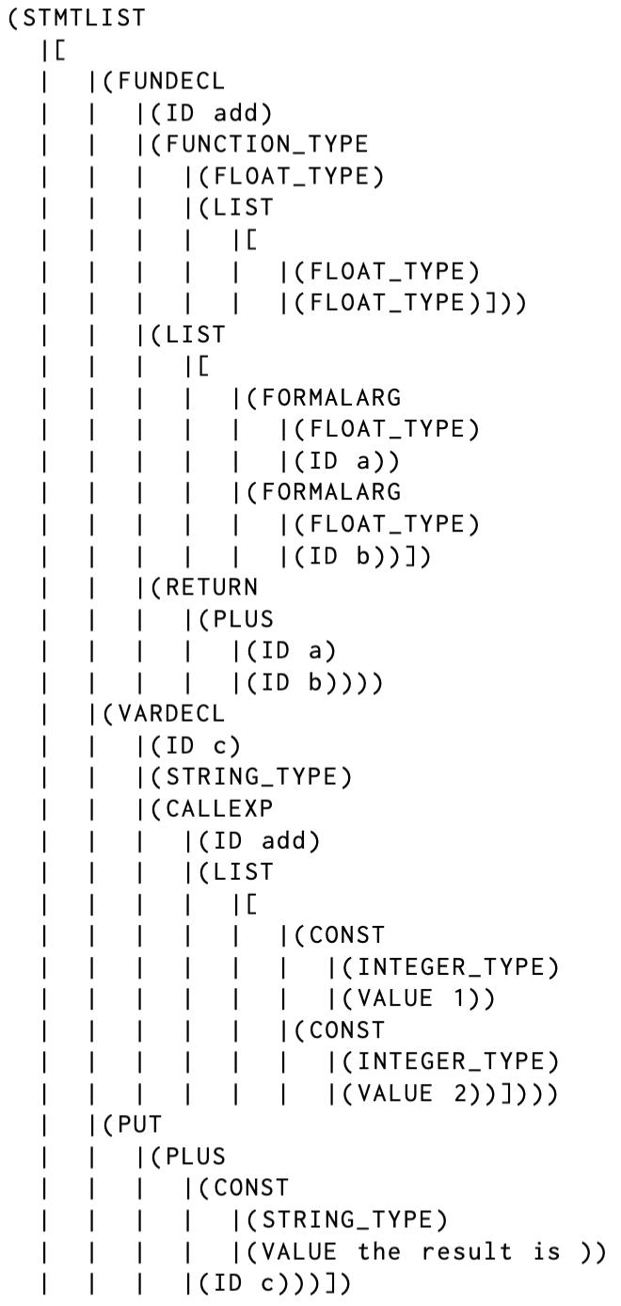
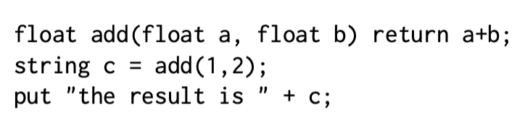
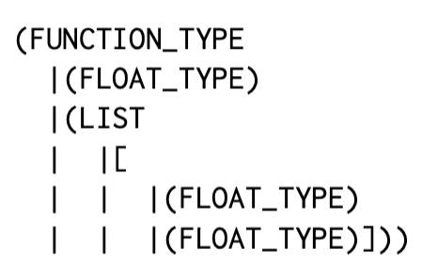
Frontend

Slide 30
Type system implementation
Even though Cuppa4 is statically typed we will implement a dynamic type checker
Type propagation is done as part of the interpretation!
Central to our implementation is the type promotion table that implements our type hierarchy.
We use the type promotion table to implement our type propagation and type checking

Slide 31
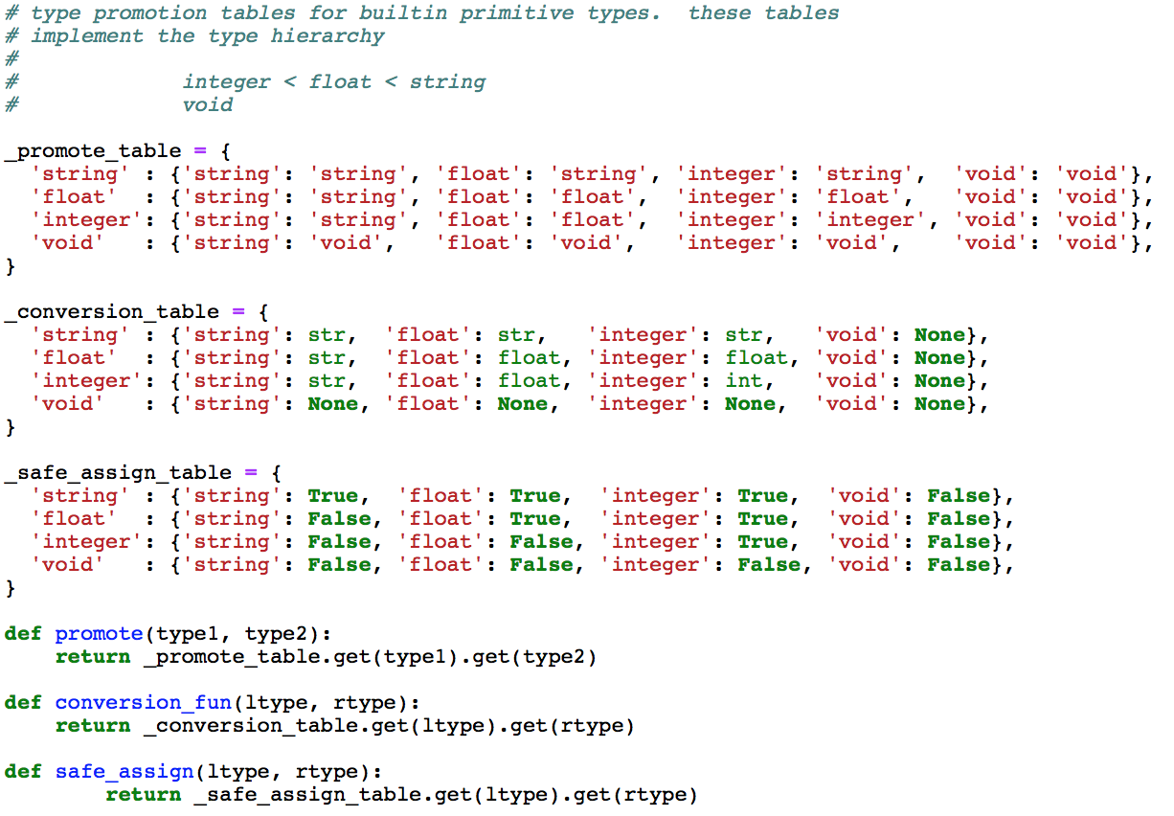
Type system implementation: Type Promotion Table

Slide 32
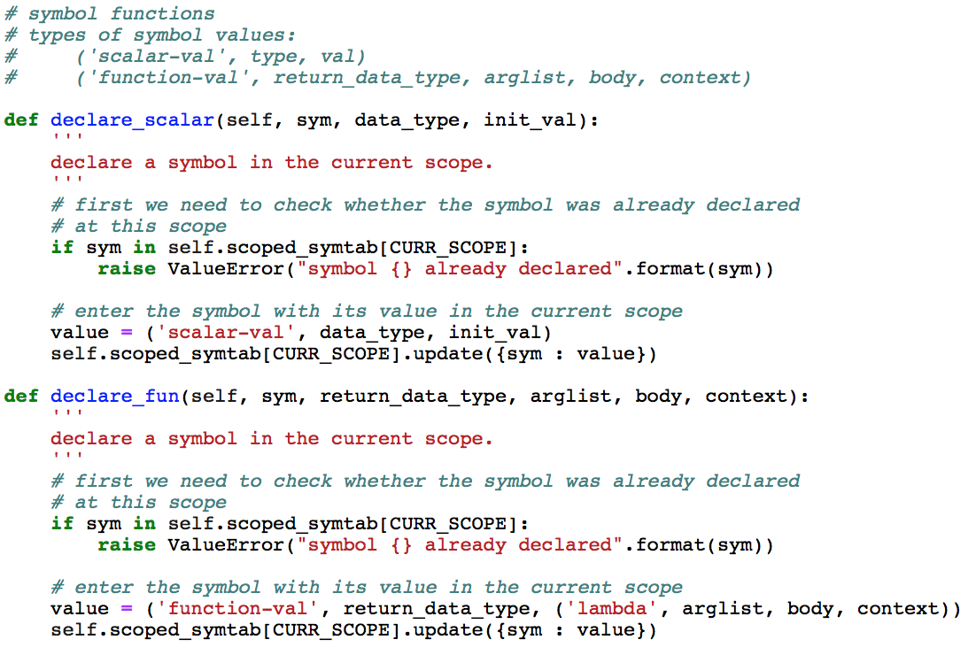
Type system implementation: Symbol Table

Slide 33
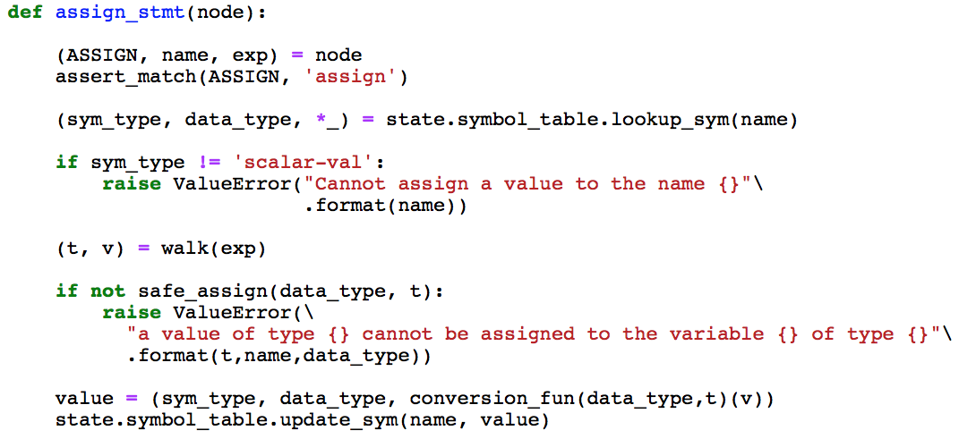
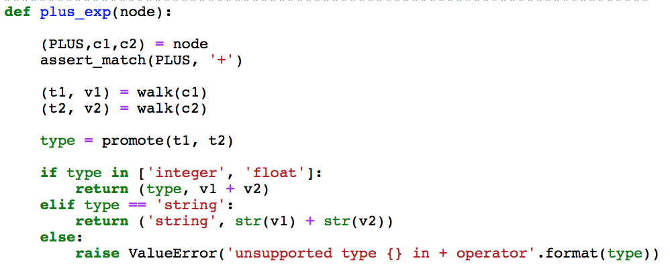
Type system implementation: Walk

Slide 34

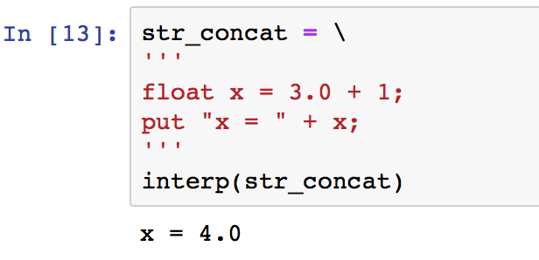
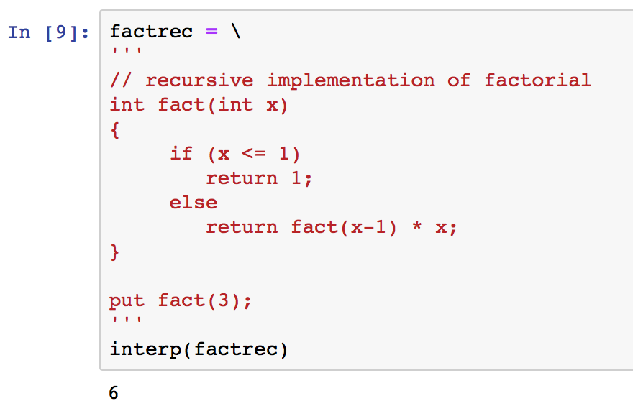
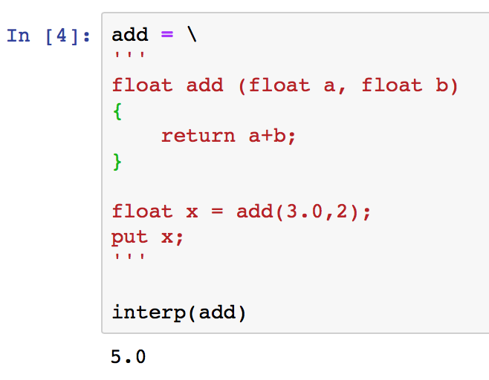
Type system implementation

