Slide 1
Intermediate Representation (IR)
Our simple, syntax directed interpretation scheme that we worked out for the exp1 language, where we computed values for expressions as soon as we recognized them in the input stream, will fail with more complex languages.
Let’s extend exp1 with conditional and unconditional jump instructions and call the language exp1bytecode

Slide 2
Reading
Chap 4

Slide 3
Exp1bytecode Language Design
New statements:
stop ;
noop ;
jumpT exp label ;
jumpF exp label ;
jump label ;
Input name ;
Note: exp is an integer expression and is interpreted as false if its value is zero otherwise it is true
Labeled statements:
store x 5;
L1:
store x (- x 1);
jumpT x L1;
Two new operators: =, =<, that return 0 when false otherwise they will return 1.
Lastly, we also allow for negative integer constants:
-2, -12

Slide 4
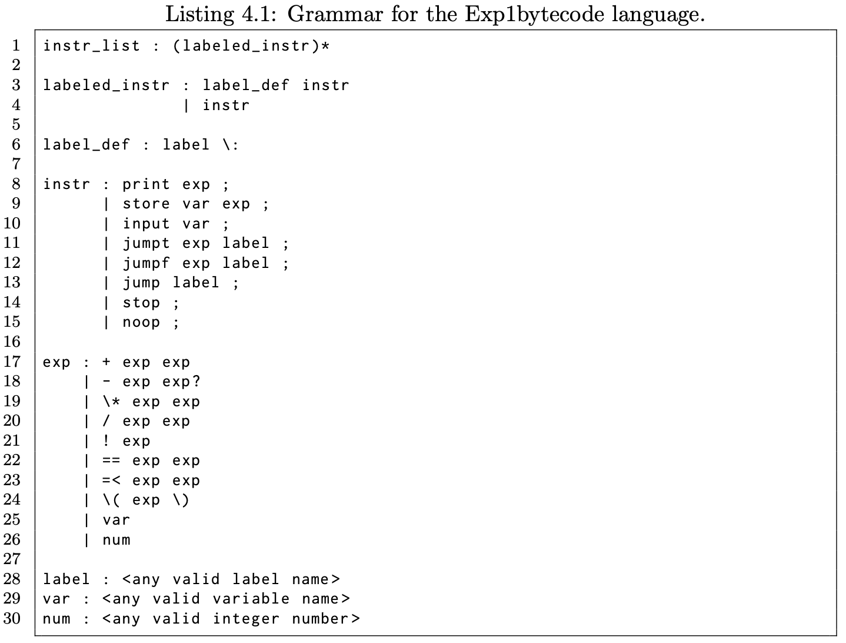
Exp1bytecode Grammar

Slide 5
Exp1bytecode
Here is a simple example program in this language:
# this program prints out a
# list of integers
store x 10 ;
L1:
print x ;
store x (- x 1) ;
jumpT x L1 ;
stop ;
☞ Problem: in syntax directed interpretation all info needs to be available at statement execution time; the label definition is not available at jump time.  Answer: we will use an IR to do the actual interpretation.

Slide 6
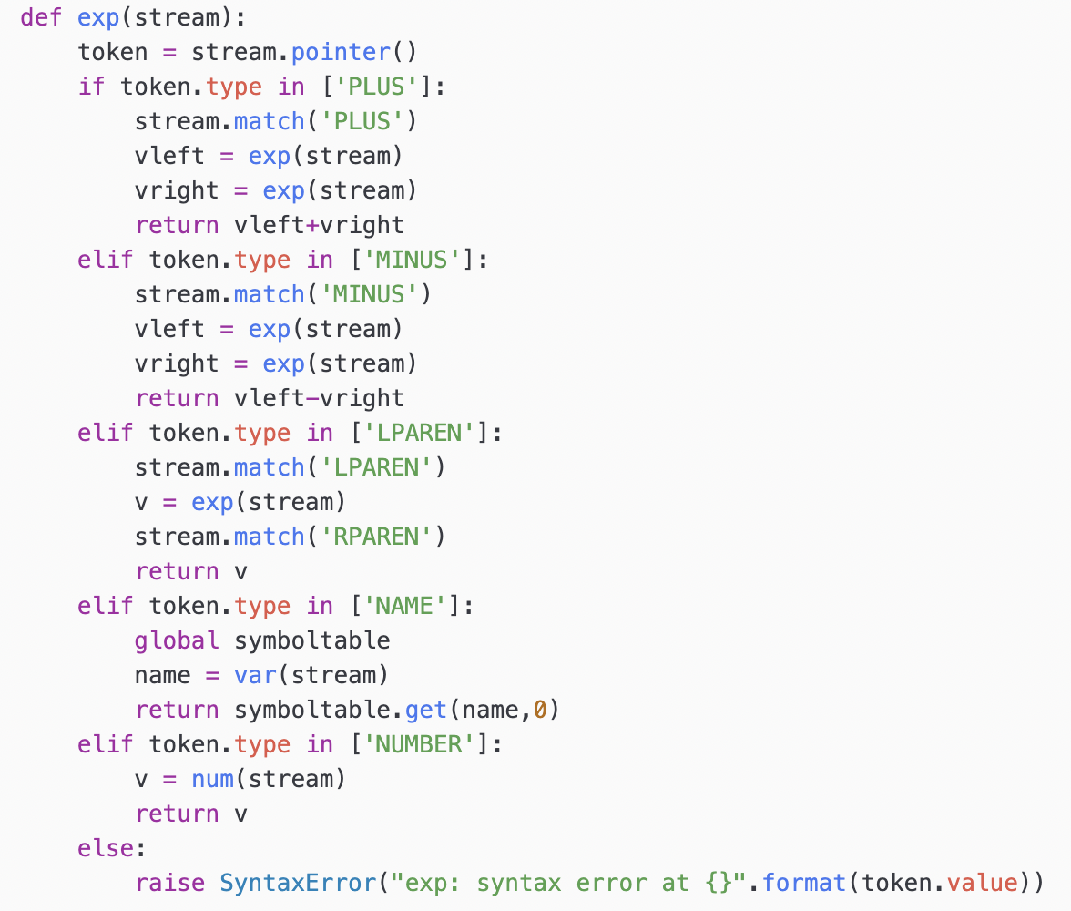
Syntax-Directed Interpretation
Values are computed as soon as structure is recognized
All relevant information has to be accessible at parse time

Slide 7
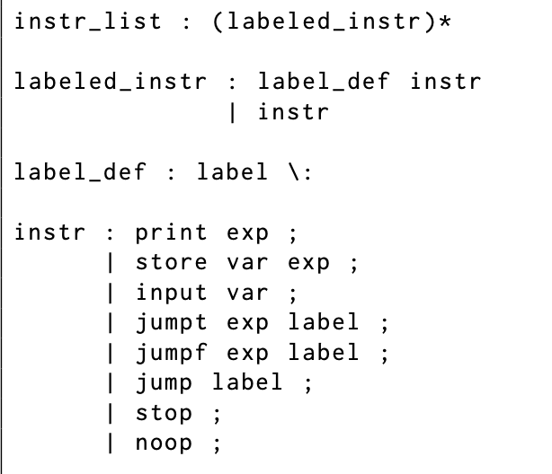
Syntax directed interpretation fails…
In exp1bytecode we see that label definitions are non-local to jump statements and therefore cannot be executed in a syntax directed manner. Even if we were to implement some sort of label table, how do we represent the instructions that we want to jump to?  Answer: we will use an IR to do the actual interpretation.

Slide 8
Top-level Design
Our interpreter will follow the layout for an interpreter very closely
IR
Syntax
Analysis
Semantic
Analysis
Program
Output
Program Text

Slide 9
IR Design
For variable values we will use the dictionary based symbol table from before
As our IR we will use an abstract representation of the program as a list of instructions
For label definitions we will use a label lookup table that associates labels with instructions in our list of instructions

Slide 10
IR Design
store x 10 ;
L1:
print x ;
store x (- x 1) ;
jumpT x L1 ;
stop ;
Program
Memory
store x 10 ;
X  [____]
FirstInstr
print x ;
store x (- x 1) ;
Label Table
L1  [___]
jumpT x L1 ;
stop ;

Slide 11
Running the Program
Program
Memory
FirstInstr
store x 10 ;
X  [____]
print x ;
store x (- x 1) ;
Label Table
L1  [___]
jumpT x L1 ;
stop ;

Slide 12
Running the Program
Program
Memory
FirstInstr
store x 10 ;
X  [__10__]
print x ;
store x (- x 1) ;
Label Table
L1  [___]
jumpT x L1 ;
stop ;

Slide 13
Running the Program
10
Program
Memory
FirstInstr
store x 10 ;
X  [__10__]
print x ;
store x (- x 1) ;
Label Table
L1  [___]
jumpT x L1 ;
stop ;

Slide 14
Running the Program
10
Program
Memory
FirstInstr
store x 10 ;
X  [__9__]
print x ;
store x (- x 1) ;
Label Table
L1  [___]
jumpT x L1 ;
stop ;

Slide 15
Running the Program
10
Program
Memory
FirstInstr
store x 10 ;
X  [__9__]
print x ;
store x (- x 1) ;
Label Table
L1  [___]
jumpT x L1 ;
stop ;

Slide 16
Running the Program
10 9
Program
Memory
FirstInstr
store x 10 ;
X  [__9__]
print x ;
store x (- x 1) ;
Label Table
L1  [___]
jumpT x L1 ;
stop ;

Slide 17
Running the Program
10 9
Program
Memory
FirstInstr
store x 10 ;
X  [__8__]
print x ;
store x (- x 1) ;
Label Table
L1  [___]
jumpT x L1 ;
stop ;

Slide 18
Running the Program
10 9
Program
Memory
FirstInstr
store x 10 ;
X  [__8__]
print x ;
store x (- x 1) ;
Label Table
L1  [___]
jumpT x L1 ;
stop ;

Slide 19
Running the Program
10 9 8
Program
Memory
FirstInstr
store x 10 ;
X  [__8__]
print x ;
store x (- x 1) ;
Label Table
L1  [___]
jumpT x L1 ;
stop ;

Slide 20
Running the Program
10 9 8
Program
Memory
FirstInstr
store x 10 ;
X  [__7__]
print x ;
store x (- x 1) ;
Label Table
L1  [___]
jumpT x L1 ;
stop ;

Slide 21
Running the Program
10 9 8
Program
Memory
FirstInstr
store x 10 ;
X  [__7__]
print x ;
store x (- x 1) ;
Label Table
L1  [___]
jumpT x L1 ;
stop ;

Slide 22
Running the Program
10 9 8
Program
Memory
FirstInstr
store x 10 ;
X  [__7__]
print x ;
store x (- x 1) ;
Label Table
L1  [___]
jumpT x L1 ;
stop ;

Slide 23
Running the Program
10 9 8 7
Program
Memory
FirstInstr
store x 10 ;
X  [__6__]
print x ;
store x (- x 1) ;
Label Table
L1  [___]
jumpT x L1 ;
stop ;

Slide 24
Running the Program
10 9 8 7
Program
Memory
FirstInstr
store x 10 ;
X  [__6__]
print x ;
store x (- x 1) ;
Label Table
L1  [___]
jumpT x L1 ;
stop ;

Slide 25
Running the Program
10 9 8 7 6
Program
Memory
FirstInstr
store x 10 ;
X  [__6__]
print x ;
store x (- x 1) ;
Label Table
L1  [___]
jumpT x L1 ;
stop ;

Slide 26
Running the Program
10 9 8 7 6
Program
Memory
FirstInstr
store x 10 ;
X  [__5__]
print x ;
store x (- x 1) ;
Label Table
L1  [___]
jumpT x L1 ;
stop ;

Slide 27
Running the Program
10 9 8 7 6
Program
Memory
FirstInstr
store x 10 ;
X  [__5__]
print x ;
store x (- x 1) ;
Label Table
L1  [___]
jumpT x L1 ;
stop ;

Slide 28
Running the Program
10 9 8 7 6 5
Program
Memory
FirstInstr
store x 10 ;
X  [__5__]
print x ;
store x (- x 1) ;
Label Table
L1  [___]
jumpT x L1 ;
stop ;

Slide 29
Running the Program
10 9 8 7 6 5
Program
Memory
FirstInstr
store x 10 ;
X  [__4__]
print x ;
store x (- x 1) ;
Label Table
L1  [___]
jumpT x L1 ;
stop ;

Slide 30
Running the Program
10 9 8 7 6 5
Program
Memory
FirstInstr
store x 10 ;
X  [__4__]
print x ;
store x (- x 1) ;
Label Table
L1  [___]
jumpT x L1 ;
stop ;

Slide 31
Running the Program
10 9 8 7 6 5 4
Program
Memory
FirstInstr
store x 10 ;
X  [__4__]
print x ;
store x (- x 1) ;
Label Table
L1  [___]
jumpT x L1 ;
stop ;

Slide 32
Running the Program
10 9 8 7 6 5 4
Program
Memory
FirstInstr
store x 10 ;
X  [__3__]
print x ;
store x (- x 1) ;
Label Table
L1  [___]
jumpT x L1 ;
stop ;

Slide 33
Running the Program
10 9 8 7 6 5 4
Program
Memory
FirstInstr
store x 10 ;
X  [__3__]
print x ;
store x (- x 1) ;
Label Table
L1  [___]
jumpT x L1 ;
stop ;

Slide 34
Running the Program
10 9 8 7 6 5 4 3
Program
Memory
FirstInstr
store x 10 ;
X  [__3__]
print x ;
store x (- x 1) ;
Label Table
L1  [___]
jumpT x L1 ;
stop ;

Slide 35
Running the Program
10 9 8 7 6 5 4 3
Program
Memory
FirstInstr
store x 10 ;
X  [__2__]
print x ;
store x (- x 1) ;
Label Table
L1  [___]
jumpT x L1 ;
stop ;

Slide 36
Running the Program
10 9 8 7 6 5 4 3
Program
Memory
FirstInstr
store x 10 ;
X  [__2__]
print x ;
store x (- x 1) ;
Label Table
L1  [___]
jumpT x L1 ;
stop ;

Slide 37
Running the Program
10 9 8 7 6 5 4 3 2
Program
Memory
FirstInstr
store x 10 ;
X  [__2__]
print x ;
store x (- x 1) ;
Label Table
L1  [___]
jumpT x L1 ;
stop ;

Slide 38
Running the Program
10 9 8 7 6 5 4 3 2
Program
Memory
FirstInstr
store x 10 ;
X  [__1__]
print x ;
store x (- x 1) ;
Label Table
L1  [___]
jumpT x L1 ;
stop ;

Slide 39
Running the Program
10 9 8 7 6 5 4 3 2
Program
Memory
FirstInstr
store x 10 ;
X  [__1__]
print x ;
store x (- x 1) ;
Label Table
L1  [___]
jumpT x L1 ;
stop ;

Slide 40
Running the Program
10 9 8 7 6 5 4 3 2 1
Program
Memory
FirstInstr
store x 10 ;
X  [__1__]
print x ;
store x (- x 1) ;
Label Table
L1  [___]
jumpT x L1 ;
stop ;

Slide 41
Running the Program
10 9 8 7 6 5 4 3 2 1
Program
Memory
FirstInstr
store x 10 ;
X  [__0__]
print x ;
store x (- x 1) ;
Label Table
L1  [___]
jumpT x L1 ;
stop ;

Slide 42
Running the Program
10 9 8 7 6 5 4 3 2 1
Program
Memory
FirstInstr
store x 10 ;
X  [__0__]
print x ;
store x (- x 1) ;
Label Table
L1  [___]
jumpT x L1 ;
stop ;

Slide 43
Running the Program
10 9 8 7 6 5 4 3 2 1
Program
Memory
FirstInstr
store x 10 ;
X  [__0__]
print x ;
store x (- x 1) ;
Label Table
L1  [___]
jumpT x L1 ;
stop ;

Slide 44
Implementation
store x 10 ;
L1:
print x ;
store x (- x 1) ;
jumpT x L1 ;
stop ;
Program
Memory
store x 10 ;
X  [____]
FirstInstr
print x ;
store x (- x 1) ;
Label Table
L1  [___]
jumpT x L1 ;
stop ;

Slide 45
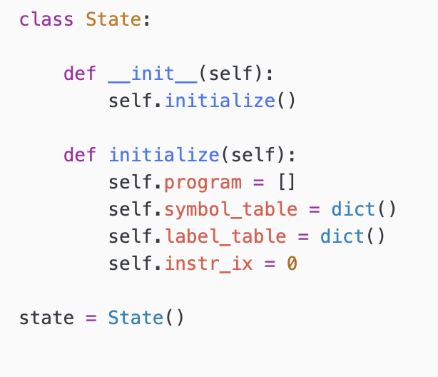
Implementation: State
exp1bytecode_interp_state.py

Slide 46
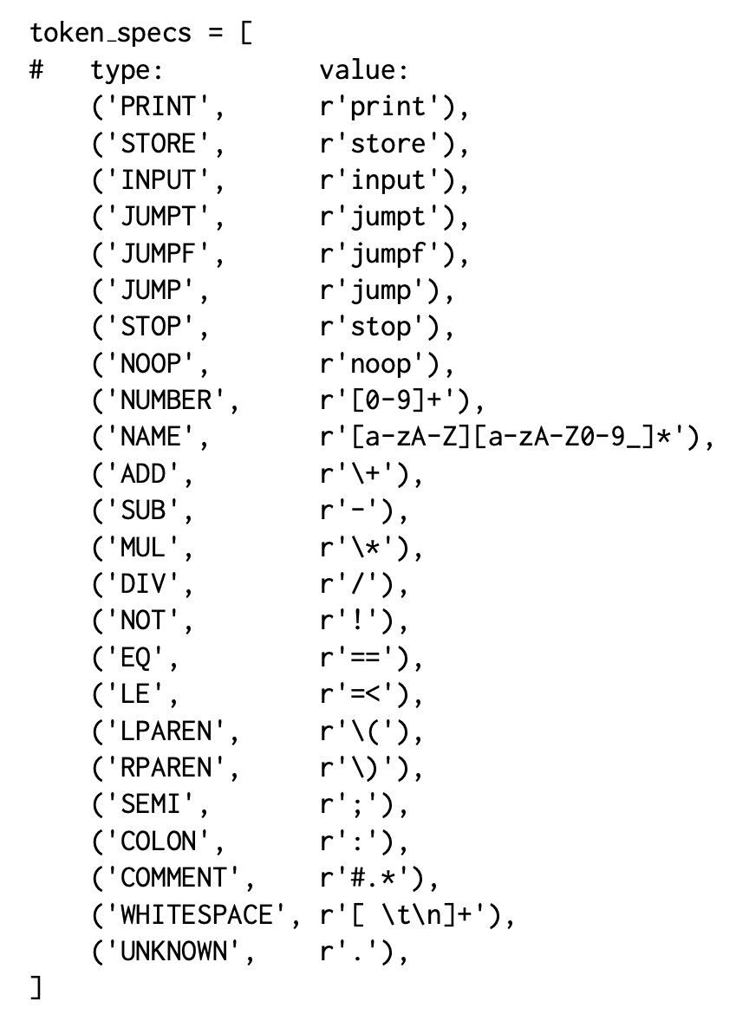
Implementation: Lexer

Slide 47
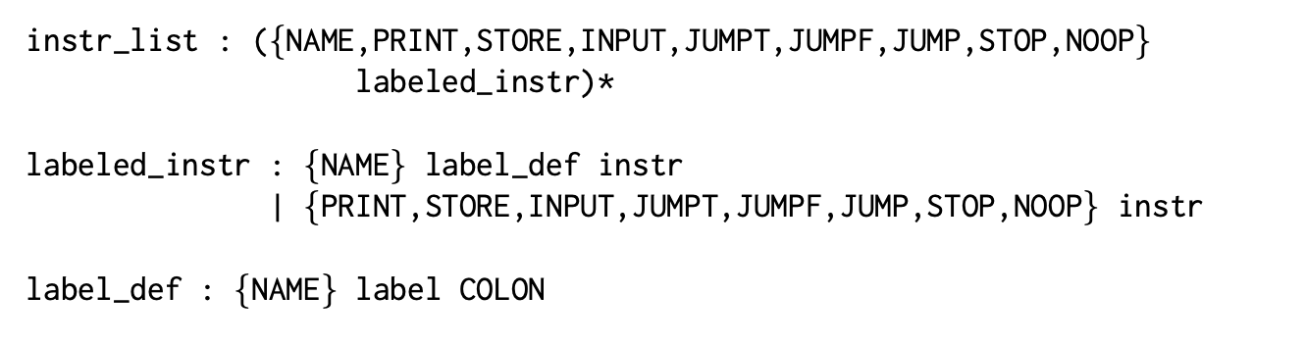
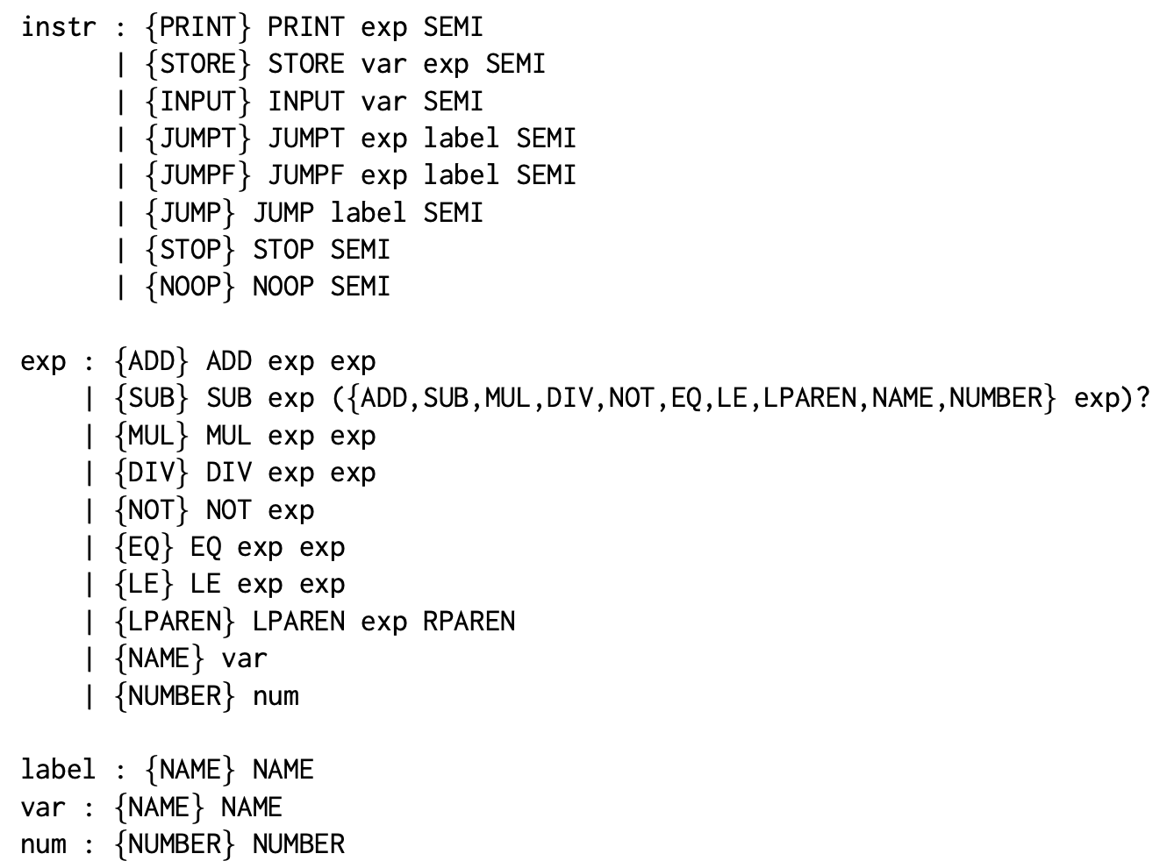
Implementation: Extended Grammar

Slide 48
Implementation: Parser
The parser has code that will construct/fill in the IR
exp1bytecode_interp_fe.py

Slide 49
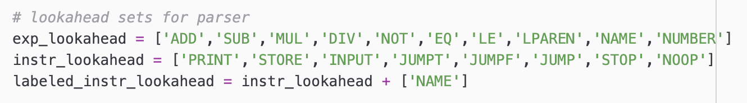
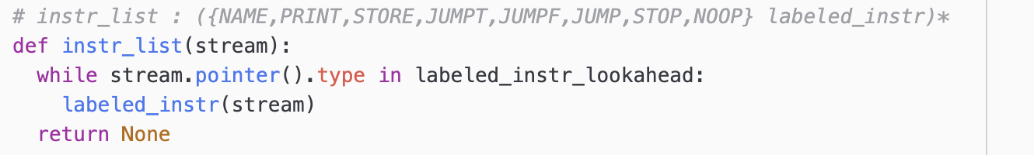
Implementation: Parser

Slide 50
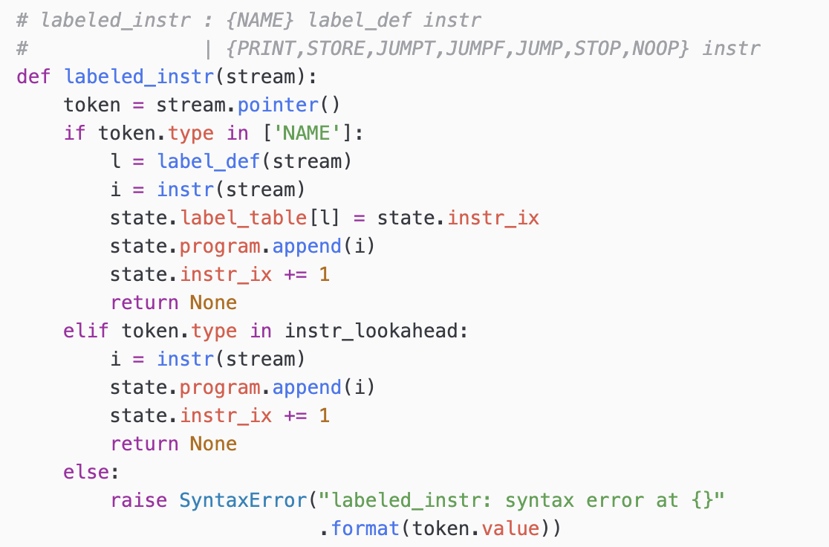
Implementation: Parser
Observation: the parser no longer performs computations but instead fills out our IR (the state to be precise).

Slide 51
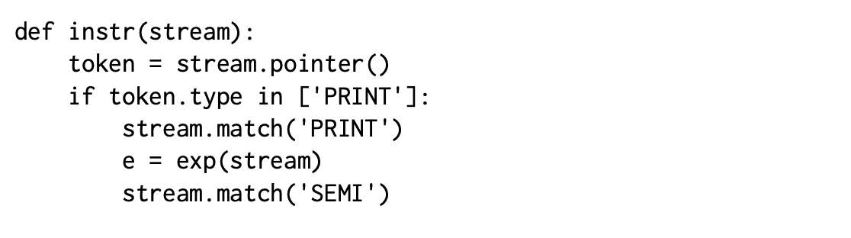
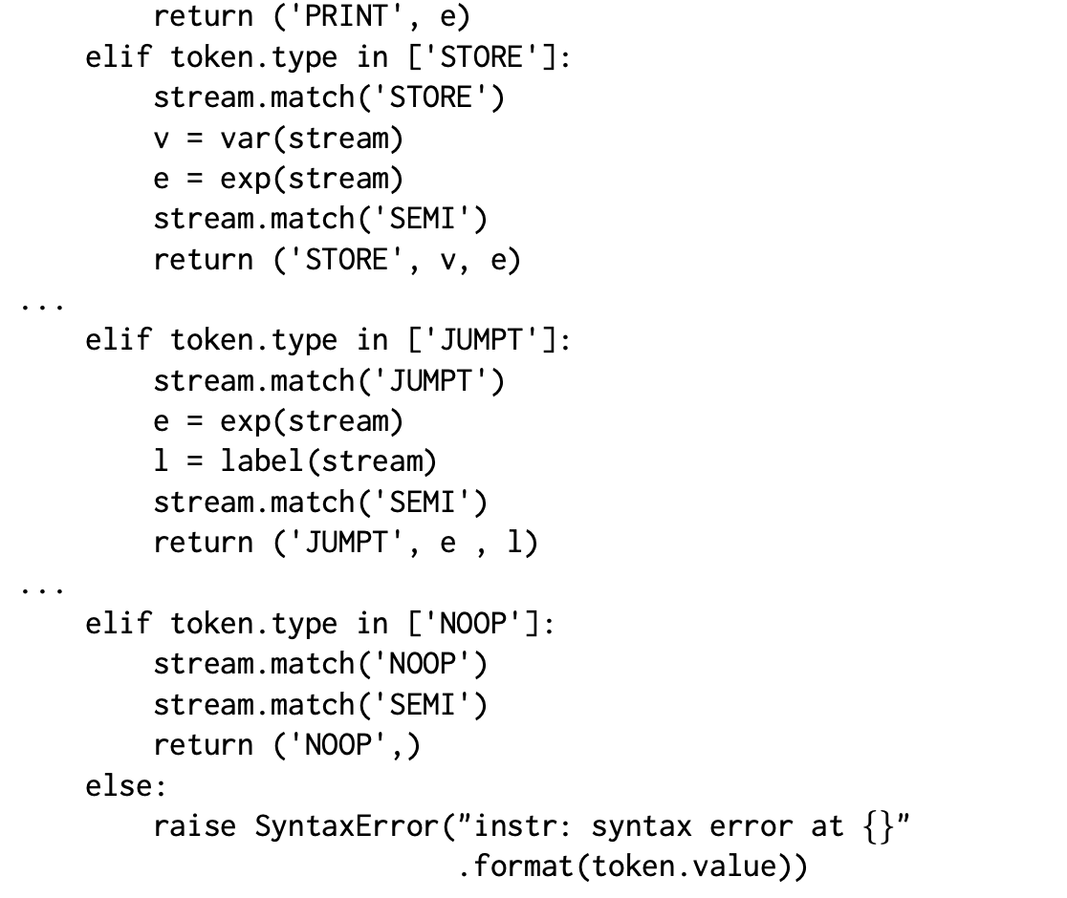
Implementation: Parser
Instruction Tuples!

Slide 52
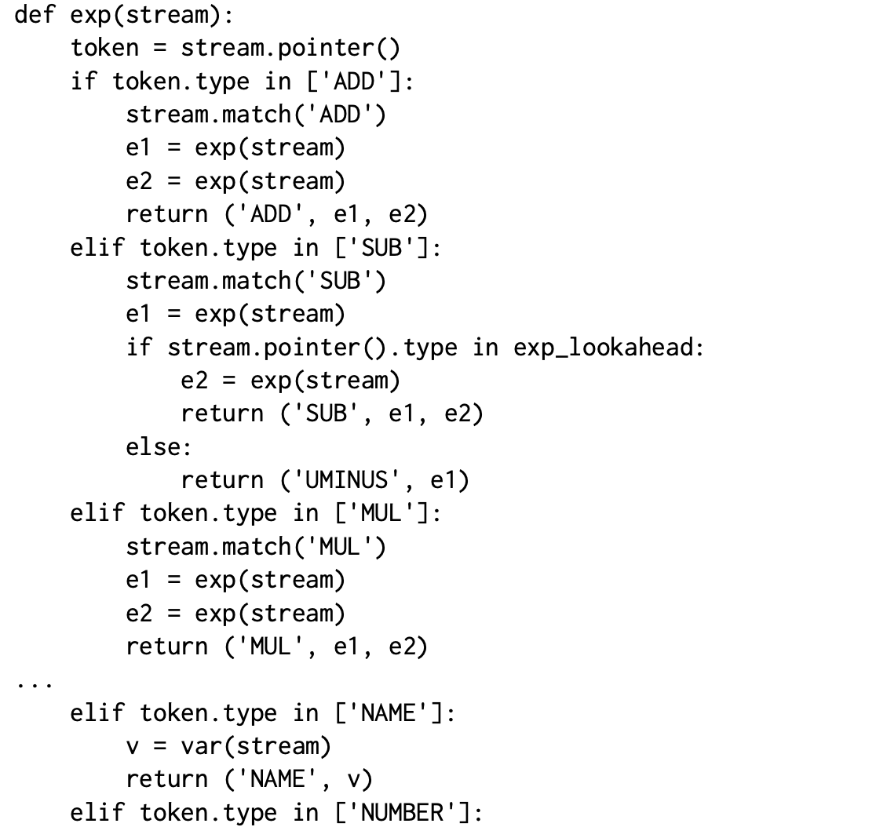
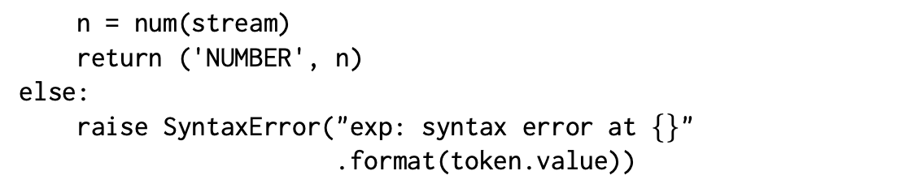
Implementation: Parser
Computing an expression tree!

Slide 53
A Note on the Expressions
We are delaying the evaluation of expressions until we have the IR constructed
We need to have some sort of representation of the expression value that we can evaluate later to actually compute a value.
The idea is that we construct an expression or term tree from the source expression and that term tree can then be evaluated later to compute an actual integer value.
Actually we are constructing a tuple expression.

Slide 54
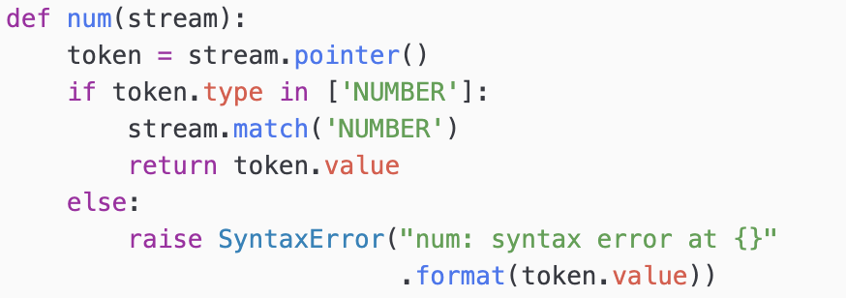
A Note on the Expressions
According to the parser the expression,
* + 3 1 2
gives rise to the term tree,
(‘MUL’,(‘ADD', ('NUMBER', 3), ('NUMBER’, 1)), ('NUMBER', 2))

Slide 55
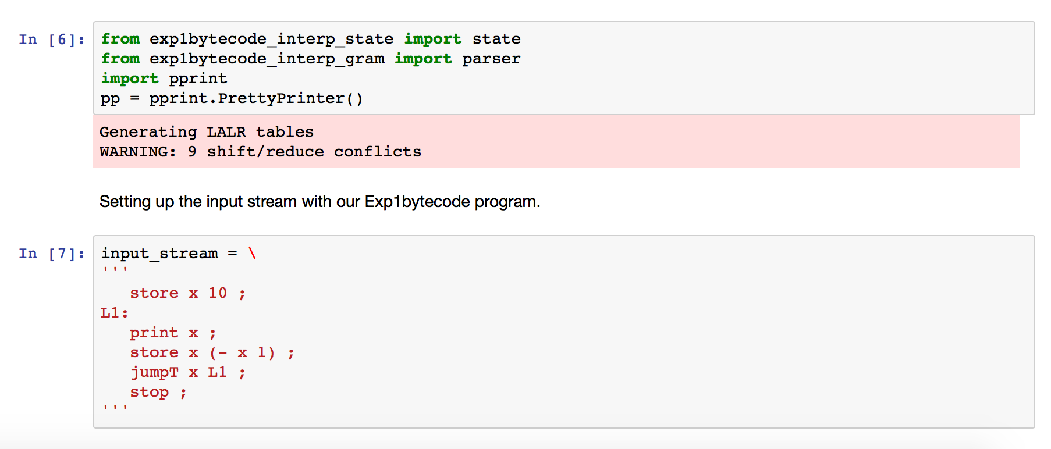
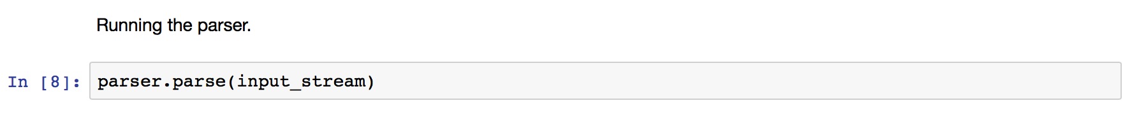
Testing our Parser

Slide 56
Testing our Parser
lutz$ python3
Python 3.8.2 (default, Jun 8 2021, 11:59:35)
[Clang 12.0.5 (clang-1205.0.22.11)] on darwin
Type "help", "copyright", "credits" or "license" for more information.
>>> from exp1bytecode_interp_state import state
>>> from exp1bytecode_interp_fe import parse
>>> import pprint
>>> pp = pprint.PrettyPrinter()
>>> input =\
... '''
... store x 10;
... L1:
... print x;
... store x - x 1;
... jumpt x L1;
... stop;
... '''
>>> parse(input)
>>> pp.pprint(state.program)
[('STORE', 'x', ('NUMBER', '10')),
('PRINT', ('NAME', 'x')),
('STORE', 'x', ('SUB', ('NAME', 'x'), ('NUMBER', '1'))),
('JUMPT', ('NAME', 'x'), 'L1'),
('STOP',)]
>>> pp.pprint(state.label_table)
{'L1': 1}
>>> pp.pprint(state.symbol_table)
{}
>>>
The symbol table is empty since we have not executed the program yet! We have just initialized our abstract machine.

Slide 57
Interpretation – running the abstract machine
In order to interpret the programs in our IR we need two functions:
The first one is the interpretation of instructions on the program list.
The second one for the interpretation of expression

Slide 58
Interpreting Instructions
def interp_program():
‘abstract bytecode machine'
# We cannot use the list iterator here because we
# need to be able to interpret jump instructions
# start at the first instruction in program
state.instr_ix = 0
# keep interpreting until we run out of instructions
# or we hit a 'stop'
while True:
if state.instr_ix == len(state.program):
# no more instructions
break
else:
# get instruction from program
instr = state.program[state.instr_ix]
# instruction format: (type, [arg1, arg2, ...])
type = instr[0]
# interpret instruction
if type == ‘PRINT':
# PRINT exp
exp_tree = instr[1]
val = eval_exp_tree(exp_tree)
print("> {}".format(val))
state.instr_ix += 1
elif type == ‘INPUT':
# INPUT NAME
var_name = instr[1]
val = input("Please enter a value for {}: ".format(var_name))
state.symbol_table[var_name] = int(val)
state.instr_ix += 1
elif type == ‘STORE':
# STORE NAME exp
var_name = instr[1]
val = eval_exp_tree(instr[2])
state.symbol_table[var_name] = val
state.instr_ix += 1
…
exp1bytecode_interp.py
One big loop that interprets the
instructions on the list (program)

Slide 59
Interpreting Instructions
…
elif type == ‘JUMPT':
# JUMPT exp label
val = eval_exp_tree(instr[1])
if val:
state.instr_ix = state.label_table.get(instr[2])
else:
state.instr_ix += 1
elif type == ‘JUMPF':
# JUMPF exp label
val = eval_exp_tree(instr[1])
if not val:
state.instr_ix = state.label_table.get(instr[2])
else:
state.instr_ix += 1
elif type == ‘JUMP':
# JUMP label
state.instr_ix = state.label_table.get(instr[1])
elif type == ‘STOP':
# STOP
break
elif type == ‘NOOP':
# NOOP
state.instr_ix += 1
else:
raise ValueError("Unexpected instruction type: {}".format(p[1]))
exp1bytecode_interp.py

Slide 60
Interpreting Expressions
def eval_exp_tree(node):
'walk expression tree and evaluate to an integer value'
# tree nodes are tuples (TYPE, [arg1, arg2,...])
type = node[0]
if type == ‘ADD':
# '+' exp exp
v_left = eval_exp_tree(node[1])
v_right = eval_exp_tree(node[2])
return v_left + v_right
elif type == ‘SUB':
# '-' exp exp
v_left = eval_exp_tree(node[1])
v_right = eval_exp_tree(node[2])
return v_left - v_right
elif type == ‘MUL':
# '*' exp exp
v_left = eval_exp_tree(node[1])
v_right = eval_exp_tree(node[2])
return v_left * v_right
elif type == ‘DIV':
# '/' exp exp
v_left = eval_exp_tree(node[1])
v_right = eval_exp_tree(node[2])
return v_left // v_right
…
exp1bytecode_interp.py
Recursive function that
walks the expression tree
and evaluates it.
Integer division!

Slide 61
Interpreting Expressions
…
elif type == ‘EQ':
# '=' exp exp
v_left = eval_exp_tree(node[1])
v_right = eval_exp_tree(node[2])
return 1 if v_left == v_right else 0
elif type == ‘LE':
# '<=' exp exp
v_left = eval_exp_tree(node[1])
v_right = eval_exp_tree(node[2])
return 1 if v_left <= v_right else 0
elif type == 'UMINUS':
# 'UMINUS' exp
val = eval_exp_tree(node[1])
return - val
elif type == ‘NOT':
# '!' exp
val = eval_exp_tree(node[1])
return 0 if val != 0 else 1
elif type == 'NAME':
# 'NAME' var_name
return state.symbol_table.get(node[1],0)
elif type == 'NUMBER':
# NUMBER val
return int(node[1])
else:
raise ValueError("Unexpected instruction type: {}".format(type))
Representing Booleans as integers.
exp1bytecode_interp.py

Slide 62
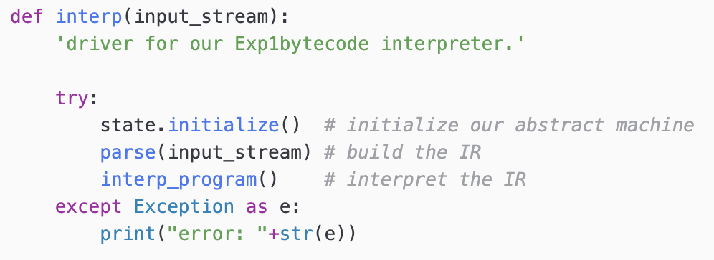
Top-level Function
exp1bytecode_interp.py

Slide 63
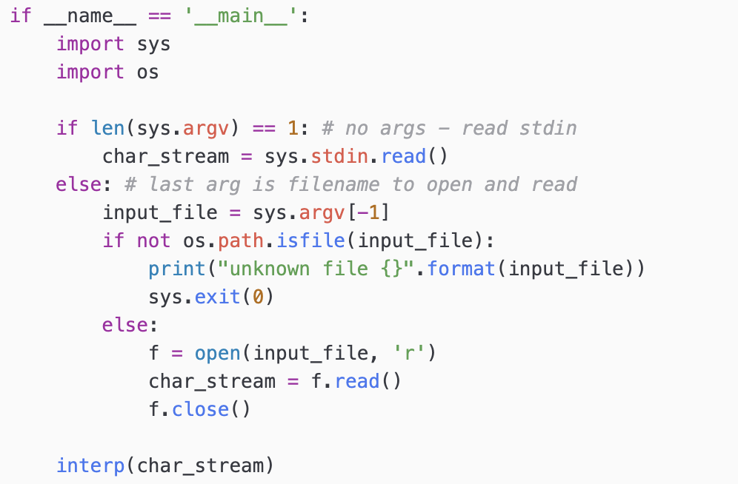
Running from Commandline

Slide 64
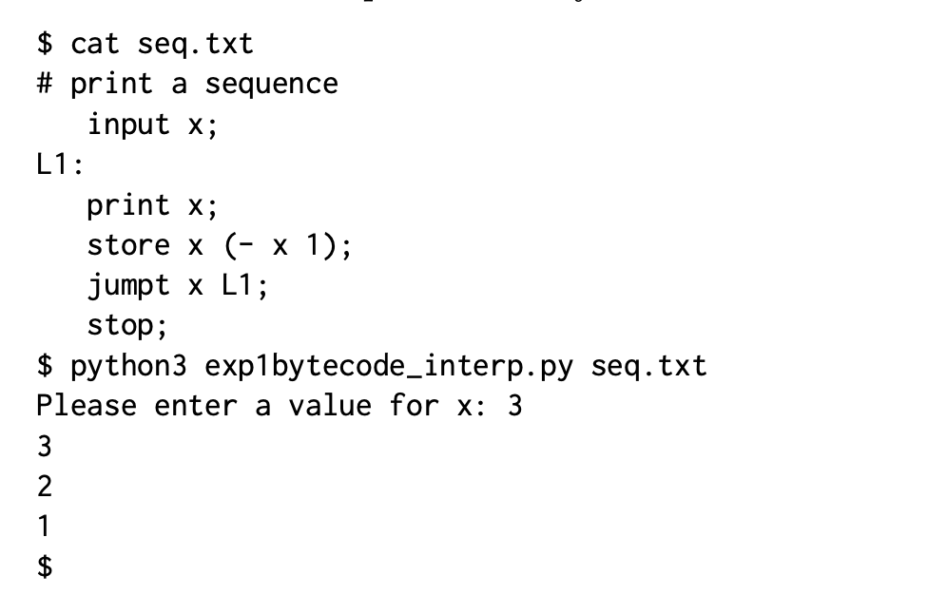
Testing our Interpreter

Slide 65
Interpreter with IR
The advantage of IR based interpretation is that we are decoupling program recognition (parsing/reading) from executing the program.
As we saw this decoupling allows us to create IRs that are convenient to use!
IR
Syntax
Analysis
Semantic
Analysis
Program
Output
Program Text

Slide 66
Reading
Chap 4

