Slide 1
The Structure of Programming Languages
With the exception of the Generator we saw that all language processors perform some kind of syntax analysis – an analysis of the structure of the program.
To make this efficient and effective we need some mechanism to specify the structure of a programming language in a straight forward manner.
➔We use grammars for this purpose.

Slide 2
Grammars
The most convenient way to describe the structure of programming languages is using a context-free grammar (often called CFG or BNF for Backus-Nauer Form).
Here we will simply refer to grammars with the understanding that we are referring to CFGs. (there are many kind of other grammars: regular grammars, context-sensitive grammars, etc)

Slide 3
Grammars
Grammars can readily express the structure of phrases in programming languages
stmt: function-def | return-stmt | if-stmt | while-stmt
function-def: function name expr stmt
return-stmt : return expr
if-stmt : if expr then stmt else stmt endif
while-stmt: while expr do stmt enddo

Slide 4
Grammars
Grammars have 4 parts to them
Non-terminal Symbols - these give names to phrase structures - e.g. function-def
Terminal Symbols - these give names to the tokens in a language – e.g. while (sometimes we don’t use explicit tokens but put the words that make up the tokens of a language in quotes)
Rules - these describe that actual structure of phrases in a language – e.g. return-stmt: return exp
Start Symbol - a special non-terminal that gives a name to the largest possible phrase(s) in the language (often denoted by an asterisk)
In our case that would probably be the stmt non-terminal

Slide 5
Example: The Exp0 Language
prog : stmt prog
| ""
stmt : p exp ;
| s var exp ;
exp : + exp exp
| - exp exp
| ( exp )
| var
| num
var : x | y | z
num : 0 | 1 | 2 | 3 | 4 | 5 | 6 | 7 | 8 |9
Example Exp0 Program:
s x 1 ; p + x 1 ;
Start Symbol: prog

Slide 6
Grammars
A grammar tells us if a sentence belongs to the language,
e.g. Does ‘s x 3 ;’ belong to the language?
We can show that a sentence belongs to the language by constructing a parse tree starting at the start symbol

Slide 7
Grammars
prog
stmt
prog
s x 3 ;
s
var
exp
;
“”
x
num
prog : stmt prog
| ""
stmt : p exp ;
| s var exp ;
exp : + exp exp
| - exp exp
| ( exp )
| var
| num
var : x | y | z
num : 0 | 1 | 2 | 3 | 4 | 5 | 6 | 7 | 8 |9
3
Note: constructing the parse tree by filling in the leftmost non-terminal at each step we obtain the left-most derivation:
prog ⇒
stmt prog ⇒
s var exp ; prog ⇒
s x exp ; prog ⇒
s x num ; prog ⇒
s x 3 ; prog ⇒
s x 3 ;
Constructing the parse tree by filling in the rightmost non-terminal
at each step we obtain the right-most derivation.

Slide 8
Grammars
Every valid sentence (a sentence that belongs to the language) has a parse tree.
Test if these sentences are valid:
p x + 1 ;
s x 1 ; s y x ;
s x 1 ; p (+ x 1) ;
s y + 3 x ;
s + y 3 x ;

Slide 9
Parsers
The converse is also true:
If a sentence has a parse tree, then it belongs to the language.
This is precisely what parsers do: to show a program is syntactically correct, parsers construct a parse tree

Slide 10
Top-Down Parsers - LL(1)
LL(1) parsers start constructing the parse tree at the start symbol
as opposed to bottom up parsers, LR
LL(1) parsers use the current position in the input stream and a single look-ahead token to decide how to construct the next node(s) in the parse tree.
LL(1)
Reads input from Left to right.
Constructs the Leftmost derivation
Uses 1 look-ahead token.
Notes:
Show a top-down parser algorithm using a queue – algorithm outline could be similar to the one for LR(1) parsing.

Slide 11
Top-Down Parsing
Lookahead Set
Consider: p + x 1 ;
prog : {p,s} stmt prog
| {""} ""
stmt : {p} p exp ;
| {s} s var exp ;
exp : {+} + exp exp
| {-} - exp exp
| {(} ( exp )
| {x,y,z} var
| {0,1,2,3,4,5,6,7,8,9} num
var : {x} x | {y} y | {z} z
num : {0} 0 | {1} 1 | {2} 2 | {3} 3 | {4} 4 | {5} 5 | {6} 6 | {7} 7 | {8} 8 | {9} 9
For top-down parsing we can think
of the grammar extended with the
one token look-ahead set.
The look-ahead set uniquely identifies
the selection of each rule within a
block of rules

Slide 12
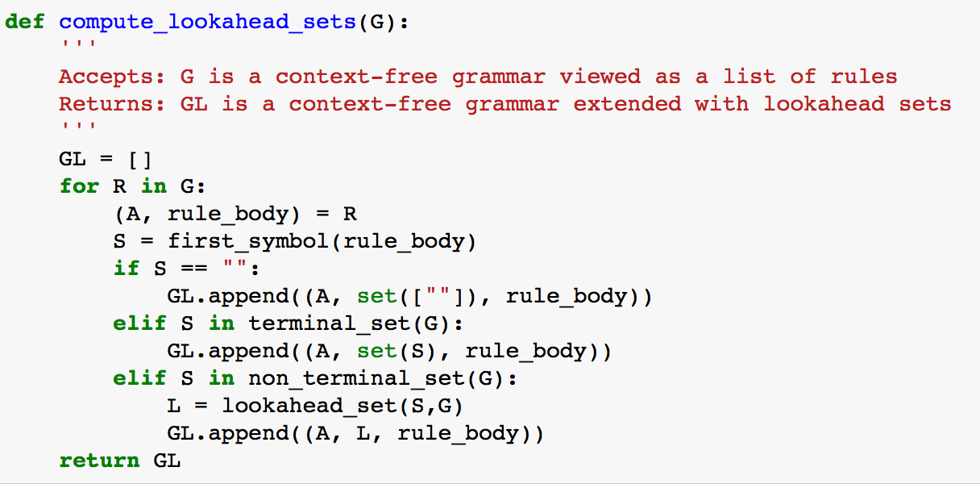
Computing the Lookahead Set
Note: a grammar is a list of rules and a rule is the tuple (non-terminal, body)
Note: a grammar extended with lookahead sets is a list of rules where each rule is the tuple (non-terminal, lookahead-set, body)

Slide 13
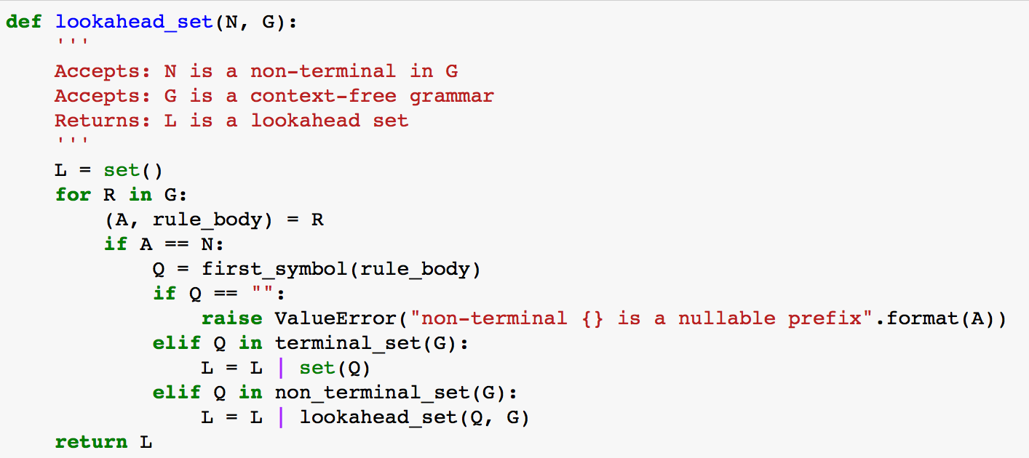
Computing the Lookahead Set
set union operator in Python

Slide 14
Computing the Lookahead Set
grammar G:
prog : stmt prog
| ""
stmt : p exp ;
| s var exp ;
exp : + exp exp
| - exp exp
| ( exp )
| var
| num
var : x | y | z
num : 0 | 1 | 2 | 3 | 4 | 5 | 6 | 7 | 8 |9
grammar GL:
prog : {p,s} stmt prog
| {""} ""
stmt : {p} p exp ;
| {s} s var exp ;
exp : {+} + exp exp
| {-} - exp exp
| {(} ( exp )
| {x,y,z} var
| {0,1,2,3,4,5,6,7,8,9} num
var : {x} x | {y} y | {z} z
num : {0} 0 | {1} 1 | {2} 2 | ... | {8} 8 | {9} 9

Slide 15
Computing the Lookahead Set
Actually, the algorithm we have outlined computes the lookahead set for a simpler parsing technique called sLL(1) – simplified LL (1) parsing.
sLL(1) parsing does not deal with non-terminals that expand into the empty string in the first position of a production – also called nullable prefixes.
All our hand-built parsers will be sLL(1) but when we use Ply and we will have access to a powerful parsing technique called LR(1).

Slide 16
Constructing a Parser
A sLL(1) parser can be constructed by hand by converting each non-terminal into a function
The body of the function implements the right sides of the rules for each non-terminal in order to:
Process terminals
Call the functions of other non-terminals as appropriate

Slide 17
Constructing a Parser by Hand
A parser for Exp0
We start with the grammar for Exp0 extended with the lookahead sets
prog : {p,s} stmt prog
| {""} ""
stmt : {p} p exp ;
| {s} s var exp ;
exp : {+} + exp exp
| {-} - exp exp
| {(} ( exp )
| {x,y,z} var
| {0,1,2,3,4,5,6,7,8,9} num
var : {x} x | {y} y | {z} z
num : {0} 0 | {1} 1 | {2} 2 | ... | {8} 8 | {9} 9

Slide 18
Constructing a Parser by Hand
We need to set up some sort of character input stream
from grammar_stuff import InputStream
InputStream supports the operations: ‘pointer’, ‘next’, and ‘end_of_file’
set_stream(InputStream([<input list of characters>]))
Note: all the Python code given in the slides is available in the ‘code’ section of the Plipy Notebooks.
Note: the hand-built parser for Exp0 is in ’exp0_recdesc.py’

Slide 19
Constructing a Parser by Hand
Consider the following rule:
prog : {p,s} stmt prog
| {""} ""
def prog():
sym = I.pointer()
if sym in ['p','s']:
stmt()
prog()
elif sym == "":
pass
else:
raise SyntaxError('unexpected symbol {} while parsing'.format(sym))
Note: a lookahead set is not necessary here – only one rule to choose from
besides the empty rule.

Slide 20
Constructing a Parser by Hand
stmt : {‘p’} 'p' exp ';'
| {‘s’} 's’ var exp ';'
def stmt():
sym = I.pointer()
if sym == 'p':
I.next()
exp()
I.match(';')
elif sym == 's':
I.next()
var()
exp()
I.match(';')
else:
raise SyntaxError('unexpected symbol {} while parsing'.format(sym))
Notice that we are using the look-ahead set to decide which rule to call!

Slide 21
Constructing a Parser by Hand
exp : {‘+’} '+' exp exp
| {‘-’} '-' exp exp
| {‘(‘} '(' exp ')'
| {‘x’,’y’,’z} var
| {‘0’…’9’} num
def exp():
sym = I.pointer()
if sym == '+':
I.next()
exp()
exp()
elif sym == '-':
I.next()
exp()
exp()
elif sym == '(':
I.next()
exp()
I.match(')')
elif sym in ['x', 'y', 'z']:
var()
elif sym in ['0', '1', '2', '3', '4', '5', '6','7', '8', '9']:
num()
else:
raise SyntaxError('unexpected symbol {} while parsing'.format(sym))

Slide 22
Constructing a Parser by Hand
var : { ‘x’ } ‘x’ | { ‘y’ } ‘y’ | { ‘z’ } 'z’
def var():
sym = I.pointer()
if sym == 'x':
I.next()
elif sym == 'y':
I.next()
elif sym == 'z':
I.next()
else:
raise SyntaxError('unexpected symbol {} while parsing'.format(sym))

Slide 23
Constructing a Parser
num : { ‘0’ } ‘0’ | { ‘1’ } ‘1’ | … | { ‘9’ } '9'
def num():
sym = I.pointer()
if sym in ['0', '1', '2', '3', '4', '5', '6','7', '8', '9']:
I.next()
else:
raise SyntaxError('unexpected symbol {} while parsing'.format(sym))

Slide 24
Constructing a Parser: An Example
def exp():
sym = I.pointer()
if sym == '+':
I.next()
exp()
exp()
elif sym == '-':
I.next()
exp()
exp()
elif sym == '(':
I.next()
exp()
I.match(')')
elif sym in ['x', 'y', 'z']:
var()
elif sym in ['0', ... , '9']:
num()
else:
raise SyntaxError(...)
p + x 1 ;
Call Tree: prog()
stmt() I.next() #‘p’
exp()
I.next() #‘+’
exp() var()
I.next() #‘x’
exp() num()
I.next() #‘1’ I.match(‘;’)
prog()
def prog():
sym = I.pointer()
if sym in ['p','s']:
stmt()
prog()
elif sym == "":
pass
else:
raise SyntaxError(...)
)
prog
def stmt():
sym = I.pointer()
if sym == 'p':
I.next()
exp()
I.match(';')
elif sym == 's':
I.next()
var()
exp()
I.match(';')
else:
raise SyntaxError(...)
prog
stmt
prog
p
exp
;
“”
+
exp
exp
rhsvar
num
x
1
Notes:
Add algorithm box

Slide 25
Constructing a Parser: An Example
Observations:
Our parser is an LL(1) parser (why?)
The parse tree is implicit in the function call activation record stack
Building a parser by hand is a lot of work and the parser is difficult to maintain.
We would like a tool that reads our grammar file and converts it automatically into a parser – that is what Ply does!

Slide 26
Running the Parser
The examples assume that you have cloned/downloaded the Plipy book and have access to the ‘code’ folder.
For notebook demos it is assumed that you navigated Jupyter to the ‘code’ folder and started a new notebook
This works for all OS’s that Anaconda supports

Slide 27
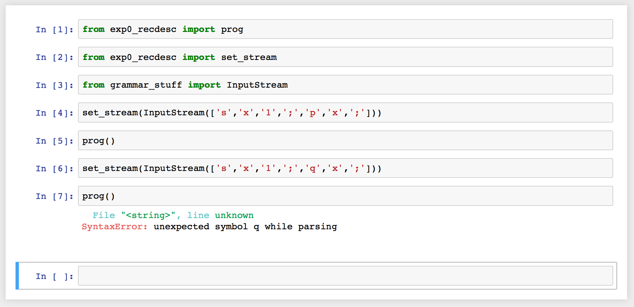
Running the Parser

Slide 28
Assignments
Read Chapter 2
Assignment #1 -- see BrightSpace

