Slide 1
The Structure of Programming Languages
All language processors perform some kind of syntax analysis – an analysis of the structure of the program.
To make this efficient and effective we need some mechanism to specify the structure of a programming language in a straightforward manner.
➔We use grammars for this purpose.

Slide 2
Reading
Read Chap 2

Slide 3
Grammars
The most convenient way to describe the structure of programming languages is using a context-free grammar (often called CFG or BNF for Backus-Nauer Form).
Here we will simply refer to grammars with the understanding that we are referring to CFGs. (there are many kind of other grammars: regular grammars, context-sensitive grammars, etc)

Slide 4
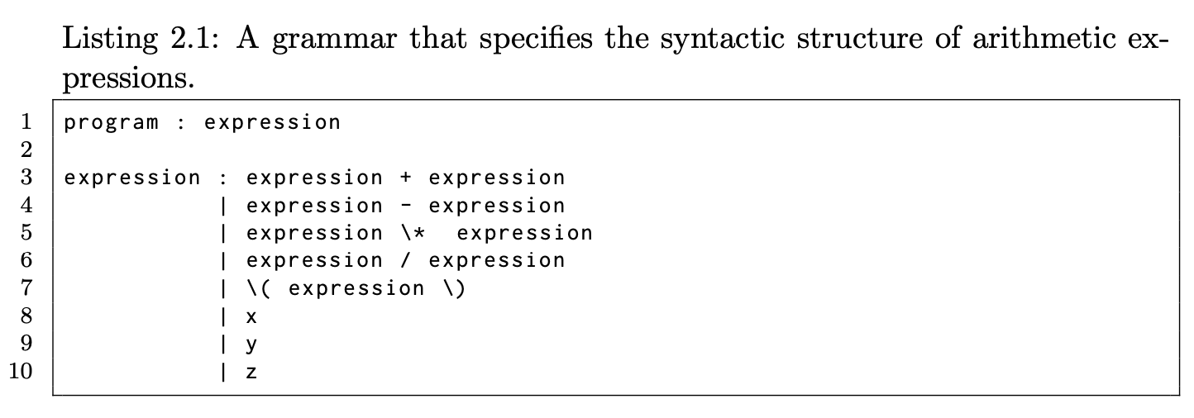
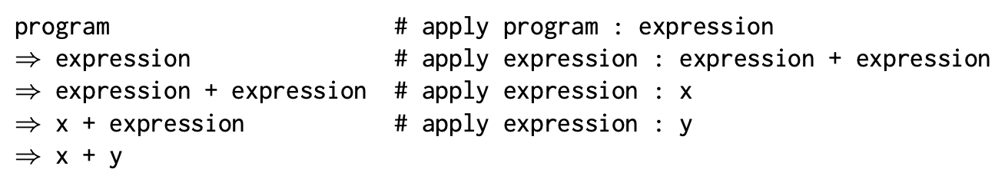
Grammars
Grammars can readily express the structure of phrases in programming languages
Grammars allow us to derive valid sentences or programs that are part of the language by applying the rules of the grammar repeatedly until no further rule application is possible.

Slide 5
Grammars
Grammars have 4 parts to them
Non-terminal Symbols - these give names to phrase structures - e.g. program
Terminal Symbols - these give names to the tokens in a language – e.g. x
Rules - these describe that actual structure of phrases in a language – e.g. expression : expression + expression
Start Symbol - a special non-terminal that gives a name to the largest possible phrase(s) in the language
By convention it is usually the non-terminal defined by the first rule.
In our case that would be the program non-terminal

Slide 6
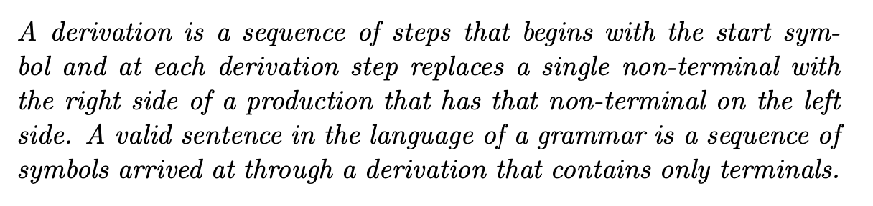

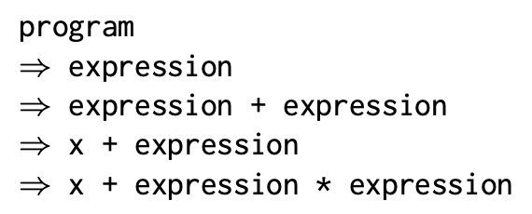
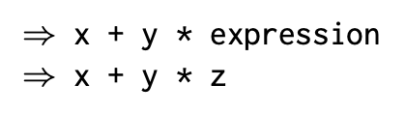
Derivations
Let’s try this with:
Since we were able to derive our sentence from the start symbol our sentence is valid!

Slide 7
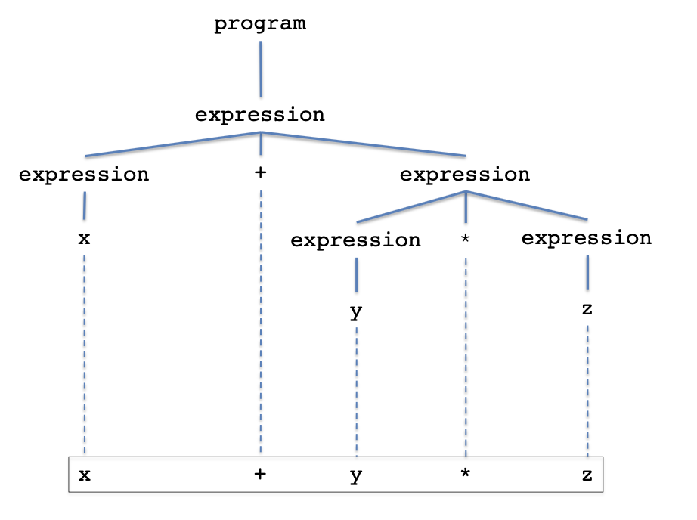
Parse Trees
Derivations can also be expressed as parse trees.

Slide 8
Example: The Exp0 Language
stmt_list : stmt stmt_list
| ""
stmt : p exp ;
| s var exp ;
exp : + exp exp
| - exp exp
| \( exp \)
| var
| num
var : x | y | z
num : 0 | 1 | 2 | 3 | 4 | 5 | 6 | 7 | 8 |9
Example Exp0 Program:
s x 1 ; p + x 1 ;
Start Symbol: prog

Slide 9
Grammars
A grammar tells us if a sentence belongs to the language,
e.g. Does ‘s x 3 ;’ belong to the language?
We can show that a sentence belongs to the language by constructing a derivation or a parse tree starting at the start symbol

Slide 10
Grammars
stmt_list
stmt
stmt_list
s x 3 ;
s
var
exp
;
“”
x
num
stmt_list : stmt stmt_list
| ""
stmt : p exp ;
| s var exp ;
exp : + exp exp
| - exp exp
| \( exp \)
| var
| num
var : x | y | z
num : 0 | 1 | 2 | 3 | 4 | 5 | 6 | 7 | 8 |9
3
Note: constructing the parse tree by filling in the leftmost non-terminal at each step we obtain the left-most derivation:
stmt_list ⇒
stmt stmt_list ⇒
s var exp ; stmt_list ⇒
s x exp ; stmt_list ⇒
s x num ; stmt_list ⇒
s x 3 ; stmt_list ⇒
s x 3 ;
Constructing the parse tree by filling in the rightmost non-terminal
at each step we obtain the right-most derivation.

Slide 11
Grammars
Every valid sentence (a sentence that belongs to the language) has a parse tree.
Test if these sentences are valid:
p x + 1 ;
s x 1 ; s y x ;
s x 1 ; p (+ x 1) ;
s y + 3 x ;
s + y 3 x ;
stmt_list : stmt stmt_list
| ""
stmt : p exp ;
| s var exp ;
exp : + exp exp
| - exp exp
| \( exp \)
| var
| num
var : x | y | z
num : 0 | 1 | 2 | 3 | 4 | 5 | 6 | 7 | 8 |9

Slide 12
Parsers
The converse is also true:
If a sentence has a parse tree, then it belongs to the language.
This is precisely what parsers do: to show a program is syntactically correct, parsers construct a parse tree

Slide 13
Top-Down Parsers - LL(1)
LL(1) parsers start constructing the parse tree at the start symbol
as opposed to bottom-up parsers, LR
LL(1) parsers use the current position in the input stream and a single look-ahead token to decide how to construct the next node(s) in the parse tree.
LL(1)
Reads input from Left to right.
Constructs the Leftmost derivation
Uses 1 look-ahead token.
Notes:
Show a top-down parser algorithm using a queue – algorithm outline could be similar to the one for LR(1) parsing.

Slide 14
Top-Down Parsing
Lookahead Set
Consider: p + x 1 ;
stmt_list : {p,s} stmt stmt_list
| {""} ""
stmt : {p} p exp ;
| {s} s var exp ;
exp : {+} + exp exp
| {-} - exp exp
| {(} \( exp \)
| {x,y,z} var
| {0,1,2,3,4,5,6,7,8,9} num
var : {x} x | {y} y | {z} z
num : {0} 0 | {1} 1 | {2} 2 | {3} 3 | {4} 4 | {5} 5 | {6} 6 | {7} 7 | {8} 8 | {9} 9
For top-down parsing we can think
of the grammar extended with the
one token look-ahead set.
The look-ahead set uniquely identifies
the selection of each rule within a
block of rules

Slide 15
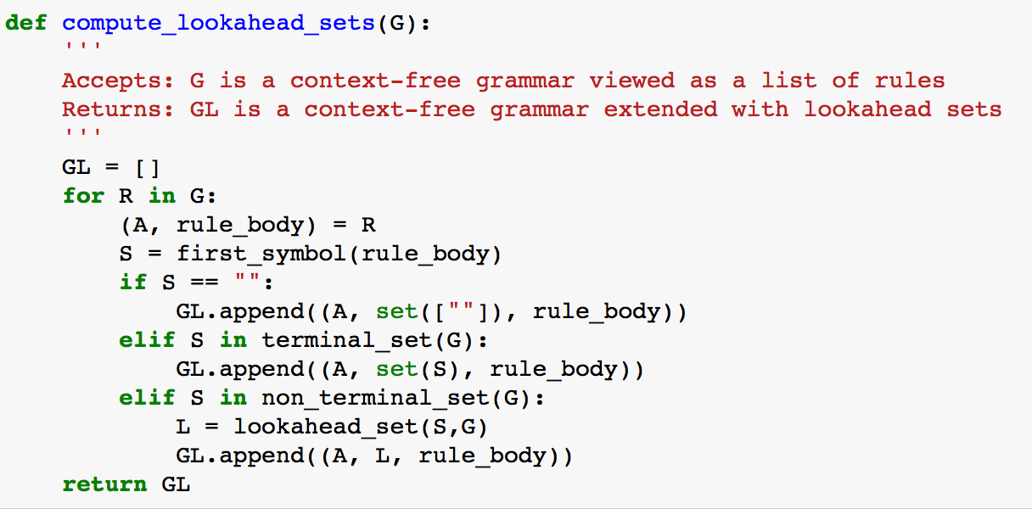
Computing the Lookahead Set
Note: a grammar is a list of rules and a rule is the tuple (non-terminal, body)
Note: a grammar extended with lookahead sets is a list of rules where each rule is the tuple (non-terminal, lookahead-set, body)

Slide 16
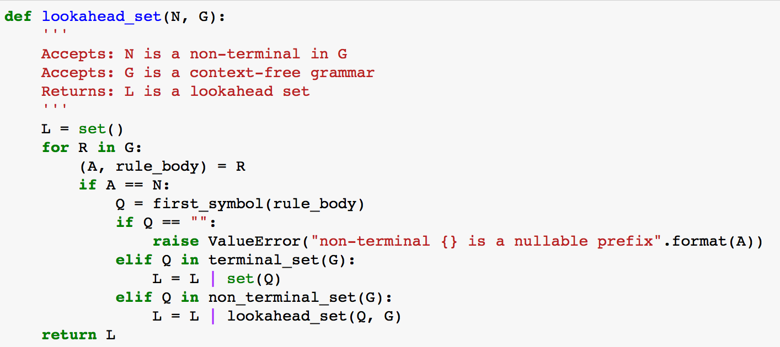
Computing the Lookahead Set
set union operator in Python

Slide 17
Computing the Lookahead Set
grammar G:
stmt_list : stmt stmt_list
| ""
stmt : p exp ;
| s var exp ;
exp : + exp exp
| - exp exp
| \( exp \)
| var
| num
var : x | y | z
num : 0 | 1 | 2 | 3 | 4 | 5 | 6 | 7 | 8 |9
grammar GL:
stmt_list : {p,s} stmt stmt_list
| {""} ""
stmt : {p} p exp ;
| {s} s var exp ;
exp : {+} + exp exp
| {-} - exp exp
| {(} \( exp \)
| {x,y,z} var
| {0,1,2,3,4,5,6,7,8,9} num
var : {x} x | {y} y | {z} z
num : {0} 0 | {1} 1 | {2} 2 | ... | {8} 8 | {9} 9

Slide 18
Computing the Lookahead Set
Actually, the algorithm we have outlined computes the lookahead set for a simpler parsing technique called sLL(1) – simplified LL (1) parsing.
sLL(1) parsing does not deal with non-terminals that expand into the empty string in the first position of a production – also called nullable prefixes.
All our parsers will be sLL(1)
Later in the course we will discuss a tool called Ply and we will have access to another parsing technique called LR(1) – which is bottom-up parsing

Slide 19
Constructing a Parser
A sLL(1) parser can be constructed by hand by converting each non-terminal into a function
The body of the function implements the right sides of the rules for each non-terminal in order to:
Process terminals
Call the functions of other non-terminals as appropriate

Slide 20
Constructing LL(1) Parsers
A parser for Exp0
We start with the grammar for Exp0 extended with the lookahead sets
stmt_list : {p,s} stmt stmt_list
| {""} ""
stmt : {p} p exp ;
| {s} s var exp ;
exp : {+} + exp exp
| {-} - exp exp
| {(} \( exp \)
| {x,y,z} var
| {0,1,2,3,4,5,6,7,8,9} num
var : {x} x | {y} y | {z} z
num : {0} 0 | {1} 1 | {2} 2 | ... | {8} 8 | {9} 9

Slide 21
Constructing LL(1) Parsers
We need to set up some sort of character input stream. In our case we use the ‘InputStream’ class
Note: all the Python code given in the slides is available in the repl.it VM.
Note: the parser for Exp0 is in ’exp0’

Slide 22
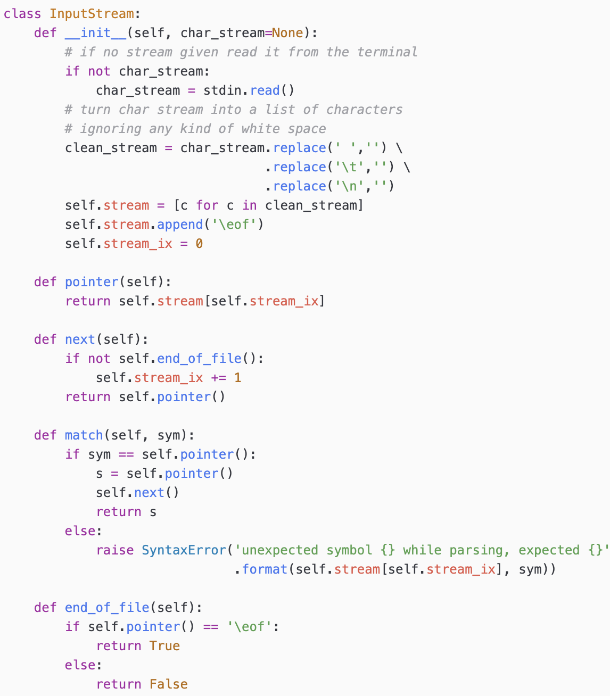
The Stream Class
It is convenient to map the input string into a stream structure.

Slide 23
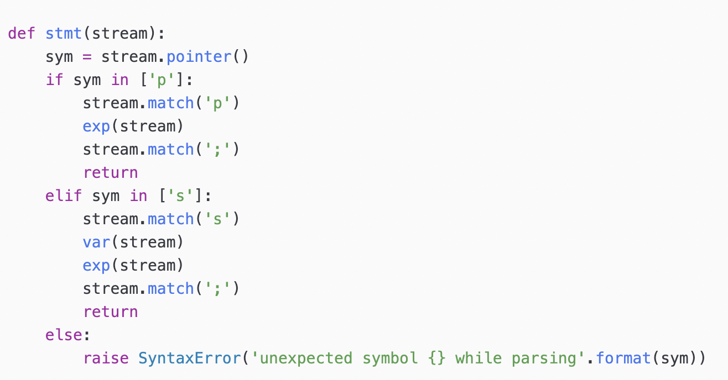
Constructing LL(1) Parsers
stmt : {p} p exp ;
| {s} s var exp ;
Notice that we are using the look-ahead set to decide which rule to call!

Slide 24
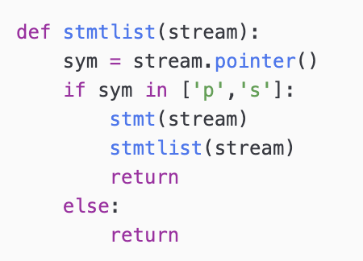
Constructing LL(1) Parsers
Consider the following rule:
stmt_list : {p,s} stmt stmt_list
| {""} ""

Slide 25
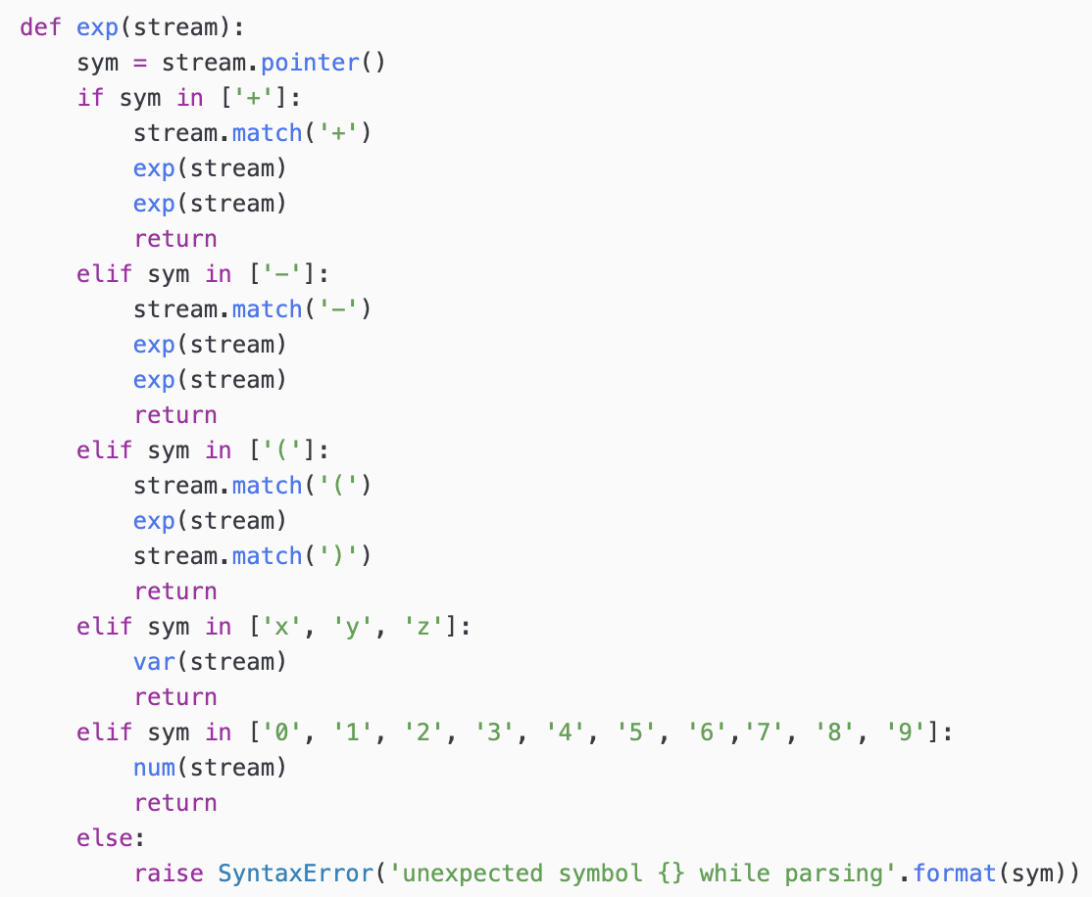
Constructing LL(1) Parsers
exp : {+} + exp exp
| {-} - exp exp
| {(} \( exp \)
| {x,y,z} var
| {0…9} num

Slide 26
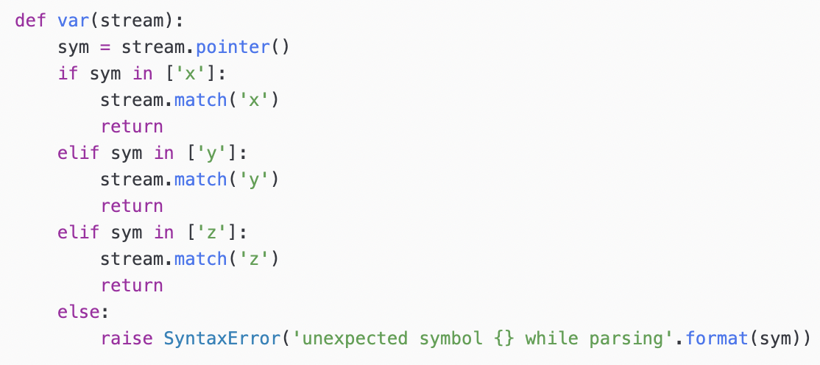
Constructing LL(1) Parsers
var : { x } x | { y } y | { z } z

Slide 27
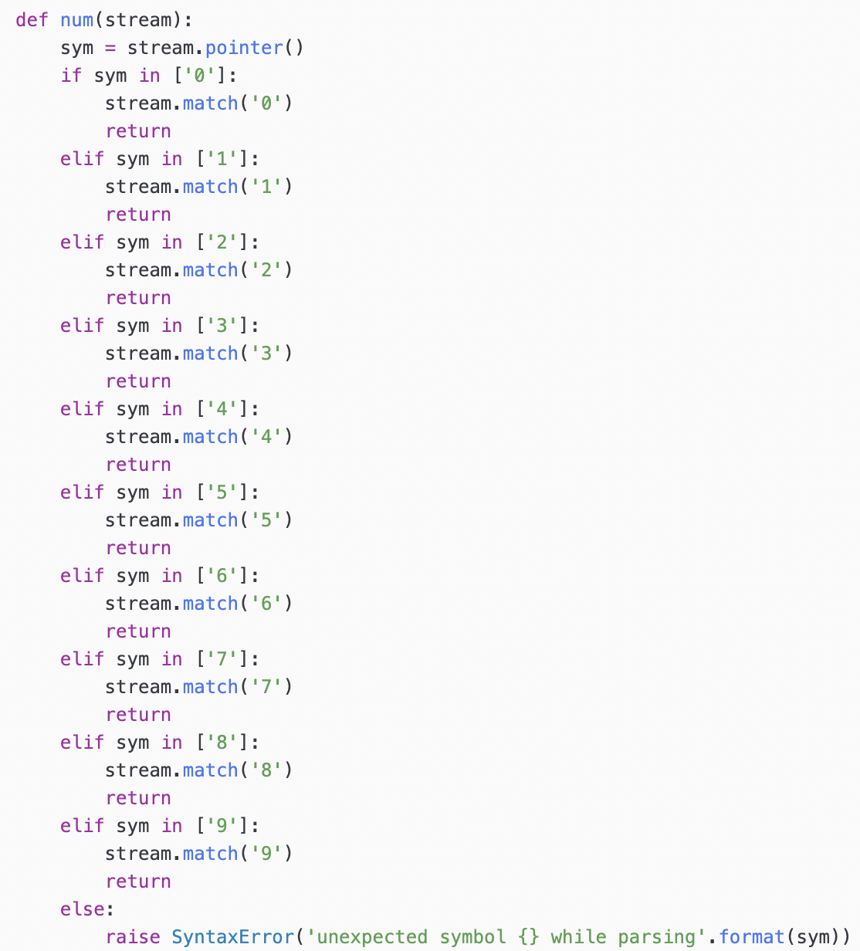
Constructing LL(1) Parsers
num : { 0 } 0 | { 1 } 1 | … | { 9 } 9

Slide 28
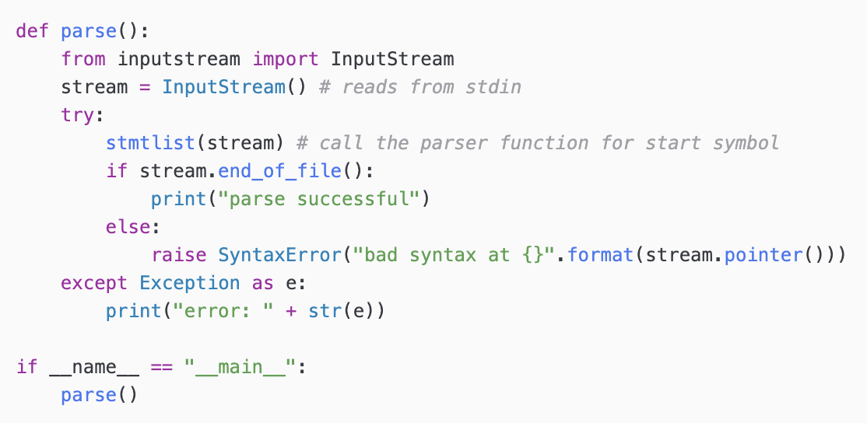
Constructing LL(1) Parsers
To pull this all together we add a high-level parsing function

Slide 29
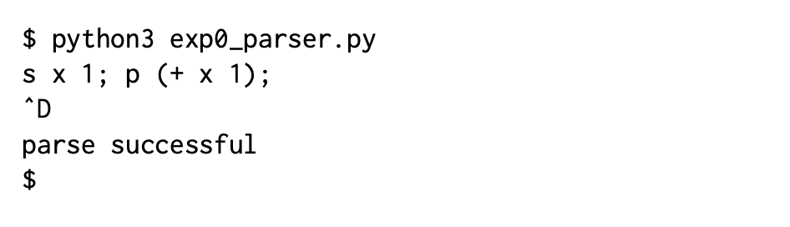
Running the Parser
Run the parser in a command shell, in our case we use the cloud based Linux VM
End of input

Slide 30
Class Exercise
Please see BrightSpace

Slide 31
Parsers build Parse Trees
To see that parsers build parse trees in order to prove that a sentence belongs to a language consider the expression: + x y
Parsing + x y will result in the following tree: exp
match(+)
exp
var
match(x)
exp
var
match(y)
Parsing function call tree == parse tree

Slide 32
Our First Language Processor
Parsers are good because they can tell us if a program is valid or not
But we have to extend it with “actions”, code that does something useful in order to go beyond just parsing
Idea: Our first language processor parses Exp0 programs and counts the number of times the value of a variable is accessed
Example: s x 1; s x (+ x 1);
In this program we only access the value of a variable once!
Note: Scanning for variable names and counting the number of times a variable name occurs does NOT work, we need to use a parser that understands the difference between a variable value reference and a variable storage reference (rvalues and lvalues, respectively).

Slide 33
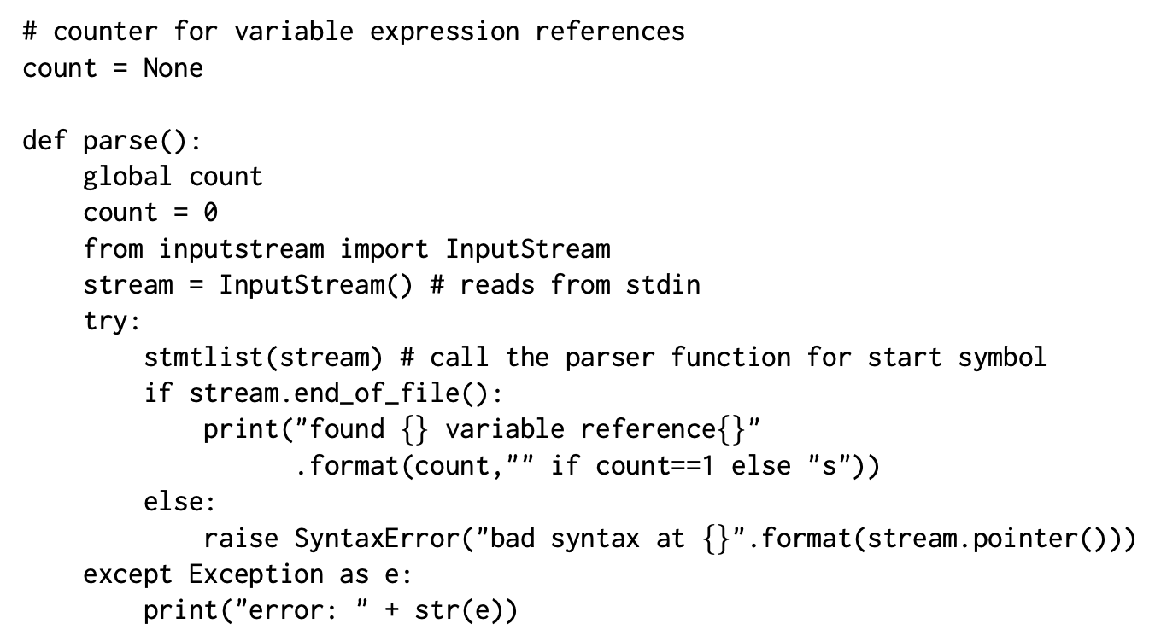
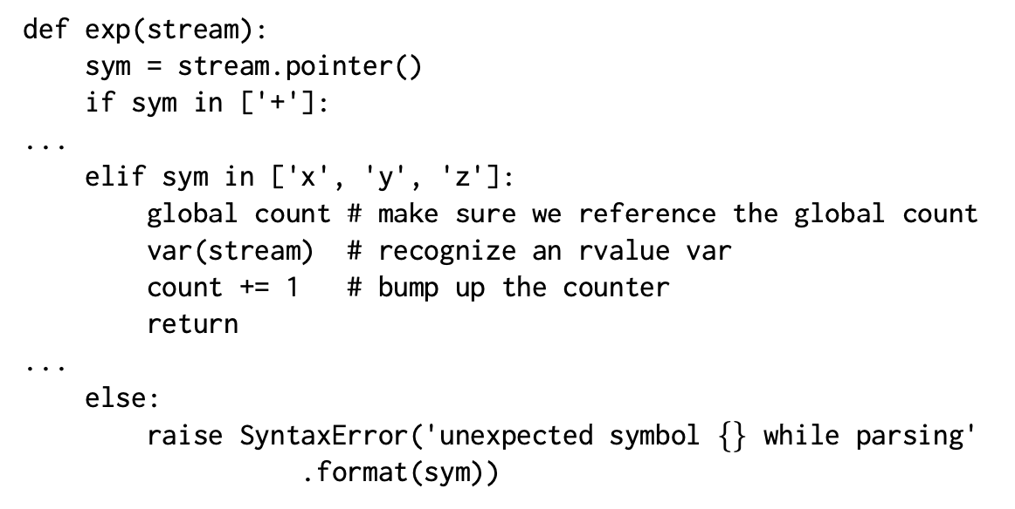
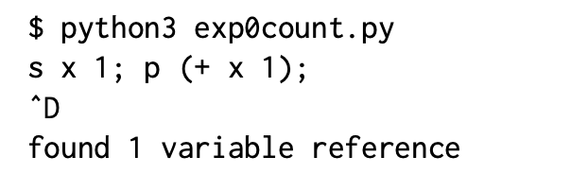
Extended Parser
Running the Processor

Slide 34
Class Exercise
Consider the grammar M : N M | r N : p | q
Identify the terminal/non-terminal symbols. Identify the start symbol
State three strings/sentences that are part of the language.
Compute the lookahead sets for the grammar rules.

Slide 35
Assignments
Read Chapter 2
Class Exercise 1 -- see BrightSpace

