Slide 1
Function Calls in Real and Virtual Machines
Function calls in real and virtual machines tend to be more complicated than interpreting function calls in high-level languages due to the fact that there is typically no notion of scope.
We begin by studying function calls in our bytecode machine and then look at function calls on the Intel chip.

Slide 2
Exp2Bytecode
In order to facilitate function calls on our bytecode machine we add the following:
A runtime stack and a ‘top of stack’ register (%tsx)
A ‘return value’ register (%rvx)
A set of instructions that manipulate the runtime stack
pushv -- push a value on the stack
popv -- pop a value off the stack
pushf -- push a stack frame
popf -- pop a stack frame
Instructions for calling and returning from functions
call -- jumps to function
return -- continues execution at the instruction after the call instruction

Slide 3
Virtual Machine Design
Program
Runtime Stack
Memory
Label Table
%tsx
%rvx

Slide 4
Exp2Bytecode
We also introduce the idea of indirect addressing in order to access stack locations
We let %tsx be the top of stack register, in order access the second to top element we write: %tsx[-1]
We can read the value, e.g.
store a %tsx[-1]
We can write a value to that location, e.g.
store %tsx[-1] 3

Slide 5
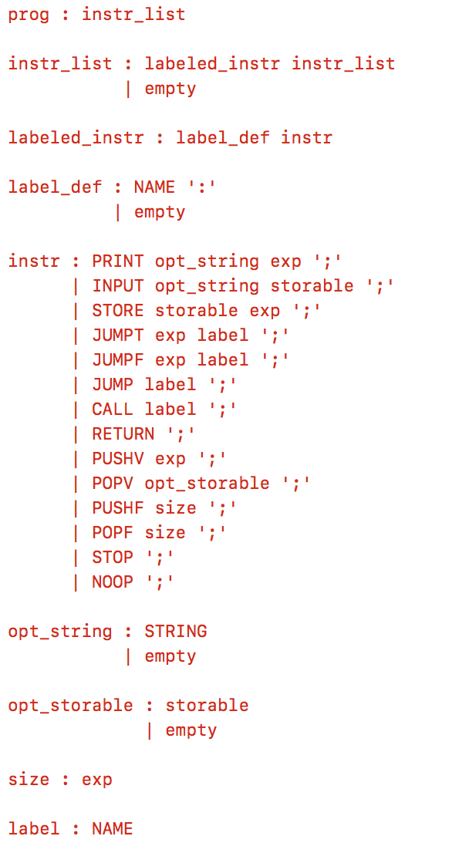
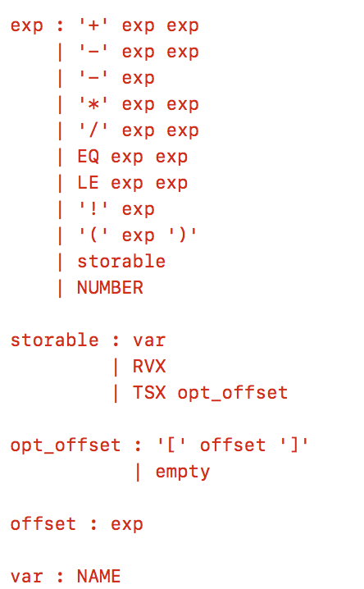
Exp2Bytecode
exp2bytecode_gram.py

Slide 6
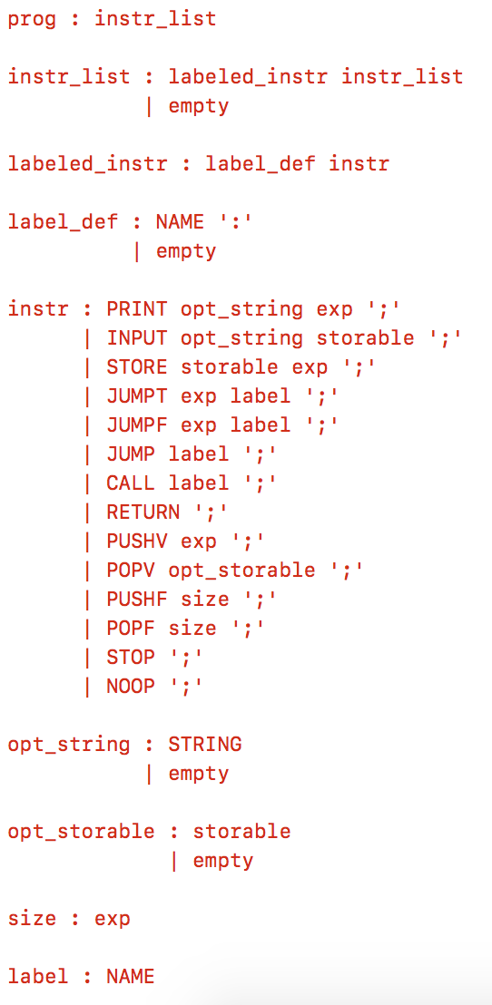
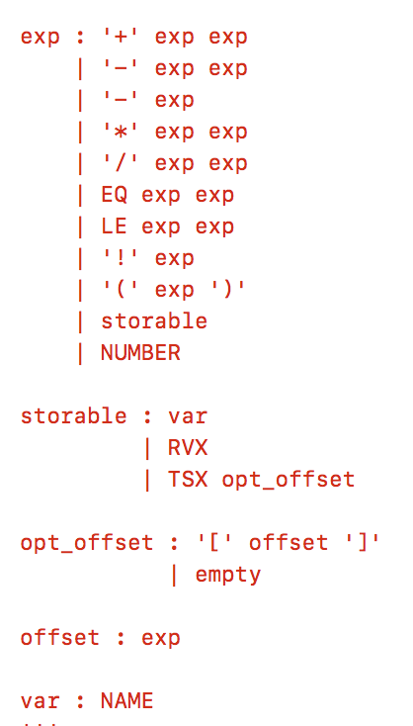
Exp2Bytecode – Abstract Machine
Exp2bytecode introduces ‘storable’ in order to deal with different classes of memory.

Slide 7
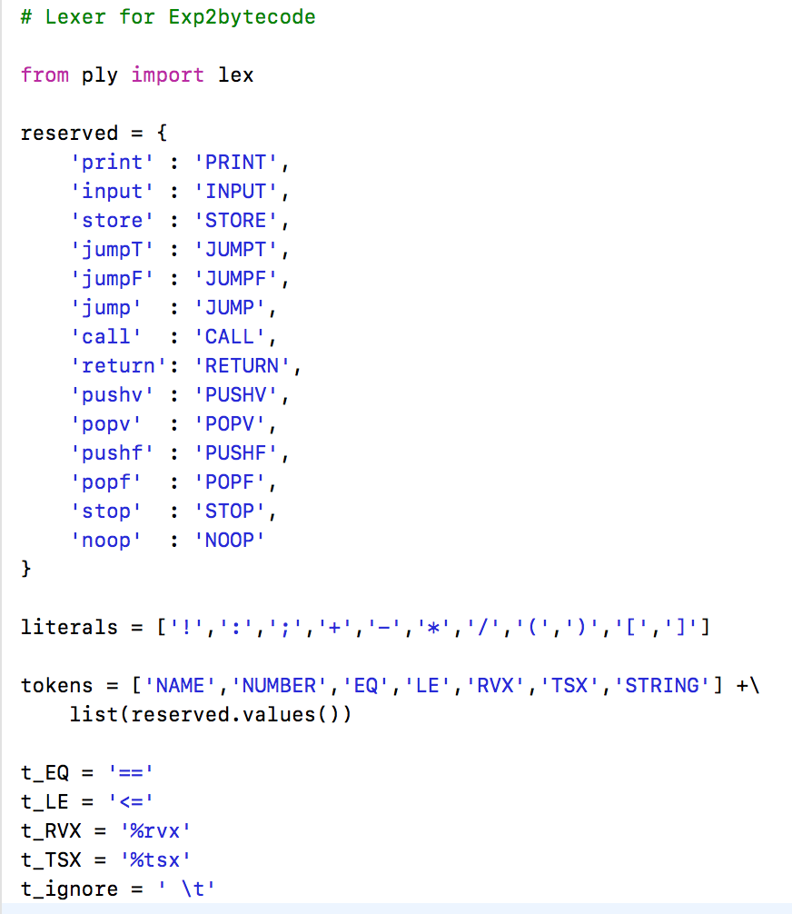
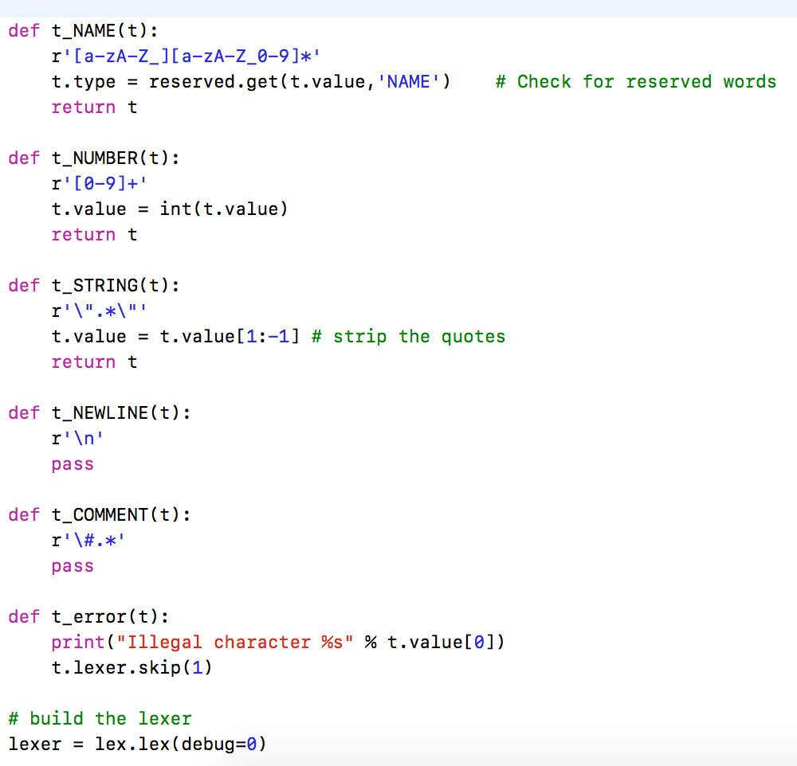
Exp2Bytecode
exp2bytecode_lex.py

Slide 8
Calling Convention
In order to execute function calls the calling function and the called function have to agree upon how arguments are passed and return values are returned -- this is called the calling convention.
Our calling convention is fairly straight forward:
Actual arguments are passed by pushing them on the stack in reverse order
Return values are returned in the %rvx register
Each function is responsible for maintaining the integrity of the runtime stack, that is, if it pushed something on the stack then it has to also remove it (this is not true for all calling conventions!)

Slide 9
Example Program
The first program we consider is written in Cuppa3 as follows:
declare add(a,b) {
return a+b
}
declare x = 3;
declare y = 2;
put add(x,y);

Slide 10
Example Program
declare add(a,b) {
return a+b
}
declare x = 3;
declare y = 2;
put add(x,y);
store x 3;
store y 2;
pushv y; # push second argumentonto stack
pushv x; # push first argumentonto stack
call add; # push current address onto stack and jump to function
popv; # pop first argument
popv; # pop second argument
print “The sum x+y is “ %rvx;
stop;
add:
store a %tsx[-1]; # get value of first argument
store b %tsx[-2]; # get value of second argument
store %rvx (+ a b); # store the sum in the ‘return value register’
return; # pop return address off stack and return to that address

Slide 11
Virtual Machine Design
Program
Runtime Stack
Memory
store x 3;
store y 2;
pushv y;
pushv x;
call add;
popv;
popv;
print “The sum x+y is “ %rvx;
stop;
add:
store a %tsx[-1];
store b %tsx[-2];
store %rvx (+ a b);
return;
Label Table
add  [___]
%tsx
%rvx

Slide 12
Virtual Machine Design
Program
Runtime Stack
Memory
x → 3
store x 3;
store y 2;
pushv y;
pushv x;
call add;
popv;
popv;
print “The sum x+y is “ %rvx;
stop;
add:
store a %tsx[-1];
store b %tsx[-2];
store %rvx (+ a b);
return;
`
Label Table
add  [___]
%tsx
%rvx

Slide 13
Virtual Machine Design
Program
Runtime Stack
Memory
x → 3
store x 3;
store y 2;
pushv y;
pushv x;
call add;
popv;
popv;
print “The sum x+y is “ %rvx;
stop;
add:
store a %tsx[-1];
store b %tsx[-2];
store %rvx (+ a b);
return;
y → 2
`
Label Table
add  [___]
%tsx
%rvx

Slide 14
Virtual Machine Design
Program
Runtime Stack
Memory
2
x → 3
store x 3;
store y 2;
pushv y;
pushv x;
call add;
popv;
popv;
print “The sum x+y is “ %rvx;
stop;
add:
store a %tsx[-1];
store b %tsx[-2];
store %rvx (+ a b);
return;
y → 2
`
Label Table
add  [___]
%tsx
%rvx

Slide 15
Virtual Machine Design
Program
Runtime Stack
Memory
2
x → 3
store x 3;
store y 2;
pushv y;
pushv x;
call add;
popv;
popv;
print “The sum x+y is “ %rvx;
stop;
add:
store a %tsx[-1];
store b %tsx[-2];
store %rvx (+ a b);
return;
y → 2
3
`
Label Table
add  [___]
%tsx
%rvx

Slide 16
Virtual Machine Design
Program
Runtime Stack
Memory
2
x → 3
store x 3;
store y 2;
pushv y;
pushv x;
call add;
popv;
popv;
print “The sum x+y is “ %rvx;
stop;
add:
store a %tsx[-1];
store b %tsx[-2];
store %rvx (+ a b);
return;
y → 2
3
`
Label Table
add  [___]
%tsx
%rvx

Slide 17
Virtual Machine Design
Program
Runtime Stack
Memory
2
x → 3
store x 3;
store y 2;
pushv y;
pushv x;
call add;
popv;
popv;
print “The sum x+y is “ %rvx;
stop;
add:
store a %tsx[-1];
store b %tsx[-2];
store %rvx (+ a b);
return;
y → 2
a → 3
3
Label Table
add  [___]
`
%tsx
%rvx

Slide 18
Virtual Machine Design
Program
Runtime Stack
Memory
2
x → 3
store x 3;
store y 2;
pushv y;
pushv x;
call add;
popv;
popv;
print “The sum x+y is “ %rvx;
stop;
add:
store a %tsx[-1];
store b %tsx[-2];
store %rvx (+ a b);
return;
y → 2
a → 3
3
b → 2
Label Table
add  [___]
`
%tsx
%rvx

Slide 19
Virtual Machine Design
Program
Runtime Stack
Memory
2
x → 3
store x 3;
store y 2;
pushv y;
pushv x;
call add;
popv;
popv;
print “The sum x+y is “ %rvx;
stop;
add:
store a %tsx[-1];
store b %tsx[-2];
store %rvx (+ a b);
return;
y → 2
a → 3
3
b → 2
Label Table
add  [___]
`
%tsx
%rvx
5

Slide 20
Virtual Machine Design
Program
Runtime Stack
Memory
2
x → 3
store x 3;
store y 2;
pushv y;
pushv x;
call add;
popv;
popv;
print “The sum x+y is “ %rvx;
stop;
add:
store a %tsx[-1];
store b %tsx[-2];
store %rvx (+ a b);
return;
y → 2
a → 3
3
b → 2
Label Table
add  [___]
%tsx
%rvx
`
5

Slide 21
Virtual Machine Design
Program
Runtime Stack
Memory
2
x → 3
store x 3;
store y 2;
pushv y;
pushv x;
call add;
popv;
popv;
print “The sum x+y is “ %rvx;
stop;
add:
store a %tsx[-1];
store b %tsx[-2];
store %rvx (+ a b);
return;
y → 2
a → 3
3
b → 2
Label Table
add  [___]
%tsx
%rvx
`
5

Slide 22
Virtual Machine Design
Program
Runtime Stack
Memory
2
x → 3
store x 3;
store y 2;
pushv y;
pushv x;
call add;
popv;
popv;
print “The sum x+y is “ %rvx;
stop;
add:
store a %tsx[-1];
store b %tsx[-2];
store %rvx (+ a b);
return;
y → 2
a → 3
b → 2
`
Label Table
add  [___]
%tsx
%rvx
5

Slide 23
Virtual Machine Design
Program
Runtime Stack
Memory
x → 3
store x 3;
store y 2;
pushv y;
pushv x;
call add;
popv;
popv;
print “The sum x+y is “ %rvx;
stop;
add:
store a %tsx[-1];
store b %tsx[-2];
store %rvx (+ a b);
return;
y → 2
a → 3
b → 2
Label Table
`
add  [___]
%tsx
%rvx
5

Slide 24
Virtual Machine Design
The sum of x+y is 5
Program
Runtime Stack
Memory
x → 3
store x 3;
store y 2;
pushv y;
pushv x;
call add;
popv;
popv;
print “The sum x+y is “ %rvx;
stop;
add:
store a %tsx[-1];
store b %tsx[-2];
store %rvx (+ a b);
return;
y → 2
a → 3
b → 2
Label Table
`
add  [___]
%tsx
%rvx
5

Slide 25
Virtual Machine Design
Program
Runtime Stack
Memory
x → 3
store x 3;
store y 2;
pushv y;
pushv x;
call add;
popv;
popv;
print “The sum x+y is “ %rvx;
stop;
add:
store a %tsx[-1];
store b %tsx[-2];
store %rvx (+ a b);
return;
y → 2
a → 3
b → 2
Label Table
add  [___]
`
%tsx
%rvx
5

Slide 26
Virtual Machine Design
Program
Runtime Stack
Memory
x → 3
store x 3;
store y 2;
pushv y;
pushv x;
call add;
popv;
popv;
print “The sum x+y is “ %rvx;
stop;
add:
store a %tsx[-1];
store b %tsx[-2];
store %rvx (+ a b);
return;
y → 2
a → 3
b → 2
Label Table
add  [___]
%tsx
%rvx
5

Slide 27
Example Program
Here is another way to write the same program taking advantage of indirect addressing.
store x 3;
store y 2;
pushv y;
pushv x;
call add;
popv;
popv;
print “The sum x+y is “ %rvx;
stop;
add:
store %rvx (+ %tsx[-1] %tsx[-2]);
return;
declare add(a,b) {
return a+b
}
declare x = 3;
declare y = 2;
put add(x,y);

Slide 28
Recursive Program
Recursive programs are tricky because function local variables, if one is not careful, are overwritten by recursive calls to the same function.
Solution: store function local variables in a stack frame with one stack frame for each function invocation.

Slide 29
Recursive Programs
As an example we will study the bytecode that implements the following Cuppa3 program:
// print the sequence 0 1 2
declare seq(x) {
if (1<=x)
seq(x-1)
put(x)
}
seq(2)

Slide 30
Recursive Programs
Our first attempt:
Note: this program does NOT work because x is a global variable which will get overwritten by each invocation of seq.
// print the sequence 0 1 2
declare seq(x) {
if (1<=x)
seq(x-1)
put(x)
}
seq(2)
# print the sequence 0 1 2
pushv 2;
call seq;
popv;
stop;
seq:
store x %tsx[-1];
jumpF x L1;
pushv (- x 1);
call seq;
popv;
L1:
print x;
return;

Slide 31
Recursive Programs
We rewrite the program using stack frames to store function local variables.
Note: This program now works, local variables have their own location on the stack per function invocation.
# print the sequence 0 1 2
pushv 2;
call seq;
popv;
stop;
seq:
pushf 1; # push a frame of size 1 - variable x
store %tsx[0] %tsx[-2]; # initialize x with the actual argument
jumpF %tsx[0] L1; # test x
pushv (- %tsx[0] 1);
call seq;
popv;
L1:
print %tsx[0];
popf 1; # remove the frame from the stack
return;
// print the sequence 0 1 2
declare seq(x) {
if (1<=x)
seq(x-1)
put(x)
}
seq(2)

Slide 32
Virtual Machine Design
Program
Runtime Stack
Memory
pushv 2;
call seq;
popv;
stop;
seq:
pushf 1;
store %tsx[0] %tsx[-2];
jumpF %tsx[0] L1;
pushv (- %tsx[0] 1);
call seq;
popv;
L1:
print %tsx[0];
popf 1;
return;
Label Table
seq  [___]
L1  [___]
%tsx
%rvx

Slide 33
Virtual Machine Design
Program
Runtime Stack
Memory
2
pushv 2;
call seq;
popv;
stop;
seq:
pushf 1;
store %tsx[0] %tsx[-2];
jumpF %tsx[0] L1;
pushv (- %tsx[0] 1);
call seq;
popv;
L1:
print %tsx[0];
popf 1;
return;
Label Table
seq  [___]
L1  [___]
%tsx
%rvx

Slide 34
Virtual Machine Design
Program
Runtime Stack
Memory
2
pushv 2;
call seq;
popv;
stop;
seq:
pushf 1;
store %tsx[0] %tsx[-2];
jumpF %tsx[0] L1;
pushv (- %tsx[0] 1);
call seq;
popv;
L1:
print %tsx[0];
popf 1;
return;
Label Table
seq  [___]
L1  [___]
%tsx
%rvx

Slide 35
Virtual Machine Design
Program
Runtime Stack
Memory
2
pushv 2;
call seq;
popv;
stop;
seq:
pushf 1;
store %tsx[0] %tsx[-2];
jumpF %tsx[0] L1;
pushv (- %tsx[0] 1);
call seq;
popv;
L1:
print %tsx[0];
popf 1;
return;
Label Table
seq  [___]
L1  [___]
%tsx
%rvx

Slide 36
Virtual Machine Design
Program
Runtime Stack
Memory
2
pushv 2;
call seq;
popv;
stop;
seq:
pushf 1;
store %tsx[0] %tsx[-2];
jumpF %tsx[0] L1;
pushv (- %tsx[0] 1);
call seq;
popv;
L1:
print %tsx[0];
popf 1;
return;
2
Label Table
seq  [___]
L1  [___]
%tsx
%rvx

Slide 37
Virtual Machine Design
Program
Runtime Stack
Memory
2
pushv 2;
call seq;
popv;
stop;
seq:
pushf 1;
store %tsx[0] %tsx[-2];
jumpF %tsx[0] L1;
pushv (- %tsx[0] 1);
call seq;
popv;
L1:
print %tsx[0];
popf 1;
return;
2
Label Table
seq  [___]
L1  [___]
%tsx
%rvx

Slide 38
Virtual Machine Design
Program
Runtime Stack
Memory
2
pushv 2;
call seq;
popv;
stop;
seq:
pushf 1;
store %tsx[0] %tsx[-2];
jumpF %tsx[0] L1;
pushv (- %tsx[0] 1);
call seq;
popv;
L1:
print %tsx[0];
popf 1;
return;
2
1
Label Table
seq  [___]
L1  [___]
%tsx
%rvx

Slide 39
Virtual Machine Design
Program
Runtime Stack
Memory
2
pushv 2;
call seq;
popv;
stop;
seq:
pushf 1;
store %tsx[0] %tsx[-2];
jumpF %tsx[0] L1;
pushv (- %tsx[0] 1);
call seq;
popv;
L1:
print %tsx[0];
popf 1;
return;
2
1
Label Table
seq  [___]
L1  [___]
%tsx
%rvx

Slide 40
Virtual Machine Design
Program
Runtime Stack
Memory
2
pushv 2;
call seq;
popv;
stop;
seq:
pushf 1;
store %tsx[0] %tsx[-2];
jumpF %tsx[0] L1;
pushv (- %tsx[0] 1);
call seq;
popv;
L1:
print %tsx[0];
popf 1;
return;
2
1
Label Table
seq  [___]
L1  [___]
%tsx
%rvx

Slide 41
Virtual Machine Design
Program
Runtime Stack
Memory
2
pushv 2;
call seq;
popv;
stop;
seq:
pushf 1;
store %tsx[0] %tsx[-2];
jumpF %tsx[0] L1;
pushv (- %tsx[0] 1);
call seq;
popv;
L1:
print %tsx[0];
popf 1;
return;
2
1
1
Label Table
seq  [___]
L1  [___]
%tsx
%rvx

Slide 42
Virtual Machine Design
Program
Runtime Stack
Memory
2
pushv 2;
call seq;
popv;
stop;
seq:
pushf 1;
store %tsx[0] %tsx[-2];
jumpF %tsx[0] L1;
pushv (- %tsx[0] 1);
call seq;
popv;
L1:
print %tsx[0];
popf 1;
return;
2
1
1
Label Table
seq  [___]
L1  [___]
%tsx
%rvx

Slide 43
Virtual Machine Design
Program
Runtime Stack
Memory
2
pushv 2;
call seq;
popv;
stop;
seq:
pushf 1;
store %tsx[0] %tsx[-2];
jumpF %tsx[0] L1;
pushv (- %tsx[0] 1);
call seq;
popv;
L1:
print %tsx[0];
popf 1;
return;
2
1
1
Label Table
0
seq  [___]
L1  [___]
%tsx
%rvx

Slide 44
Virtual Machine Design
Program
Runtime Stack
Memory
2
pushv 2;
call seq;
popv;
stop;
seq:
pushf 1;
store %tsx[0] %tsx[-2];
jumpF %tsx[0] L1;
pushv (- %tsx[0] 1);
call seq;
popv;
L1:
print %tsx[0];
popf 1;
return;
2
1
1
Label Table
0
seq  [___]
L1  [___]
%tsx
%rvx

Slide 45
Virtual Machine Design
Program
Runtime Stack
Memory
2
pushv 2;
call seq;
popv;
stop;
seq:
pushf 1;
store %tsx[0] %tsx[-2];
jumpF %tsx[0] L1;
pushv (- %tsx[0] 1);
call seq;
popv;
L1:
print %tsx[0];
popf 1;
return;
2
1
1
Label Table
0
seq  [___]
L1  [___]
%tsx
%rvx

Slide 46
Virtual Machine Design
Program
Runtime Stack
Memory
2
pushv 2;
call seq;
popv;
stop;
seq:
pushf 1;
store %tsx[0] %tsx[-2];
jumpF %tsx[0] L1;
pushv (- %tsx[0] 1);
call seq;
popv;
L1:
print %tsx[0];
popf 1;
return;
2
1
1
Label Table
0
seq  [___]
L1  [___]
0
%tsx
%rvx

Slide 47
Virtual Machine Design
Program
Runtime Stack
Memory
2
pushv 2;
call seq;
popv;
stop;
seq:
pushf 1;
store %tsx[0] %tsx[-2];
jumpF %tsx[0] L1;
pushv (- %tsx[0] 1);
call seq;
popv;
L1:
print %tsx[0];
popf 1;
return;
2
1
1
Label Table
0
seq  [___]
L1  [___]
0
%tsx
%rvx

Slide 48
Virtual Machine Design
0
Program
Runtime Stack
Memory
2
pushv 2;
call seq;
popv;
stop;
seq:
pushf 1;
store %tsx[0] %tsx[-2];
jumpF %tsx[0] L1;
pushv (- %tsx[0] 1);
call seq;
popv;
L1:
print %tsx[0];
popf 1;
return;
2
1
1
Label Table
0
seq  [___]
L1  [___]
0
%tsx
%rvx

Slide 49
Virtual Machine Design
0
Program
Runtime Stack
Memory
2
pushv 2;
call seq;
popv;
stop;
seq:
pushf 1;
store %tsx[0] %tsx[-2];
jumpF %tsx[0] L1;
pushv (- %tsx[0] 1);
call seq;
popv;
L1:
print %tsx[0];
popf 1;
return;
2
1
1
Label Table
0
seq  [___]
L1  [___]
%tsx
%rvx

Slide 50
Virtual Machine Design
0
Program
Runtime Stack
Memory
2
pushv 2;
call seq;
popv;
stop;
seq:
pushf 1;
store %tsx[0] %tsx[-2];
jumpF %tsx[0] L1;
pushv (- %tsx[0] 1);
call seq;
popv;
L1:
print %tsx[0];
popf 1;
return;
2
1
1
Label Table
0
seq  [___]
L1  [___]
%tsx
%rvx

Slide 51
Virtual Machine Design
0
Program
Runtime Stack
Memory
2
pushv 2;
call seq;
popv;
stop;
seq:
pushf 1;
store %tsx[0] %tsx[-2];
jumpF %tsx[0] L1;
pushv (- %tsx[0] 1);
call seq;
popv;
L1:
print %tsx[0];
popf 1;
return;
2
1
1
Label Table
0
seq  [___]
L1  [___]
%tsx
%rvx

Slide 52
Virtual Machine Design
0
Program
Runtime Stack
Memory
2
pushv 2;
call seq;
popv;
stop;
seq:
pushf 1;
store %tsx[0] %tsx[-2];
jumpF %tsx[0] L1;
pushv (- %tsx[0] 1);
call seq;
popv;
L1:
print %tsx[0];
popf 1;
return;
2
1
1
Label Table
seq  [___]
L1  [___]
%tsx
%rvx

Slide 53
Virtual Machine Design
0
1
Program
Runtime Stack
Memory
2
pushv 2;
call seq;
popv;
stop;
seq:
pushf 1;
store %tsx[0] %tsx[-2];
jumpF %tsx[0] L1;
pushv (- %tsx[0] 1);
call seq;
popv;
L1:
print %tsx[0];
popf 1;
return;
2
1
1
Label Table
seq  [___]
L1  [___]
%tsx
%rvx

Slide 54
Virtual Machine Design
0
1
Program
Runtime Stack
Memory
2
pushv 2;
call seq;
popv;
stop;
seq:
pushf 1;
store %tsx[0] %tsx[-2];
jumpF %tsx[0] L1;
pushv (- %tsx[0] 1);
call seq;
popv;
L1:
print %tsx[0];
popf 1;
return;
2
1
Label Table
seq  [___]
L1  [___]
%tsx
%rvx

Slide 55
Virtual Machine Design
0
1
Program
Runtime Stack
Memory
2
pushv 2;
call seq;
popv;
stop;
seq:
pushf 1;
store %tsx[0] %tsx[-2];
jumpF %tsx[0] L1;
pushv (- %tsx[0] 1);
call seq;
popv;
L1:
print %tsx[0];
popf 1;
return;
2
1
Label Table
seq  [___]
L1  [___]
%tsx
%rvx

Slide 56
Virtual Machine Design
0
1
Program
Runtime Stack
Memory
2
pushv 2;
call seq;
popv;
stop;
seq:
pushf 1;
store %tsx[0] %tsx[-2];
jumpF %tsx[0] L1;
pushv (- %tsx[0] 1);
call seq;
popv;
L1:
print %tsx[0];
popf 1;
return;
2
1
Label Table
seq  [___]
L1  [___]
%tsx
%rvx

Slide 57
Virtual Machine Design
0
1
Program
Runtime Stack
Memory
2
pushv 2;
call seq;
popv;
stop;
seq:
pushf 1;
store %tsx[0] %tsx[-2];
jumpF %tsx[0] L1;
pushv (- %tsx[0] 1);
call seq;
popv;
L1:
print %tsx[0];
popf 1;
return;
2
Label Table
seq  [___]
L1  [___]
%tsx
%rvx

Slide 58
Virtual Machine Design
0
1
2
Program
Runtime Stack
Memory
2
pushv 2;
call seq;
popv;
stop;
seq:
pushf 1;
store %tsx[0] %tsx[-2];
jumpF %tsx[0] L1;
pushv (- %tsx[0] 1);
call seq;
popv;
L1:
print %tsx[0];
popf 1;
return;
2
Label Table
seq  [___]
L1  [___]
%tsx
%rvx

Slide 59
Virtual Machine Design
0
1
2
Program
Runtime Stack
Memory
2
pushv 2;
call seq;
popv;
stop;
seq:
pushf 1;
store %tsx[0] %tsx[-2];
jumpF %tsx[0] L1;
pushv (- %tsx[0] 1);
call seq;
popv;
L1:
print %tsx[0];
popf 1;
return;
Label Table
seq  [___]
L1  [___]
%tsx
%rvx

Slide 60
Virtual Machine Design
0
1
2
Program
Runtime Stack
Memory
2
pushv 2;
call seq;
popv;
stop;
seq:
pushf 1;
store %tsx[0] %tsx[-2];
jumpF %tsx[0] L1;
pushv (- %tsx[0] 1);
call seq;
popv;
L1:
print %tsx[0];
popf 1;
return;
Label Table
seq  [___]
L1  [___]
%tsx
%rvx

Slide 61
Virtual Machine Design
0
1
2
Program
Runtime Stack
Memory
2
pushv 2;
call seq;
popv;
stop;
seq:
pushf 1;
store %tsx[0] %tsx[-2];
jumpF %tsx[0] L1;
pushv (- %tsx[0] 1);
call seq;
popv;
L1:
print %tsx[0];
popf 1;
return;
Label Table
seq  [___]
L1  [___]
%tsx
%rvx

Slide 62
Virtual Machine Design
0
1
2
Program
Runtime Stack
Memory
pushv 2;
call seq;
popv;
stop;
seq:
pushf 1;
store %tsx[0] %tsx[-2];
jumpF %tsx[0] L1;
pushv (- %tsx[0] 1);
call seq;
popv;
L1:
print %tsx[0];
popf 1;
return;
Label Table
seq  [___]
L1  [___]
%tsx
%rvx

Slide 63
Virtual Machine Design
0
1
2
Program
Runtime Stack
Memory
pushv 2;
call seq;
popv;
stop;
seq:
pushf 1;
store %tsx[0] %tsx[-2];
jumpF %tsx[0] L1;
pushv (- %tsx[0] 1);
call seq;
popv;
L1:
print %tsx[0];
popf 1;
return;
Label Table
seq  [___]
L1  [___]
%tsx
%rvx

Slide 64
Virtual Machine Design
0
1
2
Program
Runtime Stack
Memory
pushv 2;
call seq;
popv;
stop;
seq:
pushf 1;
store %tsx[0] %tsx[-2];
jumpF %tsx[0] L1;
pushv (- %tsx[0] 1);
call seq;
popv;
L1:
print %tsx[0];
popf 1;
return;
Label Table
seq  [___]
L1  [___]
%tsx
%rvx

Slide 65
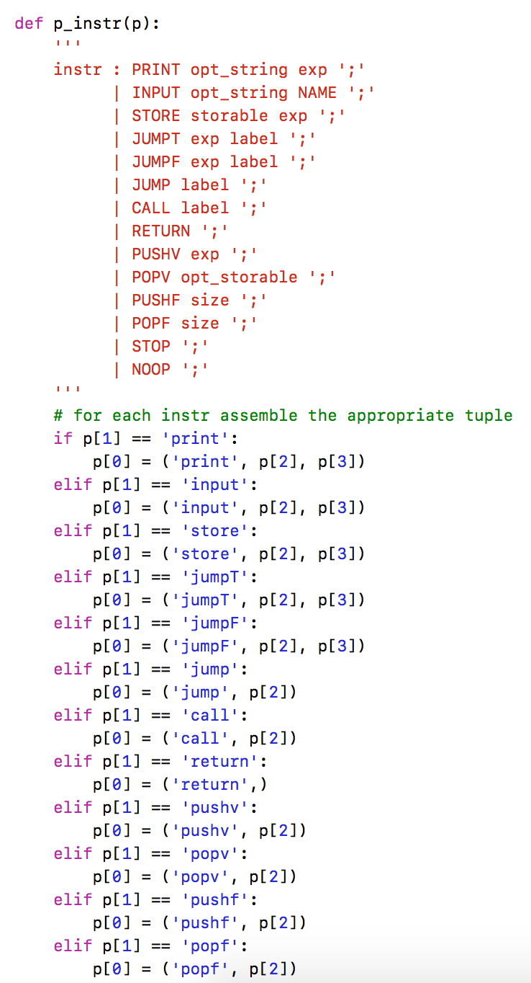
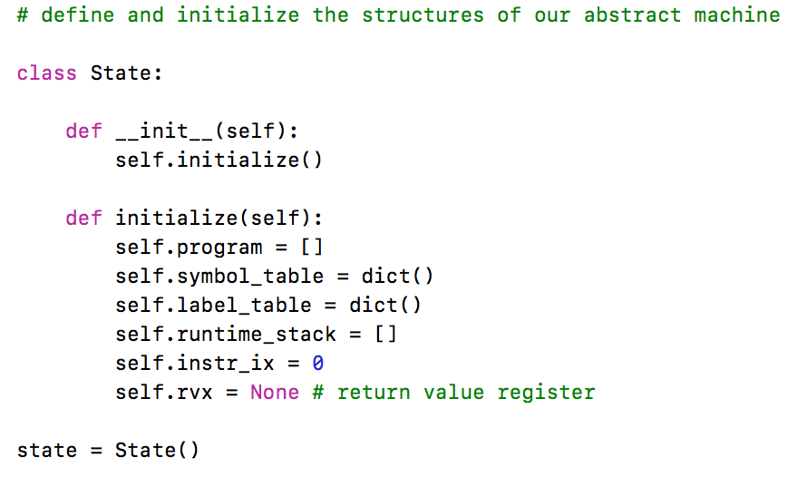
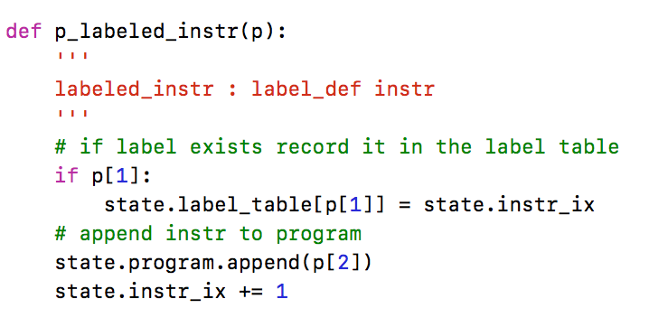
Exp2Bytecode – Abstract Machine
…

Slide 66
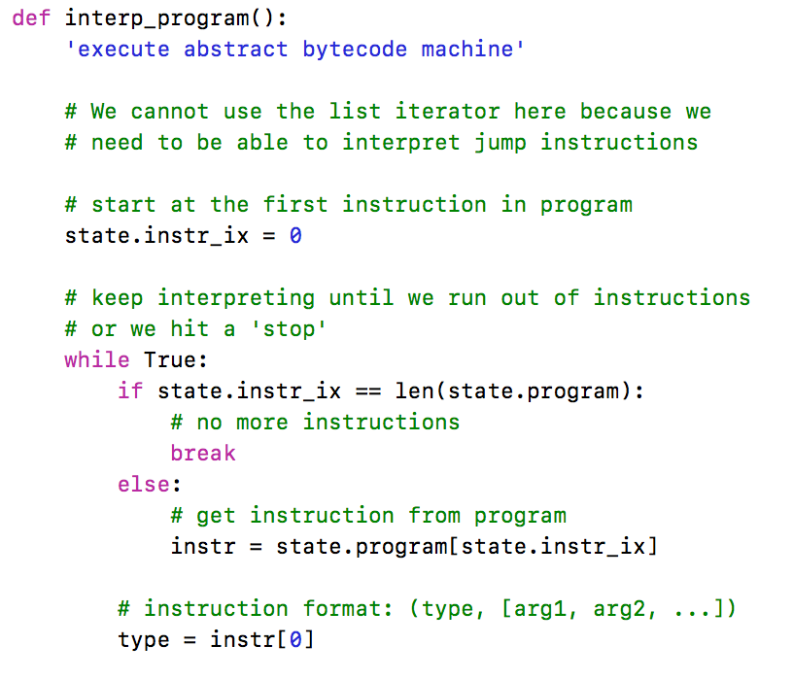
Exp2Bytecode – Abstract Machine
As in exp1bytecode – the interpreter is just one big loop that interprets the instructions on the program list.
Interpret instructions here…

Slide 67
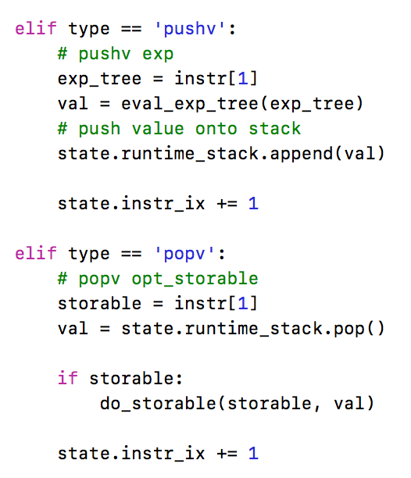
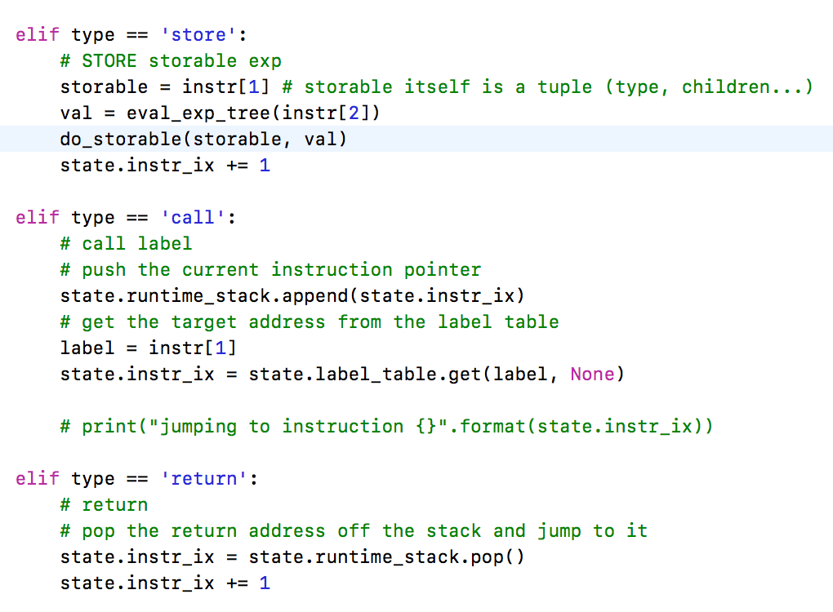
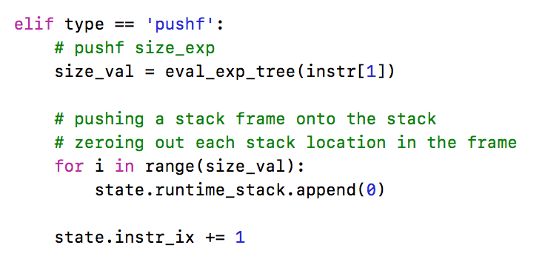
Exp2Bytecode – Abstract Machine

Slide 68
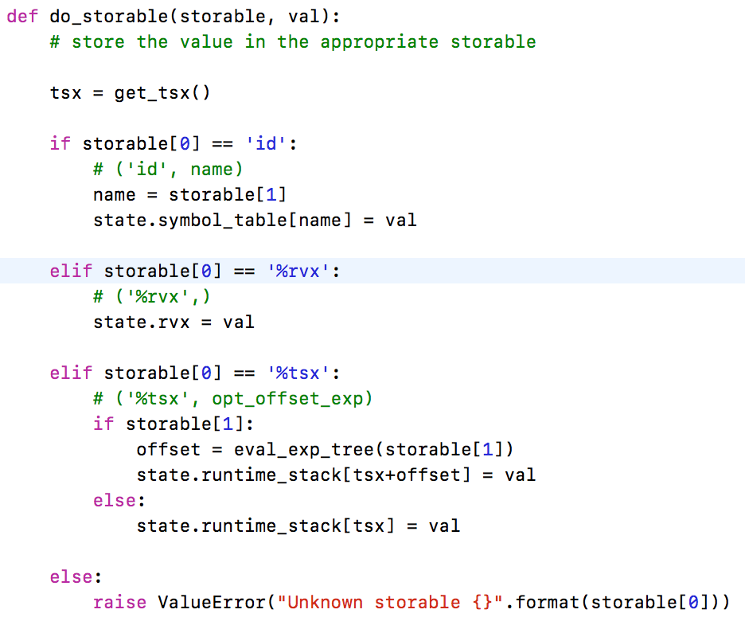
Exp2Bytecode – Abstract Machine

Slide 69
Function Calls on Real Machines
Function calls on real machines work similar to the function calls on our bytecode virtual machine.
The main difference is the level of abstraction of the instruction set.
We show examples of programs compiled on an Intel Mac.

Slide 70
Function Calls on Real Machines
Functions on real machines are broken into three parts:
Function prologue - set up the stack environment in which the function executes
Function code - the code in the body of the function
Function epilogue - clean up the stack.
On the Intel chip the function prologue looks something like this:
pushl %ebp // push the basepointer/framepointer on the stack
movl %esp, %ebp // make the current stack pointer the current frame pointer
subl $n, %esp // make a new frame of size n

Slide 71
Function Calls on Real Machines
The function epilogue usually looks like this:
movl %ebp, %esp
popl %ebp
ret
The x86 processor contains a built-in instruction which performs part of the epilogue. The following code is equivalent to the above code:
leave
ret

Slide 72
The Add Program
call.s
Compiling a C program on an Intel Mac.
.text
.globl _add
_add:
pushl %ebp
movl %esp, %ebp
subl $8, %esp
movl 12(%ebp), %eax
addl 8(%ebp), %eax
leave
ret
.globl _main
_main:
pushl %ebp
movl %esp, %ebp
subl $40, %esp
movl $2, 4(%esp)
movl $3, (%esp)
call _add
movl %eax, -12(%ebp)
leave
ret
.subsections_via_symbols
call.c
int add(int a, int b) {
return a+b;
}
int main() {
int x = add(3,2);
}
gcc -S -fno-asynchronous-unwind-tables -fno-dwarf2-cfi-asm call.c

Slide 73
The Add Program
.text
.globl _add
_add:
pushl %ebp // save base ptr onto stack
movl %esp, %ebp // move stack ptr to base ptr
subl $8, %esp // make a new frame on stack
movl 12(%ebp), %eax // get argument a at offset 12 from base ptr, store in register %eax
addl 8(%ebp), %eax // get argument b at offset 8 from base pts, add to %eax
leave // remove frame
ret // return from call
.globl _main
_main:
pushl %ebp // save base ptr onto stack
movl %esp, %ebp // move stack ptr to base ptr
subl $40, %esp // make a new frame on stack
movl $2, 4(%esp) // move constant 2 to TOS offset 4
movl $3, (%esp) // move constant 3 to TOS
call _add // call function add
movl %eax, -12(%ebp) // retrieve result from eax register and store it at the ‘location’ for x.
leave // clean up the stack
ret // return to OS
.subsections_via_symbols
See http://en.wikipedia.org/wiki/Function_prologue and http://en.wikipedia.org/wiki/X86

Slide 74
The Recursive Seq Program
seq.s
.text
.globl _seq
_seq:
pushl %ebp
movl %esp, %ebp
subl $24, %esp
cmpl $0, 8(%ebp)
jle L2
movl 8(%ebp), %eax
decl %eax
movl %eax, (%esp)
call _seq
L2:
movl 8(%ebp), %eax
movl %eax, (%esp)
call L_print$stub
leave
ret
.globl _main
_main:
pushl %ebp
movl %esp, %ebp
subl $24, %esp
movl $2, (%esp)
call _seq
leave
ret
seq.c
void seq(int x) {
if (1<=x)
seq(x-1);
print(x);
}
int main() {
seq(2);
}
gcc -S
We have more to say about this when we look at compiling programs for actual machines.

