Slide 1
Type system implementation
We extend our Cuppa3 language to Cuppa4 with the addition of a type system with four types:
int
float
string
void
We also assume that int is a subtype of float and float is a subtype of string, that is, a compiler/interpreter is allowed to insert widening conversions and should flag errors for narrowing conversions, int < float < string

Slide 2
Type system implementation
We want to be able to write programs such as these:
float pow(float b, int p) {
if (p == 0)
return 1.0;
else
return b*pow(b,p-1);
}
float v;
get v;
int p;
get p;
float result = pow(v,p);
put v + ” to the power of “ + p +” is “+result;
int inc(int x) return x+1;
int y = inc(3);
put "the result is” + y;

Slide 3
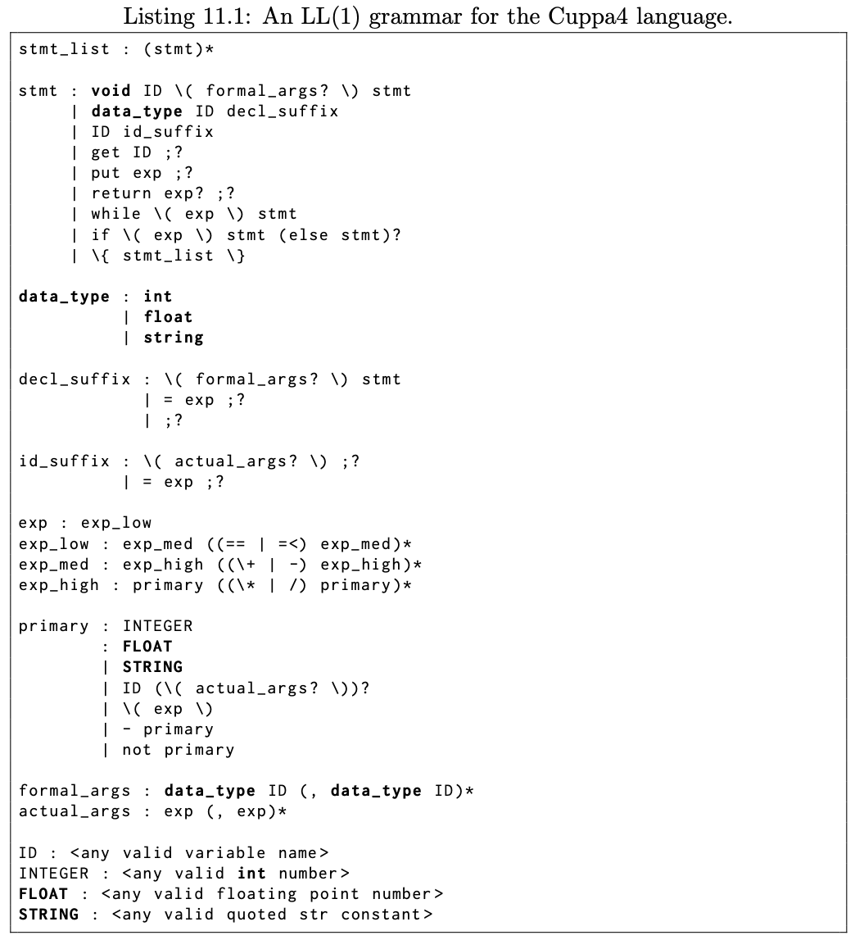
Type system implementation: Syntax
New additions to the language are shown in bold face.

Slide 4
Type system implementation: Semantics
At the semantic level we annotate all ASTs with type information
We use type propagation to check that expressions/statements are properly typed.
Type propagation is the systematic tagging of an AST from leafs up with type information.

Slide 5
Type system implementation: Semantics
Consider the simple example:
int y;
int x;
y = 3;
x = y + 1;
stmtlist
stmt
=
stmt
y
3
=
x
+
y
1

Slide 6
Type system implementation: Semantics
Consider the simple example:
int y;
int x;
y = 3;
x = y + 1;
stmtlist
stmt
=
stmt
y
3
=
x
+
{int}
y
1

Slide 7
Type system implementation: Semantics
Consider the simple example:
int y;
int x;
y = 3;
x = y + 1;
stmtlist
stmt
=
stmt
y
3
=
x
+
{int}
y
1
{int}

Slide 8
Type system implementation: Semantics
Consider the simple example:
int y;
int x;
y = 3;
x = y + 1;
stmtlist
stmt
=
stmt
y
3
=
x
+
{int}
{int}
y
1
{int}

Slide 9
Type system implementation: Semantics
Consider the simple example:
int y;
int x;
y = 3;
x = y + 1;
stmtlist
stmt
=
stmt
y
3
=

x
{int}
+
{int}
{int}
y
1
{int}

Slide 10
Type system implementation: Semantics
Consider the simple example:
int y;
int x;
y = 3;
x = y + 1;
stmtlist
stmt
=
stmt
y
{int}
3
=

x
{int}
+
{int}
{int}
y
1
{int}

Slide 11
Type system implementation: Semantics
Consider the simple example:
int y;
int x;
y = 3;
x = y + 1;
stmtlist
stmt
=

stmt
y
{int}
3
{int}
=

x
{int}
+
{int}
{int}
y
1
{int}

Slide 12
Type system implementation: Semantics
Consider this example which has a typecheck error:
float y;
int x;
y = 3.7;
x = y + 1;
stmtlist
stmt
=
stmt
y
3.7
=
x
+
y
1

Slide 13
Type system implementation: Semantics
Consider this example which has a typecheck error:
float y;
int x;
y = 3.7;
x = y + 1;
stmtlist
stmt
=
stmt
y
3.7
=
x
+
{float}
y
1

Slide 14
Type system implementation: Semantics
Consider this example which has a typecheck error:
float y;
int x;
y = 3.7;
x = y + 1;
stmtlist
stmt
=
stmt
y
3.7
=
Widening
conversion
x
+
{float}
y
1
{int → float}

Slide 15
Type system implementation: Semantics
Consider this example which has a typecheck error:
float y;
int x;
y = 3.7;
x = y + 1;
stmtlist
stmt
=
stmt
y
3.7
=
x
+
{float}
{float}
y
1
{int → float}

Slide 16
Type system implementation: Semantics
Consider this example which has a typecheck error:
float y;
int x;
y = 3.7;
x = y + 1;
stmtlist
stmt
=
stmt
y
3.7
=
❒
x
{int}
+
{float}
{float}
y
1
{int → float}

Slide 17
Type system implementation: Semantics
Consider this example which has a typecheck error:
float y;
int x;
y = 3.7;
x = y + 1;
stmtlist
stmt
=
stmt
{float}
y
3.7
=
❒
x
{int}
+
{float}
{float}
y
1
{int → float}

Slide 18
Type system implementation: Semantics
Consider this example which has a typecheck error:
float y;
int x;
y = 3.7;
x = y + 1;
stmtlist
stmt
=

stmt
{float}
y
3.7
{float}
=
❒
x
{int}
+
{float}
{float}
y
1
{int → float}

Slide 19
Type system implementation: Semantics
Here is an example with a function call:
int inc(int i) return i+1;
int x;
x = inc(1);
stmtlist
stmt
=
x
callexpr
inc
1

Slide 20
Type system implementation: Semantics
Here is an example with a function call:
int inc(int i) return i+1;
int x;
x = inc(1);
stmtlist
stmt
=
x
callexpr
{f:int→int}
inc
1
We have to track function symbols, both for their formal parameter types and return types.

Slide 21
Type system implementation: Semantics
Here is an example with a function call:
int inc(int i) return i+1;
int x;
x = inc(1);
stmtlist
stmt
=
x
callexpr
{f:int→int}
inc
1
{int}

Slide 22
Type system implementation: Semantics
Here is an example with a function call:
int inc(int i) return i+1;
int x;
x = inc(1);
stmtlist
stmt
=
x
callexpr
{int}
{f:int→int}
inc
1
{int}

Slide 23
Type system implementation: Semantics
Here is an example with a function call:
int inc(int i) return i+1;
int x;
x = inc(1);
stmtlist
stmt
=

{int}
x
callexpr
{int}
{f:int→int}
inc
1
{int}

Slide 24
Type system implementation: Semantics
Here is an example with a function call and a type error:
int inc(int i) return i+1;
int x;
x = inc(3.7);
stmtlist
stmt
=
x
callexpr
inc
3.7

Slide 25
Type system implementation: Semantics
Here is an example with a function call and a type error:
int inc(int i) return i+1;
int x;
x = inc(3.7);
stmtlist
stmt
=
x
callexpr
{f:int→int}
inc
3.7

Slide 26
Type system implementation: Semantics
Here is an example with a function call and a type error:
int inc(int i) return i+1;
int x;
x = inc(3.7);
stmtlist
stmt
=
x
callexpr
❒
{f:int→int}
inc
3.7
{float}

Slide 27
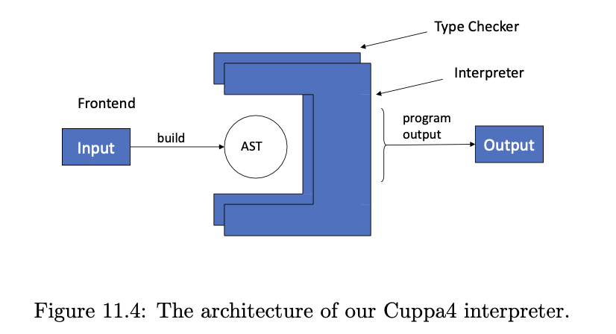
Type System Implementation
We will implement a static type checker

Slide 28
Frontend
The frontend is the Cuppa3 frontend with explicit type information.
The changes necessary are simple extensions to the Cuppa3 frontend.

Slide 29
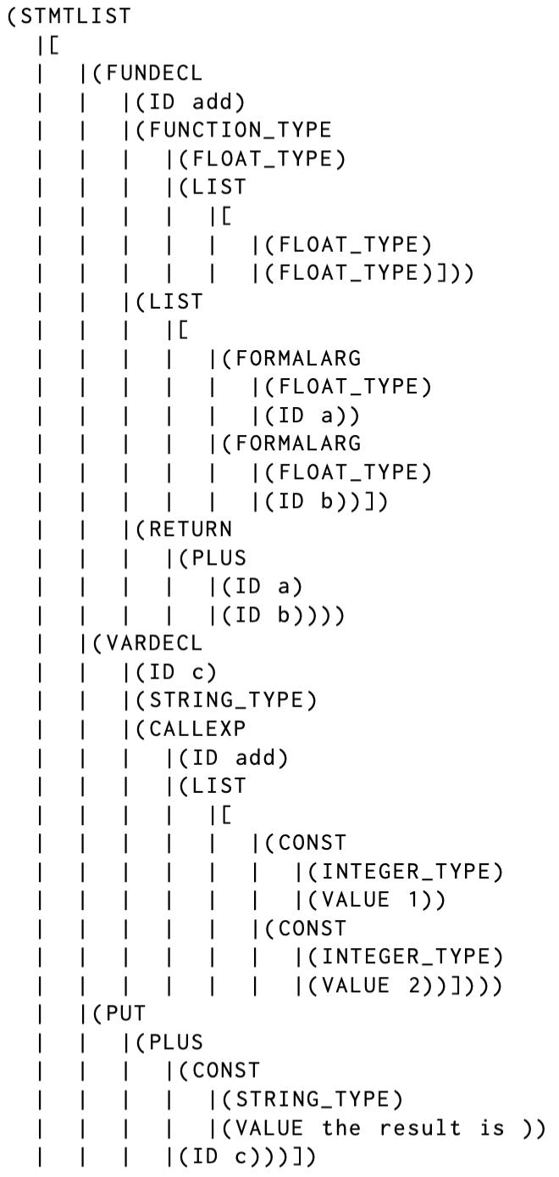
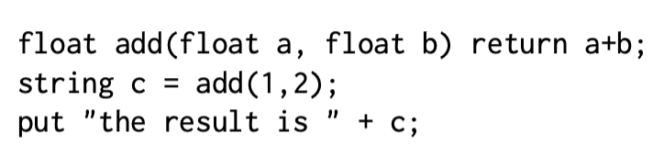
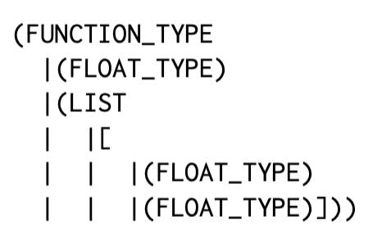
Frontend
(float,float) → float

Slide 30
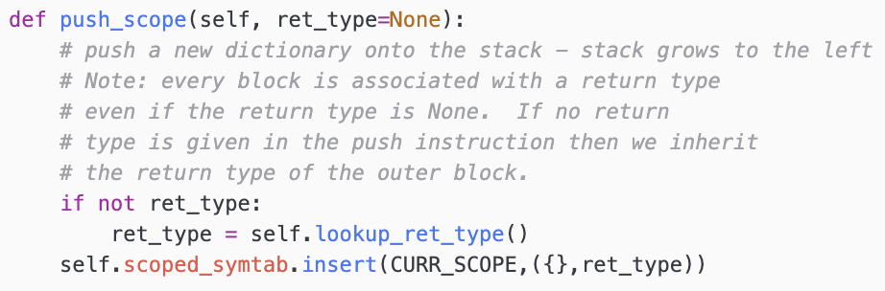
Symbol Table
Almost identical symbol table!
We are using the same approach as we did in Cuppa3:
Use tags in the symbol table to figure out what kind of types we bound into the symbol table.
We have to keep track of the return types of functions…we do that at the block scope level.

Slide 31
The Type Checker
As we saw, the type checker is a tree walker
Turns out that out that it looks very similar to an interpretation walker with one important difference: ☞ It computes TYPES rather than values.
Types for us are tuples where the first component of the tuple tells us what kind of type we are looking at, e.g.
(‘INTEGER_TYPE’,)
(‘STRING_TYPE’,)
We are using tuples because complex types such as function types need to store additional information such return type and argument types, e.g.

Slide 32
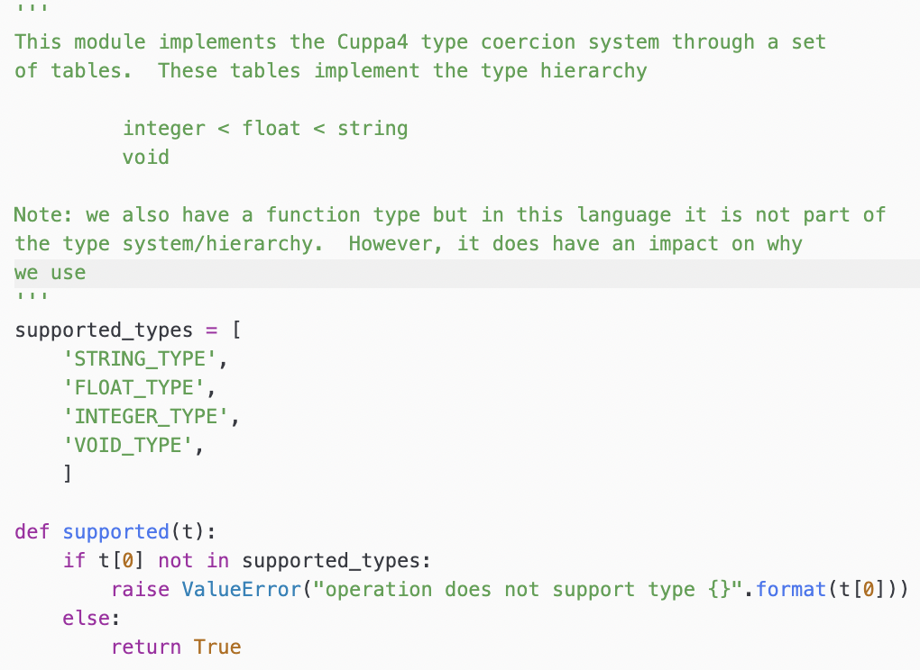
The Type Checker
Central to our implementation is the type promotion table that implements our type hierarchy.
We use the type promotion table to implement our type propagation and type checking
cuppa4_types.py
Note: function types are not supported in our type hierarchy

Slide 33
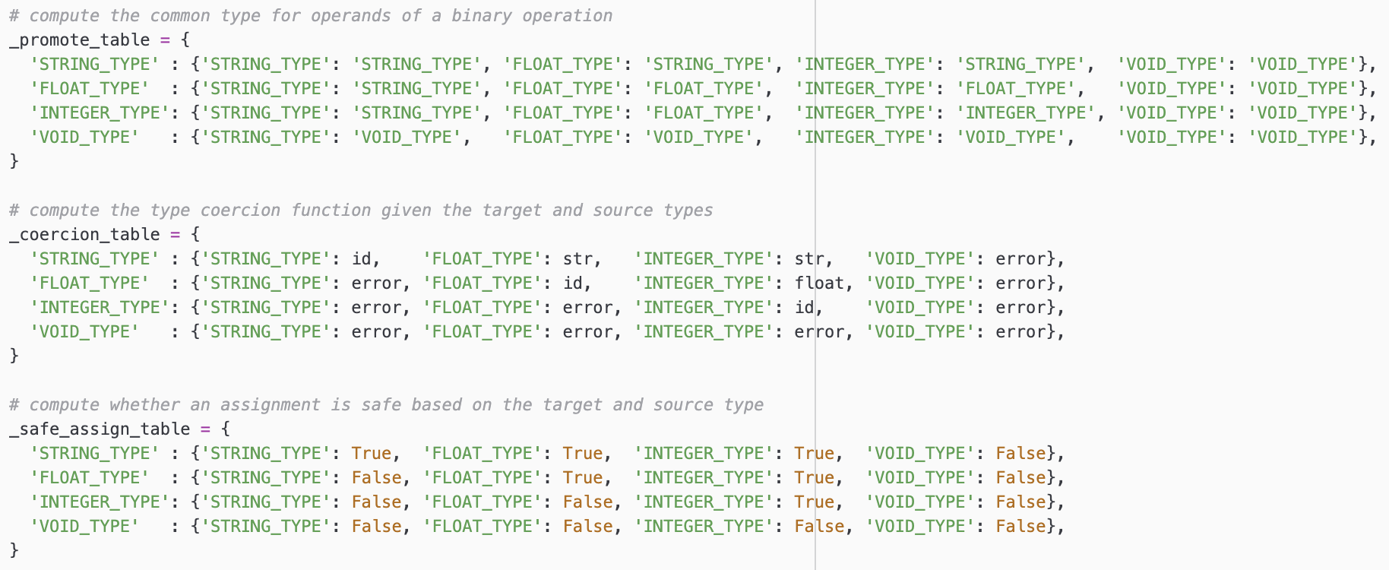
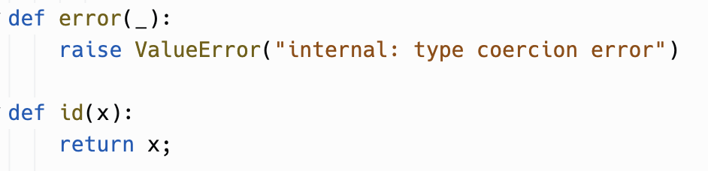
The Type Checker
cuppa4_types.py
The type checker uses a number of tables to coerce types
The functions ‘str’ and ‘float’ are Python
built-ins.

Slide 34
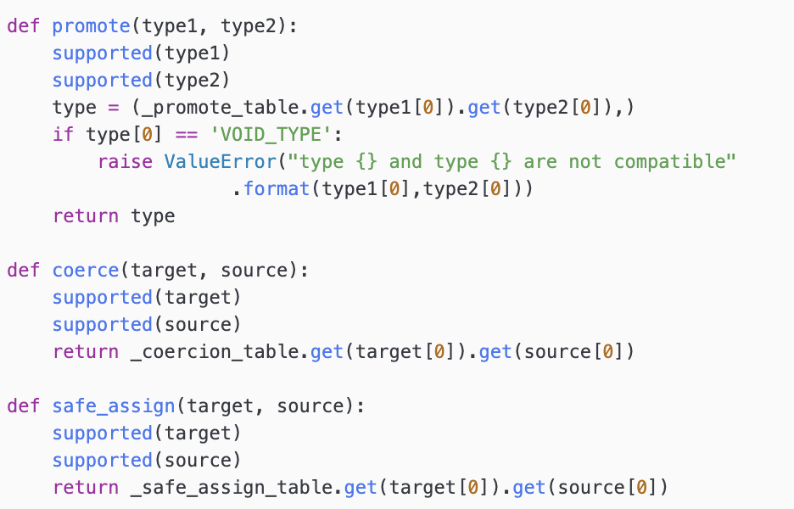
The Type Checker
Interface functions to tables
cuppa4_types.py

Slide 35
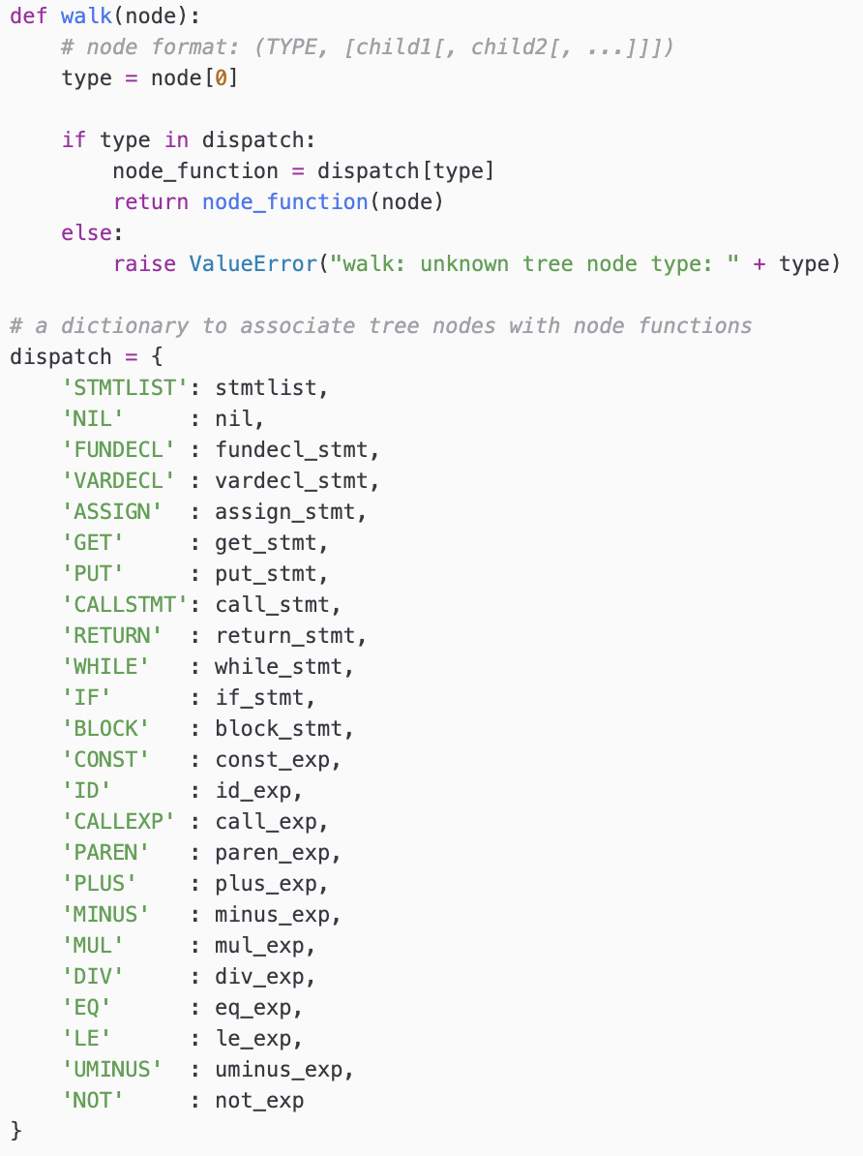
The Tree Walker
Architecture wise looks like all our other tree walkers
cuppa4_typecheck.py

Slide 36
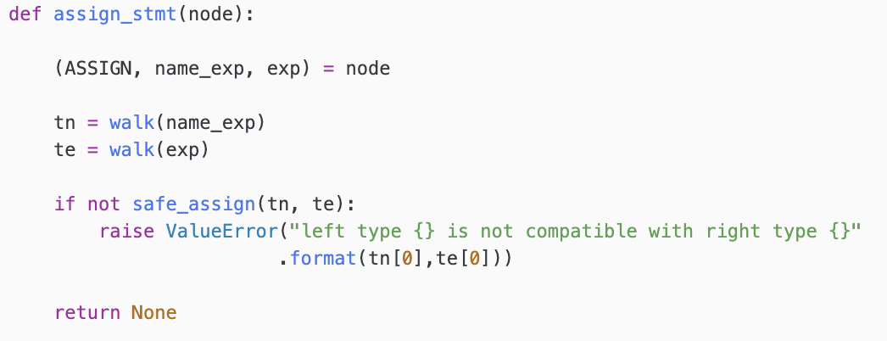
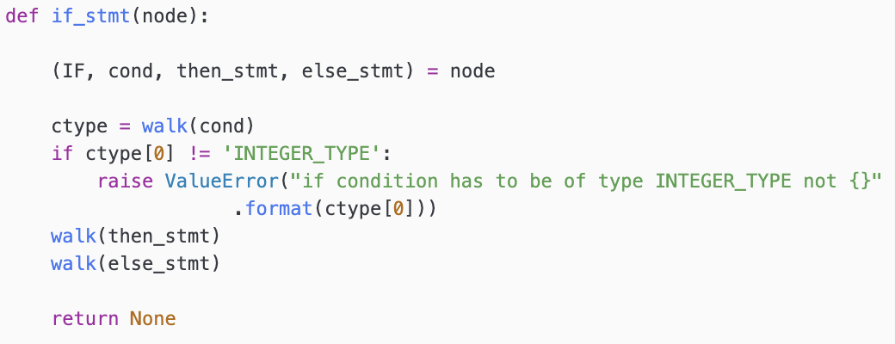
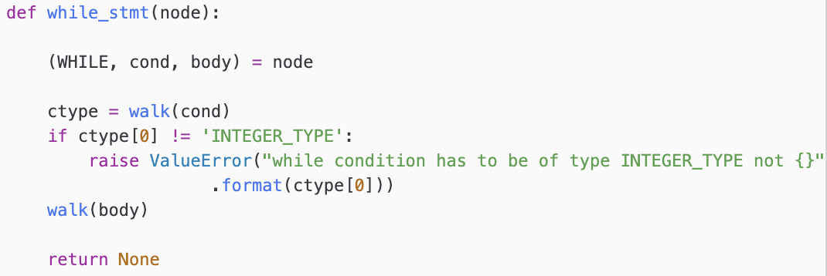
The Tree Walker - Statements
No value computation, just type propagation!

Slide 37
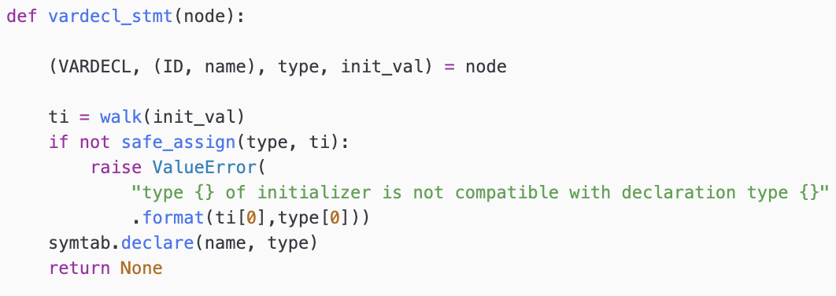
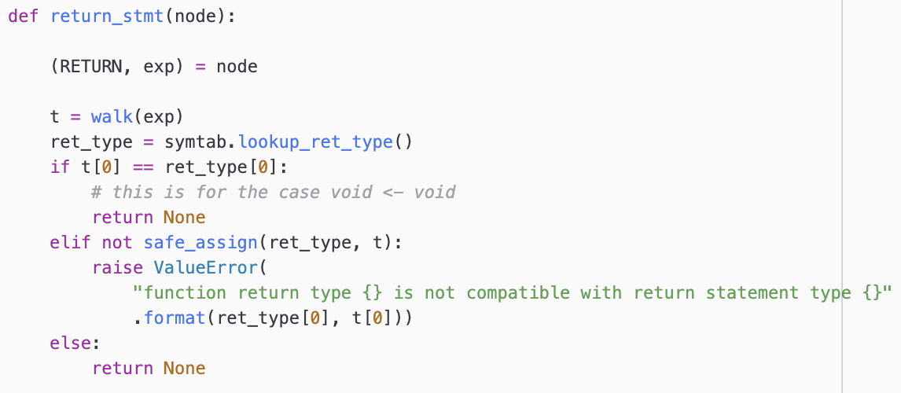
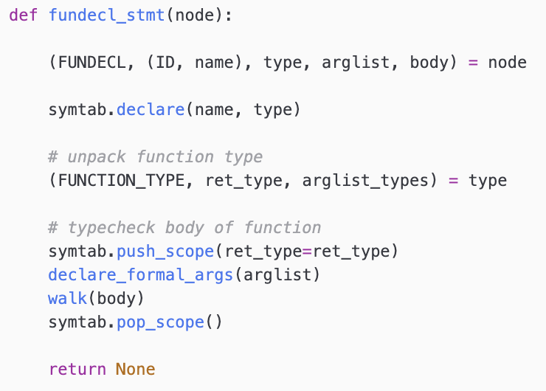
The Tree Walker - Declarations
Note: we only store type info in the symtab.

Slide 38
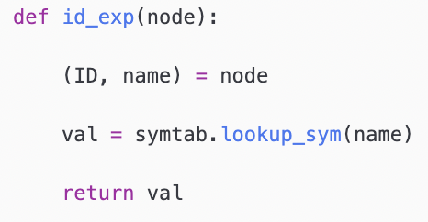
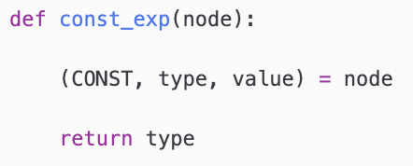
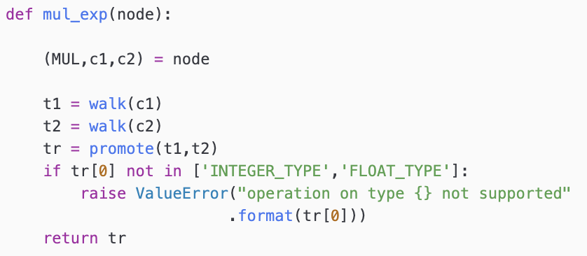
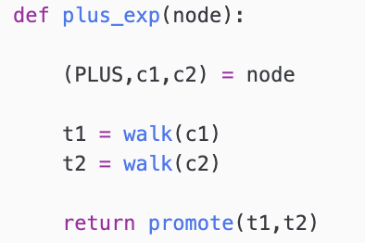
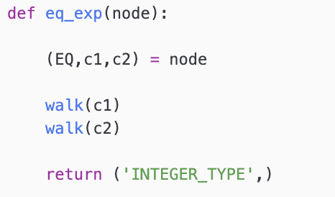
The Tree Walker - Expressions
No value computation, just type propagation!

Slide 39
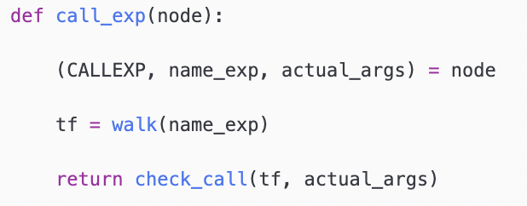
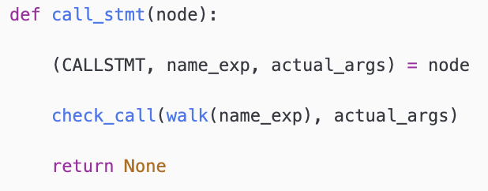
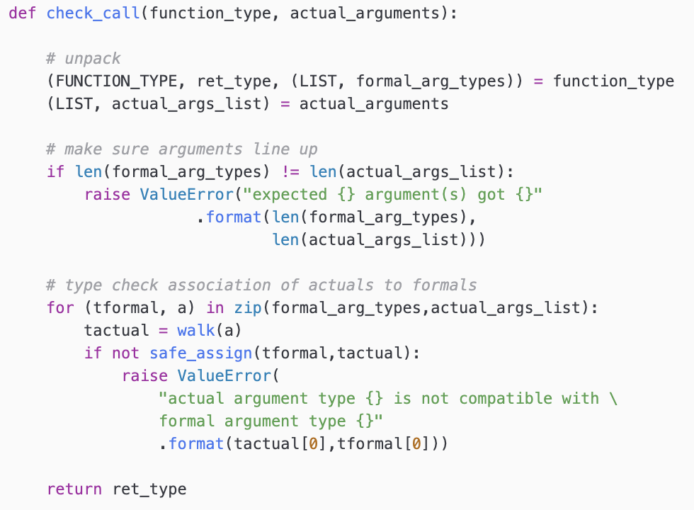
The Tree Walker - Calls
No value computation, just type propagation!

Slide 40
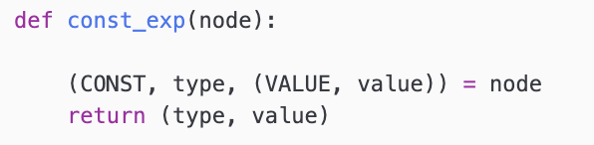
The Interpreter Tree Walk
The interpreter tree walker walks the type checked AST and computes…wait for it… ☞ Values! Well, actually we compute type-value tuples.
It uses the type coercion table.
Look up appropriate type conversion functions

Slide 41
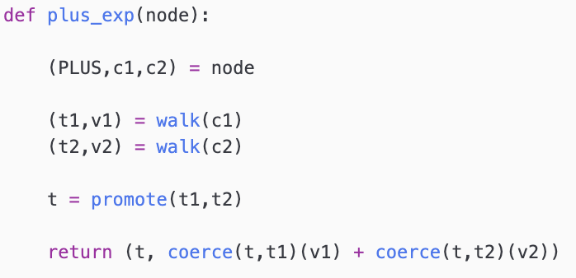
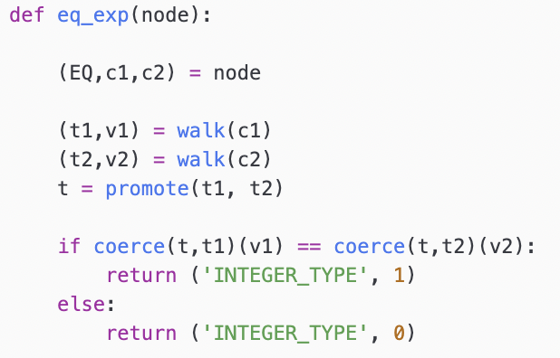
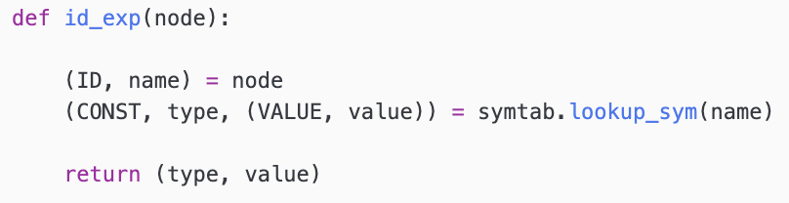
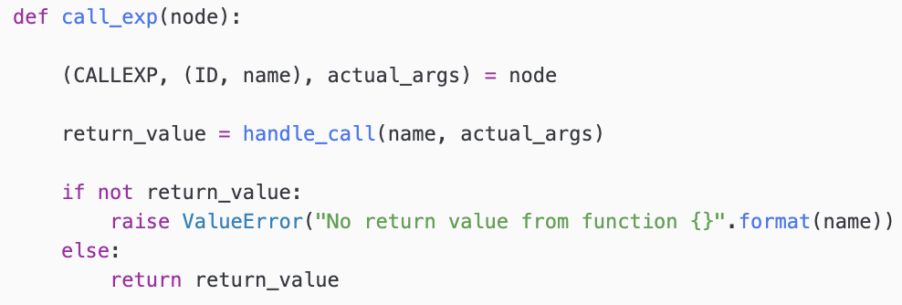
The Interpreter Tree Walk -- Expressions
Very little error checking! All that is done in the type checker!

Slide 42
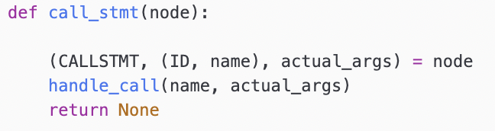
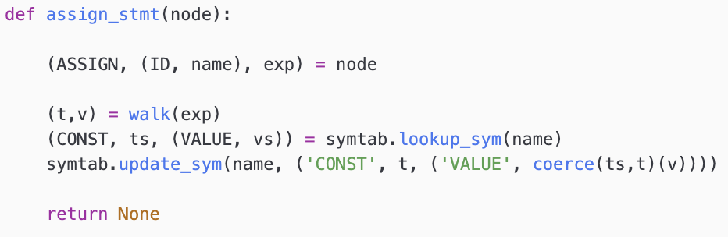
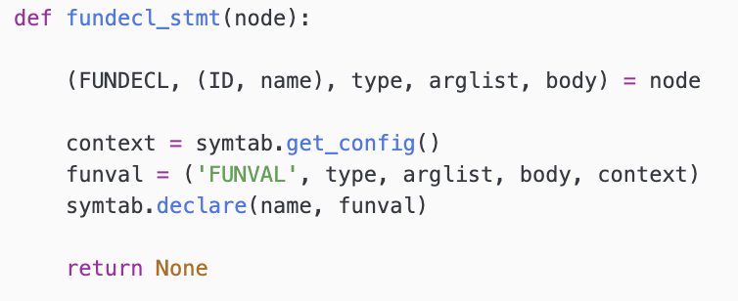
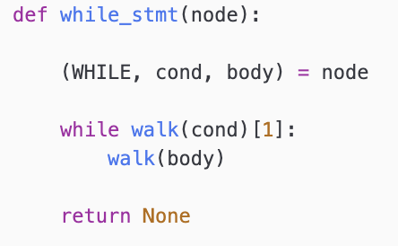
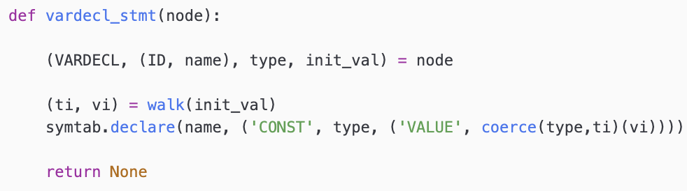
The Interpreter Tree Walk -- Statements

Slide 43
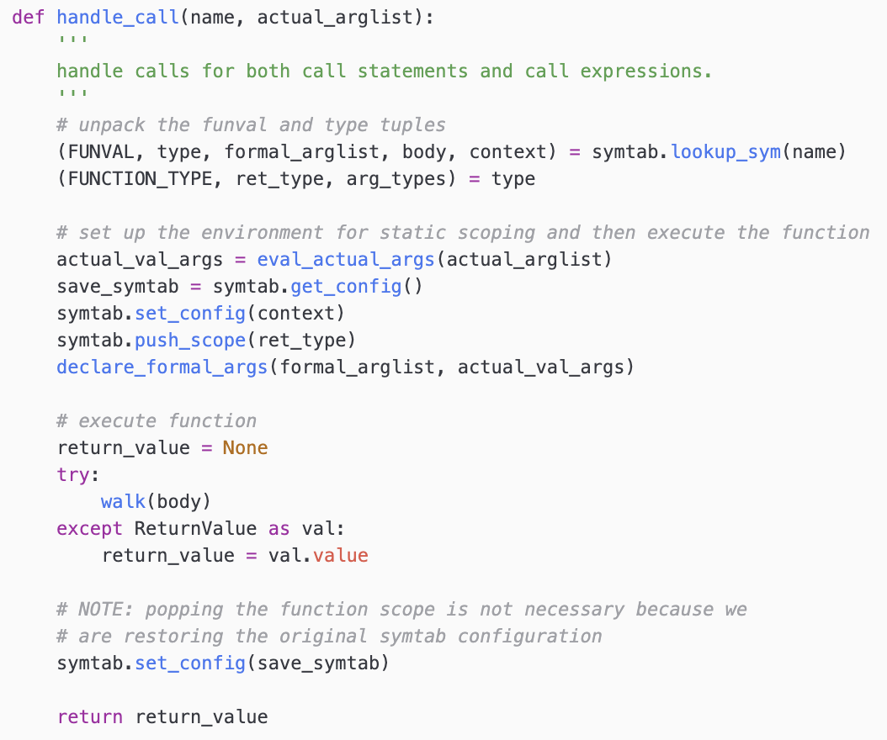
The Interpreter Tree Walk – Handle Call

Slide 44
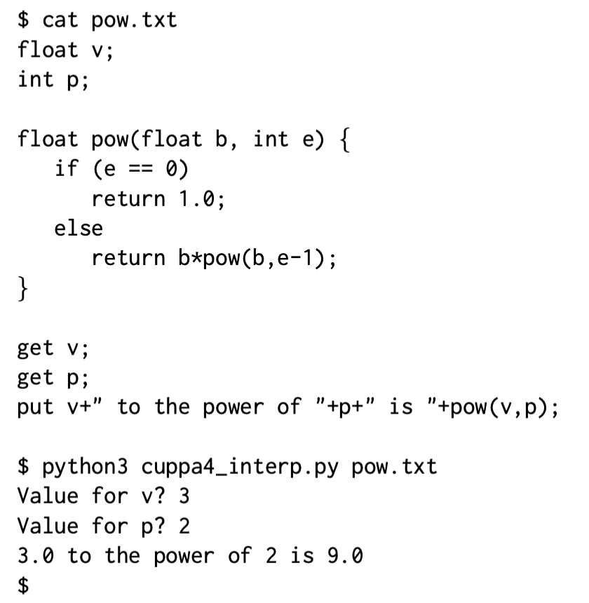
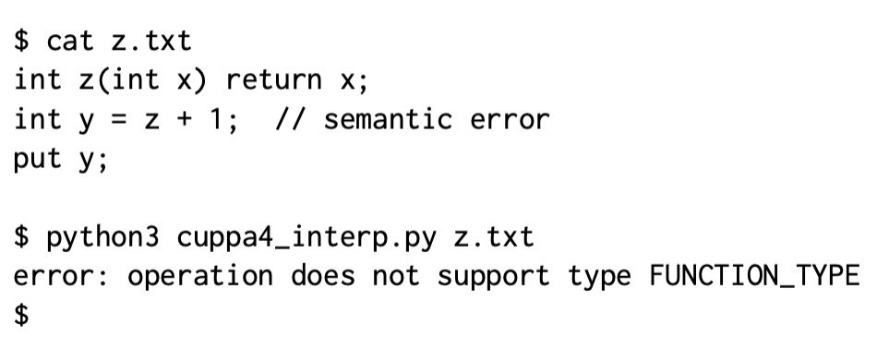
Running the Interpreter

