Slide 1
CSC402 Programming Language Implementation
Dr. Lutz Hamel
Tyler Hall Rm 251
lutzhamel@uri.edu
Welcome!

Slide 2
Course Objectives
Provide a solid foundation with respect to programming language implementation including
grammar construction
parsing techniques,
intermediate representations (tree construction, pattern matching and tree walking techniques)
symbol table construction
code generation
We will study a number of different programming language implementation techniques including compilers, interpreters, and virtual machines.
You can add domain specific and general programming language implementations to your tool chest.

Slide 3
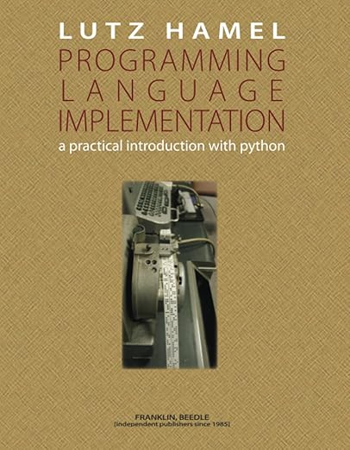
Required Textbook
Required textbook: Programming Language Implementation: A Practical Introduction with Python. Lutz Hamel, Franklin & Beedle, 2024.
Available in URI bookstore and on Amazon.

Slide 4
Some Definitions
Domain Specific Language (DSL)
In software development a DSL is a programming language or specification language dedicated to a particular problem domain, a particular problem representation technique, and/or a particular solution technique.‡
Examples: Html, MSDOS/Linux shell scripts, game engine scripting languages
‡ Wikipedia

Slide 5
Some Definitions
General (Purpose) Programming Language‡
A general purpose programming language is a programming language designed to be used for writing software in a wide variety of application domains.
In many ways a general purpose language only has this status because it does not include language constructs designed to be used within a specific application domain (e.g., a page description language contains constructs intended to make it easier to write programs that control the layout of text and graphics on a page).
‡ Wikipedia

Slide 6
Some Definitions
High-Level Programming Language
A language that supports data abstraction and “structured programming”
e.g. class definitions and while-loops, if-then-else statements
Low-Level Programming Language
A language that does NOT support data abstraction and “structured programming”
Most assembly languages and bytecodes fall into this category

Slide 7
The Structure of Programming Languages
A programming language is a formal system of symbols that are combined to make up larger structures according to certain rules – the Syntax of a Programming Language
The combination of symbols and the larger structures carry information which language processors need to decode.
We will see that the architecture of language processors is geared towards extracting this information by accessing the hierarchy of symbols and structures embedded in programming languages – Syntax Analysis

Slide 8
The Structure of Programming Languages
The hierarchy (low to high):
symbol (character) word (token) phrase sentence
Symbols are combined to form words, words are combined to form phrases, and phrases are combined to form sentences.
A programming language is a collection of valid sentences; a sentence is valid if the symbols, words, and phrases are combined according to the rules of the language.
These rules are usually specified using a grammar (more on that later)

Slide 9
The Structure of Programming Languages
An Example: Function Definition
Symbol
Token
a function definition is a sentence, this sentence is a stmt
the stmt is composed of two tokens (function, inc), an expr, and a stmt
the expr is composed of four tokens: (,),int,i
the stmt is composed of a token (return) and an expr
the expr is composed of three tokens: I, +, 1 👉 Language processors are built to extract this kind of hierarchy and process it.
function inc (int i) { return i + 1; }
token
expr
token
token
expr
stmt
stmt
sentence
Note: the structure of a language is also called the syntax.

Slide 10
The Structure of Programming Languages
Programming text page vs. Symbol Stream
We usually represent programs as 2D text i=0 while i < 10 do print i i=i+1 enddo
However, to the language processor this appears to be just a stream of symbols: i=0<cr>while<sp>i<sp><<sp>10<sp>do<cr><tab>print<sp>i<cr>…
Here, <cr>, <sp>,and <tab> are special symbols

Slide 11
The Behavior of Programming Languages
In addition to specifying the syntax of a programming language we also need to specify its behavior – the Semantics of the Language
Every programmer instinctively knows what the following program fragment does: i=0 while i < 10 do print i i=i+1 enddo
But we need to tell the language processor what this program means; how it should behave.

Slide 12
The Behavior of Programming Languages
Example of a specification:
Syntax:
WhileStatement:
while Expression do Statement enddo
Semantics:
The while statement executes an Expression and a Statement repeatedly
until the value of the Expression is false.
The Expression must have type Boolean, or an error occurs.
A while statement is executed by first evaluating the Expression:
If the value is true, then the contained Statement is executed. If execution of the Statement completes normally, then the entire while statement is executed again, beginning by re-evaluating the Expression.
If the value is false, no further action is taken and the while statement terminates.

Slide 13
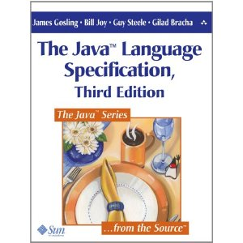
The Behavior of Programming Languages
The specification of general purpose programming languages can be very complex.
In the case of Java this is a 700 page book!
Domain specific programming languages tend to be less complex and therefore much easier and faster to implement.
The Java Language Specification, Gosling, Joy, Steele, Bracha, 3rd edition, Wiley, 2005.

Slide 14
Building Blocks of Language Processors
Most programming language processors are made up of one or more three main building blocks:
Syntax Analysis – program text/structure analysis
Semantic Analysis – program behavior analysis
Code Generation

Slide 15
Syntax Analysis
Syntax
Analysis
Intermediate
Representation (IR)
Program Text
The syntax analysis reads the program text and produces an intermediate representation (IR)
The IR is an abstract representation of the program text

Slide 16
Semantic Analysis
Semantic
Analysis
IR
Annotated IR
The semantic analysis reads the IR and analyzes the encoded behavior
The semantics analysis typically outputs an annotated version of the IR
These annotations insure the correct behavior of the program, for example, memory space for a declared variable.

Slide 17
Code Generation
Code
Generation
Target Language
IR
The semantic analysis reads the IR and translates it into the target language
The target language could be a high level language, assembly code, or byte code.
The target code can also be a spreadsheet that summarizes data described with the IR, etc.

Slide 18
The Structure of Language Processors
We can now plug these building blocks together in different configuration in order to obtain a variety of language processors.
In particular, we can configure these building blocks as:
Interpreter
Translator/Compiler
Simple Translator

Slide 19
The Interpreter
IR
Syntax
Analysis
Semantic
Analysis
Program
Output
Program Text
An interpreter is made up of a syntactic and a semantic analysis block.
An interpreter reads, decodes, and executes code.
For interpreters the semantic analysis block is slightly modified – it analyzes and executes the IR producing the program output.
Examples include simple programmable calculators as well as languages such as Ruby and Python.

Slide 20
The Translator/Compiler
IR
IR
Syntax
Analysis
Semantic
Analysis
Code
Generation
Target Language
Program Text
A translator consists of all three of our building blocks.
A translator reads text in one language and emits output conforming to another language.
We often fit an additional optimization phase between the semantic analysis and the code generation phases.
Examples include log file generators, assemblers and of course compilers.
Note: A compiler is a translator that translates a high-level language to a low-level language.

Slide 21
The Simple Translator
IR
Syntax
Analysis
Code
Generation
Target Language
Program Text
A simple translator consists of a syntax analysis block and a code generation block
It does not perform any semantic analysis
Think of it as the Reader followed by the Generator.
Examples include pretty printers and other formatters.

Slide 22
Example: Processing the Java Language
A processing pipeline for a language can consist of multiple language processors.
The language processing pipeline for Java consists mainly of
A compiler from Java to bytecode
A bytecode interpreter

Slide 23
Example: Processing the Java Language
Java:
class Funny {
public int i = 0;
public Funny(int x) {
i = x;
}
public static void main(String[] args) {
Funny a[] = new Funny[10];
for (int j = 0; j < 10; j++) {
a[j] = new Funny(j);
}
}
}
Bytecode:
class Funny extends java.lang.Object{
public int i;
public Funny(int);
Code:
0: aload_0
1: invokespecial #1; //Method java/lang/Object."<init>":()V
4: aload_0
5: iconst_0
6: putfield #2; //Field i:I
9: aload_0
10: iload_1
11: putfield #2; //Field i:I
14: return
public static void main(java.lang.String[]);
Code:
0: bipush 10
2: anewarray #3; //class Funny
5: astore_1
6: iconst_0
7: istore_2
8: iload_2
9: bipush 10
11: if_icmpge 31
14: aload_1
15: iload_2
16: new #3; //class Funny
19: dup
20: iload_2
21: invokespecial #4; //Method "<init>":(I)V
24: aastore
25: iinc 2, 1
28: goto 8
31: return
}
compile
Program
Output
interpret
Note: javap -c <classname> will show bytecode.

Slide 24
Example: Processing the Java Language - Compiler
IR
IR
Java
Code
Syntax
Analysis
Semantic
Analysis
Code
Generation
Bytecode

Slide 25
Example: Processing the Java Language – Bytecode Interpreter
IR
Syntax
Analysis
Semantic
Analysis
Program
Output
Bytecode File
(Class File)

Slide 26
Assignments & Readings
Read Chapter 1
Assignment #0:
Download & Read Syllabus
upload a copy into BrightSpace

