Slide 1
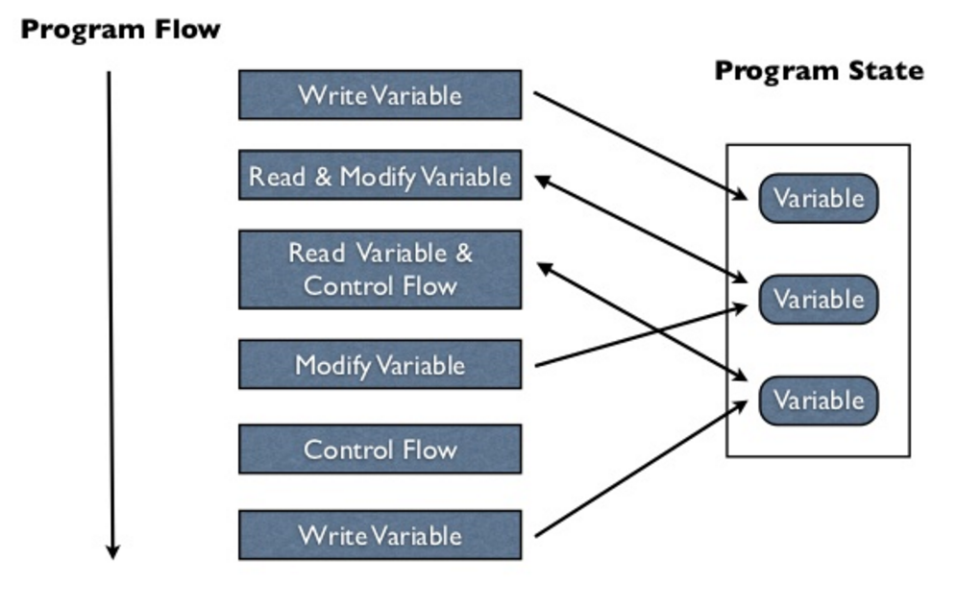
Imperative Programming in Asteroid – the Basics
Imperative programming –
Explicit statements that change the program state
The program state is defined by the values assigned to the variables in a program
The most common way to change the state in imperative programming is through an explicit assignment of a new value to an existing variable
Image source: https://practical.li/clojure/concepts/what-is-functional-programming.html

Slide 2
Imperative Programming in Asteroid – the Basics
All three of our programming languages are at their core imperative programming languages.
Here we look at basics of Asteroid programming

Slide 3
Names
In Asteroid names are alpha-numeric symbols starting with an alpha character (as in most languages)
x1
my_function
pi

Slide 4
Primitive Types & Constants
Constants are available for all the primitive data types,
integer, e.g. 1024
real, e.g. 1.75
string, e.g. "Hello, World!"
boolean, e.g. true

Slide 5
Type Hierarchies
Asteroid arranges primitive data types in a type hierarchy,
boolean < integer < real < string
Type hierarchies facilitate automatic type promotion, e.g.
ln002/let2.ast
Type promotion: plus as string concatenate op

Slide 6
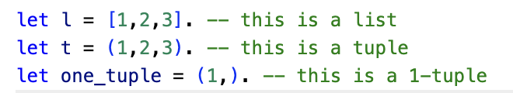
Structured Data Types
Asteroid also supports the built-in data types:
list
tuple
These are structured data types in that they can contain entities that belong to other data types.
Lists are mutable objects whereas tuples are immutable.
Some examples,
Note: (1,) ≠ (1)
ln002/let1.ast

Slide 7
Structured Data Types
Lists and tuples themselves are also embedded in type hierarchies, although very simple ones:
list < string
tuple < string
That is, any list or tuple can be viewed as a string. This is very convenient for printing lists and tuples,
load system io.
io @println ("this is my list: " + [1,2,3]).

Slide 8
The None Type
Asteroid supports the none type.
The none type has only one member
A constant named none.
The empty set of parentheses () can be used as a shorthand for the none constant.
That is: none = ()

Slide 9
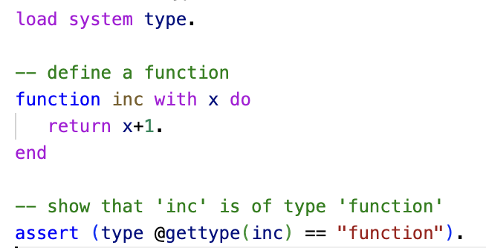
Other Data Types
In Asteroid we also have additional data types:
function
pattern
user defined data types via structures
ln002/ftype.ast

Slide 10
Reading
The Basics
asteroid-lang.readthedocs.io/en/latest/User%20Guide.html#the-basics

