Slide 1
Functional Programming in Asteroid
Asteroid supports a functional sublanguage largely inspired by ML.
You can turn the Asteroid interpreter into a functional language interpreter with the ‘-F’ flag
In this mode imperative statements will be rejected with some exceptions
Most notable exception is the let statement – we’ll discuss this later

Slide 2
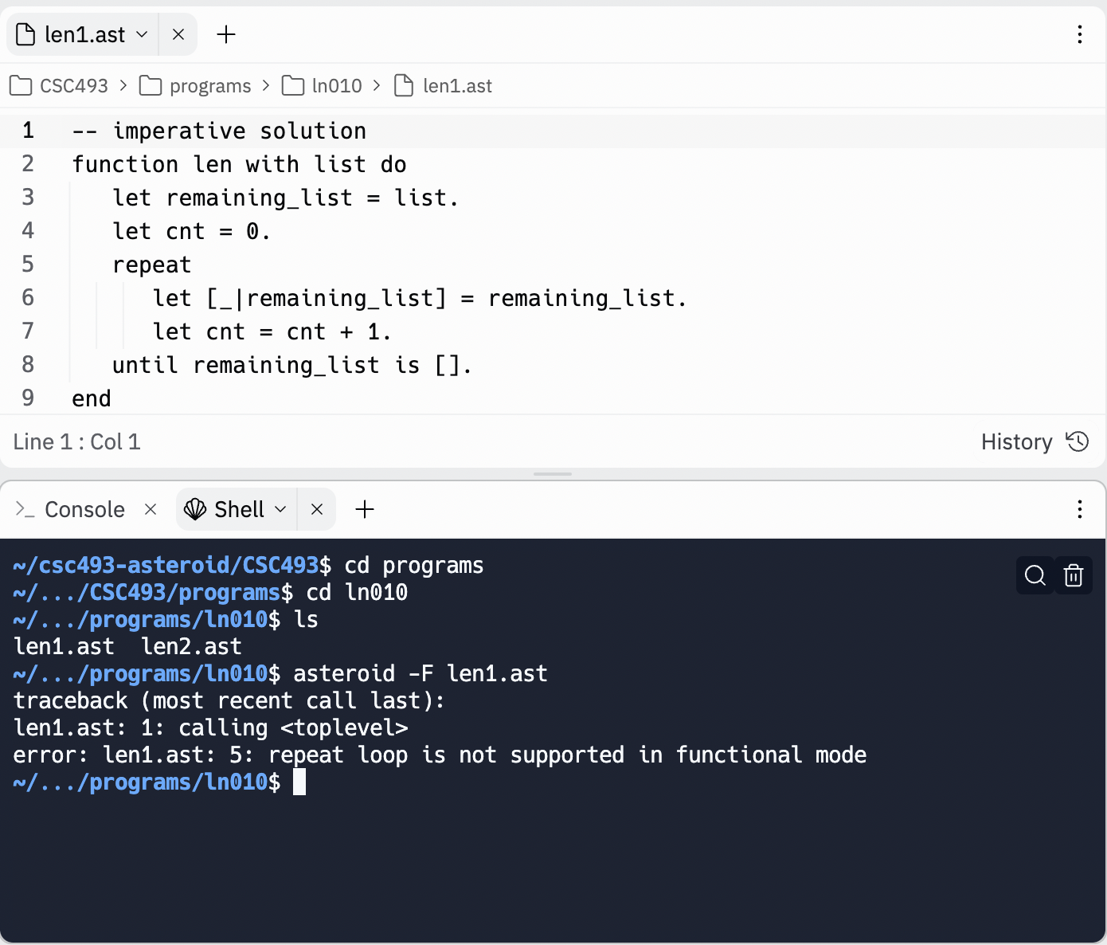
Functional Programming in Asteroid

Slide 3
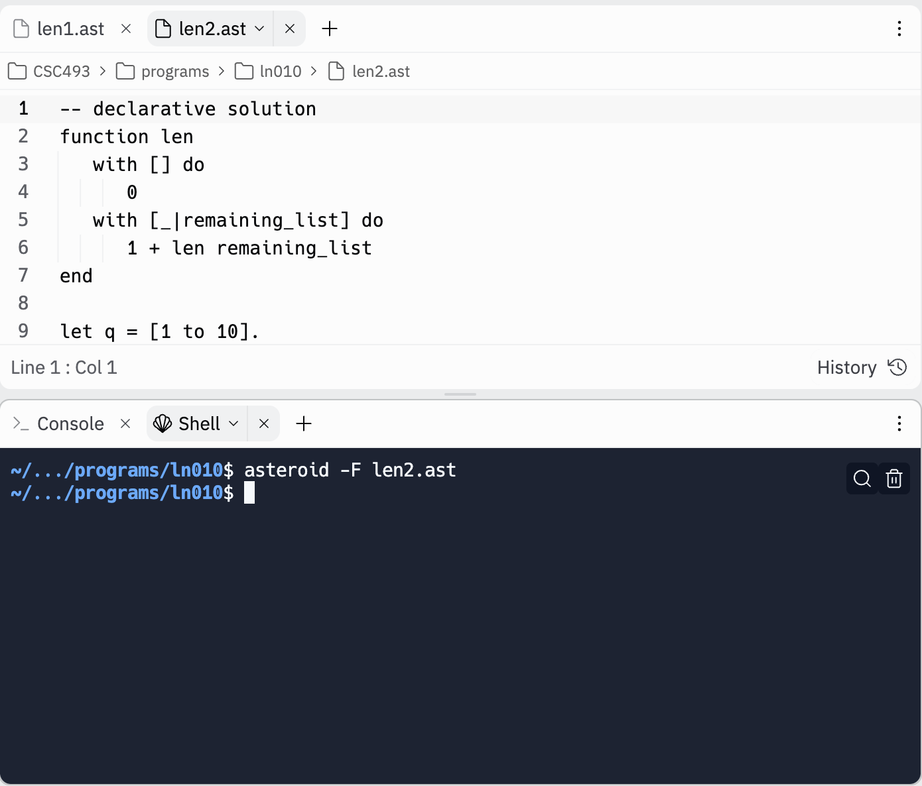
Functional Programming in Asteroid

Slide 4
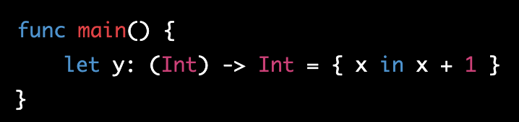
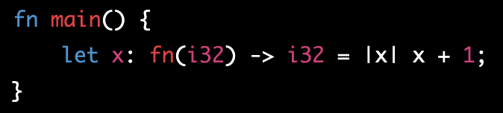
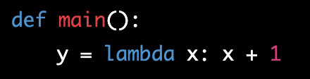
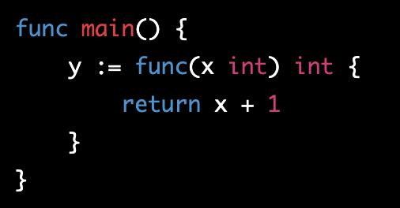
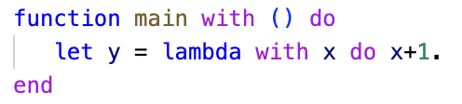
Lambda Functions
The most recognizable feature of the functional programming paradigm is the lambda function
Virtually every programming language designed in the last decade or two supports lambda functions – by extension, they support the functional programming paradigm (even if limited)
Swift
Rust
Python
Go
Asteroid

Slide 5
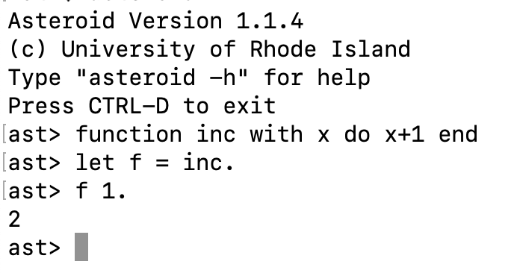
Lambda Functions
The implication of the support of lambda functions is that functions are considered first-class citizens,
☞ They are Values!
Consider,
We can copy function values like any other value!

Slide 6
Other Characteristics of Functional Programming
No iteration – only recursion.
No if statements – only if expressions.
”Single valued variables”
Variables are shorthand notations for expression values

Slide 7
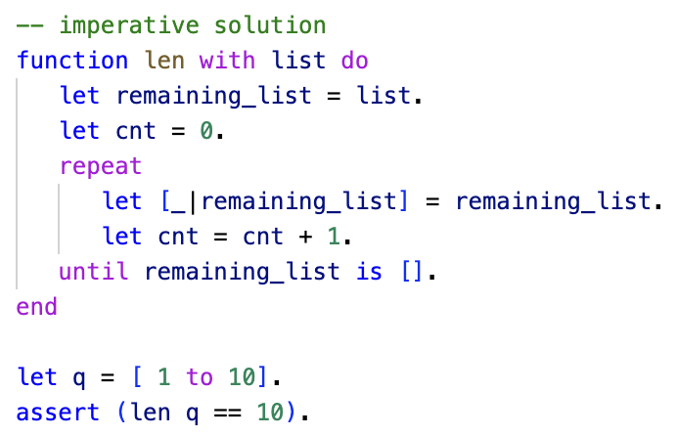
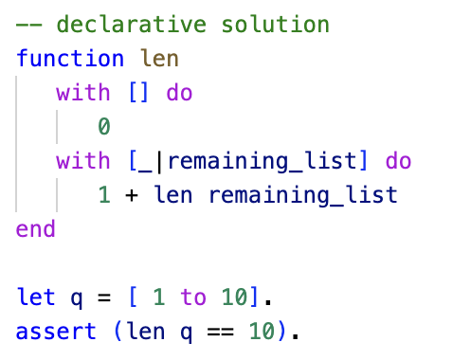
No Iteration
Iteration is not supported
Data structures must be traversed with recursion
Recursive functions with multi-dispatch!
vs

Slide 8
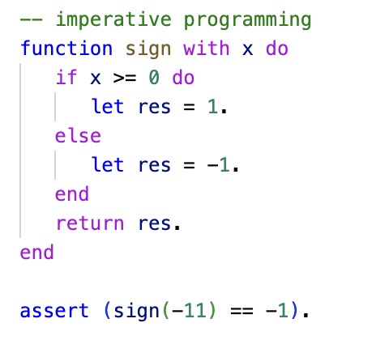
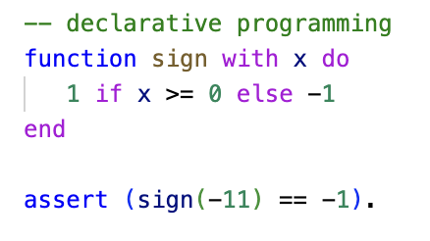
No If Statements
If statements are designed to inherently modify machine state and therefore are not allowed in functional programming
We use if expressions instead
Also fits better into the notion of “everything is a value”
vs

Slide 9
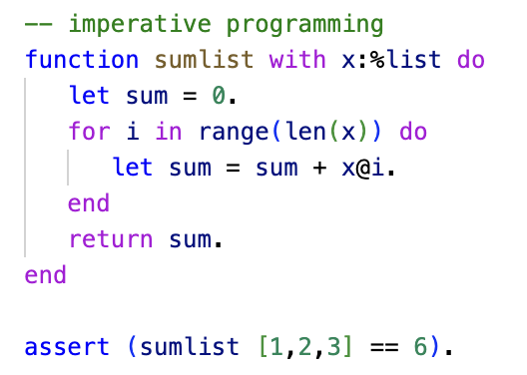
Single Valued Variables
In imperative programming variables maintain the machine state,
The variable sum is updated iteratively and at each iteration contains the partial solution computed so far. Note that the evolution of the values stored in sum depends on the length of the input list!

Slide 10
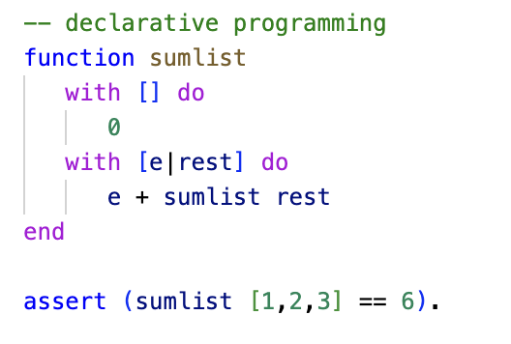
Single Valued Variables
In functional programming variables act like a shorthand notation for a single value (per function call)
Here e and rest contain a single value (per function call) that does not change throughout that function call.

Slide 11
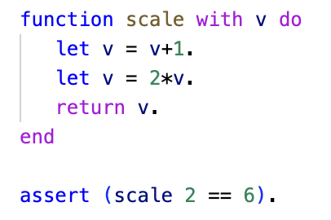
Single Valued Variables
Even if we assign multiple values to the same variable, it still has the flavor of a value shorthand notation
We don’t have iteration to evolve the value further than the given assignments
Here we use the multiple assignments to v to break the expression computation, return 2*(v+1)
Into simpler computational steps.

Slide 12
Functional Programming in Asteroid
Let’s see how the programs that we developed in the lambda calculus translate into Asteroid
Should be straight forward since Asteroid supports the functional programming paradigm.

Slide 13
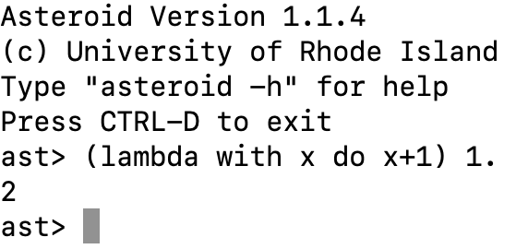
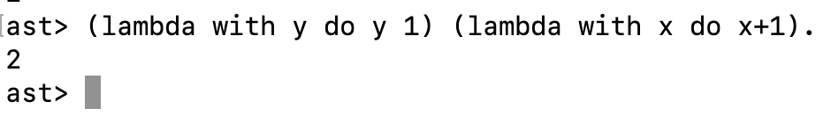
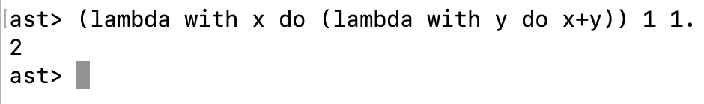



Original Lambda Examples
$$\left(λx.x+1\right) 1 ⇒2$$
$$\left(λy.y 1\right)\left(λx.x+1\right)⇒2$$
$$\left(λx.\left(λy.x+y\right)\right) 1 1⇒2$$

Slide 14
Classic Functional Programming
Let’s look at some classic functional programming examples
The most noticeable issue of course is that data structures like lists are accessed in a sequential manner with the head-tail pattern using recursion.

Slide 15
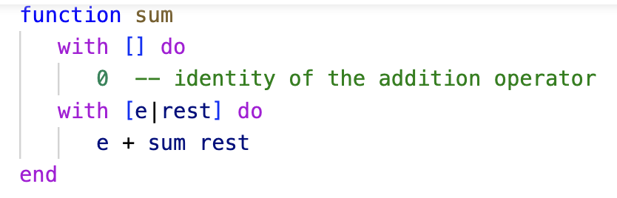
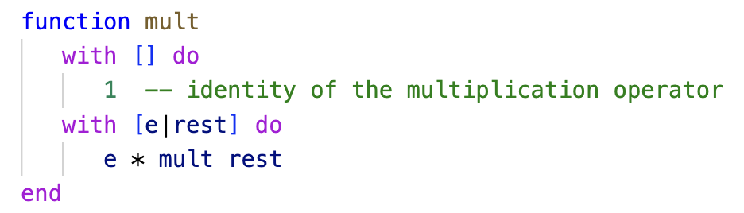
Sum/Mult
Sum/multiply all the elements of a list.

Slide 16
Sum/Mult
Identity means it is a value that if added/multiplied to another value returns the original value, e.g
2+0 = 2
2*1 = 2
In functional algorithm design identity values are often important as part of the recursion base cases.

Slide 17
Sum/Mult
Consider sum [1,2,3]
1 + sum [2,3]
1 + 2 + sum [3]
1 + 2 + 3 + sum []
1 + 2 + 3 + 0

Slide 18
String Concatenation
If we consider the + operator to work as a string concatenation operator,
“abc” + “edf” = “abcdef”
What is the identity of string concatenation?

Slide 19
Reverse
Given a list of values the reverse function reverses that list, e.g.
reverse [1,2,3] = [3,2,1]
Assume that the + operator functions as a list concatenation operator, what is the identity of + as a list concatenation operator?

Slide 20
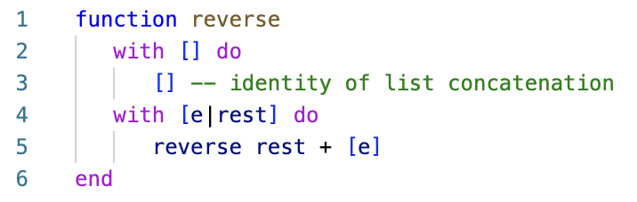
Reverse
Note the empty list as the identity of list concatenation.

Slide 21
Filter
Another classic functional programming algorithm is ‘filter’,
Given a list of values, return a list of values that are smaller/larger than a given pivot value.
For example,
filter_lt ([1,2,3,4,5],4) = [1,2,3]

Slide 22
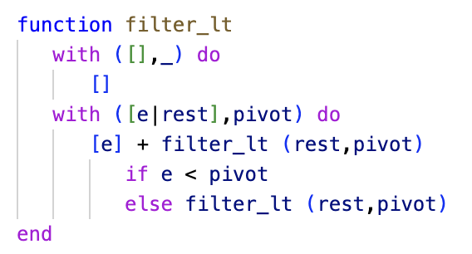
Filter
Again we can observe that the base case is the identity of the fundamental operation in the recursive case: list concatenation
Also, in keeping with with declarative programming we see that we “declare” what we want to do with each input configuration.

Slide 23
QuickSort
Sort a list according to the quicksort algorithm - recursive partitioning according to a pivot value,
qsort [3,1,2] = [1,2,3]
In the declarative setting this algorithm is straight forward.

Slide 24
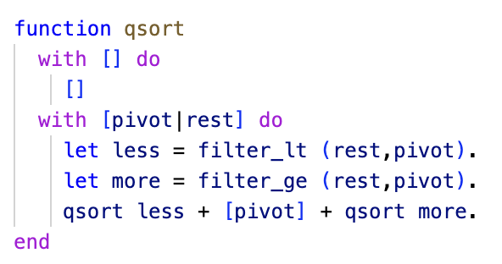
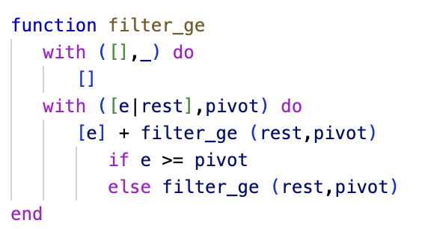
QuickSort

