Slide 1
Patterns
In most modern programming languages patterns are “baked into” the syntax of pattern match statement such as ‘match’ statements/expressions
That is, patterns are not standalone structures/values in those languages
This is true for Asteroid as well
But…

Slide 2
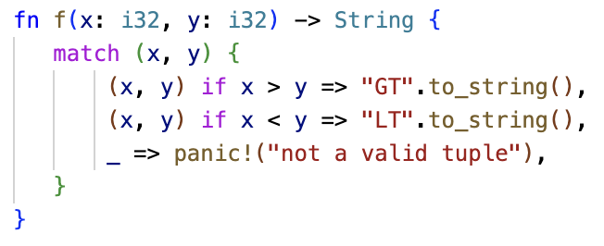
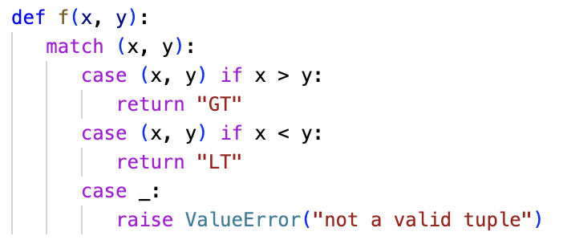
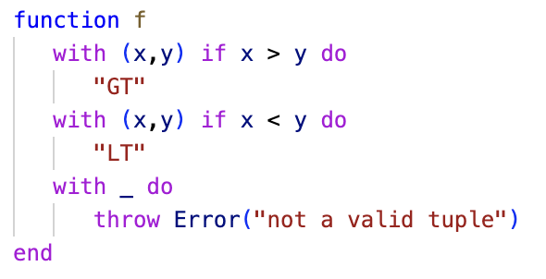
Patterns
Rust
Python
ln014/match.rs
ln014/match.py
Asteroid
ln014/match.ast

Slide 3
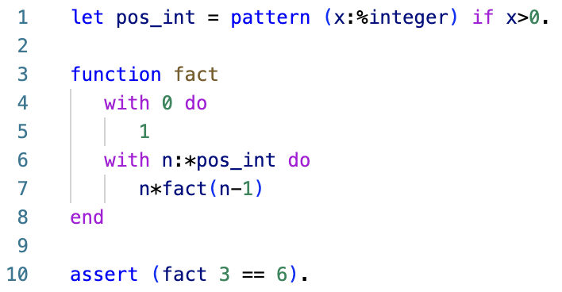
First-Class Patterns
But, Asteroid allows the user to store patterns in variables which can then be dereferenced when needed
An interesting consequence of first-class patterns is that programs become much more readable.
ln014/int_match2.ast

Slide 4
First-Class Patterns
Promoting a language feature to first-class status does not increase the computational power of a language (they all are Turing-Complete) but it does increase its expressiveness usually perceived as more readable programs!

Slide 5
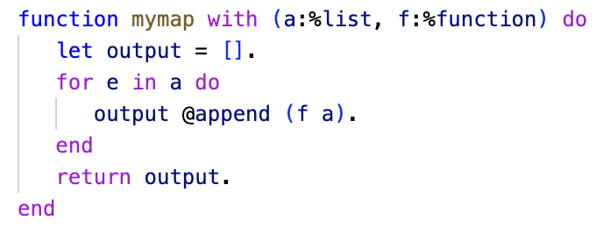
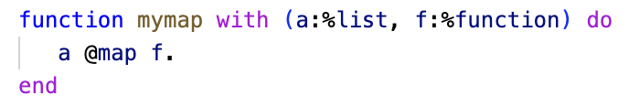
First-Class Features
We have observed this with functions,
Promoting functions to first-class status enables higher-order programming
Higher-order programming enables features such as the ‘map’ function
Programs taking advantage of higher-order programming tend to be easier to read and understand.
ln014/map1.ast
ln014/map2.ast

Slide 6
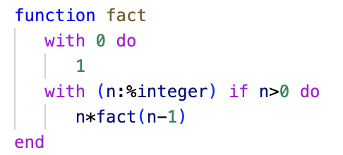
First-Class Patterns
We can observe the same phenomenon with first-class patterns
Programs written with first-class patterns tend to be easier to read and understand
ln014/int_match1.ast
Observation: first-class patterns tend to behave like types – more on that later
ln014/int_match2.ast

Slide 7
First-Class Patterns
Just like in higher-order programming where any function can be stored in a variable or passed/returned to/from a function…
…we can do the same with first-class patterns
Any pattern can be stored in a variable
Any pattern can be passed/returned to/from a function

Slide 8
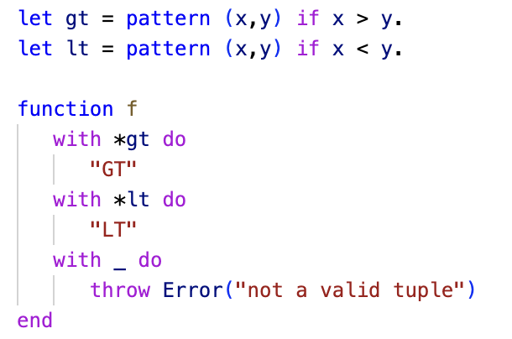
First-Class Patterns
Any pattern can be stored in a variable.
ln014/matchhp.ast

Slide 9
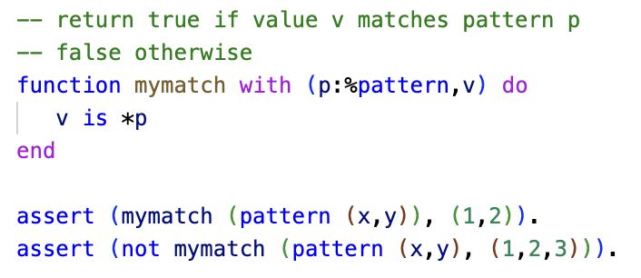
First-Class Patterns
We can pass patterns to functions.
ln014/mymatch.ast

Slide 10
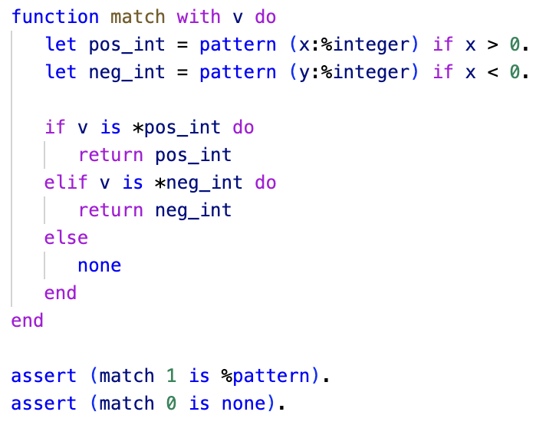
First-Class Patterns
Returning patterns from functions.
ln014/return.ast

Slide 11
Reading
asteroid-lang.readthedocs.io/en/latest/User%20Guide.html#patterns-as-first-class-citizens

