Slide 1
Advanced Features & Applications
Having promoted patterns to first-class status means that we have effectively separated the point of definition of patterns from the point where patterns are applied
This allows for novel applications of patterns.

Slide 2
Pattern Reuse
The ability of reusing patterns frees a developer from having to retype the same pattern repeatedly in their code.
The ability of reusing patterns makes code much more robust from a software engineering perspective
In software engineering it is frowned upon to explicitly repeat the same code in your program
A maintenance nightmare: if anything ever changes in the repeated code you will have to go through all the repeated instances manually and update them

Slide 3
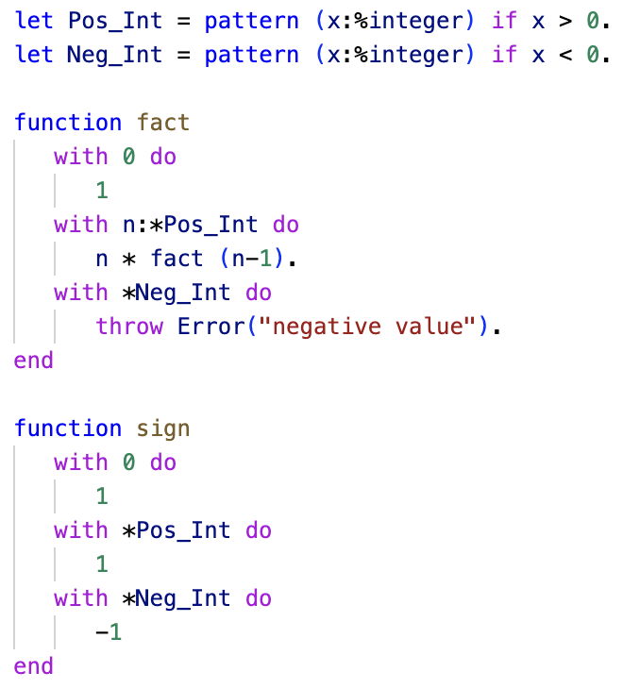
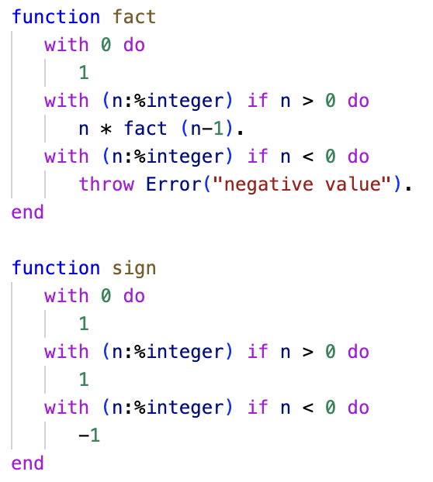
Pattern Reuse
ln015/reuse1.ast
ln015/reuse2.ast

Slide 4
Pattern Factoring
Patterns can become quite complex given that we can add
Conditionals with multiple terms
Nested structures such as lists of lists, tuples of lists, lists of tuples, etc.
First-class patterns allow us to factor patterns into smaller manageable pieces.

Slide 5
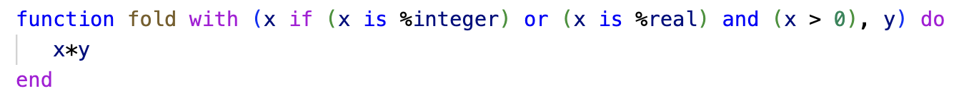
Pattern Factoring
What exactly is the input structure to the function ‘fold’ – difficult to see…

Slide 6
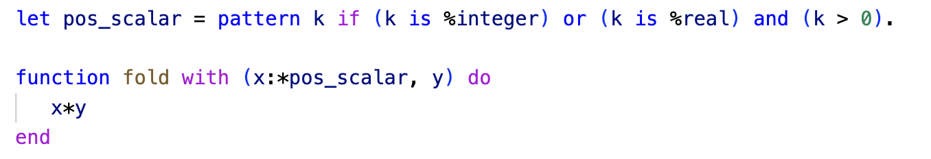
Pattern Factoring
Ahh – it is a pair where the first component is a positive scalar
Using first-class patterns let’s us bring that to the forefront

