Slide 1
First-Class Patterns as Types
We already have seen that patterns behave like data types, consider,
let x:%integer = v.
Here the pattern %integer that matches all integer values limits what kind of values can be assigned to the variable x.
That is precisely what type declarations do!

Slide 2
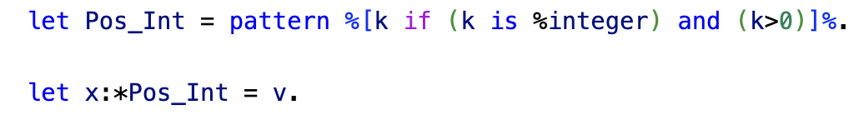
Subtypes
First-class patterns can be used to define subtypes of existing types
Consider for example,
Here we can treat the pattern Pos_Int as a subtype of the integers, in effect we have
Pos_Int < integer

Slide 3
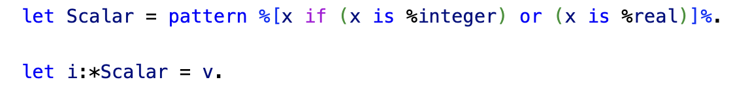
Supertypes
We can use first class patterns to also define supertypes, consider
Here the second let statement is only successful if it fulfills the requirements of the pattern Scalar.
In effect, Scalar acts like a supertype of real and integer
or more precisely it acts like an abstract base class since you since you cannot instantiate a value of type Scalar.

Slide 4
Sub- and Supertypes
We use first-class patterns to instantiate both subtypes and supertypes – how do they differ?

Slide 5
Sub- and Supertypes
Subtypes: the pattern definition adds conditions that contract a given data type
integers
positive
integers

Slide 6
Sub- and Supertypes
Supertypes: the pattern definition expands given data types so that the supertype pattern covers more objects than any given data type within the pattern definition.
scalar
reals
integers

Slide 7
Programming with Patterns as Data Types
We an impose a certain amount of type safety with patterns as data types
Specification of function domains
Type safety for objects using patterns as types in constructors
Subtype polymorphism

Slide 8
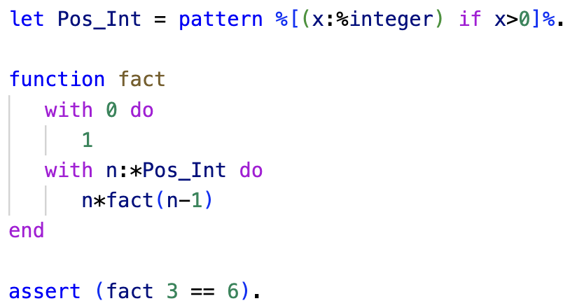
Function Domains
ln016/fact.ast

Slide 9
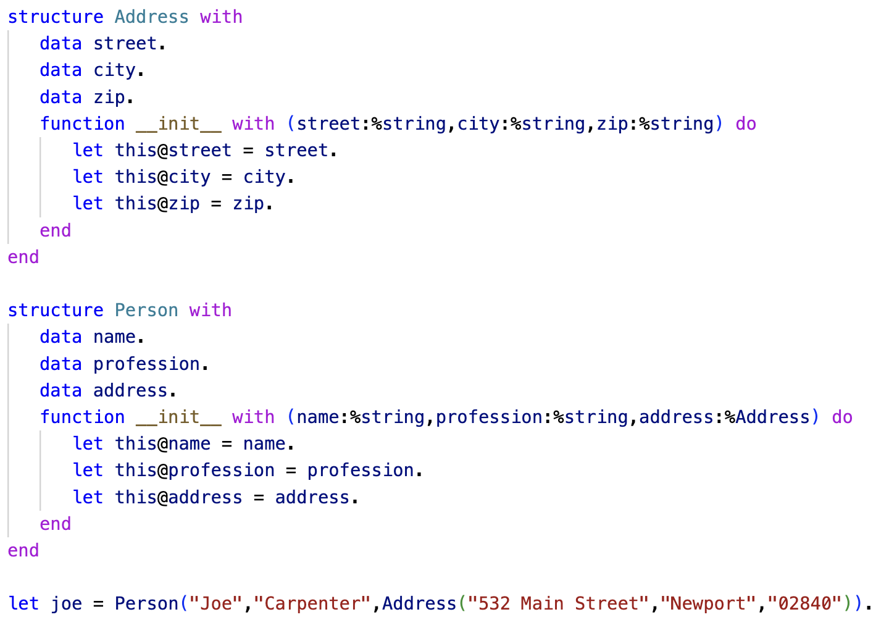
Objects

