Slide 1
Flow of Control
Control structure implementation in Asteroid is along the lines of any of the modern programming languages such as Python, Swift, or Rust. For example,
The for loop allows you to iterate over lists without having to explicitly define a loop index counter.
The if-elif-else statement expresses familiar condition handling

Slide 2
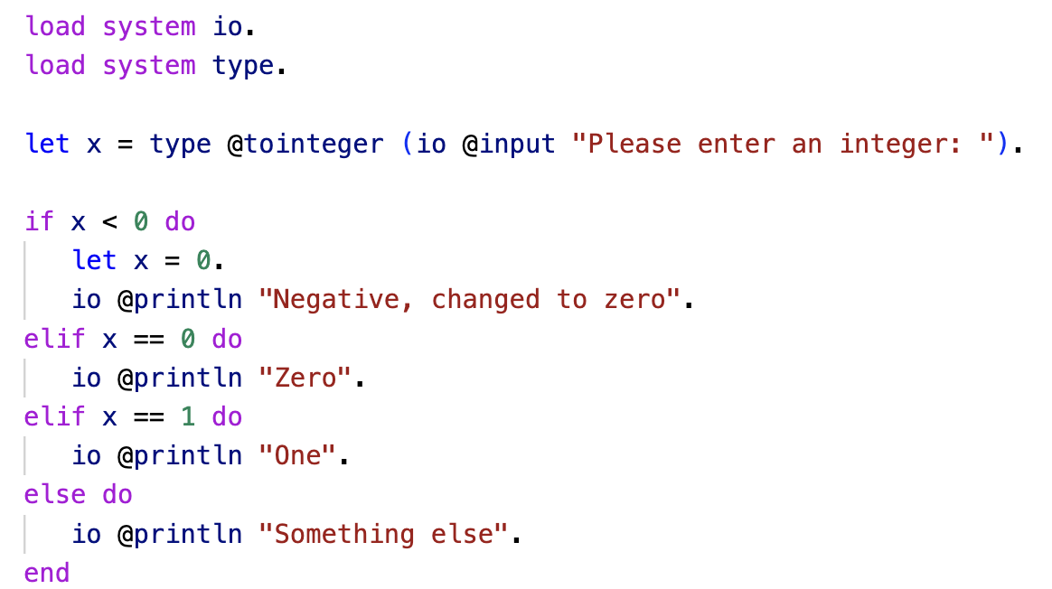
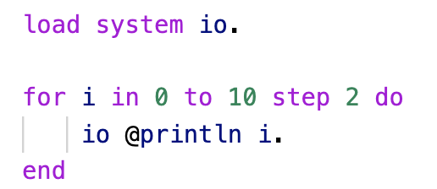
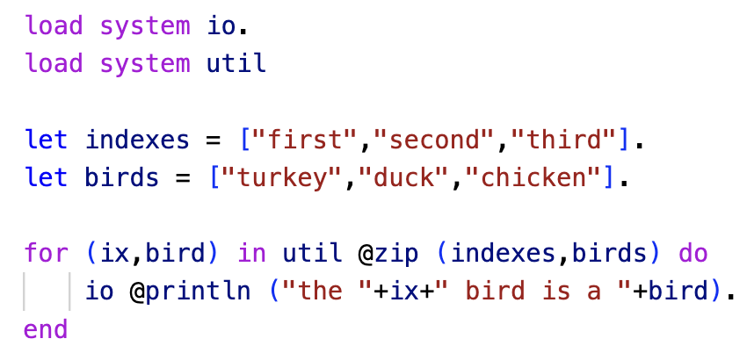
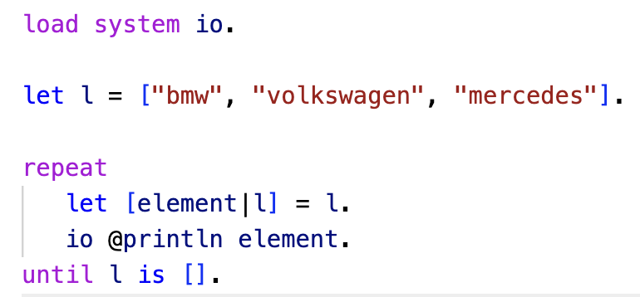
Flow of Control
ln005/if1.ast
ln005/loop1.ast
ln005/loop3.ast
ln005/loop2.ast

Slide 3
Pattern Matching in Control Structures
Pattern matching lies at the heart of Asteroid
Imperative programming and pattern matching cannot really be separated in Asteroid even though they belong to different programming paradigms
We saw some of Asteroid’s pattern matching ability when we discussed the let statement.
Some of the true power of pattern matching is revealed when using it within control structures

Slide 4
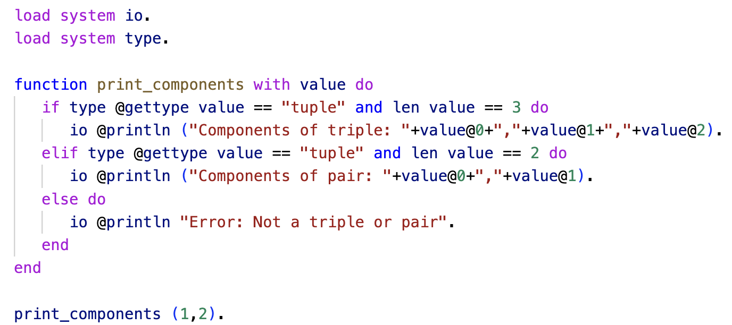
Pattern Matching in If Statements
In if statements we can use the is predicate to do pattern matching.
Example: write a function that accepts a single value. If the value is a triple, print out its component values. If the value is a pair, print out its component values. Otherwise, print out an error message.
ln005/pmif1a.ast

Slide 5
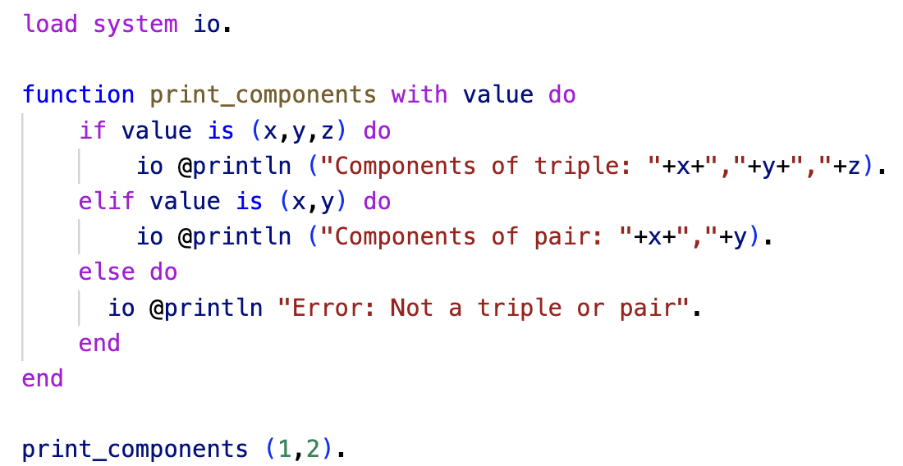
Pattern Matching in If Statements
This has a much nicer solution with pattern matching using the is predicate within the if clauses.
ln005/pmif1b.ast

Slide 6
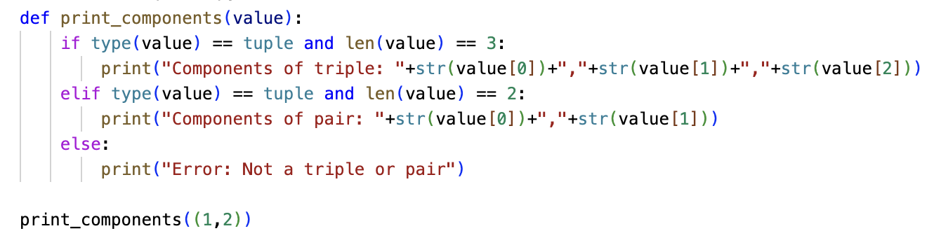
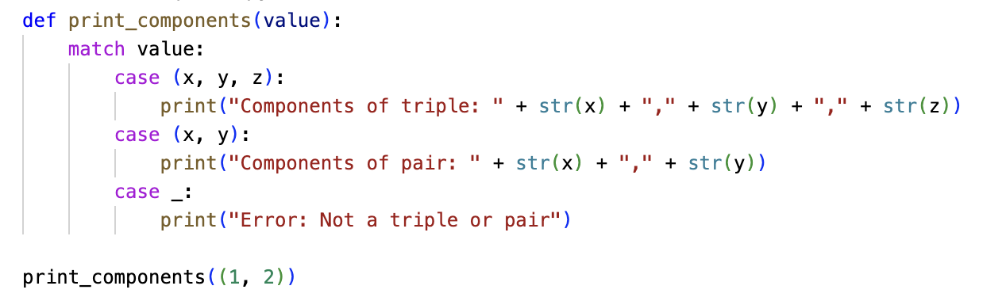
Pattern Matching in If Statements (Python)
ln005/pmif1a.py
ln005/pmif1b.py

Slide 7
Pattern Matching in For Loops
Example: Write a program that constructs a list of Person objects where each object has a name and an age field. Then iterate over this list and write out the name of the persons whose names contain a lowercase ‘p’.

Slide 8
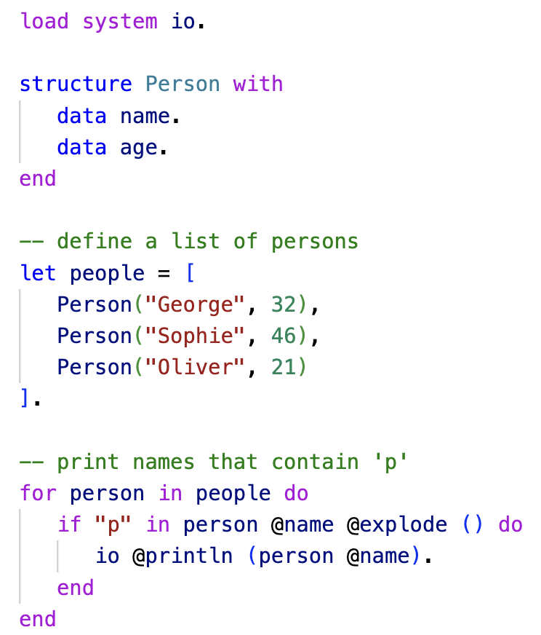
Pattern Matching in For Loops
ln005/pmloop1a.ast

Slide 9
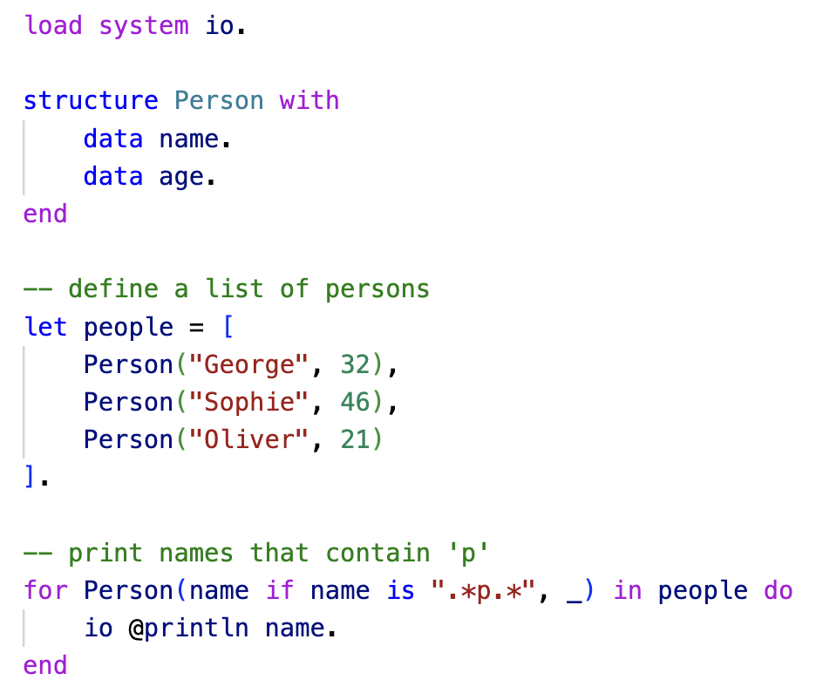
Pattern Matching in For Loops
Here we pattern match the Person object in the for loop,
then use a regular expression to see if the name of that person matches our requirement that it contains a lower case ‘p’.
The output is Sophie.
Pattern matching
ln005/pmloop1b.ast

Slide 10
Declarative Programming
The differences between the non-pattern-match approach and the pattern-match approach are very subtle
In general, pattern matching makes the code more readable because the developer’s intentions and the structure of the data are directly visible
We often talk about declarative programming
Declarative programming is a programming paradigm in which the programmer describes what the program should accomplish, rather than how to accomplish it. In a declarative program, the focus is on the logic of the computation, rather than the control flow.
“The what” rather than the “The How”

Slide 11
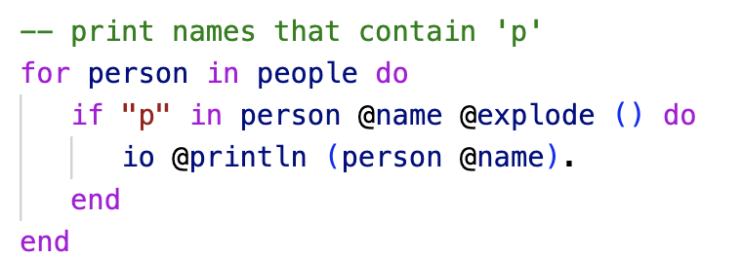
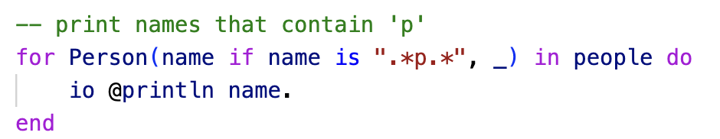
Declarative Programming
Pattern matching is considered a declarative programming technique.
In pattern matching, the programmer specifies patterns that data can match against, rather than explicitly specifying how to manipulate the data.
This allows the programmer to express the logic of the computation in a more direct and readable way,
by describing what the expected inputs look like and what should be done with them,
rather than describing how to manipulate the data step-by-step.
Vs.

Slide 12
Declarative Programming
If we look carefully at our if-else example, we can see the declarative characteristics also
Patterns vs. data access/manipulation logic
Vs.

Slide 13
Pattern Matching in Try-Catch Statements
Exception handling in Asteroid is very similar to exception handling in many of the other modern programming languages available today with one major difference:
Exception objects can be any kind of object
In catch statements the exception objects are pattern matched

Slide 14
Pattern Matching in Try-Catch Statements
Idea: write a program that generates a random value between 0 and 1. If the value is greater or equal to 0.5 then throw a Head object otherwise throw a Tail object.

Slide 15
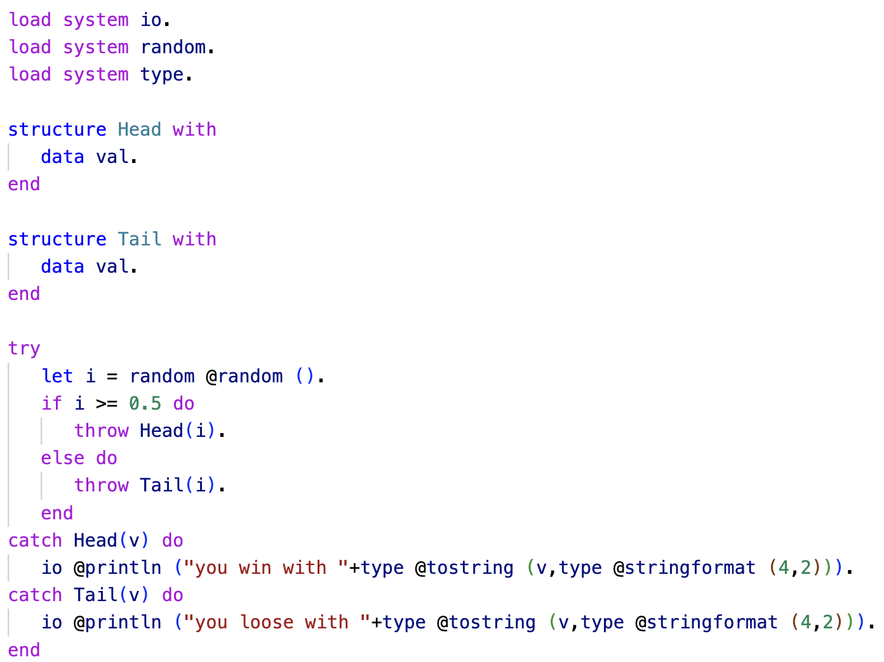
Pattern Matching in Try-Catch Statements

Slide 16
Pattern Matching in Try-Catch Statements
Asteroid also provides built-in Exception objects
All Asteroid and system errors are mapped into these object
See the Asteroid user guide section “More on Exceptions”
asteroid-lang.readthedocs.io/en/latest/User%20Guide.html#more-on-exceptions

Slide 17
Reading
Asteroid user guide section “Flow of Control”
asteroid-lang.readthedocs.io/en/latest/User%20Guide.html#flow-of-control
Asteroid reference guide
https://asteroid-lang.readthedocs.io/en/latest/Reference%20Guide.html

