Slide 1
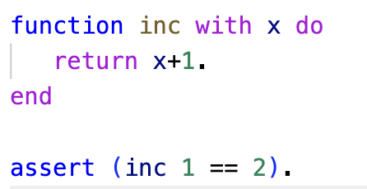
Asteroid Functions
ln006/inc1.ast
Function call via juxtaposition

Slide 2
Asteroid Functions
In the functional programming tradition, Asteroid’s function calls are constructed by juxtaposing a function with a value, e.g. <fname> <arg value>
The implication is that all functions have only a single argument. If you want to pass more than one value to a function you have to construct a tuple of values, e.g. foo (1,2).
Syntactically this looks the same as a function call to foo in Python but semantically it is very different – call foo with the value (1,2) in Asteroid as apposed to call foo with the list of values (1,2) in Python.
As we will see, this slight change of perspective enables effective pattern matching within function definitions in Asteroid.

Slide 3
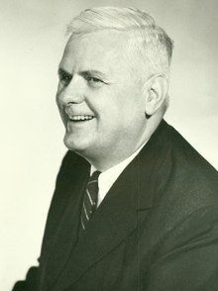
Lambda Calculus
Alonzo Church (1903–1995),
mathematician, logician.
The mathematical idea of function application to values was used by the logician Alonzo Church to create the lambda calculus as a computational foundation of mathematics in the 1930’s.
It can be considered as an alternative to the Turing machine
It is Turing-complete
Anything a TM can compute can also be computed with the lambda calculus
It is considered the semantic foundation of our modern functional languages such as Haskell, Ocaml, Clojure, etc
We have more to say about the lambda calculus when we look at the functional paradigm.
https://en.wikipedia.org/wiki/Lambda_calculus

Slide 4
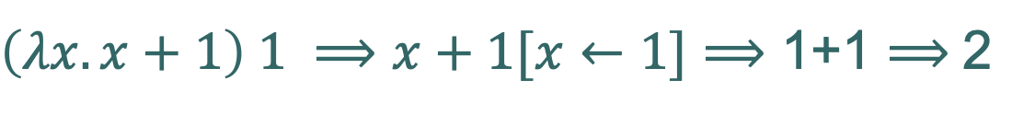
Lambda Calculus
Here is an example of an increment function as a lambda expression applied to a value,
Function application
Function evaluation
$\left(λx.x+1\right) 1 ⟹x+1[x←1]⟹$ 1+1 $⟹$2
body
Function parameter
Value
Substitution

Slide 5
Asteroid Functions
ln006/inc1.ast
inc applied to the value 1

Slide 6
Lambda Calculus
Another example that scales a point in 2D space (a pair of values),
$$\left(λ(x,y).(2x,3y\right)) \left(1,2\right)⟹\left(2x,3y\right)\left[x←1,y←2\right]⟹(2,6)$$
Single parameter!

Slide 7
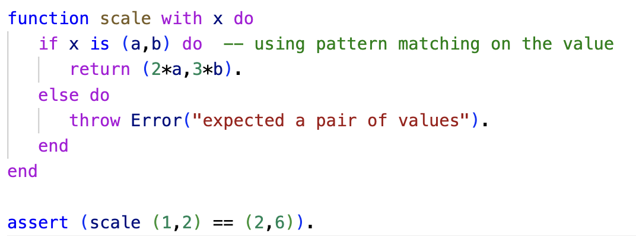
Asteroid Functions
Due to its foundation in Lambda calculus, Asteroid functions have only a single formal parameter,
Single, formal parameter
ln006/scale1.ast

Slide 8
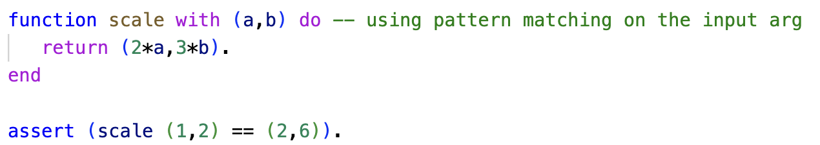
Asteroid Functions
We can pattern match on the single formal parameter,
Single, formal parameter pattern matched
ln006/scale2.ast

Slide 9
Function Calls & the None Type
What if we have a function f that does not require any input parameters?
The problem is that in our function model we need to apply our functions to some sort of value in order to execute the function, e.g. f <value>
But our function does not need an input value…
Solution: make that value the none value, f none or written in the 0-tuple notation f ()
Note: here the () does NOT mean the empty parameter list but represents the value none.
Since this is a value, we can pattern match it in the function body.

Slide 10
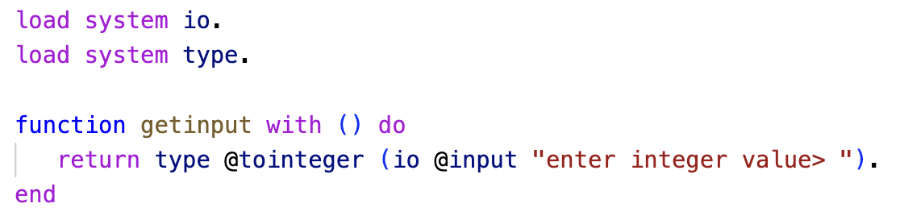
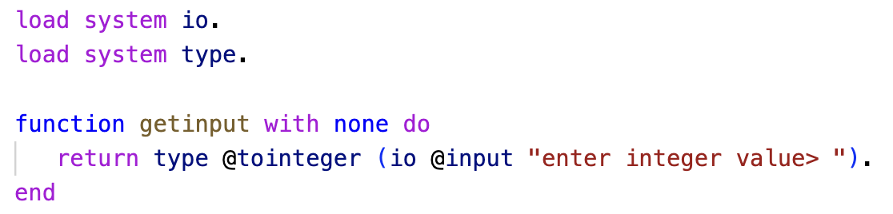
Function Calls & the None Type
For example, a function that asks the user for input and returns that input as an integer value.
Pattern matching
none type constant none = ()
ln006/input1.ast
ln006/input2.ast

Slide 11
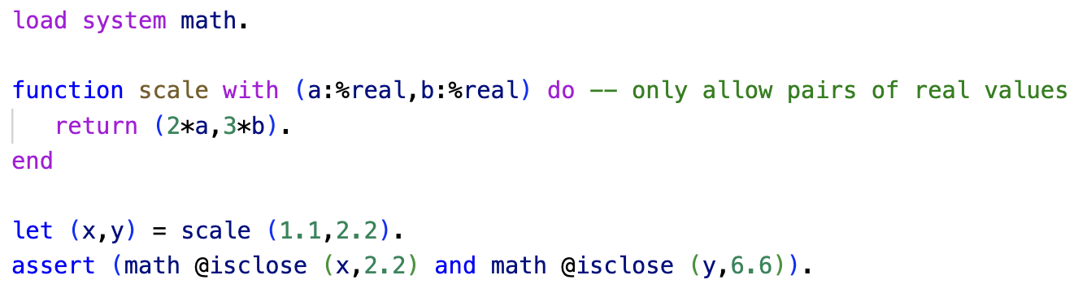
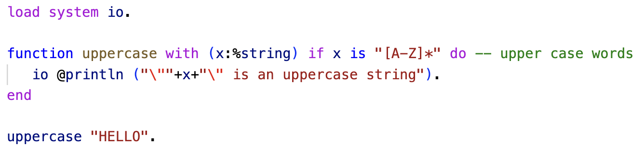
Pattern Matching in Functions
As we have seen, we can pattern match on the function argument
That means we can use all the patterns we have learned so far
ln006/scale3.ast
ln006/string1.ast

Slide 12
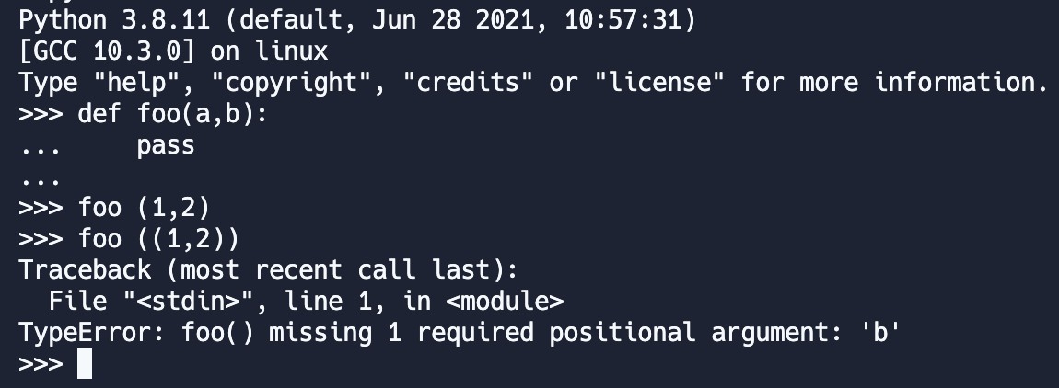
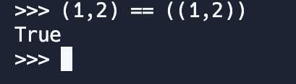
Function Calls in Python
The interpretation of function arguments as a list of values has unexpected implications in Python
foo (1,2) ≠ foo ((1,2)), but
(1,2) = ((1,2))
Inconsistent handling of parenthesized tuples!
but…

Slide 13
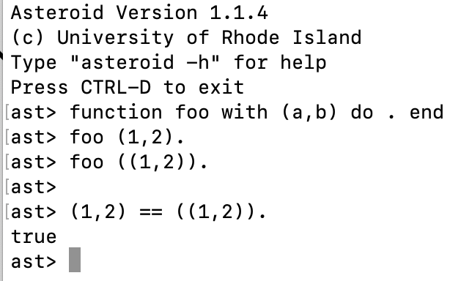
Function Calls
But it works fine in Asteroid,

Slide 14
Functions are Multi-Dispatch
In Asteroid functions are multi-dispatch:
a single function can have multiple bodies each attached to a different pattern matching the actual argument.
This is along the line of declarative programming
Highlight programmer’s intention instead of computational logic

Slide 15
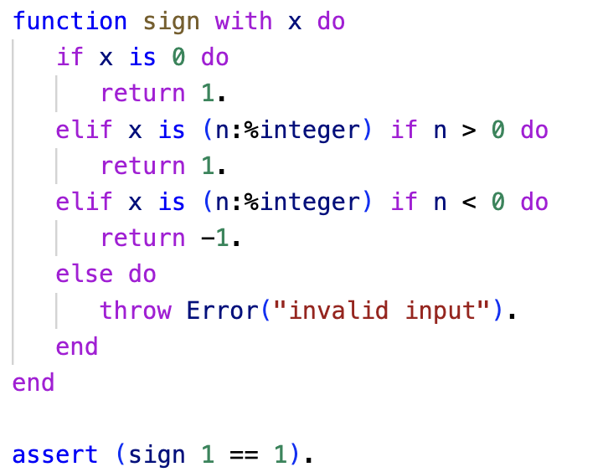
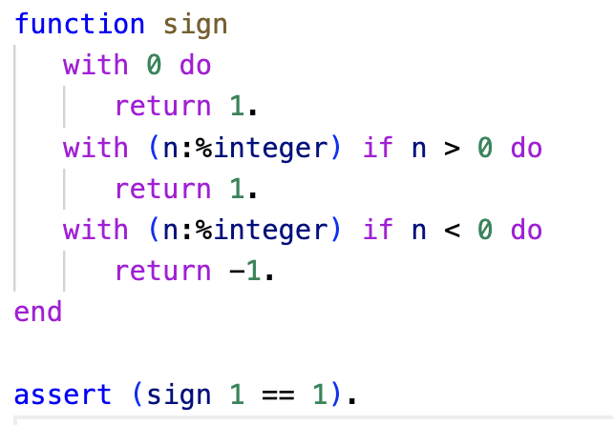
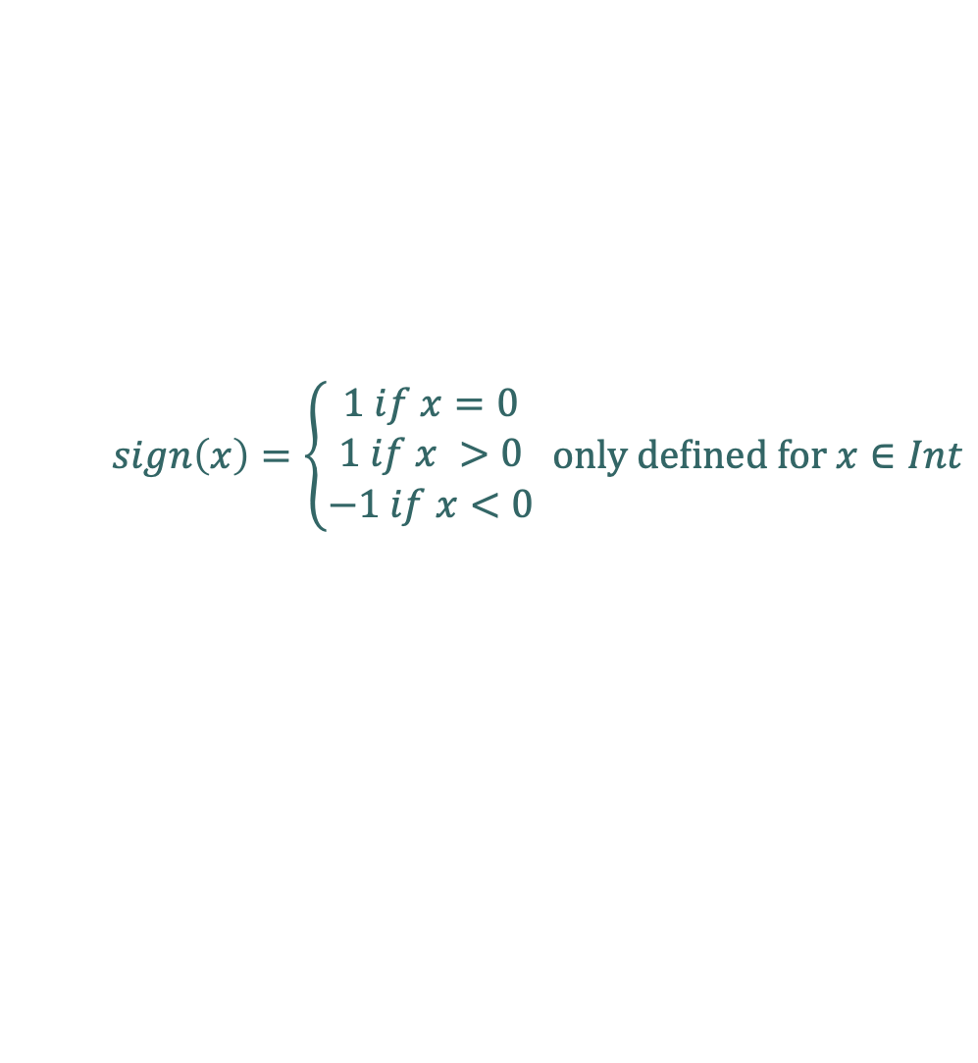
Functions are Multi-Dispatch
$$sign\left(x\right)=\left\{\begin{matrix}1 if x=0 \\ 1 if x >0 \\ −1 if x<0\end{matrix} \text{only} \text{defined} \text{for} x∈Int\right.$$
Multi-Dispatch
ln006/sign1a.ast
ln006/sign1b.ast

Slide 16
Multi-Dispatch and Recursion
Multi-dispatch works exceptionally well with recursive functions
Separate ‘with’ clauses for base- and recursive cases
Recursion is a technique in programming where a function calls itself in order to solve a problem. The function defines a base case, which is the point at which the recursion stops, and a set of rules for reducing the problem to a simpler version of itself. Each time the function calls itself, it applies these rules to the problem in order to make progress towards the base case. Eventually, the problem is simplified enough that the base case is reached and the function stops calling itself, returning a final result.

Slide 17
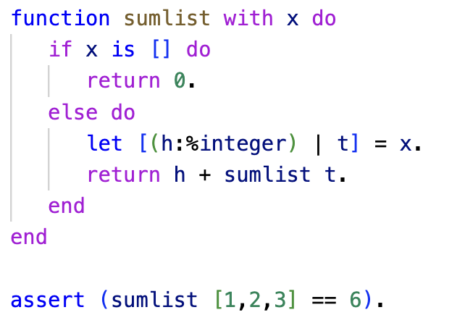
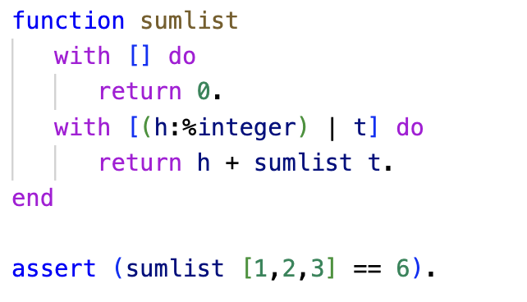
Multi-Dispatch and Recursion
Example: Recursive function that sums the elements of an integer list.
Observation: multi-dispatch preserves the declarative nature of pattern matching
Multi-dispatch
ln006/sumlist1a.ast
ln006/sumlist1b.ast

Slide 18
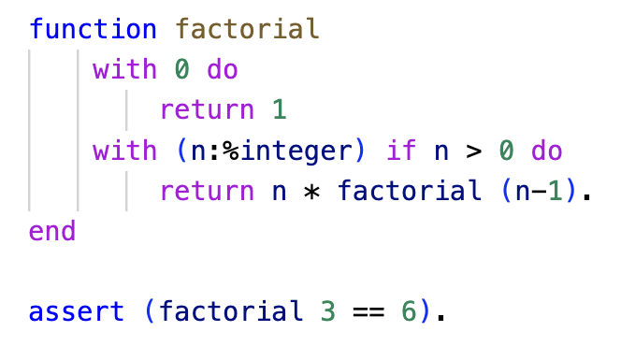
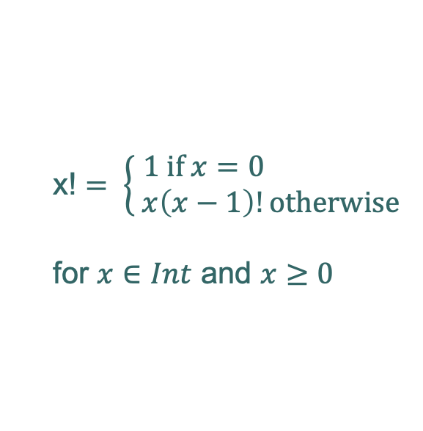
Multi-Dispatch and Recursion
x! $= \left\{\begin{matrix}1 \text{i}\text{f} x=0 \\ x\left(x−1\right)!\text{otherwise}\end{matrix} \right.$
for $x∈Int$ and $x≥0$
ln006/fact1.ast

Slide 19
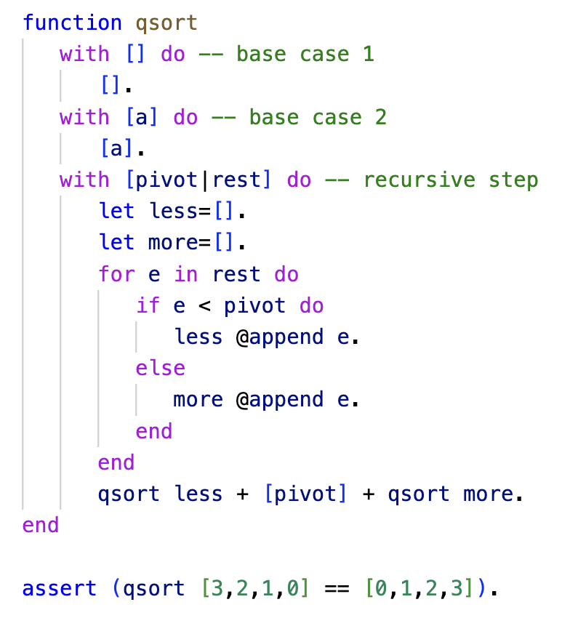
Multi-Dispatch and Recursion
The QuickSort
Recursion with multiple base cases

Slide 20
Reading
asteroid-lang.readthedocs.io/en/latest/User%20Guide.html#functions
asteroid-lang.readthedocs.io/en/latest/User%20Guide.html#pattern-matching

