Slide 1
The Let Statement & Basic Pattern Matching
The let statement is a pattern-match statement in Asteroid, let <pattern> = <value>.
where the pattern on the left side of the equal sign is matched against the value of the right side of the equal sign.
Simple patterns are expressions that consist purely of constructors and variables

Slide 2


The Let Statement & Basic Pattern Matching
When the pattern is just a single variable then the let statement looks like an assignment statement,
However, statements like,
are completely legal,
the 1 on the left is a constructor viewed as pattern, the 1 on the right is a constructor viewed as a value.
highlighting the fact that the let statement is not equivalent to an assignment statement.
Pattern
Value

Slide 3
Basic Patterns
In programs values are represented by constructors,
1
“Hello, World!”
[1,2,3]
Any structure that cannot be reduced any further consists purely of constructors and is the minimal representation of a value
[1,2] + [3] and 1 + 1 can be reduced further
[1,2,3] and 2 cannot be reduced further
The latter are considered the minimal representations of the former values and consist purely of constructors
The idea of values being represented purely by constructors is important for patterns and pattern matching

Slide 4
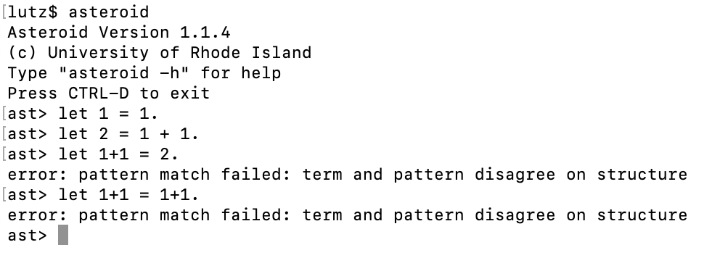
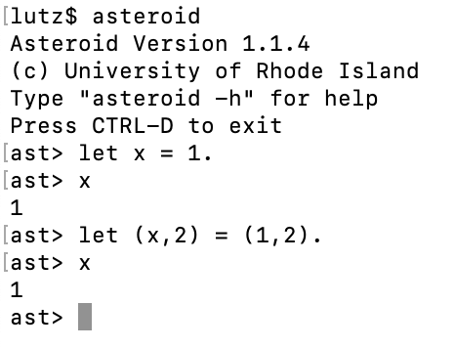
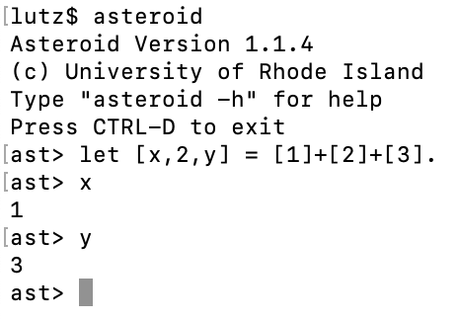
Basic Patterns
Def: A pattern is an expression that consists of constructors and possibly variables.

Slide 5
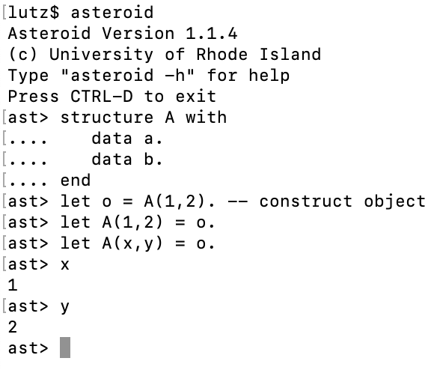
Basic Patterns
This also works for user defined structures/objects
The expression A(1,2) on the left side is considered a constructor and also a pattern
We can insert variables into the constructor, A(x,y), for easy access to the components of the object o
destructuring

Slide 6
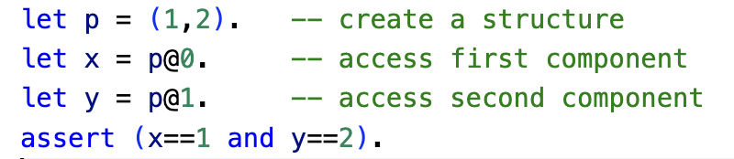
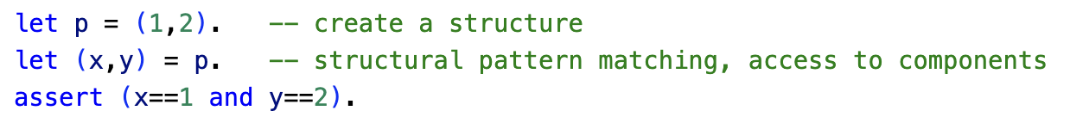
Destructuring
The idea of destructuring is fundamental to pattern matching
It makes access to substructures much more readable (and efficient).
Without structural pattern matching
ln004/destruct1.ast
With structural pattern matching
ln004/destruct2.ast

Slide 7
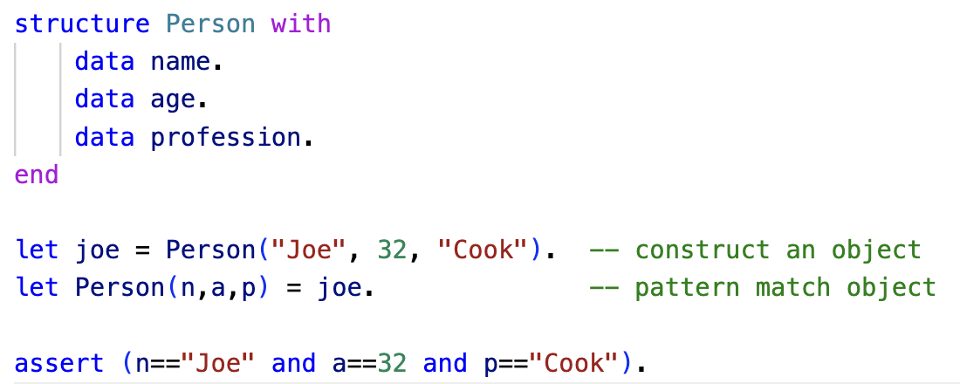
Destructuring
Here is another example using structures and objects
ln004/destruct3.ast

Slide 8
Basic Pattern Matching Summary
The let statement let <pattern> = value .
On the right side of equal sign constructors represent values
Operators/functions are allowed
On the left side they represent structure
Operators/functions are not allowed
Constructors must minimally represent structure

Slide 9
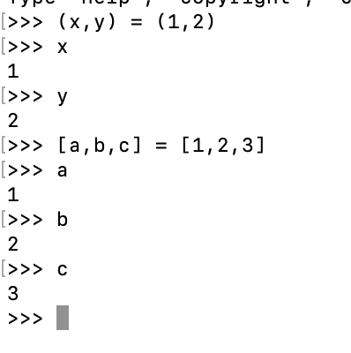
Pattern Matching in Python
Limited pattern matching available with the assignment statement
Called destructuring assignment

Slide 10
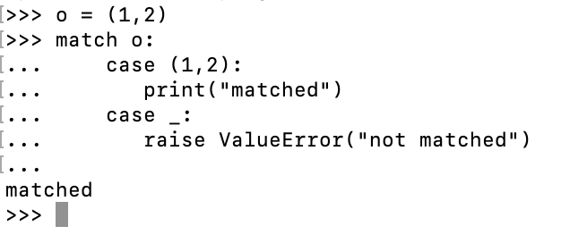
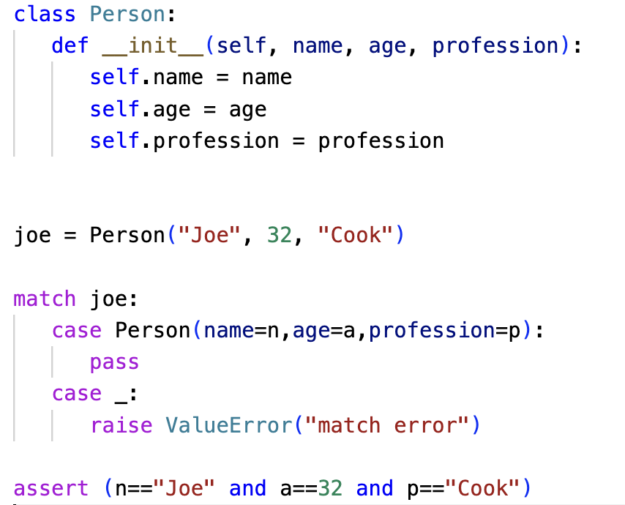
Pattern Matching in Python
The match statement as of 3.10 provides a bit more functionality
ln004/destruct3.py
https://peps.python.org/pep-0636/

Slide 11
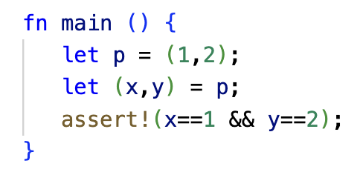
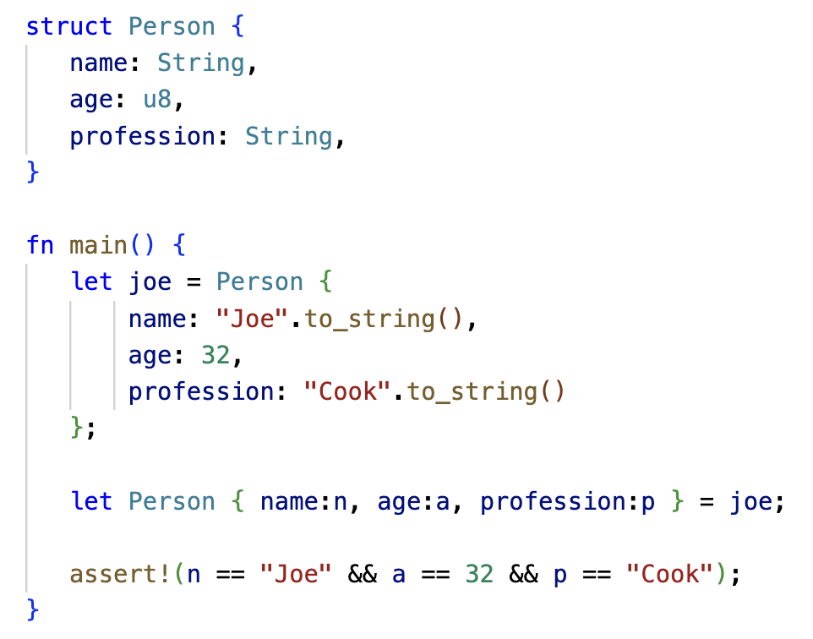
Pattern Matching in Rust
Rust also supports pattern matching
ln004/destruct2.prs
ln004/destruct3.rs

Slide 12
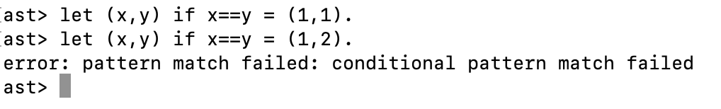
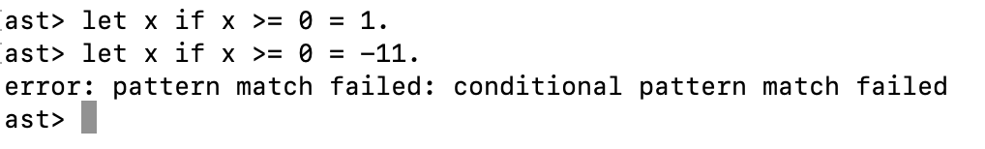
Conditional Pattern Matching
Only assign a pair if the two component values are the same
Only assign positive values to x

Slide 13
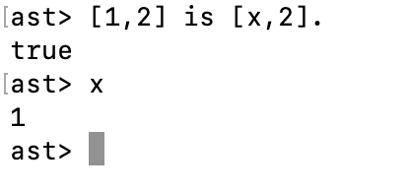
The is Predicate & Type Patterns
Note: a predicate is a function/operator that always returns true or false. No other return value is permitted.
The is predicate is of the form <value> is <pattern and returns true if the value matches the pattern otherwise it will return false
The is predicate allows us to do pattern matching is expressions

Slide 14
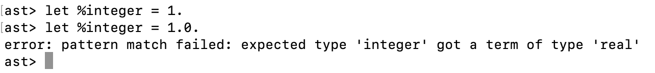
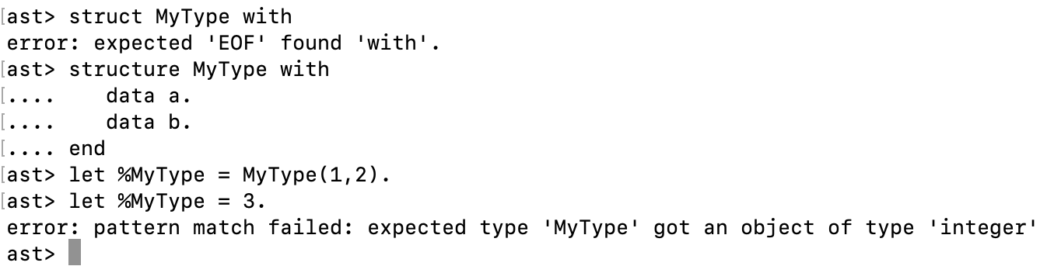
The is Predicate & Type Patterns
Type patterns are patterns of the form %<type name> and match all instances of the <type name>
All built-in types have associated type patterns such as %integer, %real, %string etc.
User defined types are also supported, %<user defined type name>

Slide 15
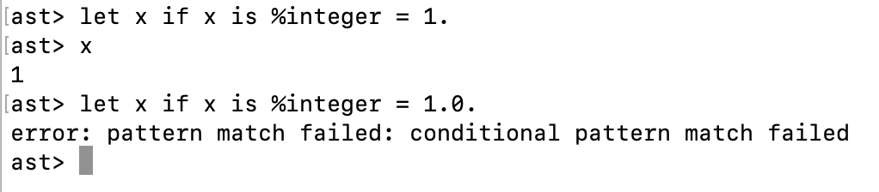
Advanced Pattern Match Expressions
We can combine conditional pattern matching with type patterns and the is predicate to express sophisticated patterns
E.g., only assign a value to x if it is an integer value

Slide 16
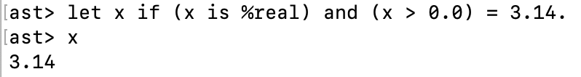
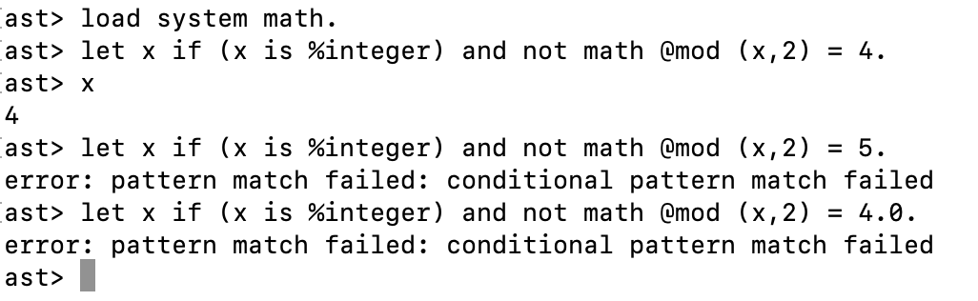
Advanced Pattern Match Expressions
Here are some additional examples,
Note: ‘mod’ is the modulus function

Slide 17
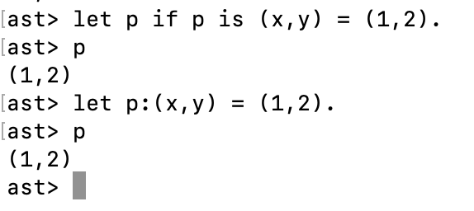
Named Patterns
The simple conditional pattern x if x is <pattern> appears a lot in Asteroid programs
Named patterns of the form x:<pattern> represent a shorthand for the simple conditional patterns above
E.g.

Slide 18
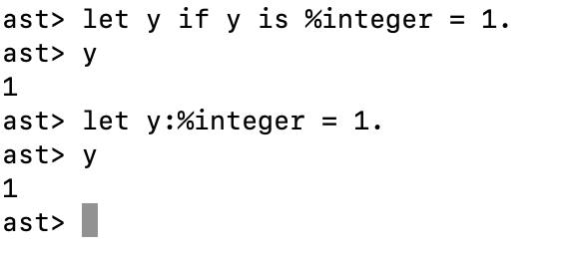
Named Patterns
This shorthand notation is especially useful when combined with type patterns,

Slide 19
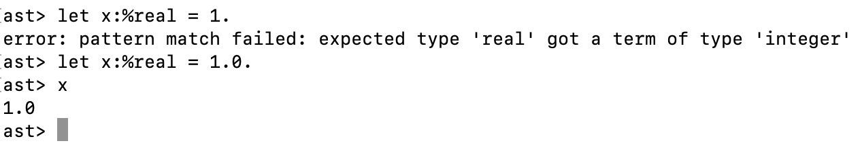
Named Patterns
Beware: even though named patterns with type patterns look like a declarations they are not!
They are pattern match statements; consequently, implicit type conversions we are used to from other programming languages do not work!

Slide 20
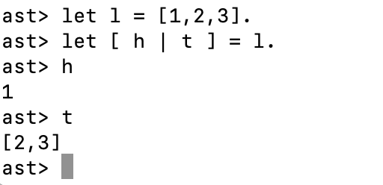
Head-Tail Pattern
The head-tail pattern [ <head var> | <tail var> ] is a useful pattern that allows us to destructure a list into into its first element and the rest of the list; the list with its first element removed.
As we will see later, this pattern will prove extremely useful when dealing with recursion or iteration over lists.

Slide 21
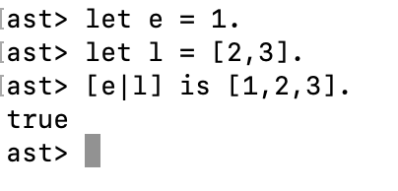
Head-Tail Pattern
The head-tail pattern can also be used “in reverse” – as a constructor,
Given an element and a list it will prepend the element to the list

Slide 22
Pattern Matching with Regular Expressions
Regular expressions are patterns that can be applied to strings
e.g., the regex “a(b)*” matches any string that starts with an a followed by zero or more b’s.
In Asteroid regular expressions are considered patterns and therefore we can write expressions like “abbbb” is “a(b)*”
Asteroid’s regex syntax follows Python’s regex syntax
https://docs.python.org/3/library/re.html

Slide 23
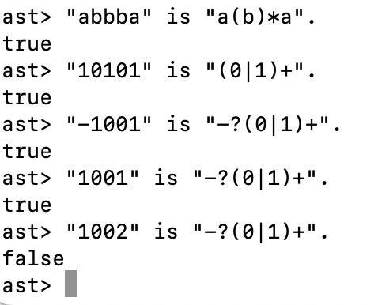
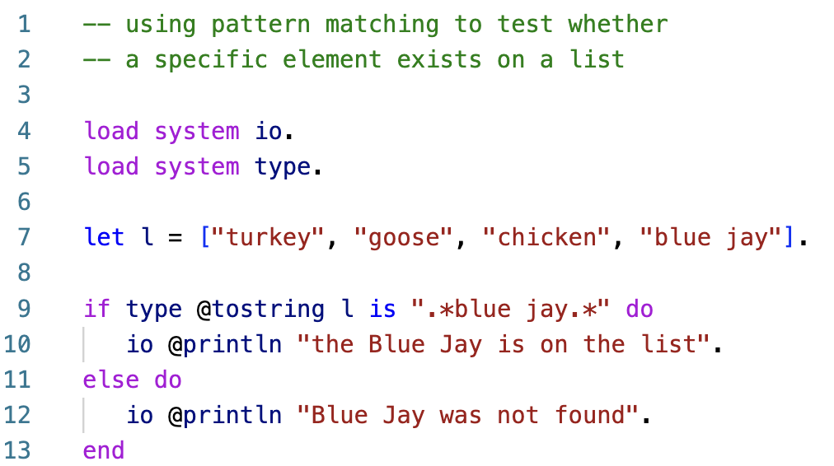
Pattern Matching with Regular Expressions
Pattern matching with regex
Note: (a)+ = a(a)*
ln004/list1.ast

Slide 24
Reading
The Let Statement
asteroid-lang.readthedocs.io/en/latest/User%20Guide.html#the-let-statement

