Slide 1
Higher-Order Programming: The Essence of Functional Programming
Higher-Order programming is defined as
Programming with functions as arguments to other functions or functions as return values from functions.

Slide 2
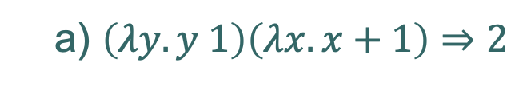
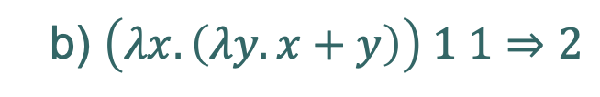
Higher-Order Programming: A Cornerstone of Functional Programming
It is a natural outgrowth from the lambda calculus where
lambda expressions can be passed to other lambda expressions, and
new lambda expressions can be computed by lambda expressions
E.g.
a) $\left(λy.y 1\right)\left(λx.x+1\right)⇒2$
b) $\left(λx.\left(λy.x+y\right)\right) 1 1⇒2$

Slide 3
Modifying Behavior of a Function
We can use this to write generic functions which we can then make specific by passing in desired behavior via a function.
Note: this is NOT programming with generics
Generics are generic with respect to types
Higher-order functions are generic with respect to behavior!

Slide 4
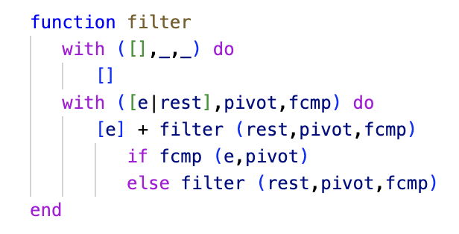
Modifying Behavior of a Function
The ‘filter’ function is generic with regards to the ordering predicate
If e is kept or discarded depends on the passed in function – the filter function has a generic filtering capability which is made specific by the passed in predicate.

Slide 5
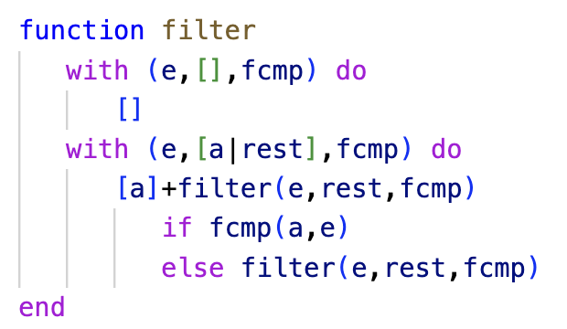
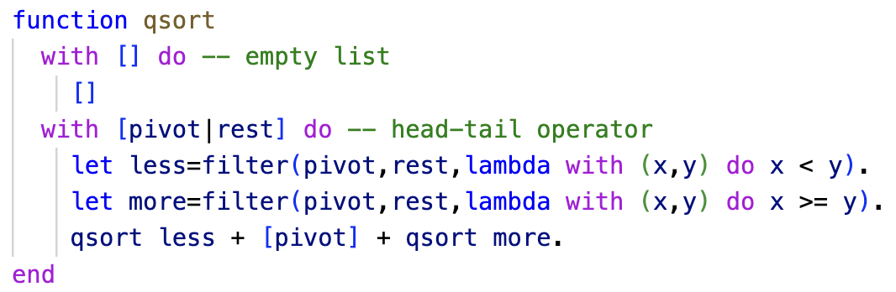
Modifying Behavior of a Function - QuickSort

Slide 6
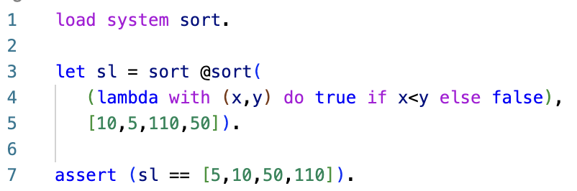
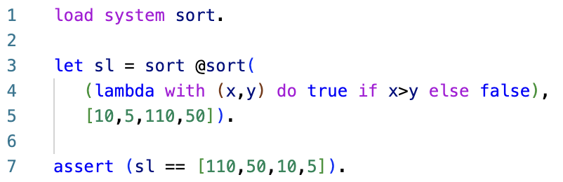
Modifying Behavior of a Function
The Asteroid sort module is another example, sort @sort (p:%function, l:%list)

Slide 7
Dispatch Tables
We can also associate behavior with appropriate keys in a dispatch table.
We can then dispatch (lookup) desired behavior given specific keys.
Example: A generic ‘calculate’ function that takes two values and a key symbol and then performs the appropriate computation.

Slide 8
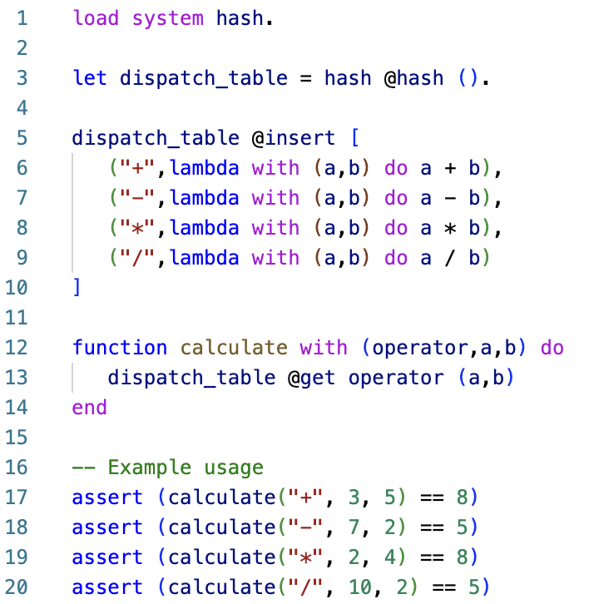
Dispatch Tables
ln012/dispatch2.ast

Slide 9
Map & Reduce
The ‘map’ and ‘reduce’ functions are functions that take a function and apply the given function to ALL the elements of a list.
Both functions are higher-order functions that come straight out of the functional programming tradition.

Slide 10
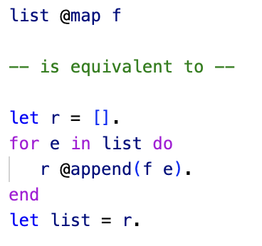
Map
Below is Asteroid code that explains the behavior of the map function.
Beware that map is not required to apply the function f in the sequential manner shown here
For example, it is free to exploit threads to apply the function f in parallel to the elements of the list.
The function argument to f must be of
the same type as the list elements

Slide 11
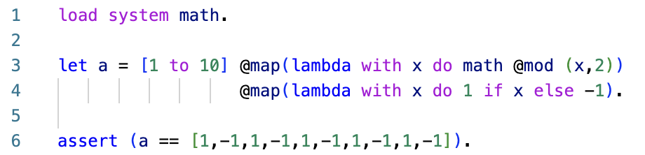
Map
One interesting application of map is the transformation of a simple list constructor into any kind of list
Here we compute a list of alternating 1’s and -1’s.
ln012/map.ast

Slide 12
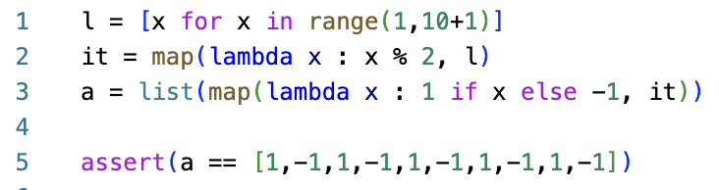
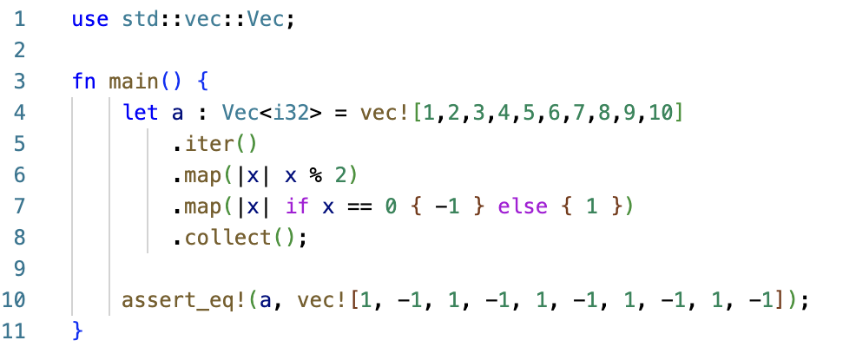
Map
Most modern languages support some form of ‘map’ since it is such a powerful programming tool.
Python
ln012/map.py
Rust
ln012/map.rs

Slide 13
Reduce
Whereas ‘map’ applies a function to a list producing another list, the ‘reduce’ function applies a function to a list so that the list gets reduced to a single value.
In functional languages this is often called ‘fold’ – folding the list into a single value

Slide 14
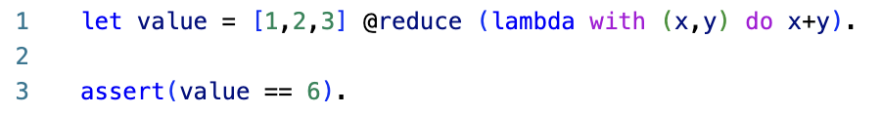
Reduce
For example, the reduce function lets us sum the elements of a list without a loop
ln012/reduce.ast
The argument of the reduce function must be a pair where each component of the pair is of the element type of the list.

Slide 15
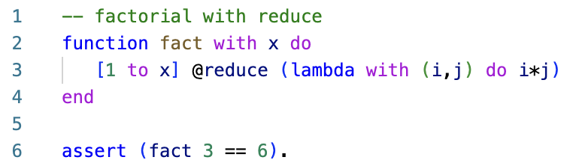
Reduce
The reduce function gives us an interesting way to implement the factorial of an integer
ln012/fact.ast

Slide 16
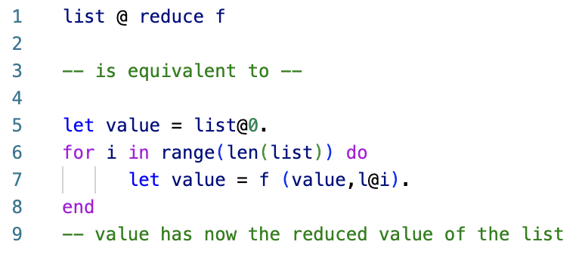
Reduce
The Asteroid code below illustrates the behavior of the ‘reduce’ function
Notice the function application to a pair of values!
The first value of the pair acts like an accumulator containing the partially reduced value at each function application
In the default setting it is initialized to the first element of the list.

Slide 17
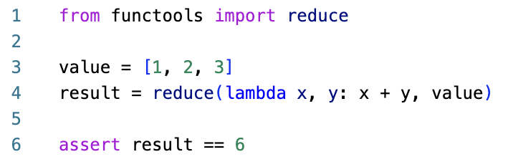
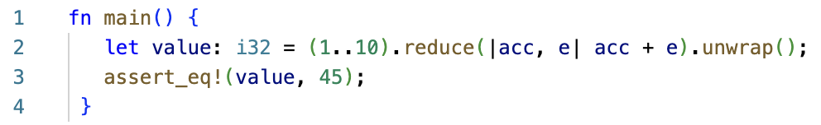
Reduce
Python
ln012/reduce.py
Rust
ln012/reduce.rs

