Slide 1
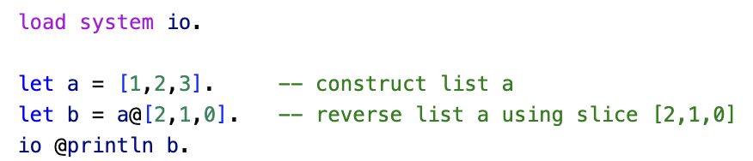
The Let Statement & Basic Pattern Matching
Up till now we have used the let statement basically as an assignment statement into a single variable in the imperative fashion let <var> = <value>.

Slide 2
The Let Statement & Basic Pattern Matching
However, the let statement is a pattern-match statement in Asteroid, let <pattern> = <value>.
where the pattern on the left side of the equal sign is matched against the value of the right side of the equal sign.
Simple patterns are expressions that consist purely of constructors and variables

Slide 3
Pattern Matching – Foundations
In programs values are represented by constructors,
1
“Hello, World!”
[1,2,3]
(“Harry”, 32)
Any structure that cannot be reduced any further consists purely of constructors and is the minimal/canonical representation of a value.
The following are all representations of the value two:
1+1; 3-1; 2*1; 2+0; 2
Only the last one is the canonical representation of the value two.
We say that 2 is a constructor for the value two.
In this case the constructor happens to be a constant.

Slide 4
Pattern Matching – Foundations
Here is another example using lists
The following are all representations of a list with the values one, two, and three
[1]+[2]+[3]; [1,2]+[3]; [1,2,3]+[]; [1,2,3]
Again, only the last one is the canonical representation of the list
It represents the value of a list with integer values one, two, and three.

Slide 5
Pattern Matching – Foundations
Constructors are interesting,
When they are part of an expression being evaluated, they represent values
Otherwise, they represent structure.
We see this with the let statement, let <pattern> = <value>.
On the right of the = sign constructors represent values
On the left of the = sign constructors represent structure
In a let statement, when the structure of the value on the right matches the structure of the pattern on the left, we say that we have a successful pattern match.

Slide 6
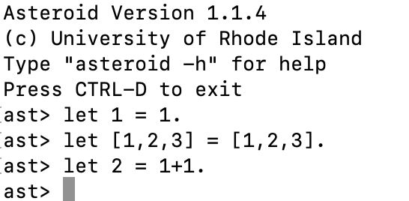
Pattern Matching – Foundations
For example,
The last example is interesting, the right is not in the canonical representation for the value 2, so it is first reduced (evaluated) to its canonical form and then successfully pattern matched.

Slide 7
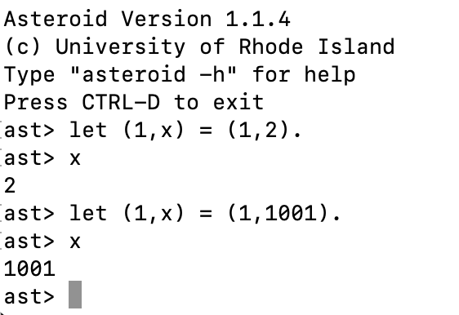
Pattern Matching – Foundations
You can think of variables in a pattern as a “I don’t care” structure
During a pattern match the variable will receive the structure that was actually matched during the pattern match

Slide 8


Pattern Matching – Foundations
When the pattern is just a single variable then the let statement looks like an assignment statement,
However, statements like,
are completely legal,
the 1 on the left is a constructor viewed as pattern, the 1 on the right is a constructor viewed as a value.
highlighting the fact that the let statement is not equivalent to an assignment statement.
Pattern
Value

Slide 9
Pattern Matching – Foundations
Patterns are all about structure
For example,
a wildlife biologist might use pattern matching to identify a specific species of bird based on its size, coloration, and distinctive markings on its feathers – structure.
They would compare these characteristics to a known set of patterns for different bird species from a field guide and use this information to make an accurate identification.
Observe, the structure of a value (unknown bird) is pattern-matched against a set of known patterns. If one of the patterns matches the value (bird) then we have a match (identification).

Slide 10
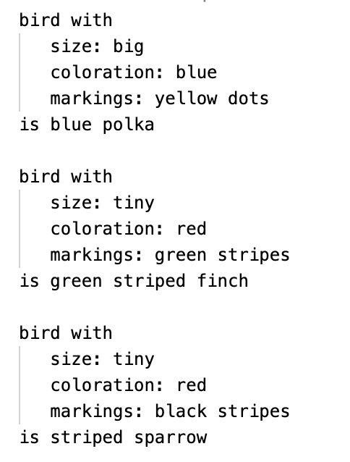
Pattern Matching – Foundations
We can code that biologist example using pattern matching
Assume we have a field guide with the following patterns

Slide 11
Pattern Matching – Foundations
We can solve this problem nicely with pattern matching in Asteroid,
We will encode the patterns as 3-tuples
We write a let statement for each pattern
When let statements fail they throw an exception, we will embed the let statements in a try-catch block so we can detect the pattern match failure

Slide 12
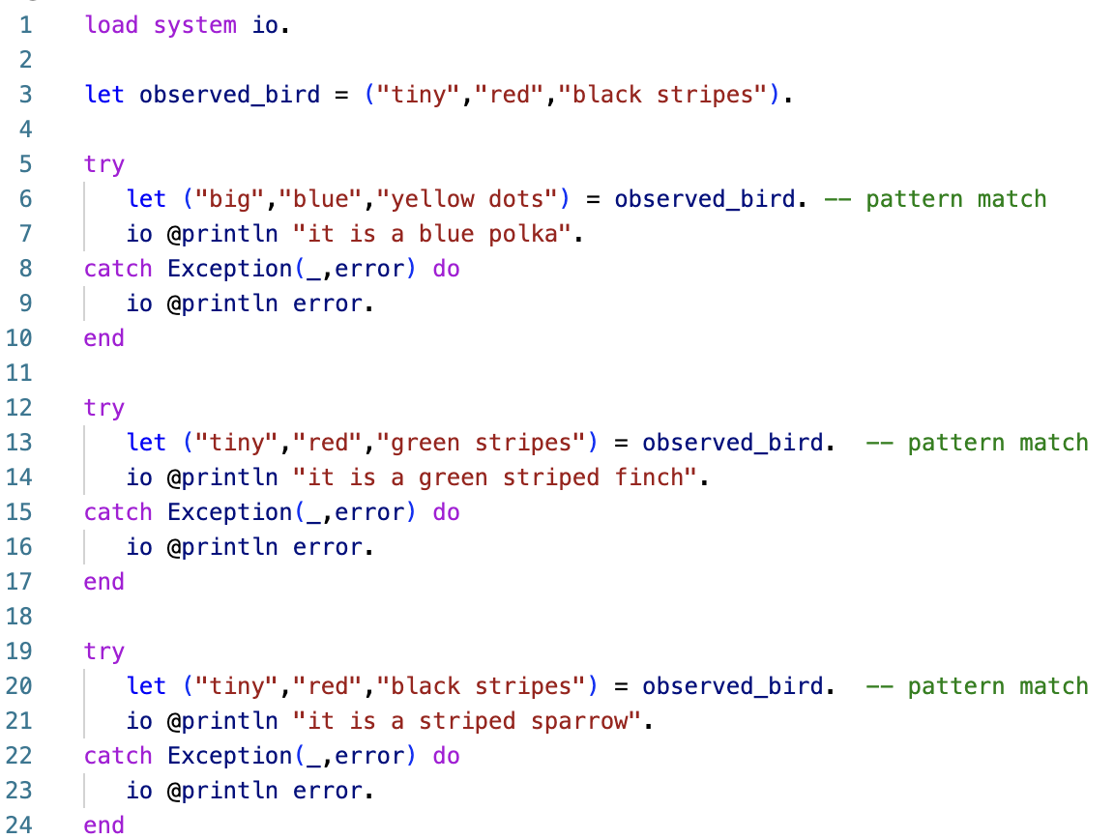
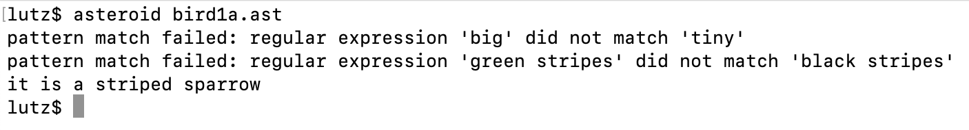
Pattern Matching – Foundations
ln004/bird1a.ast

Slide 13
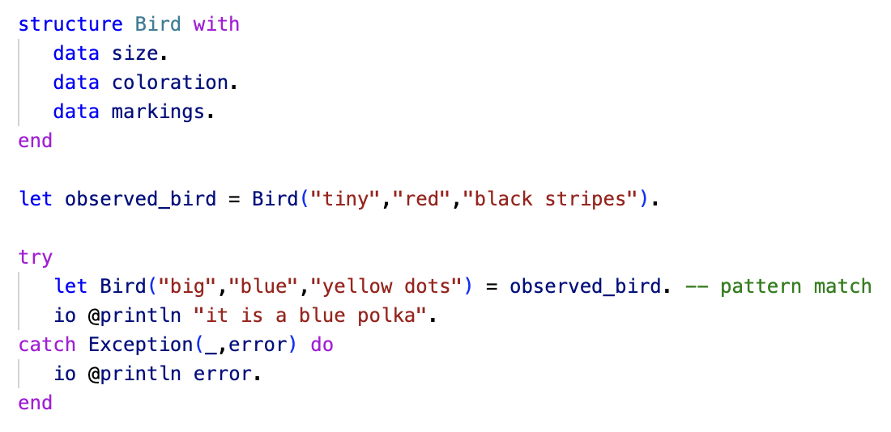
Pattern Matching – Foundations
It is nicer to represent the patterns as bird objects
This way we stay closer to the original problem setting. E.g.,

Slide 14
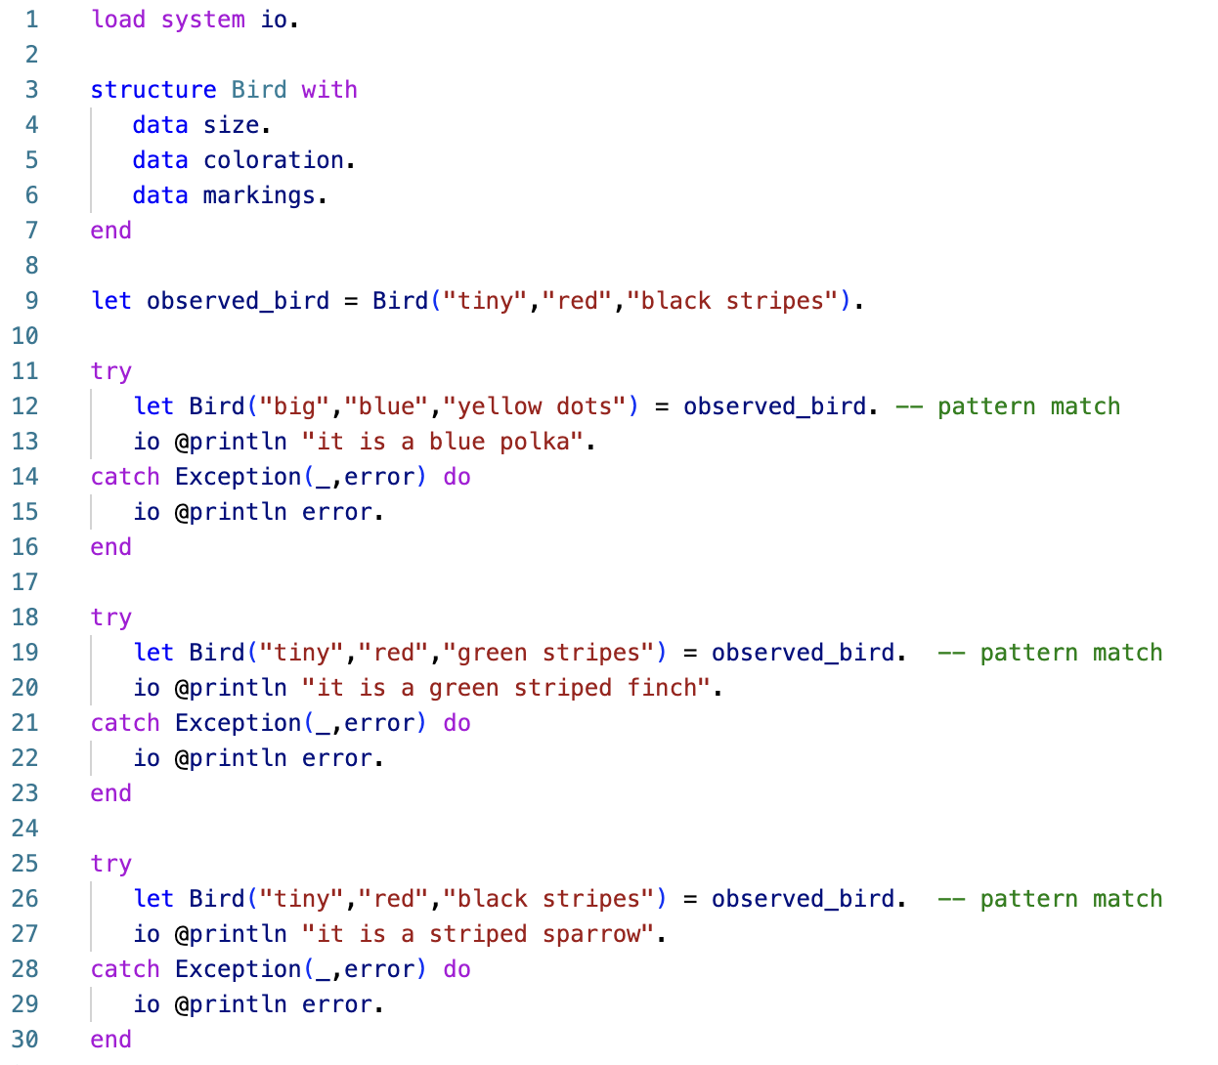
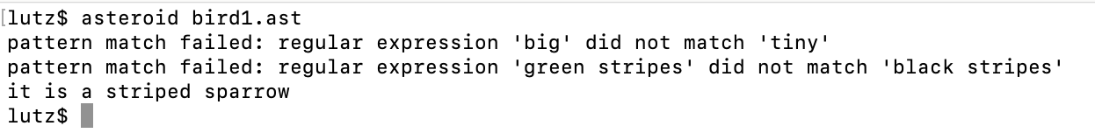
Pattern Matching – Foundations
ln004/bird1b.ast

Slide 15
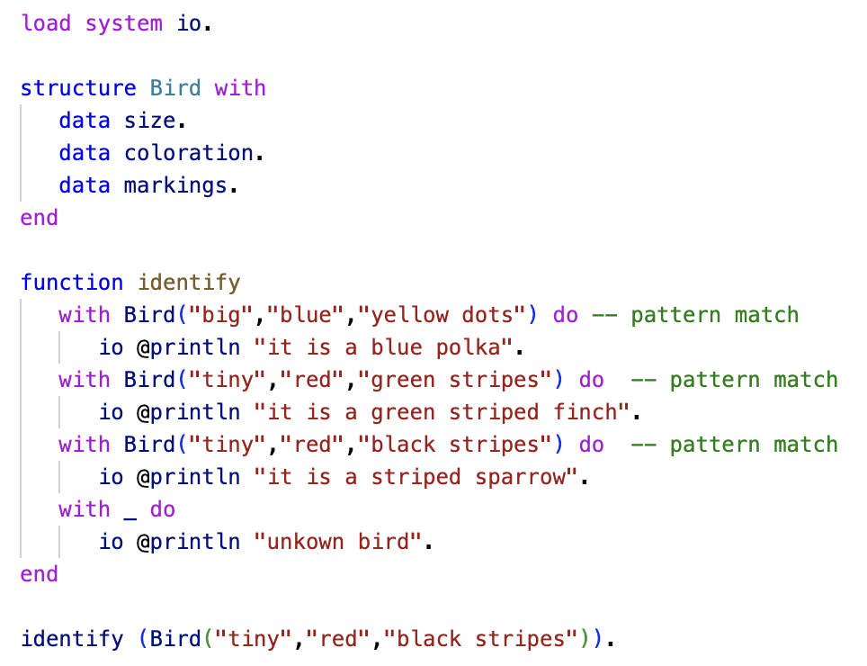
Pattern Matching – Foundations
Here is a much more elegant solution using pattern matching in functions
ln004/bird2.ast

Slide 16
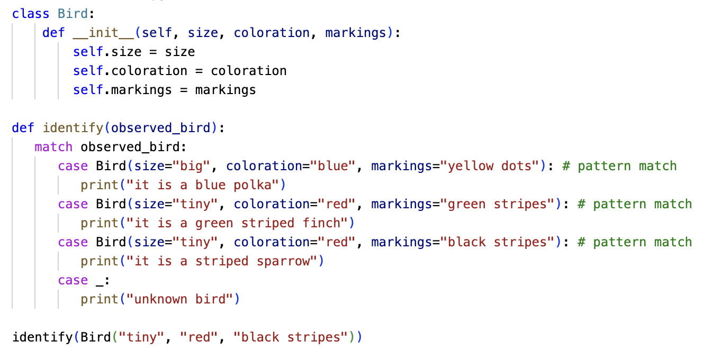
Pattern Matching – Foundations
Here is a solution using pattern matching in Python
ln004/bird2.py

Slide 17
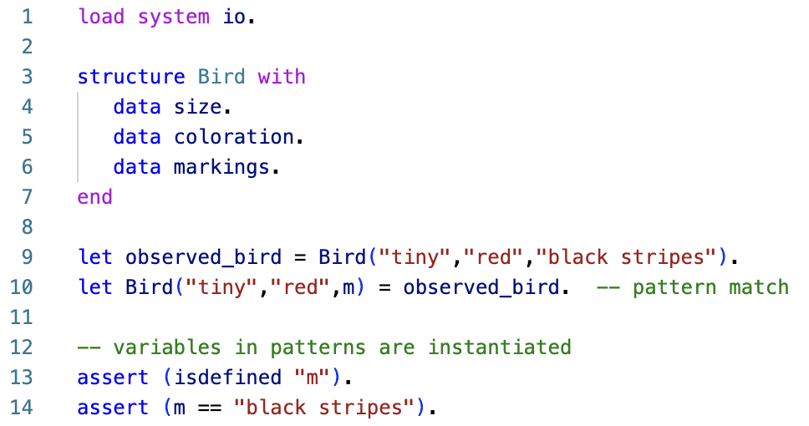
Pattern Matching – Foundations
Variables allow for partial matches
Variables in patterns are instantiated in the current environment
ln004/bird3.ast

Slide 18
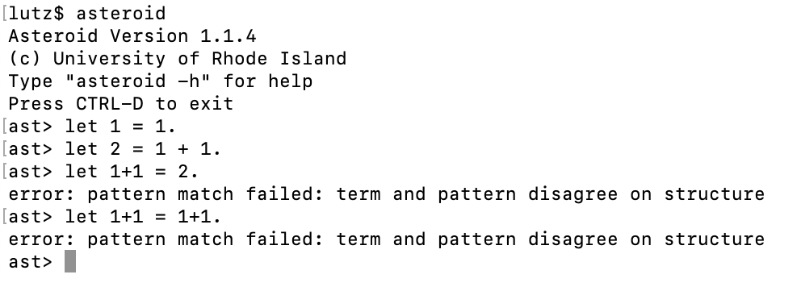
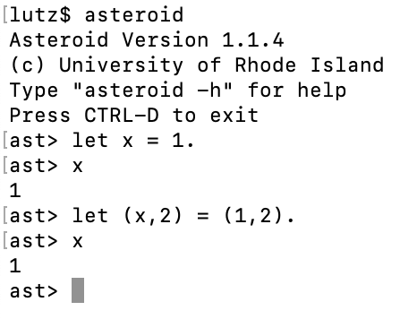
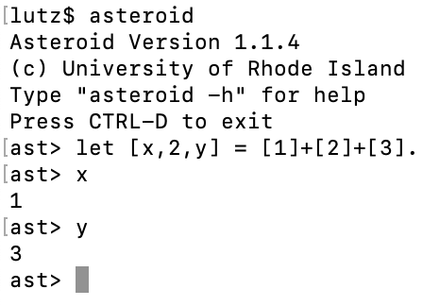
Basic Patterns
Something a bit more CS related

Slide 19
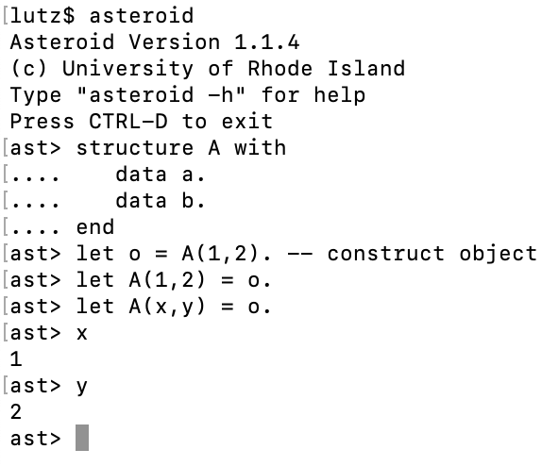
Basic Patterns
The idea of constructors on the right representing values and, on the left, representing structure/patterns also works for objects!
The expression A(1,2) on the left side is a constructor for the object considered as a pattern
We can insert variables into the constructor, A(x,y), for easy access to the components of the object o
destructuring

Slide 20
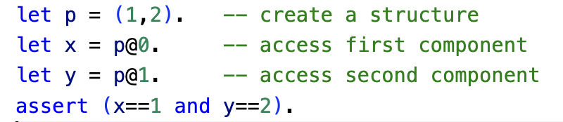
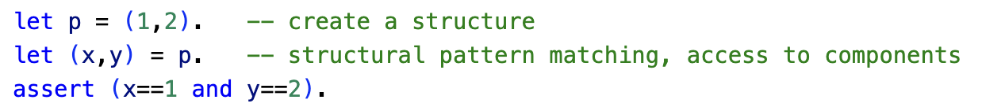
Destructuring
The idea of destructuring is fundamental to pattern matching
It makes access to substructures much more readable (and efficient).
Without structural pattern matching
ln004/destruct1.ast
With structural pattern matching
ln004/destruct2.ast

Slide 21
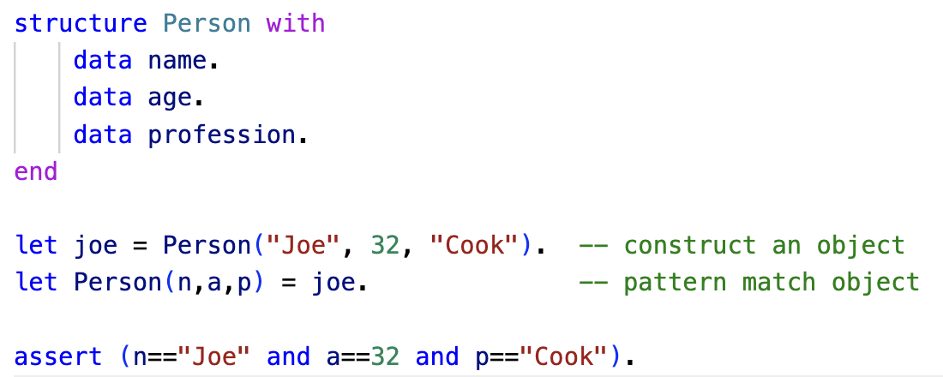
Destructuring
Here is another example using structures and objects
ln004/destruct3.ast

Slide 22
Basic Pattern Matching Summary
The let statement let <pattern> = value .
On the right side of equal sign constructors represent values
Operators/functions are allowed
On the left side constructors represent structure
Operators/functions are not allowed
Constructors must minimally represent structure
Variables are allowed in patterns for partial matches/destructuring
Pattern matching is part of a programming paradigm called declarative programming
We will look at this more carefully when we examine control structures in Asteroid.

Slide 23
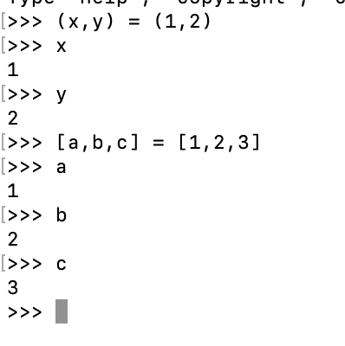
Pattern Matching in Python
Limited pattern matching available with the assignment statement
Called destructuring assignment

Slide 24
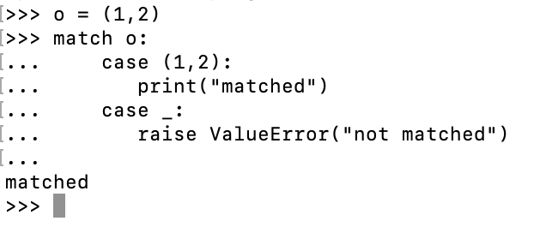
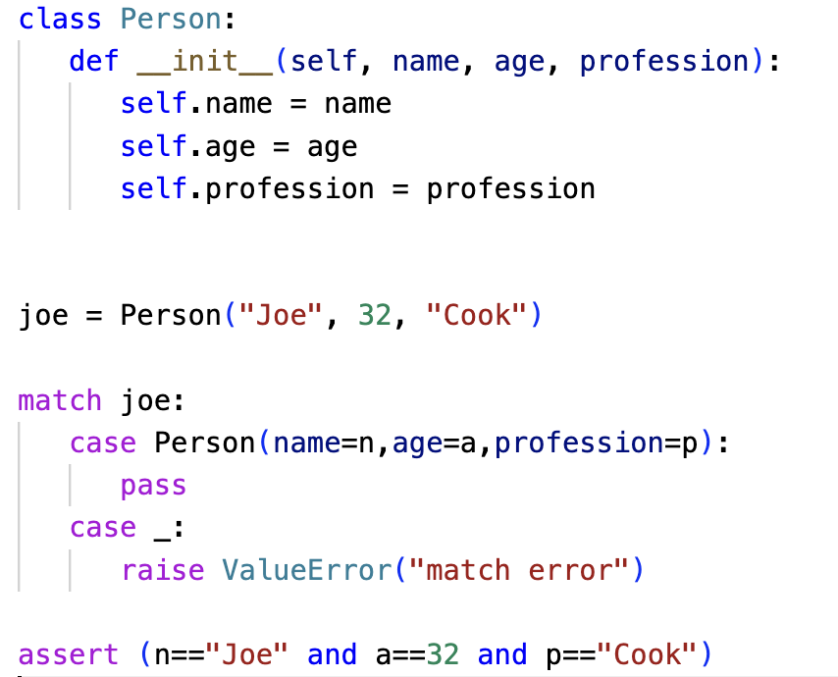
Pattern Matching in Python
The match statement as of 3.10 provides a bit more functionality
ln004/destruct3.py
https://peps.python.org/pep-0636/

Slide 25
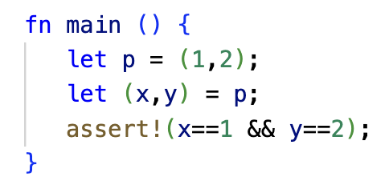
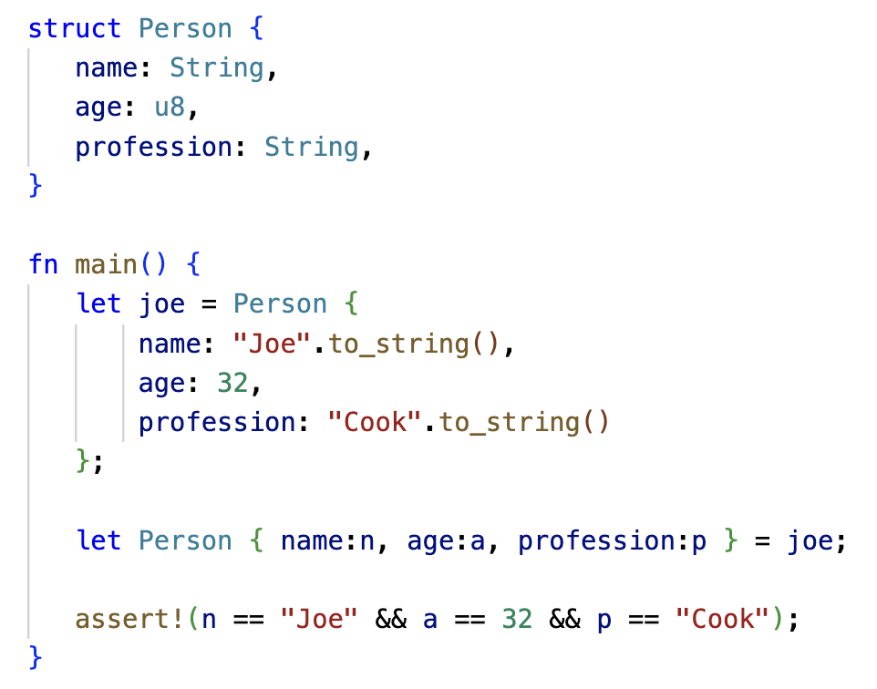
Pattern Matching in Rust
Rust also supports pattern matching
ln004/destruct2.prs
ln004/destruct3.rs

Slide 26
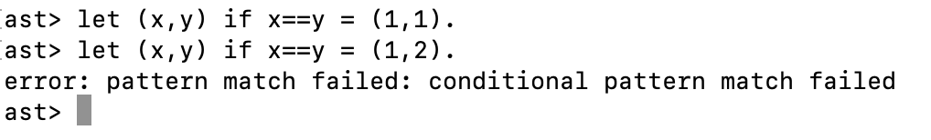
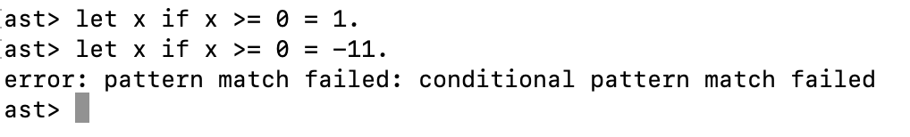
Conditional Pattern Matching
Only assign a pair if the two component values are the same
Only assign positive values to x

Slide 27
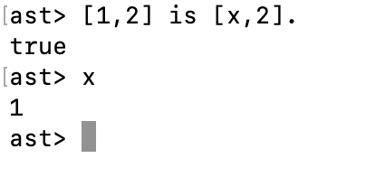
The is Predicate
Note: a predicate is a function/operator that always returns true or false. No other return value is permitted.
The is predicate is of the form <value> is <pattern> and returns true if the value matches the pattern otherwise it will return false
The is predicate allows us to do pattern matching is expressions

Slide 28
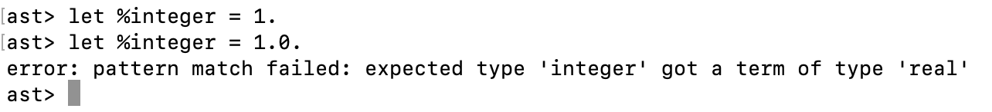
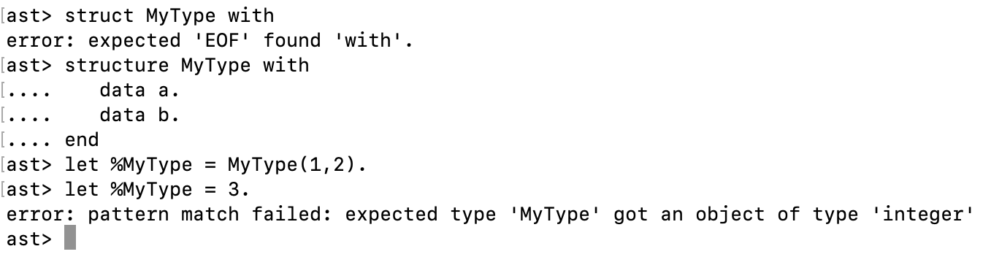
Type Patterns
Type patterns are patterns of the form %<type name> and match all instances of the <type name>
All built-in types have associated type patterns such as %integer, %real, %string etc.
User defined types are also supported, %<user defined type name>

Slide 29
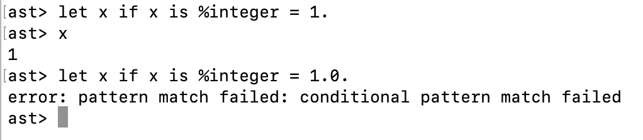
Advanced Pattern Match Expressions
We can combine conditional pattern matching with type patterns and the is predicate to express sophisticated patterns
E.g., only assign a value to x if it is an integer value

Slide 30
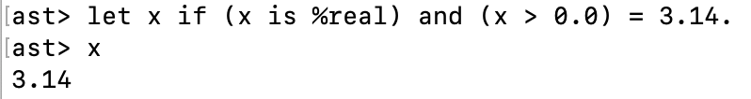
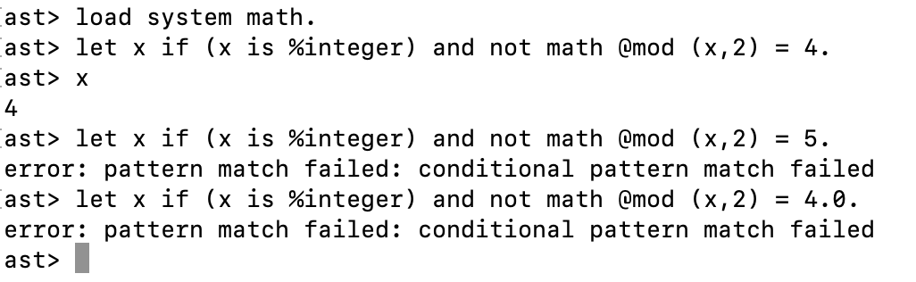
Advanced Pattern Match Expressions
Here are some additional examples,
Note: ‘mod’ is the modulus function

Slide 31
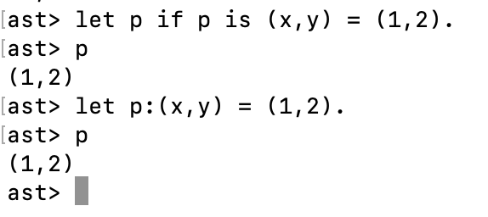
Named Patterns
The simple conditional pattern x if x is <pattern> appears a lot in Asteroid programs
Named patterns of the form x:<pattern> represent a shorthand for the simple conditional pattern above
E.g.

Slide 32
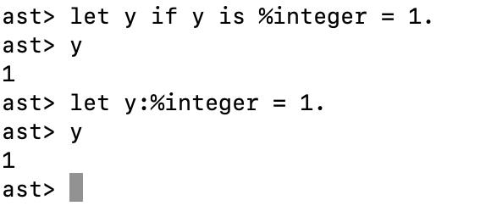
Named Patterns
This shorthand notation is especially useful when combined with type patterns,

Slide 33
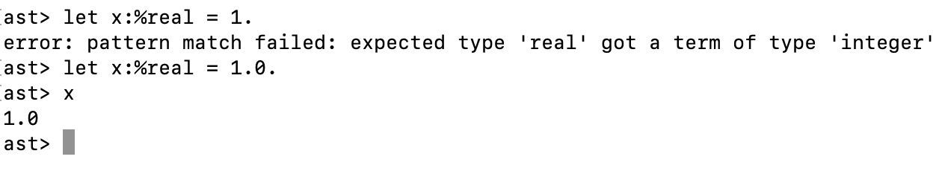
Named Patterns
Beware: even though named patterns with type patterns look like a declarations they are not!
They are pattern match statements; consequently, implicit type conversions we are used to from other programming languages do not work!

Slide 34
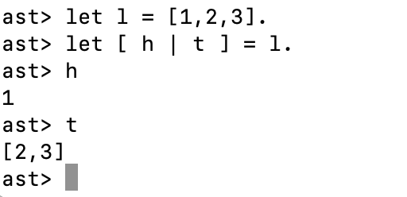
Head-Tail Pattern
The head-tail pattern [ <head var> | <tail var> ] is a useful pattern that allows us to destructure a list into into its first element and the rest of the list; the list with its first element removed.
As we will see later, this pattern will prove extremely useful when dealing with recursion or iteration over lists.

Slide 35
Pattern Matching with Regular Expressions
Regular expressions are patterns that can be applied to strings
e.g., the regex “a(b)*” matches any string that starts with an a followed by zero or more b’s.
In Asteroid regular expressions are considered patterns and therefore we can write expressions like “abbbb” is “a(b)*”
Asteroid’s regex syntax follows Python’s regex syntax
https://docs.python.org/3/library/re.html

Slide 36
Pattern Matching with Regular Expressions
Regular expressions is a formal language that defines lexical patterns of character strings
As shown before, the regular expression “a(b)*” describes a pattern that matches any string that starts with an ‘a’ character followed by zero or more ‘b’ characters.
Possible matches are “a”, “ab”, “abb”, “abbb”, etc

Slide 37
Pattern Matching with Regular Expressions
Any single, printable character is a RE, e.g., “A” or “1”
The concatenation “<RE1><RE2>” is also an RE, e.g. “ab”
The “<RE>*” operator means match the RE zero or more times, e.g. “a*” and “(ab)*”
The “<RE>+” operator means match the RE one or more times, e.g. “a+” and “(ab)+”
The “<RE>?” operator means match the RE if it exists, e.g. “a(b)?c”
The “<RE1>|<RE2>” operator means match either RE1 or RE2.
The ”.” operator matches any character
“a+” = “a(a)*”
Note: REs are a very rich language, see more at https://docs.python.org/3/library/re.html

Slide 38
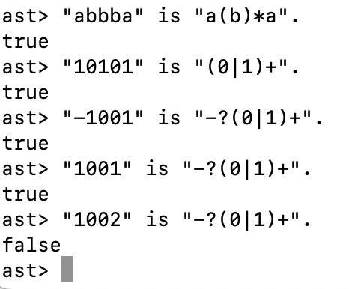
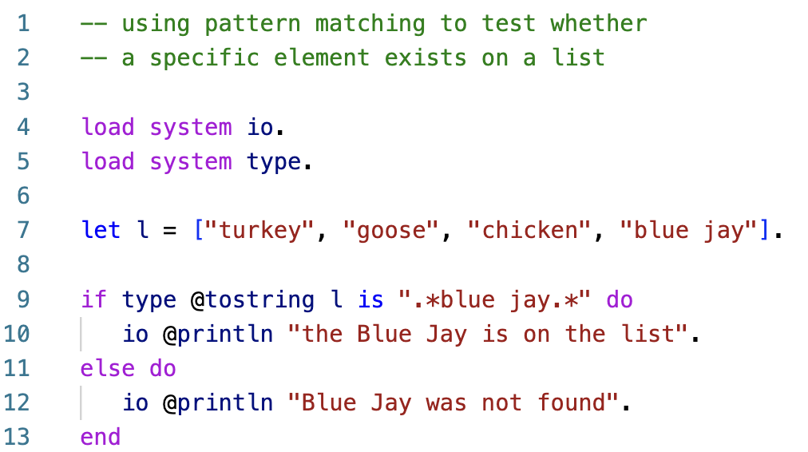
Pattern Matching with Regular Expressions
Pattern matching with regex
ln004/list1.ast

Slide 39
Reading
The Let Statement
asteroid-lang.readthedocs.io/en/latest/User%20Guide.html#the-let-statement

