Slide 1
Advanced Features & Applications
Having promoted patterns to first-class status means that we have effectively separated the point of definition of patterns from the point where patterns are applied
This allows for novel applications of patterns.

Slide 2
Pattern Reuse
The ability of reusing patterns frees a developer from having to retype the same pattern repeatedly in their code.
The ability of reusing patterns makes code much more robust from a software engineering perspective
In software engineering it is frowned upon to explicitly repeat the same code in your program
A maintenance nightmare: if anything ever changes in the repeated code you will have to go through all the repeated instances manually and update them

Slide 3
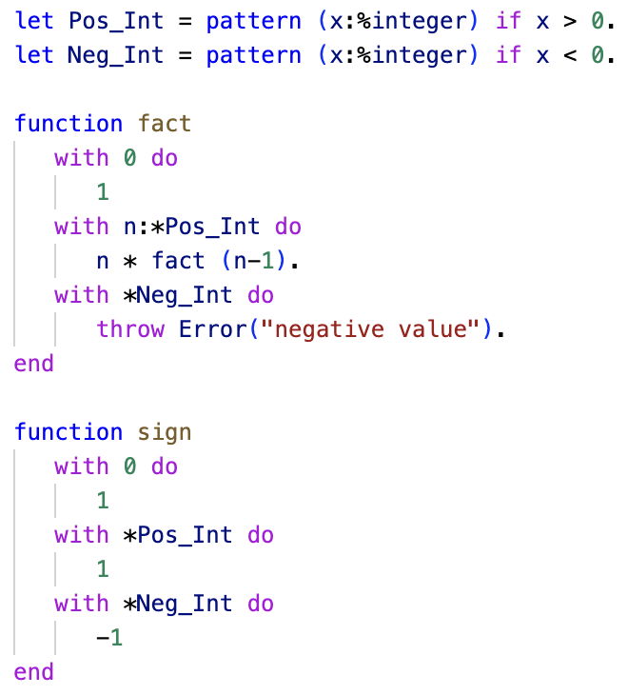
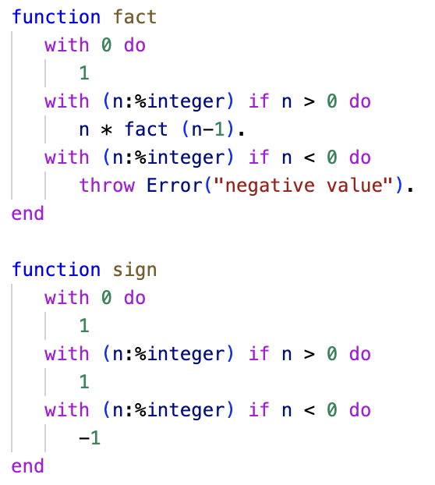
Pattern Reuse
ln015/reuse1.ast
ln015/reuse2.ast

Slide 4
Pattern Factoring
Patterns can become quite complex given that we can add
Conditionals with multiple terms
Nested structures such as lists of lists, tuples of lists, lists of tuples, etc.
First-class patterns allow us to factor patterns into smaller manageable pieces.

Slide 5
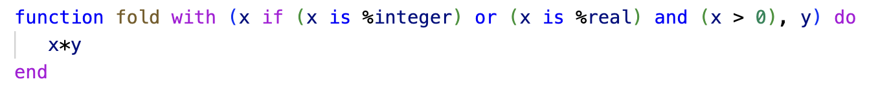
Pattern Factoring
What exactly is the input structure to the function ‘fold’ – difficult to see…
ln015/factor1.ast

Slide 6
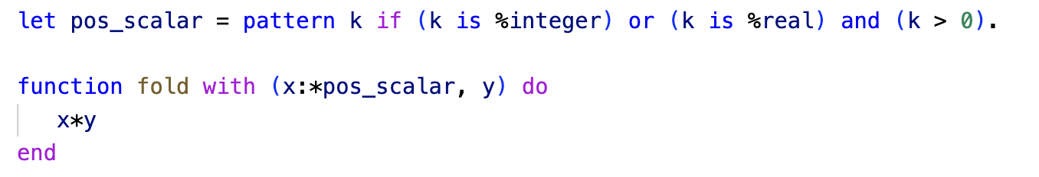
Pattern Factoring
…it is a pair where the first component is a positive scalar
Using first-class patterns let’s us bring that to the forefront
ln015/factor2.ast

Slide 7
Patterns as Constraints
The use of patterns as constraints is nothing new
We have seen this before with statements such as,
let x : %integer = value.
where we are not interested in the exact value the pattern %integer matches but just the fact that it matches an integer value rather than anything else.

Slide 8
Patterns as Constraints
The following pattern matches any scalar value between 1 and 9
let p = pattern k if k > 0 and k < 10.
We can use this pattern as a constraint,
let x : *p = value.
It works, BUT the pattern instantiates the variable k every time it matches
…this can lead to difficult to trace bugs

Slide 9
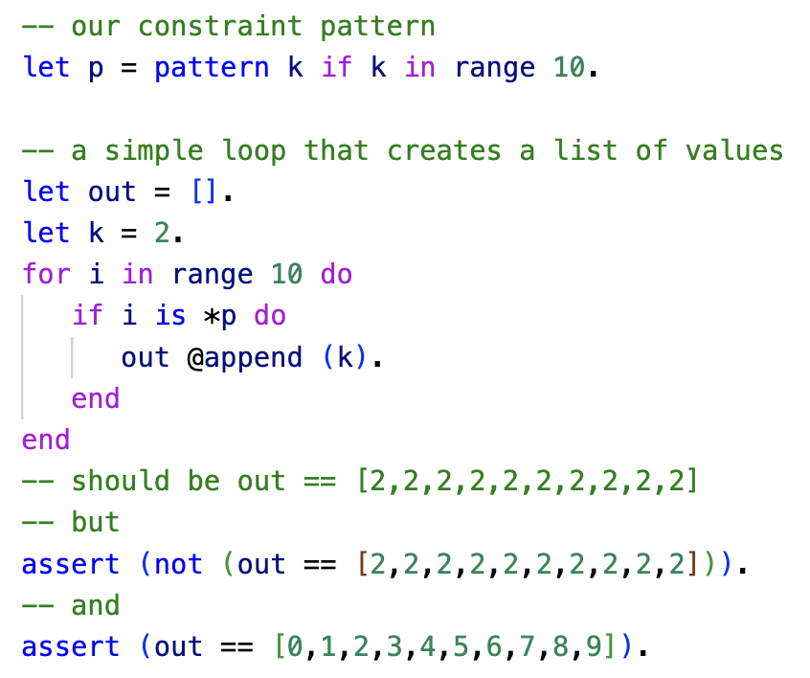
Patterns as Constraints
ln015/constraint1a.ast

Slide 10
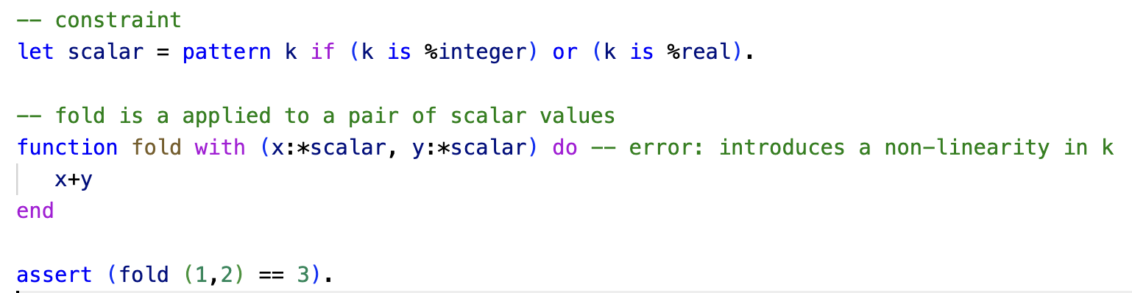
Patterns as Constraints
ln015/constraint2a.ast

Slide 11
Patterns as Constraints
We saw in each of the previous examples that the first-class pattern introduced an undesirable variable instantiation into the current scope of the program
We can prevent that with the scope operator %[…]% in a first-class pattern
Any variable instantiated within the scope operator is not visible outside of the pattern

Slide 12
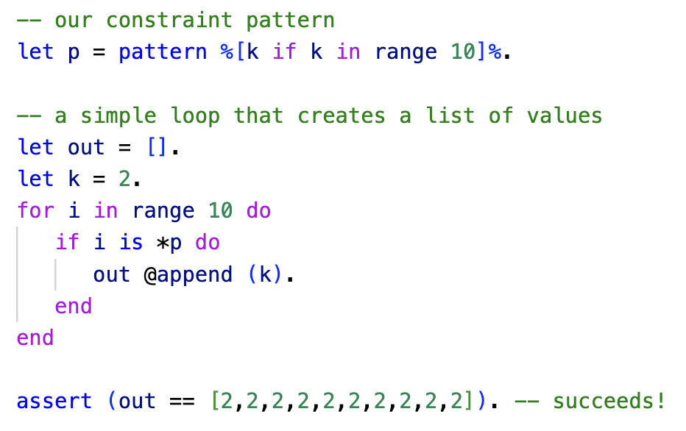
Patterns as Constraints
ln015/constraint1b.ast

Slide 13
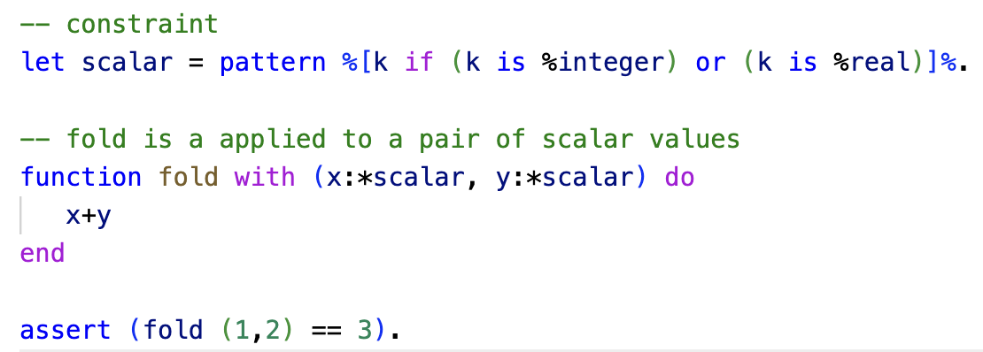
Patterns as Constraints
ln015/constraint2b.ast

Slide 14
Managing Pattern Variable Bindings
As we have seen: repeated first-class patterns lead to non-linearities
The scope operator allows us to manage this hiding the variables
BUT, what if we want the variables of repeated first-class patterns to be bound into our current scope in some shape or form?
The scope operator allows us to selectively bind variables into our current scope

Slide 15
Managing Pattern Variable Bindings
Consider that we want to compute the dot product of two 2D vectors,
(x1,y1) • (x2,y2)
Writing this as a function
dot ((x1,y1),(x2,y2))
The function takes a pair of pairs, the inner pairs must be pairs of scalars in order for the dot operation to make sense

Slide 16
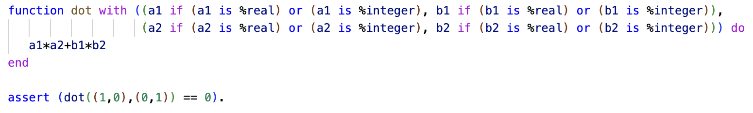
Managing Pattern Variable Bindings
First attempt without first-class patterns
It’s a mess…the function definition becomes almost unreadable
☞ We can solve this by pattern factoring with first-class patterns
ln015/dot1.ast

Slide 17
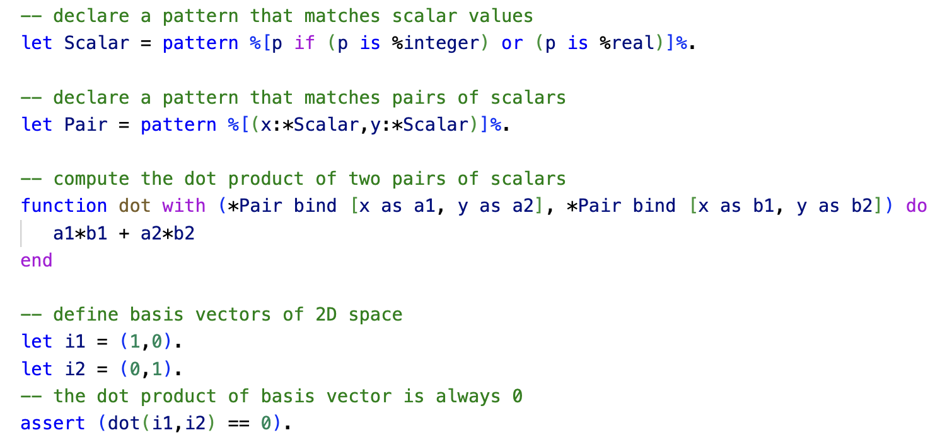
Managing Pattern Variable Bindings
ln015/dot2.ast
Binding lists applied to constraint patterns allow us to selectively bind variables into the current scope.

