Slide 1
Semester Review
Imperative Programming
Inspired by the explicit state manipulation of Von-Neuman hardware architecture
CPU↔️Memory

Slide 2
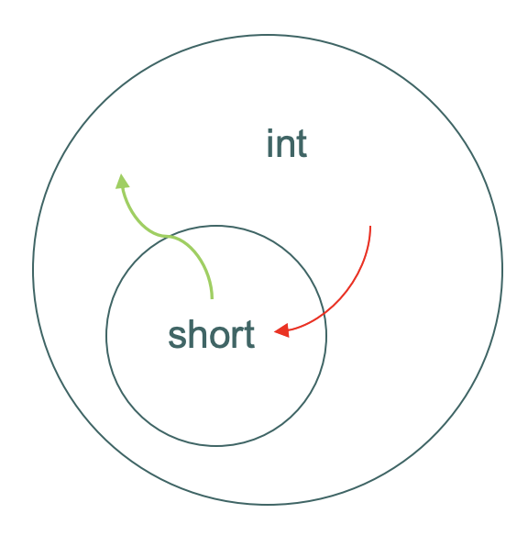
Semester Review
Type Systems
“A type is a set of values”
Help identify programming errors
A type mismatch usually indicates a programming error
Type propagation
Dynamic/static type systems
Subtypes/Supertypes
Type hierarchies
Automatic type coercion (conversion, promotion)
Widening/narrowing conversions

Slide 3
Semester Review
Pattern matching
Simple patterns are expressions that consist purely of constructors and variables
Canonical representations!
Destructuring
let (x,y) = (1,2)
Powerful declarative way of accessing substructures of objects

Slide 4
Semester Review
OOP
“classic” vs “modern” OOP
Modern OOP
No classes, instead structures with behavior
No (class) inheritance – traits/interfaces instead or object composition
Limited if any member protection – facilitates pattern matching on objects.
Subtype polymorphism with dynamic dispatch for statically typed languages
Duck typing for dynamically typed languages

Slide 5
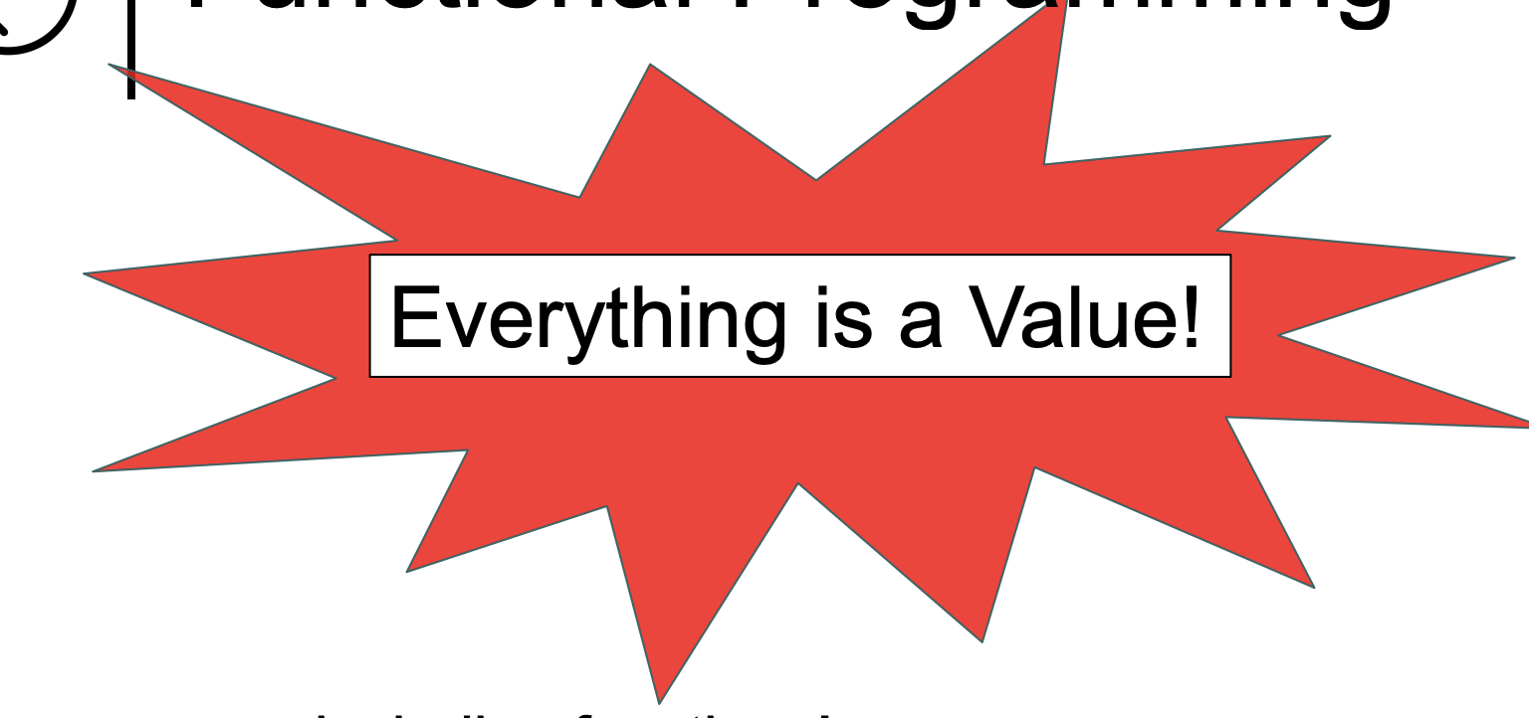
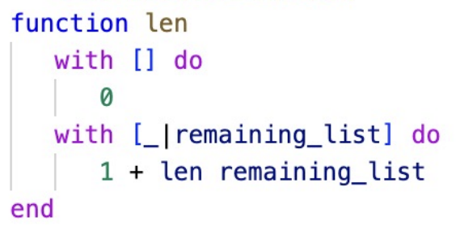
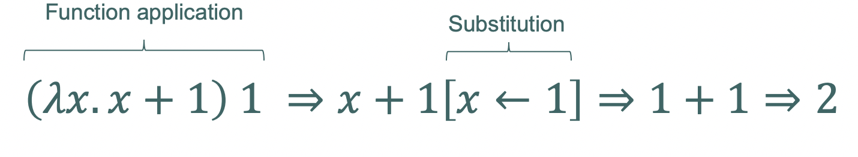
Semester Review
Functional Programming
Based on the lambda calculus
“Everything is a value”
No explicit state
First-class functions
Declarative:
“The What rather than the How”

Slide 6
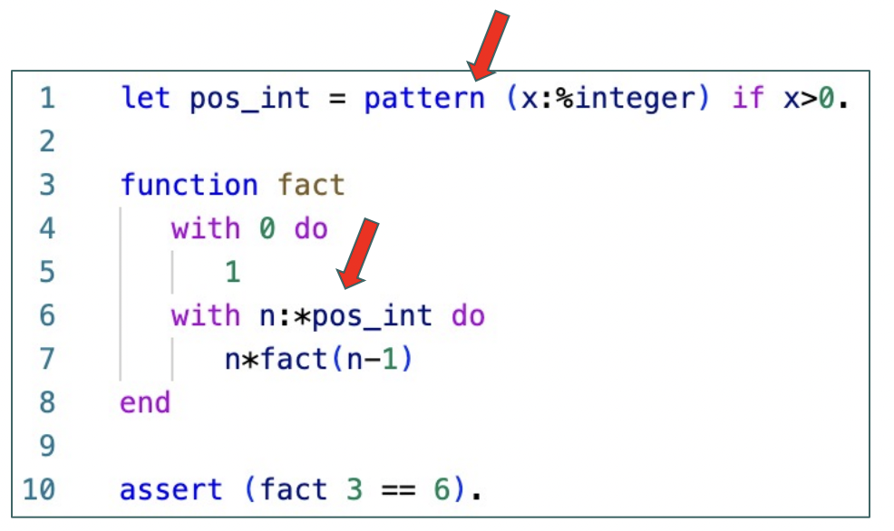
Semester Review
First-Class Patterns
Patterns themselves are considered values
Store in variables
Pass to/from functions
Promoting features to first-class status increases expressiveness of programming languages
Shorter programs that make intentions of programmer clearer.

Slide 7
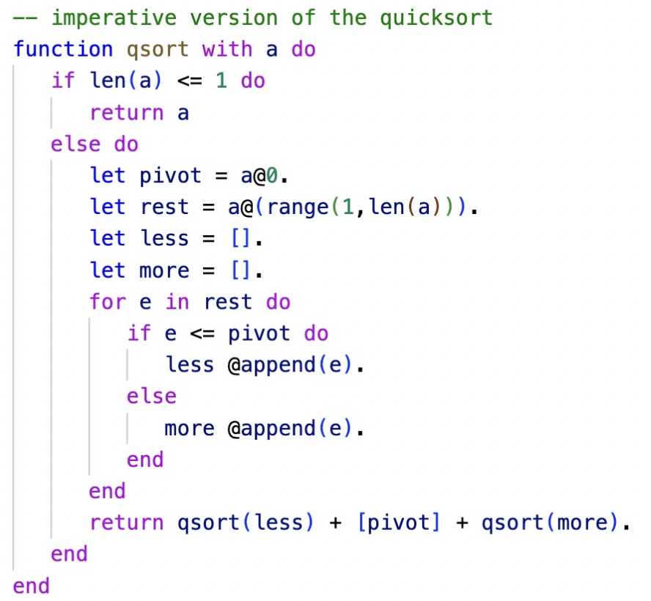
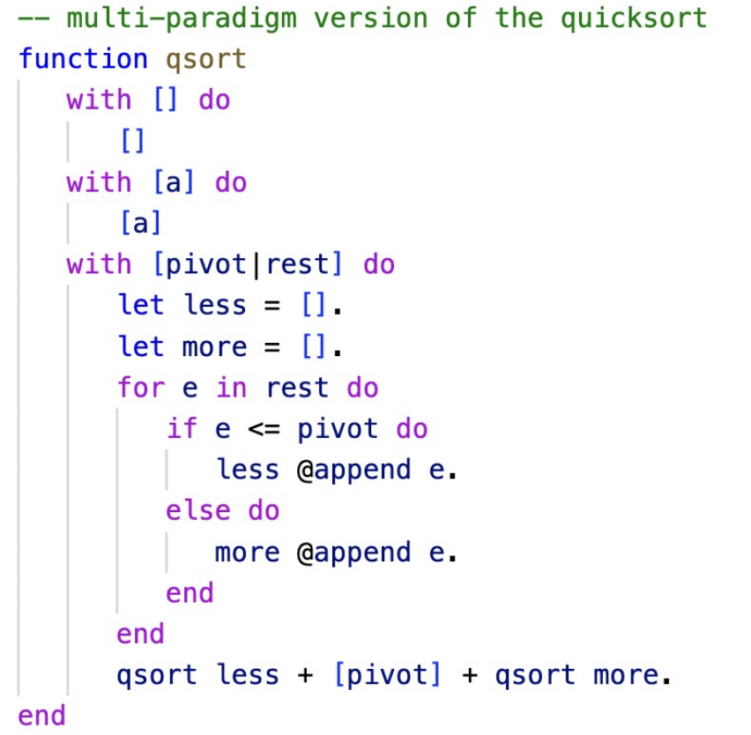
Semester Review
Putting it all together

Slide 8
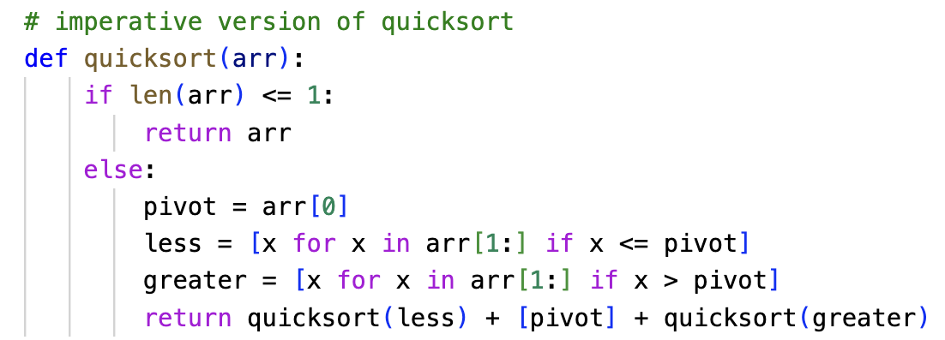
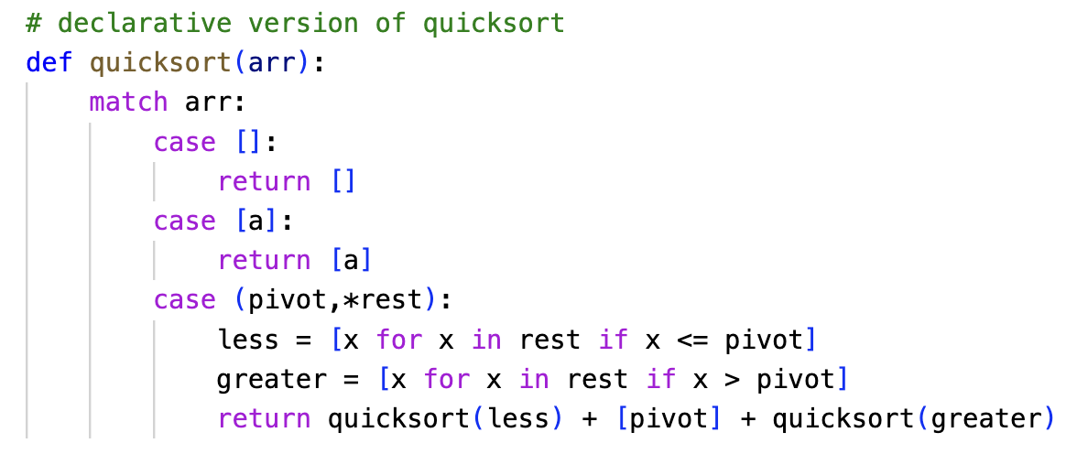
Semester Review
Putting it all together – multi-paradigm

Slide 9
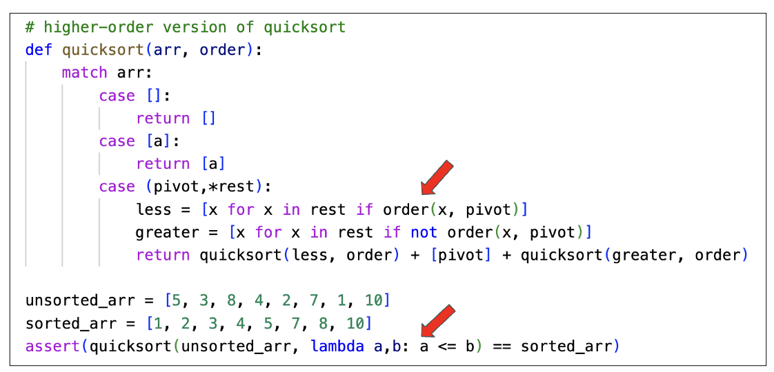
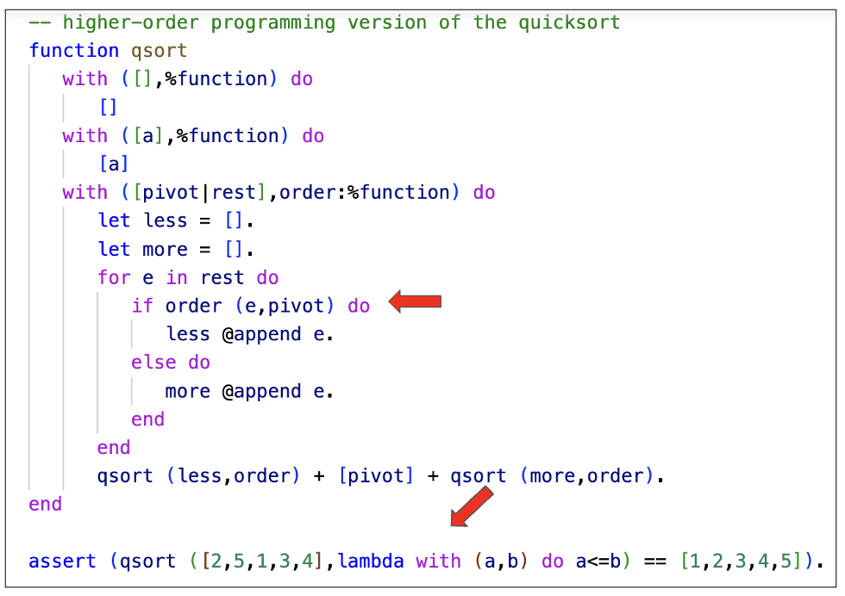
Semester Review
Putting it all together – higher-order

Slide 10
Semester Review
The End

