Slide 1
Functional Programming
Functional programming is a declarative programming paradigm where programs are constructed by applying and composing functions.
Function definitions are expressions that map values to other values, rather than a sequence of imperative statements which update the running state of a program.

Slide 2
Functional Programming
Everything is a Value!
…including functions!
This sets functional programming apart from imperative programming where statements like loops and conditionals do not represent values but change of an explicit machine state

Slide 3
Lambda Calculus
Let’s explore this using the lambda calculus before we commit to any particular language.
Recall that in the lambda calculus we construct functions as lambda expressions and these functions can be applied to values, e.g.
Function application
Substitution
$$\left(λx.x+1\right) 1 ⇒x+1\left[x←1\right]⇒1+1⇒2$$

Slide 4
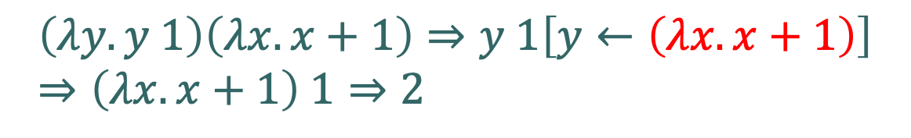
Lambda Calculus
Functions can be input values to other functions!
Function as value
$$\left(λy.y 1\right)\left(λx.x+1\right)⇒y 1\left[y←\left(λx.x+1\right)\right]⇒\left(λx.x+1\right) 1⇒2$$

Slide 5
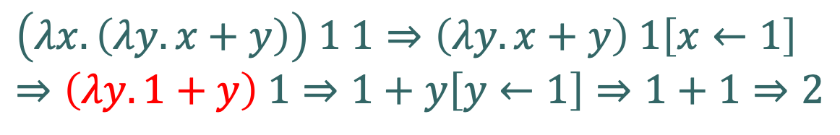
Lambda Calculus
Functions as return values from functions
That is, functions computing new functions!
Function as return value
$$\left(λx.\left(λy.x+y\right)\right) 1 1⇒\left(λy.x+y\right) 1\left[x←1\right]⇒\left(λy.1+y\right) 1⇒1+y\left[y←1\right]⇒1+1⇒2$$

Slide 6
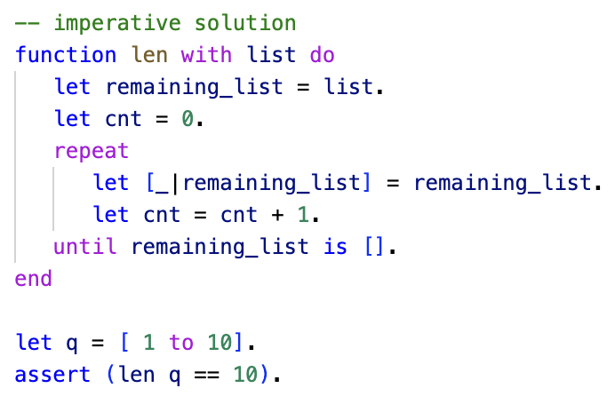
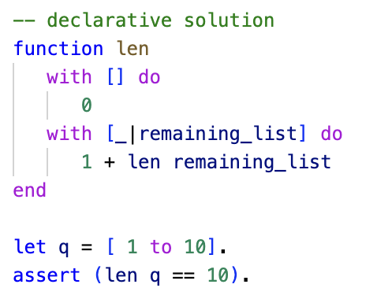
Functional Programming
Functional programming is declarative in that the programs deal more with the what rather than the how.
One way to think about this is: in declarative programming we “declare” what to do for each input configuration.
This is in stark contrast to imperative programming where we describe how to solve the whole problem in one go without subdivision.
“The How”
“The What”

Slide 7
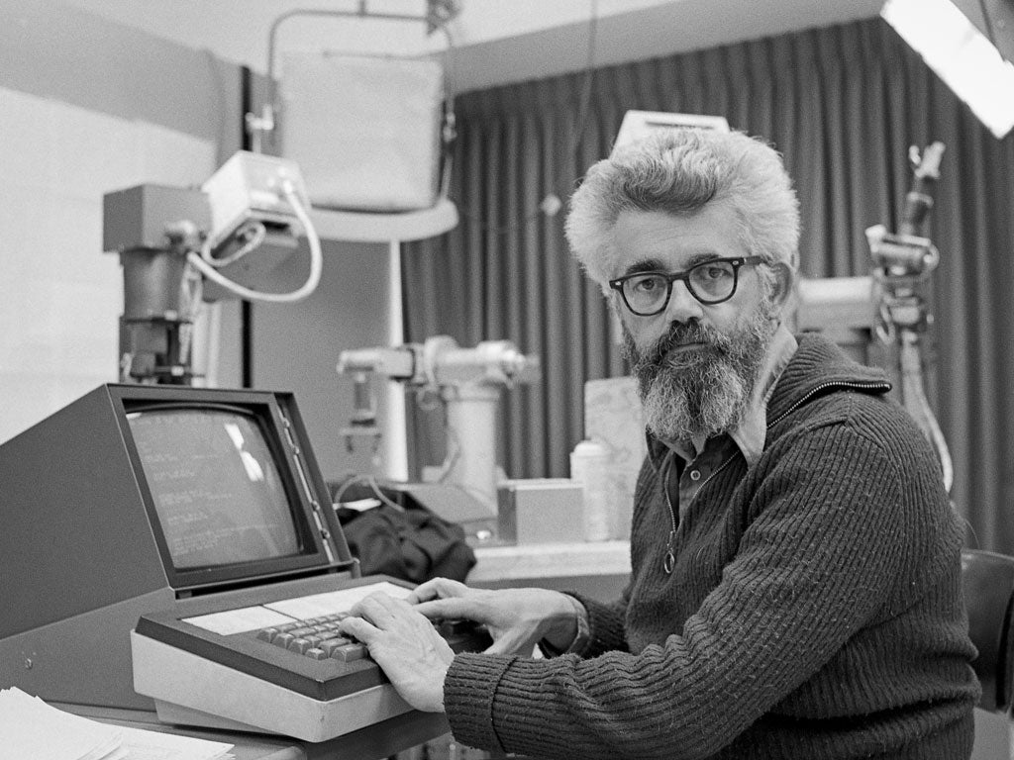

Lisp
Dr John McCarthy, computer scientist, 1927 – 2011.
Lisp was developed by John McCarthy in the late 1950’s early 60’s to solve problems in AI.
It is the oldest functional programming language.
Its syntax has been inspired by the lambda calculus.
It introduced novel features such as recursion and garbage collection.
It is still in use today as Common Lisp (ANSI compliant).
Modern descendants: Scheme, Racket, Clojure
https://en.wikipedia.org/wiki/Lisp_%28programming_language%29

Slide 8
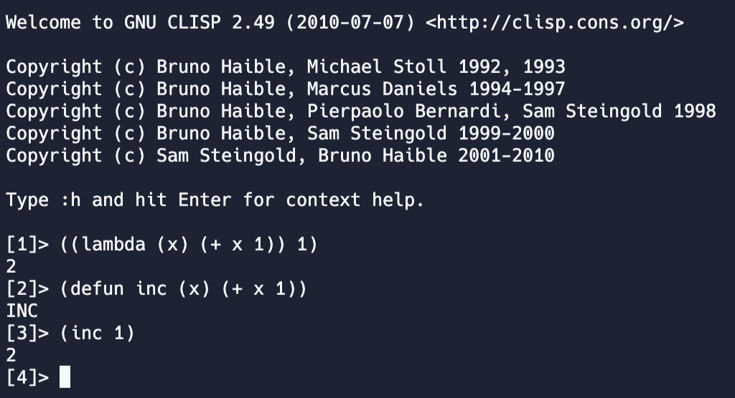
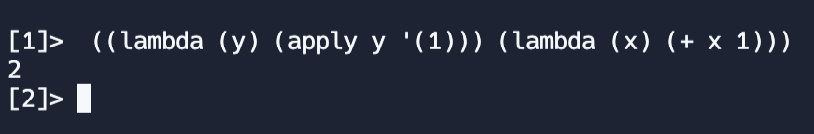
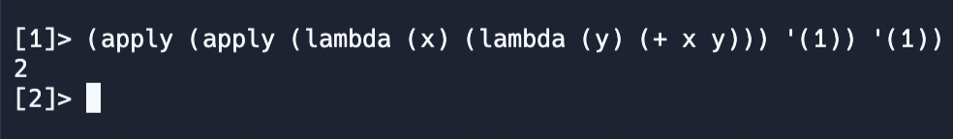



Lisp
$$\left(λx.x+1\right) 1 ⇒2$$
$$\left(λy.y 1\right)\left(λx.x+1\right)⇒2$$
$$\left(λx.\left(λy.x+y\right)\right) 1 1⇒2$$

Slide 9
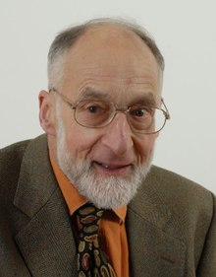

ML
Robin Milner, computer scientist 1934 – 2010.
Robin Milner designed ML as the implementation language for his proof assistant LCF (Logic for Computable Functions) in the 1970’s.
It can be considered the first modern functional programming language,
Statically type checked
A syntax that is easily recognized by today’s developers
Very influential, virtually every modern functional programming language can trace its ancestry back to ML
It is also one of the few high-level programming languages with a full mathematical specification.
Dialects of ML in wide use today: SMLNJ, Ocaml, F#
https://smlnj.org/ and https://en.wikipedia.org/wiki/ML_(programming_language)

Slide 10
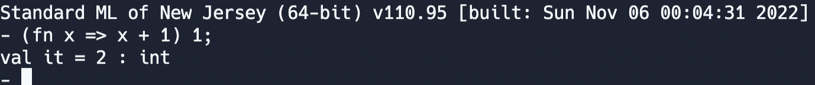
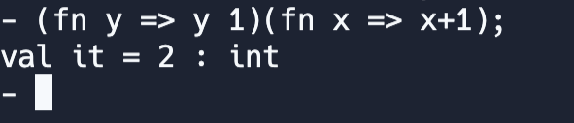
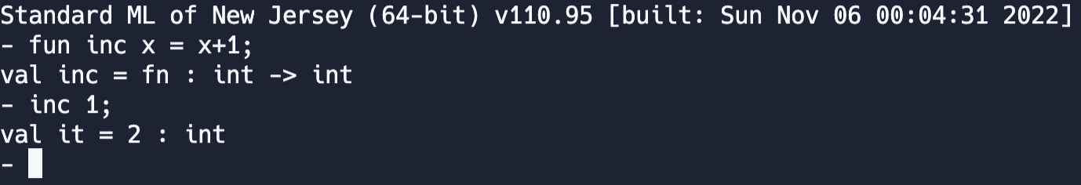



ML
$$\left(λx.x+1\right) 1 ⇒2$$
$$\left(λy.y 1\right)\left(λx.x+1\right)⇒2$$
$$\left(λx.\left(λy.x+y\right)\right) 1 1⇒2$$

Slide 11
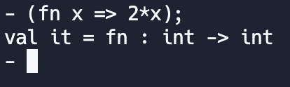
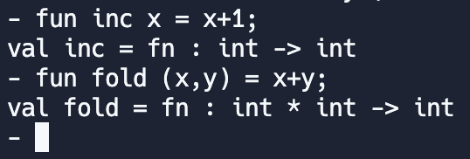
Function as Values: Another Look
A Type is a Set of Values.
If we view functions as values, then they have to belong to a type.
We can use ML’s type system to compute the function types,

Slide 12


Function as Values: Another Look
In the previous slide we saw that we have at least two different types
Function
Types
$$int →int$$
$$int∗int →int$$
“All functions that map pairs of integers to integers”
“All functions that map integers to integers”

Slide 13
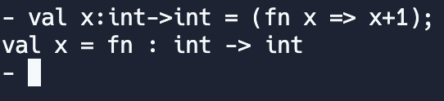
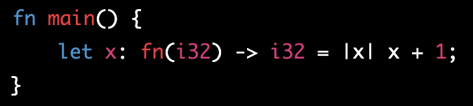
Function as Values: Another Look
Since we now have function types we can declare variables of that type,
ML
Rust

Slide 14
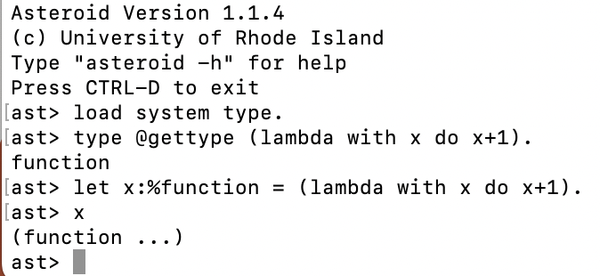
Function as Values: Another Look
Every function belongs to a particular function type.
We can view a function as a value in the set of all values of a particular type.
This particularly visible in statically typed languages like ML and Rust.
But it is also supported in dynamically typed languages like Python and Asteroid.
In Asteroid, all functions are members of the type ‘function’.

Slide 15
Reading
Please read Chapter I in the following paper, lutzhamel.github.io/CSC493/docs/intro-fp-barendregt.pdf

