Slide 1
Functional Programming in Asteroid
Asteroid supports a functional sublanguage largely inspired by ML.
You can turn the Asteroid interpreter into a functional language interpreter with the ‘-F’ flag
In this mode imperative statements will be rejected with some exceptions
Most notable exception is the let statement – we’ll discuss this later

Slide 2
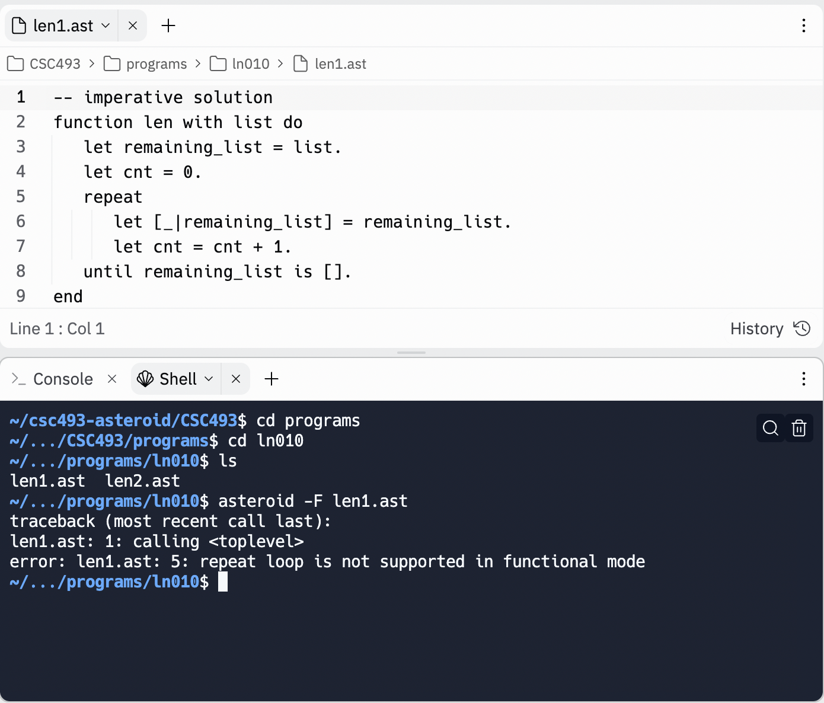
Functional Programming in Asteroid

Slide 3
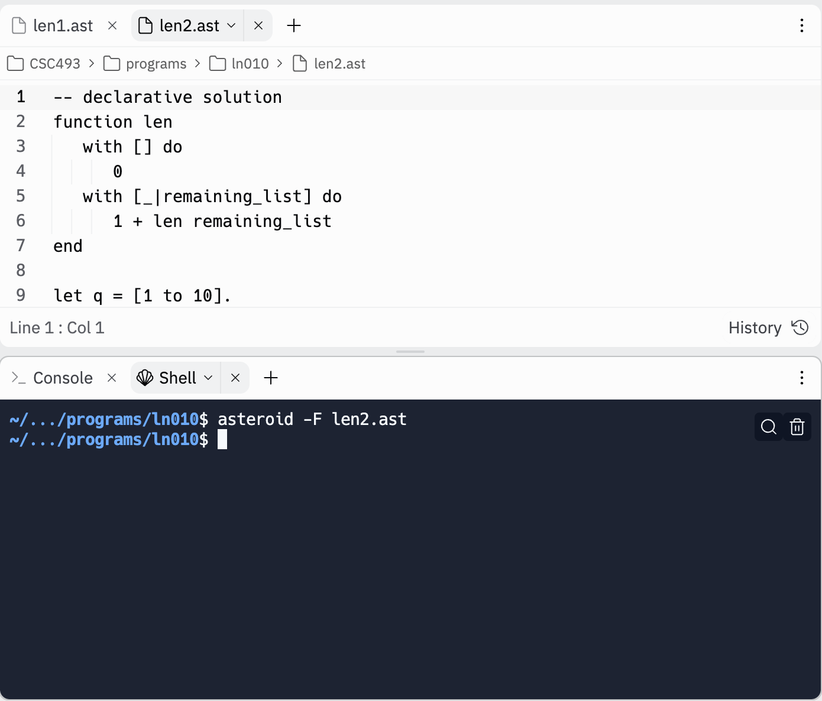
Functional Programming in Asteroid

Slide 4
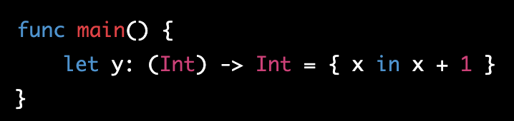
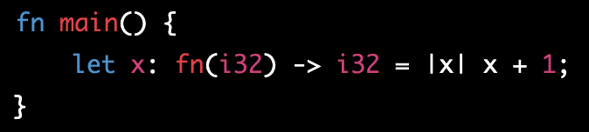
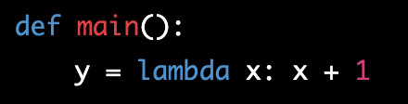
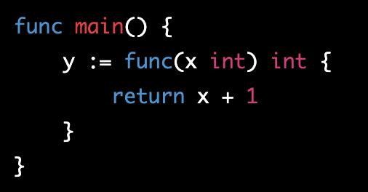
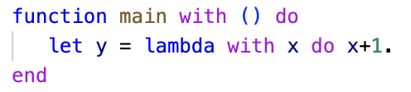
Lambda Functions
The most recognizable feature of the functional programming paradigm is the lambda function
Virtually every programming language designed in the last decade or two supports lambda functions – by extension, they support the functional programming paradigm (even if limited)
Swift
Rust
Python
Go
Asteroid

Slide 5
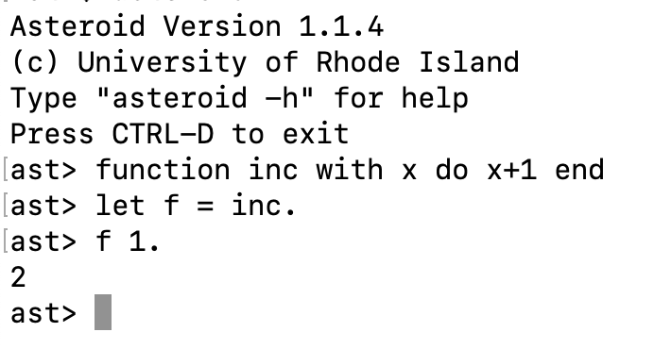
Lambda Functions
The implication of the support of lambda functions is that functions are considered first-class citizens,
☞ They are Values!
Consider,
We can copy function values like any other value!

Slide 6
Other Characteristics of Functional Programming
No iteration – only recursion.
No if statements – only if expressions.
”Single valued variables”
Variables are shorthand notations for expression values

Slide 7
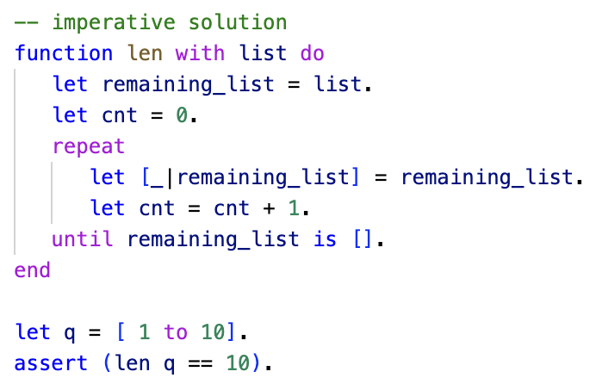
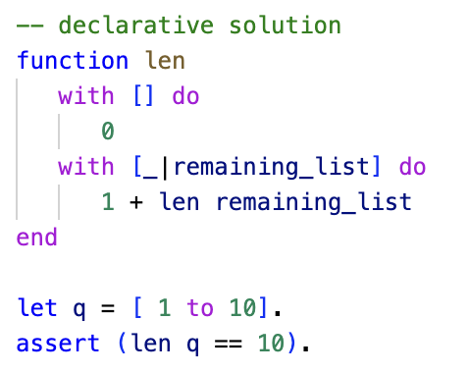
No Iteration
Iteration is not supported
Data structures must be traversed with recursion
Recursive functions with multi-dispatch!
vs

Slide 8
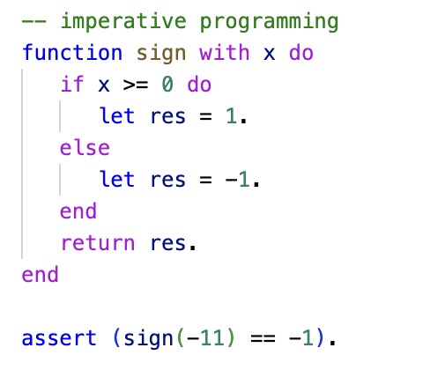
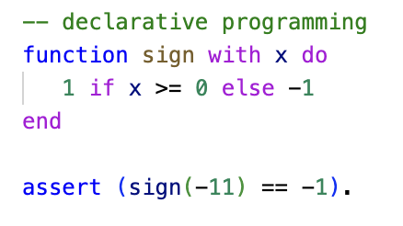
No If Statements
If statements are designed to inherently modify machine state and therefore are not allowed in functional programming
We use if expressions instead
Also fits better into the notion of “everything is a value”
vs

Slide 9
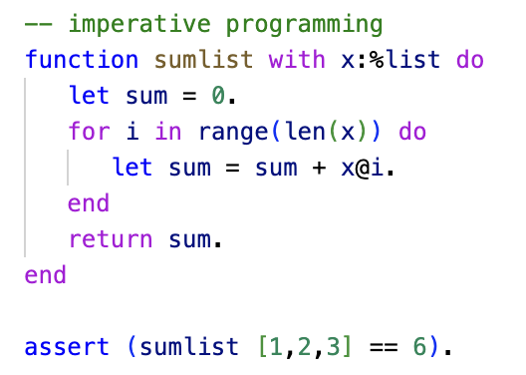
Single Valued Variables
In imperative programming variables maintain the machine state,
The variable sum is updated iteratively and at each iteration contains the partial solution computed so far. Note that the evolution of the values stored in sum depends on the length of the input list!

Slide 10
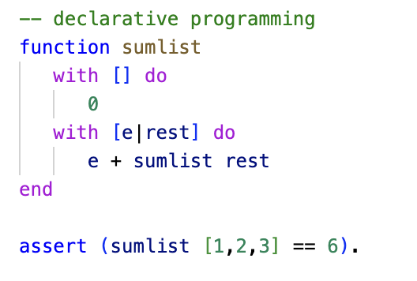
Single Valued Variables
In functional programming variables act like a shorthand notation for a single value (per function call)
Here e and rest contain a single value (per function call) that does not change throughout that function call.

Slide 11
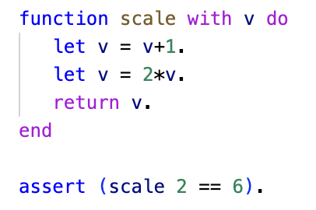
Single Valued Variables
Even if we assign multiple values to the same variable, it still has the flavor of a value shorthand notation
We don’t have iteration to evolve the value further than the given assignments
Here we use the multiple assignments to v to break the expression computation, return 2*(v+1)
Into simpler computational steps.

Slide 12
Functional Programming in Asteroid
Let’s see how the programs that we developed in the lambda calculus translate into Asteroid
Should be straight forward since Asteroid supports the functional programming paradigm.

Slide 13
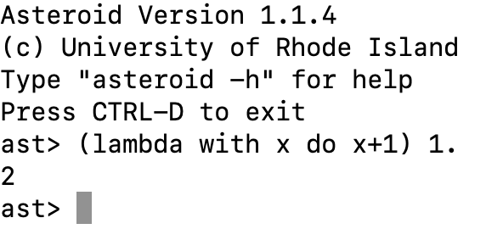
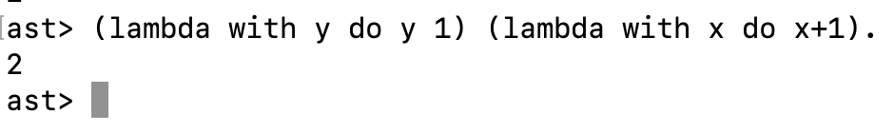
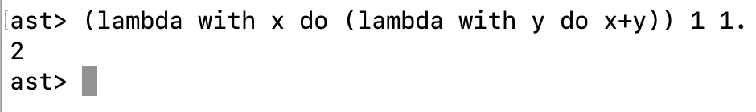



Original Lambda Examples
$$\left(λx.x+1\right) 1 ⇒2$$
$$\left(λy.y 1\right)\left(λx.x+1\right)⇒2$$
$$\left(λx.\left(λy.x+y\right)\right) 1 1⇒2$$

Slide 14
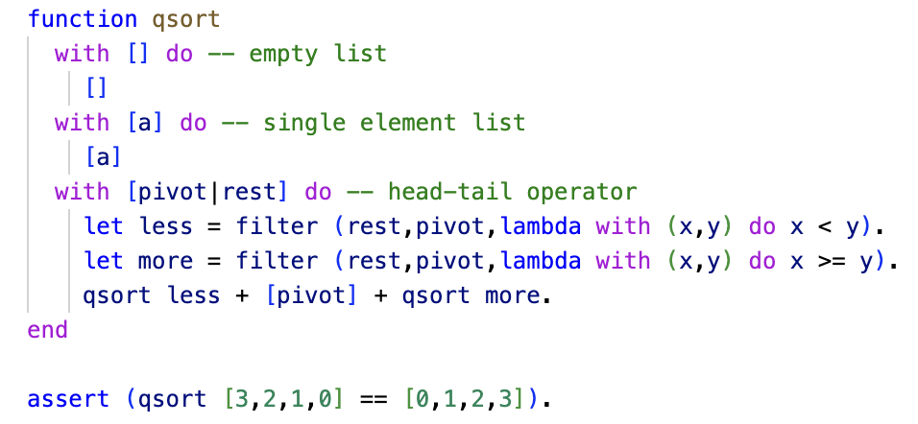
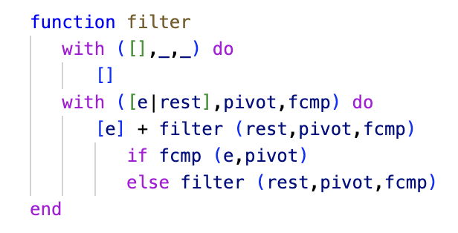
The QuickSort – Purely Functional

