Slide 1
Imperative Programming in Asteroid – the Basics
Imperative programming –
explicit statements that change the program state
All three of our programming languages are at their core imperative programming languages.
Here we look at basics of Asteroid programming

Slide 2
Names
In Asteroid names are alpha-numeric symbols starting with an alpha character (as in most languages)
x
my_function
pi

Slide 3
Constants
Constants are available for all the primitive data types,
integer, e.g. 1024
real, e.g. 1.75
string, e.g. "Hello, World!"
boolean, e.g. true

Slide 4
Primitive Data Types
Asteroid arranges primitive data types in a type hierarchy,
boolean < integer < real < string
Type hierarchies facilitate automatic type promotion, e.g.
let x:%string = "value: " + 1.
Type promotion: plus as string concatenate op

Slide 5
Structured Data Types
Asteroid also supports the built-in data types:
list
tuple
These are structured data types in that they can contain entities that belong to other data types.
Lists are mutable objects whereas tuples are immutable.
Some examples,
Note: (1,) ≠ (1)
let l = [1,2,3]. -- this is a list
let t = (1,2,3). -- this is a tuple
let one_tuple = (1,). -- this is a 1-tuple

Slide 6
Structured Data Types
Lists and tuples themselves are also embedded in type hierarchies, although very simple ones:
list < string
tuple < string
That is, any list or tuple can be viewed as a string. This is very convenient for printing lists and tuples,
load system io.
io @println ("this is my list: " + [1,2,3]).

Slide 7
The None Type
Asteroid supports the none type.
The none type has only one member
A constant named none.
The empty set of parentheses () can be used as a shorthand for the none constant.
That is: none = ()

Slide 8
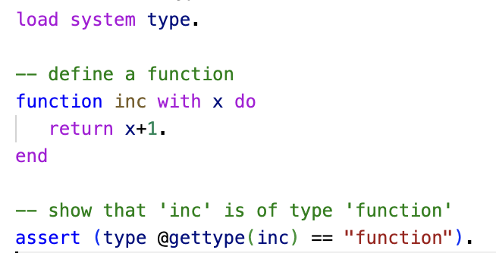
Other Data Types
In Asteroid we also have additional data types:
function
pattern
user defined data types via structures
ln002/ftype.ast

