Slide 1
Advanced Features & Applications
Having promoted patterns to first-class status means that we have effectively separated the point of definition of patterns from the point where patterns are applied
This allows for novel applications of patterns.

Slide 2
Pattern Reuse
The ability of reusing patterns frees a developer from having to retype the same pattern repeatedly in their code.
The ability of reusing patterns makes code much more robust from a software engineering perspective
In software engineering it is frowned upon explicitly repeating the same code in your program
A maintenance nightmare: if anything ever changes in the repeated code you will have to go through all the repeated instances manually and update them

Slide 3
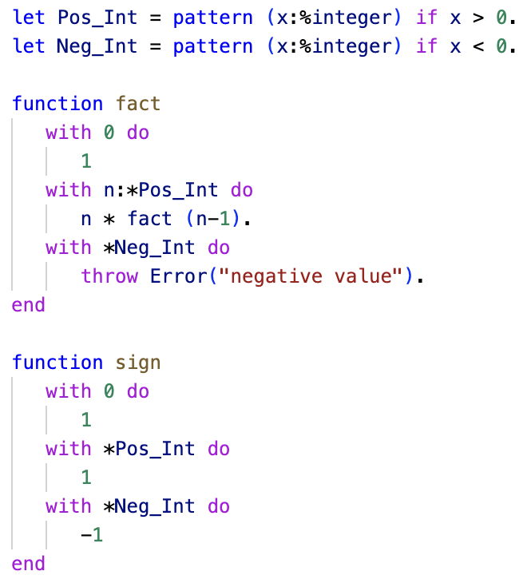
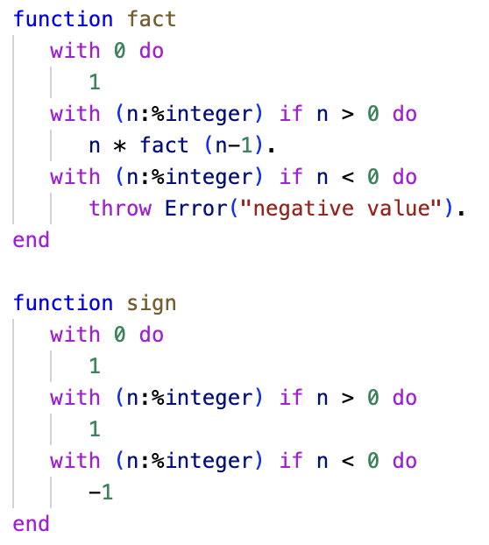
Pattern Reuse

