Slide 1
Data Structures
We saw that Asteroid has built-in data structures such as lists and tuples
Let’s look at these a bit closer

Slide 2
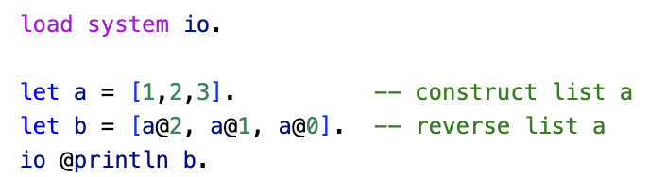
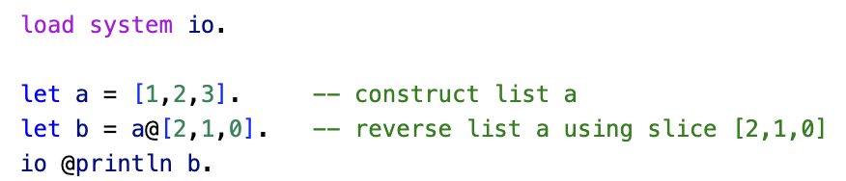
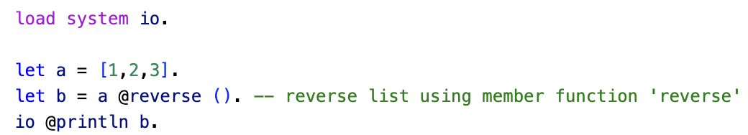
Lists
ln003/reverse1.ast
ln003/reverse2.ast
A slice is a list of indexes that can be used to access elements of a list.
ln003/reverse3.ast
In Asteroid lists are considered objects with member functions.

Slide 3
The General Access Operator
The @ operator is Asteroid’s general access operator:
individual elements, slices, or member functions of lists.
members and functions of tuples and objects.
The println function:
the io module is an object and println is a member function, therefore io @println <string>
In Asteroid all system modules are objects

Slide 4
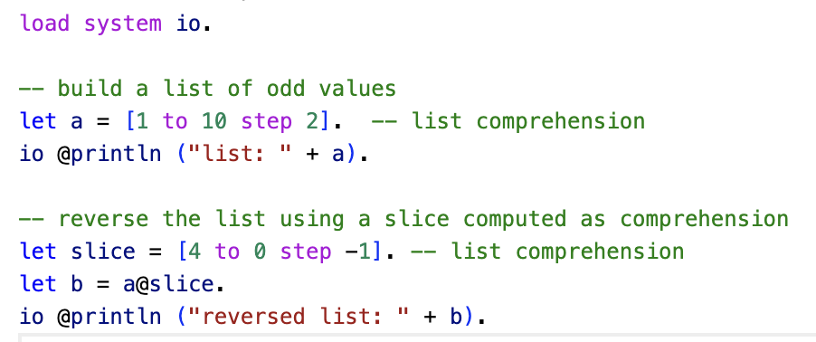
List Comprehensions
In Asteroid a list comprehension consist of a range specifier together with an optional step specifier allowing you to generate a list of integer values within that range, [ <start> to <end> ] or [ <start> to <end> step <value> ]
If a comprehension is invalid Asteroid returns an empty list, e.g. [0 to 4 step -1]
ln003/comprehension.ast

Slide 5
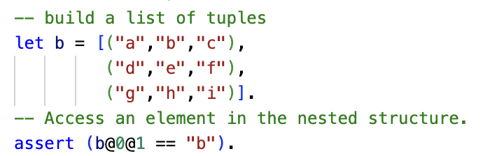
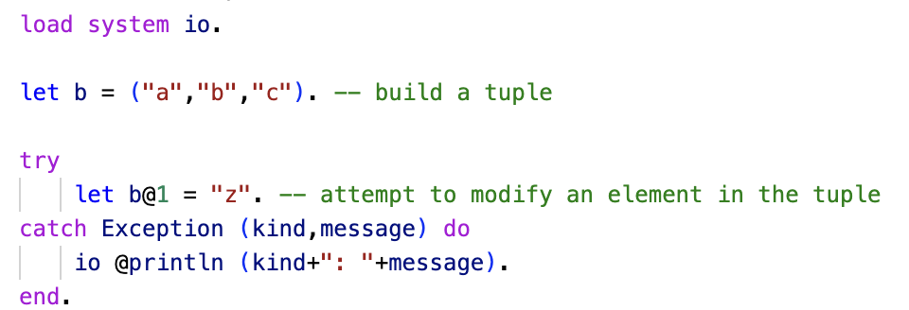
Tuples
ln003/tuples1.ast
ln003/tuples2.ast
Tuples are immutable objects!

Slide 6
Data Structures
Asteroid also support custom data structures via the ‘structure’ keyword
Structures allow us to instantiate objects with a particular internal structure

Slide 7
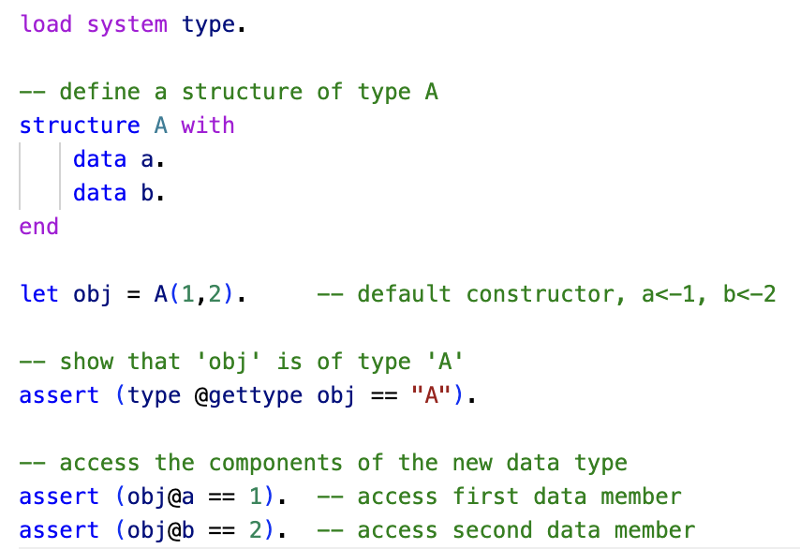
Structures & Objects
Structures in Asteroid are similar to classes in Python and almost identical to structures in Rust.
A structure introduces a data structure as a new type
For each structure Asteroid creates a default constructor
ln003/struct1.ast

Slide 8
Reading
Data Structures
asteroid-lang.readthedocs.io/en/latest/User%20Guide.html#data-structures

