Slide 1
Putting it All Together
Multi-paradigm programming means picking and choosing from our various paradigms,
Imperative
Declarative with pattern matching
Functional
OOP
First-class patterns
To create the most readable and maintainable programs.

Slide 2
Case Study: QuickSort
We start with the imperative and the functional versions of the quicksort
Examining both the strengths and weaknesses of each approach
We then pick and choose from each of these implementations and create a multi-paradigm version of the quicksort.
Finally, we’ll create some extensions such as a flexible sorting predicate based on higher-order programming.

Slide 3
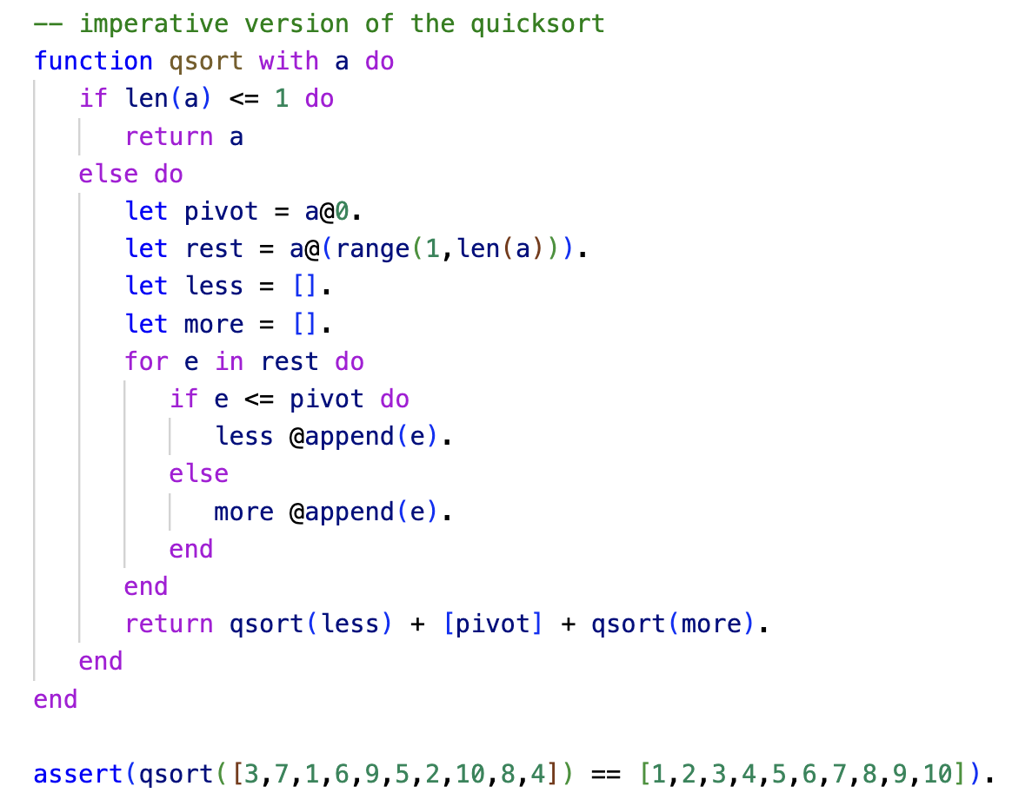
Imperative Programming
ln017/qimp.ast

Slide 4
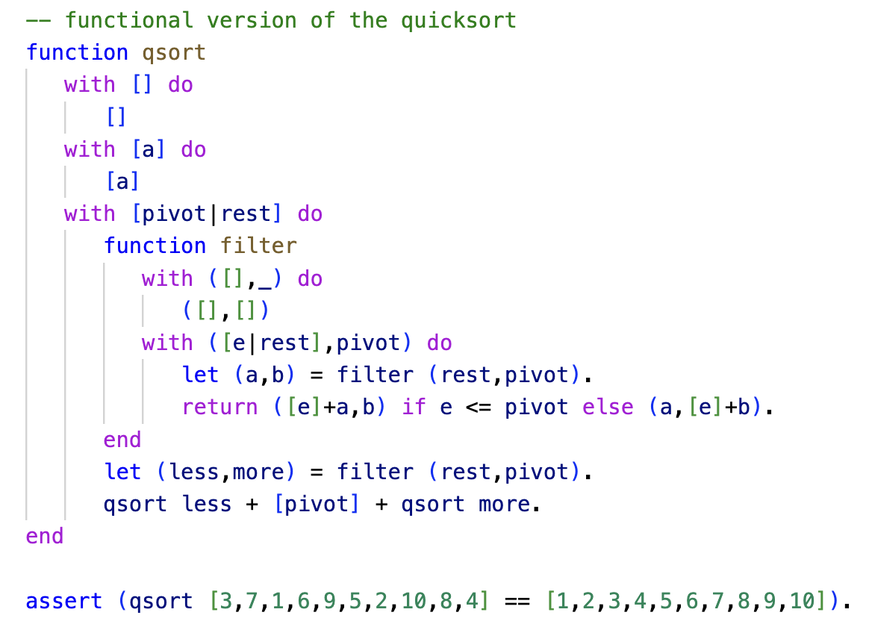
Functional Programming
ln017/qfun.ast

Slide 5
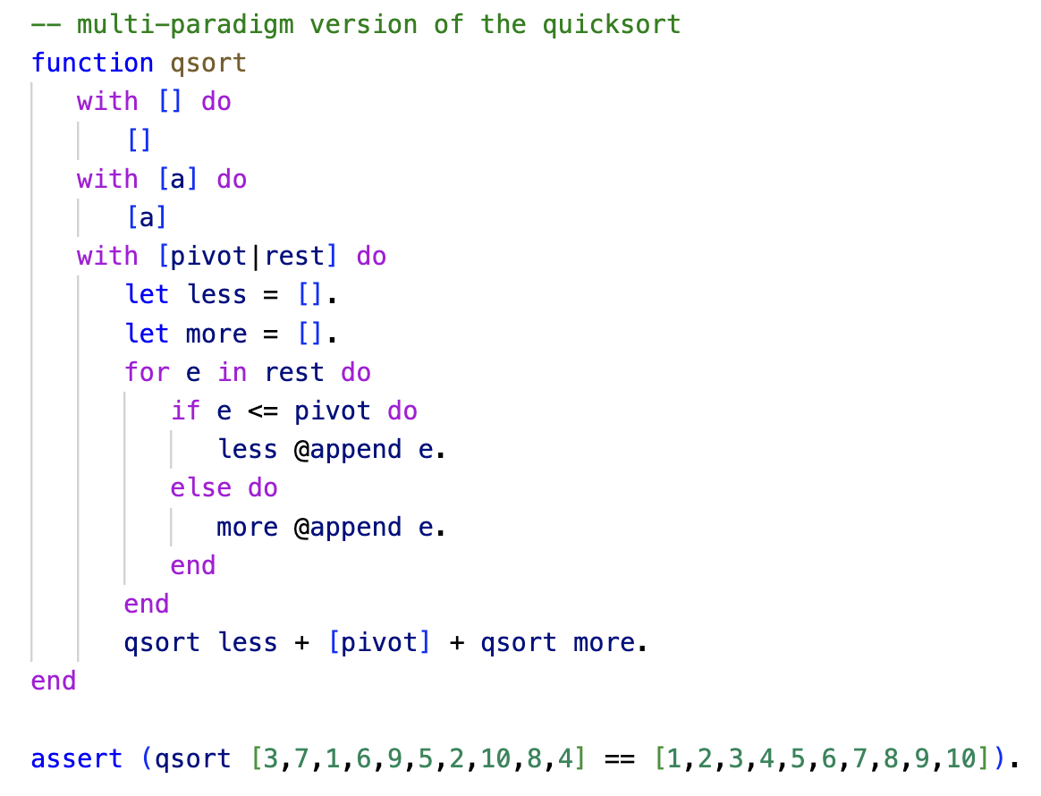
Multi-Paradigm Programming
ln017/qmulti.ast

Slide 6
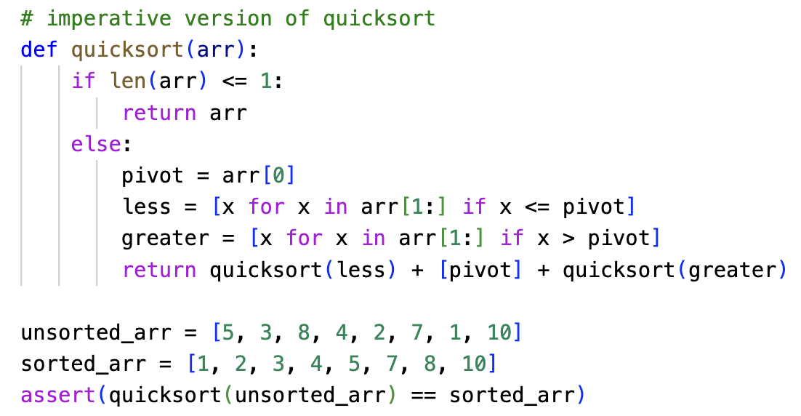
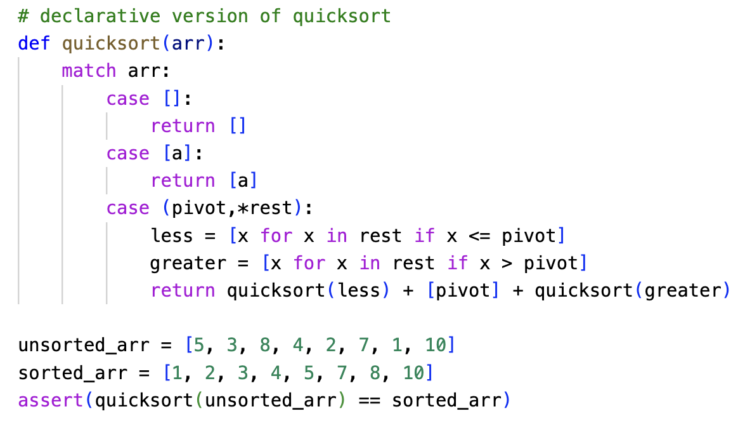
Multi-Paradigm Programming - Python
ln017/qimp.py
ln017/qmulti.py

Slide 7
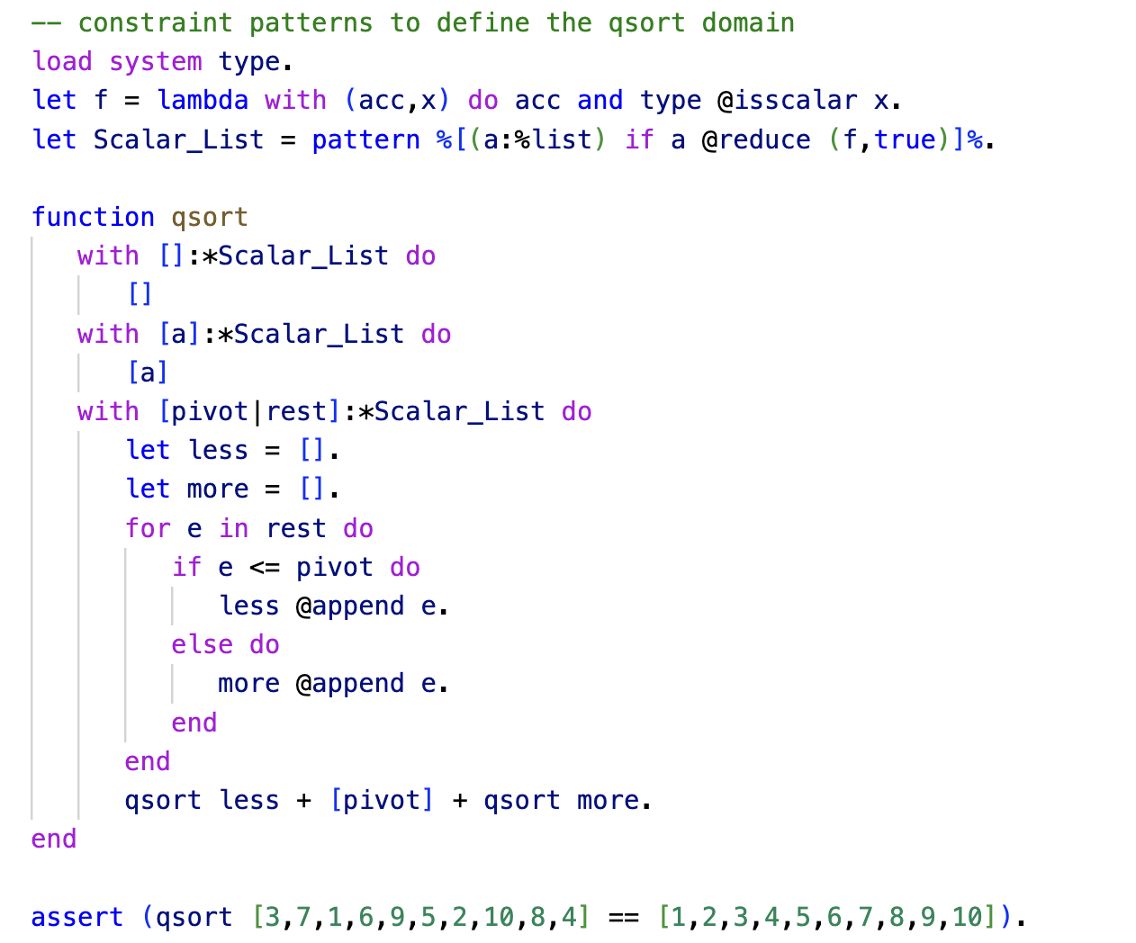
Constraint Patterns
ln017/qconstr.ast

Slide 8
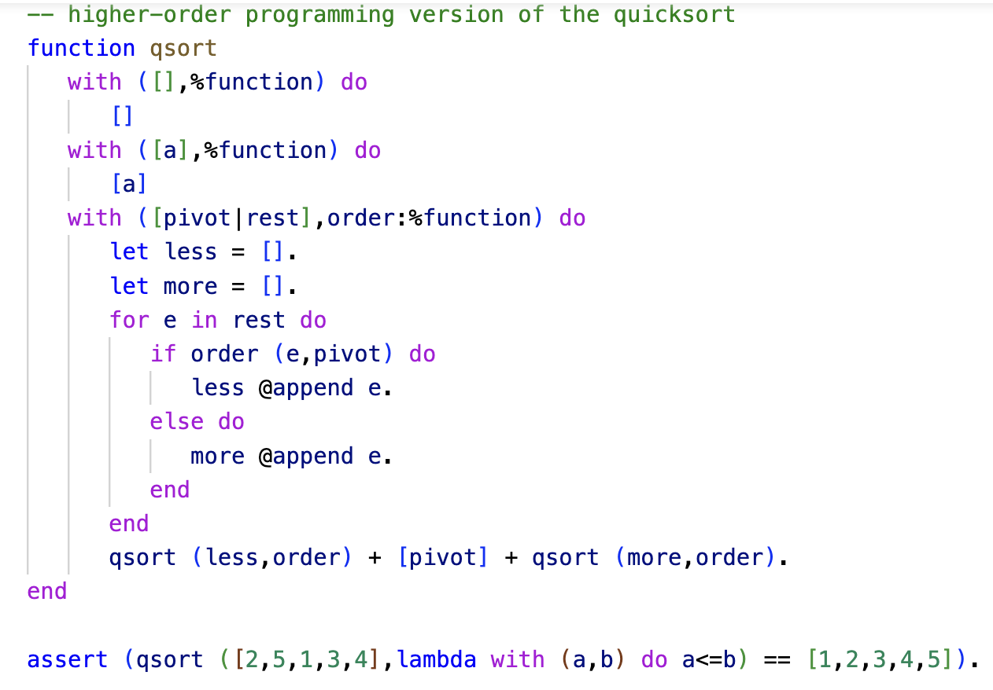
Higher-Order Programming
ln017/qhigh.ast

Slide 9
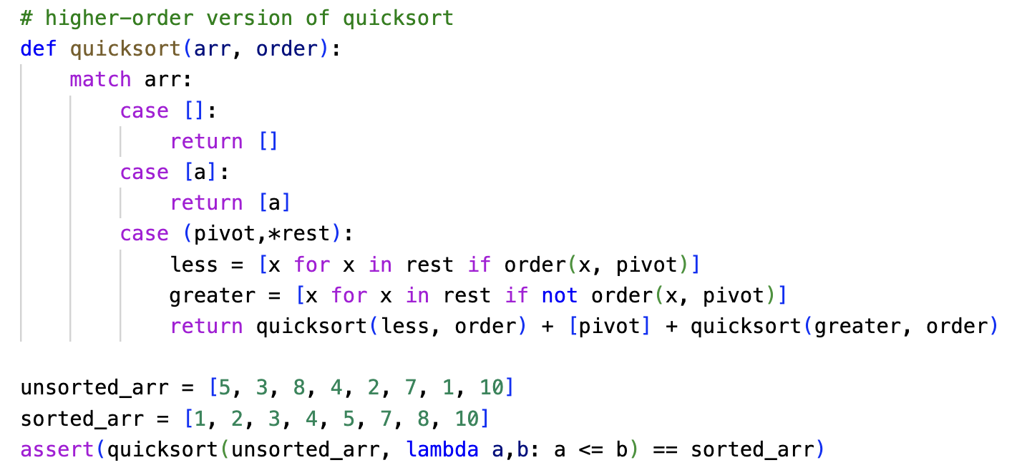
Higher-Order Programming - Python
ln017/qhigh.py

Slide 10
Higher-Order Programming
The version quicksort that uses a passed in order predicate is interesting because it is now generic over the objects it can sort…

Slide 11
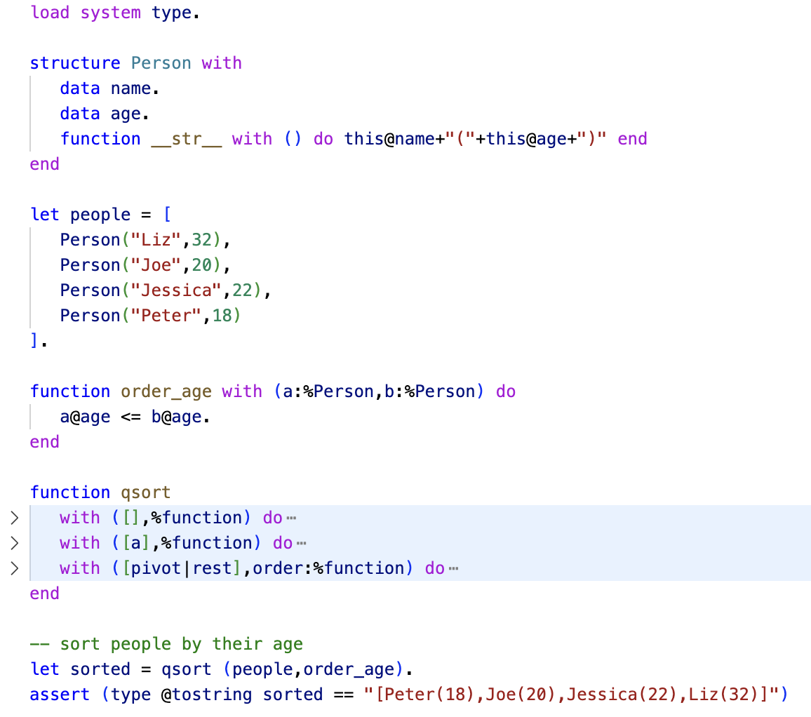
Higher-Order Programming

Slide 12
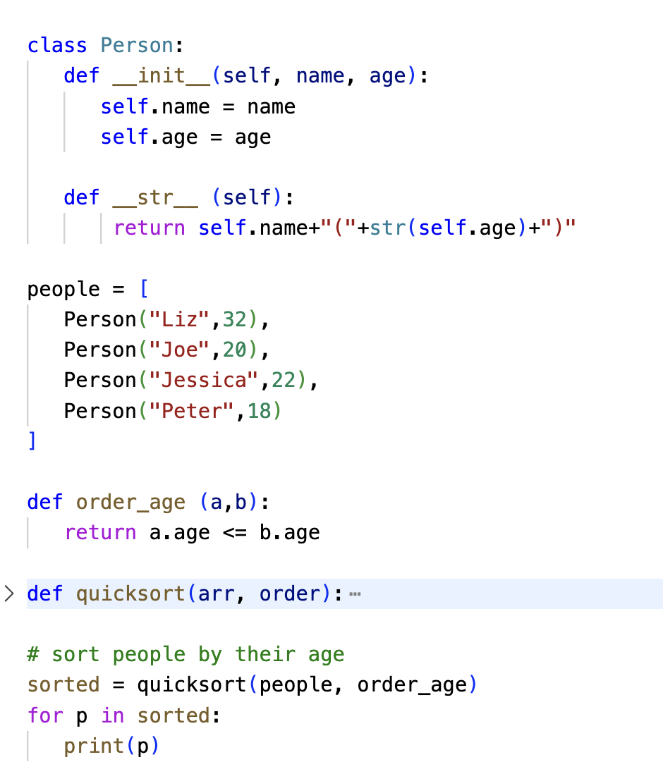
Higher-Order Programming - Python

Slide 13
Case Study: SpaceObjects
This program is inspired by the programs from the Wikipedia page: https://en.wikipedia.org/wiki/Multiple_dispatch
The idea is that we are given pairs of space objects and we have to write a function that determines what kind of collision we are looking at and print out messages accordingly.
We’ll start with an imperative solution to this

Slide 14
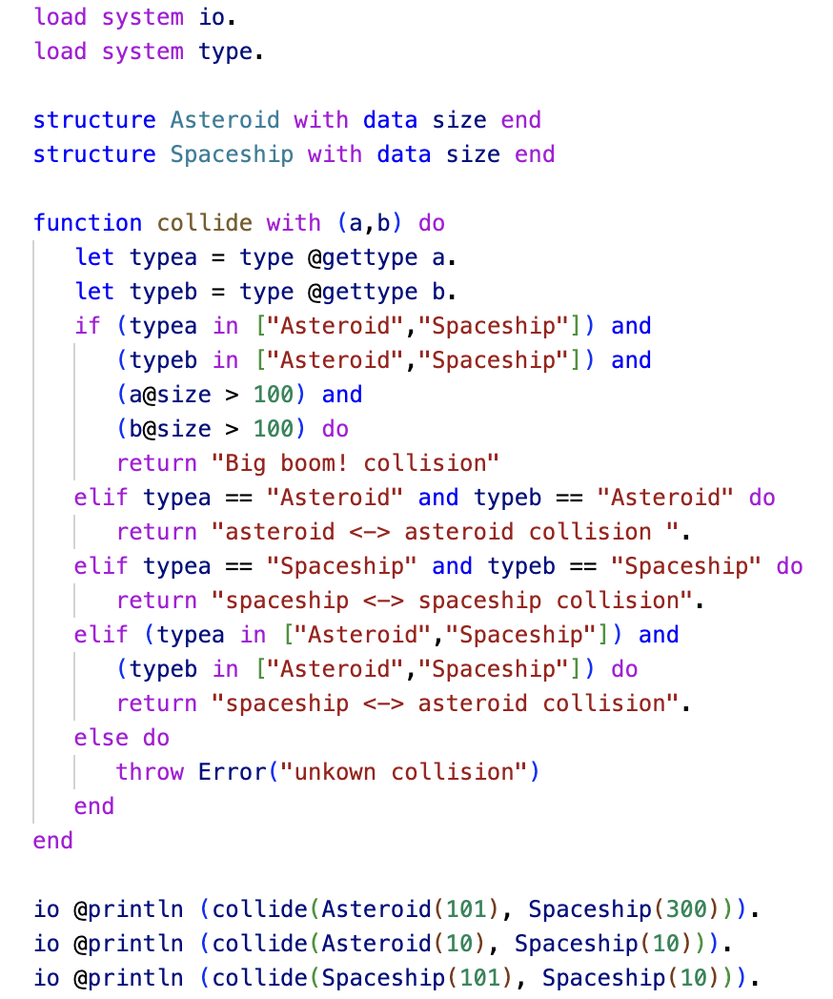
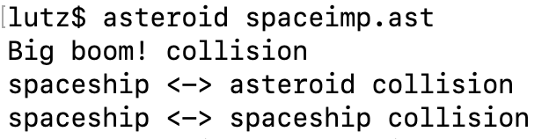
Imperative Solution
Everything is accomplished computationally.
Developer’s intentions are not immediately visible.
ln017/spaceimp.ast

Slide 15
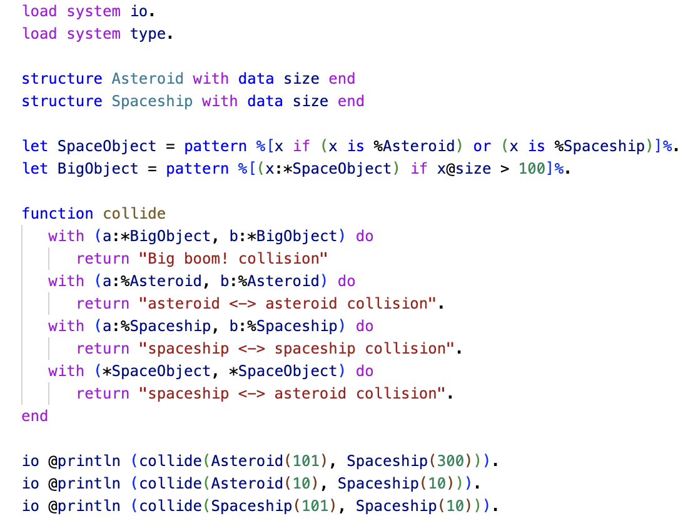
Multi-Paradigm Solution
Employs:
Multi-dispatch
Pattern matching
First-Class Patterns
A more declarative approach due to pattern matching ☞ makes developer intentions much more visible!
ln017/spacemulti.ast

