Slide 1
Welcome – CSC493
Introduction to Multi-Paradigm Programming
Instructor: Dr Lutz Hamel
Email: lutzhamel@uri.edu
Website: lutzhamel.github.io/CSC493/
BrightSpace

Slide 2
What is a Paradigm?
A paradigm is a distinct set of concepts and practices that define a discipline.
Source: https://en.wikipedia.org/wiki/Paradigm

Slide 3
What is a Programming Paradigm?
A programming paradigm is an approach to programming using a distinct set of concepts and practices. E.g.
Imperative programming paradigm – explicit statements that change the program state
Object-oriented programming paradigm – uses data structures consisting of data fields and methods together with their instantiations (objects) to design programs
Functional programming paradigm – uses evaluation of mathematical functions where everything is considered a value and avoids explicit state manipulation
Pattern matching paradigm – uses patterns to access or destructure data structures (declarative programming).

Slide 4
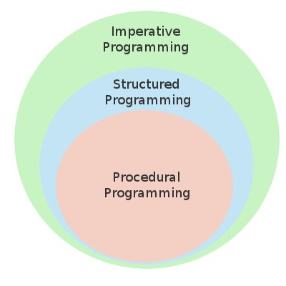
Imperative Programming
There is a lot of confusion of terminology around imperative, structured, and procedural programming.
However, these terms form roughly a hierarchy as seen on the right.
When we talk about imperative programming we mean all these things
Note: there are many exceptions, e.g.,
you can have procedural programs with
goto statements – not structured! Think C.

Slide 5
What is a Multi-Paradigm Programming Language?
A multi-paradigm programming language is a programming language supporting more than one programming paradigm, in order to allow the most suitable programming style for a task.
Source: https://en.wiktionary.org/wiki/multi-paradigm

Slide 6
Why Study?
Different programming paradigms provide different tools/approaches to tackle programming challenges
Picking the right paradigm for the job at hand is an essential skill of every software developer

Slide 7
Our Languages
The languages we will be discussing/using all support the following to varying degrees,
Imperative programming
OOP
Functional programming
Pattern matching

Slide 8

Python
www.python.org/
ln001/hello.py

Slide 9
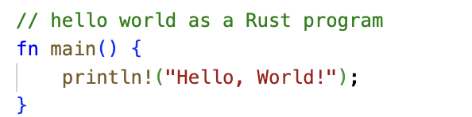
Rust
www.rust-lang.org/
ln001/hello.rs

Slide 10
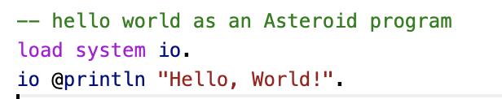
Asteroid
asteroid-lang.org/
ln001/hello.ast

Slide 11
Reading
Installing and Running Asteroid
asteroid-lang.readthedocs.io/en/latest/Installing%20and%20Running.html
Intro
asteroid-lang.readthedocs.io/en/latest/User Guide.html#introduction

