Slide 1
Object-Oriented Programming with Asteroid
Structures with behavior
No inheritance
No member protection, everything is public
Member function specification
Uses standard function syntax within structures
Internal object identity is given via the ‘this’ keyword.
Special member functions:
__init__
__str__

Slide 2
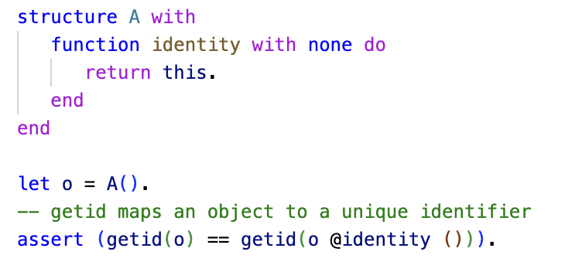
Object Identity
Internal and external object identities are the same
ln009/objid.ast

Slide 3
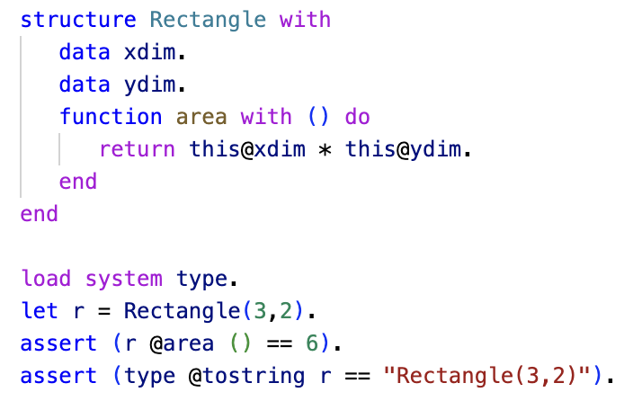
Basic Objects with Behavior
Data and function members
Member functions are functions defined in the context of a structure.
Notice the use of ‘this’
We are using the default constructor that fills out the data members according to the order they appear.
Taking advantage of default behavior when mapping object to a string.
ln009/rect1.ast

Slide 4
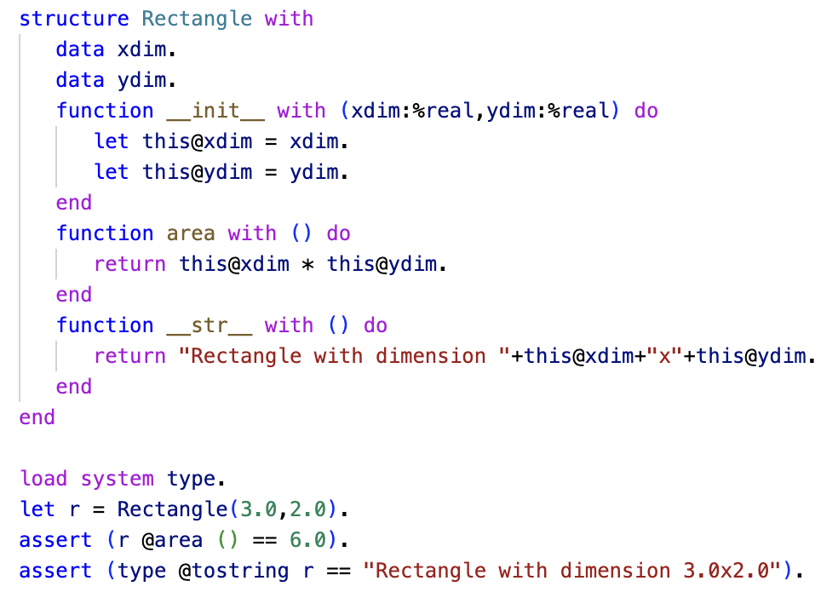
Custom Constructors and String Mapping
Taking advantage of the special functions __init__ and __str__
We use the constructor __init__ to enforce that we only want real values for dimensions
The __str__ functions allows us to create a custom string representation for Rectangle objects
ln009/rect2.ast

Slide 5
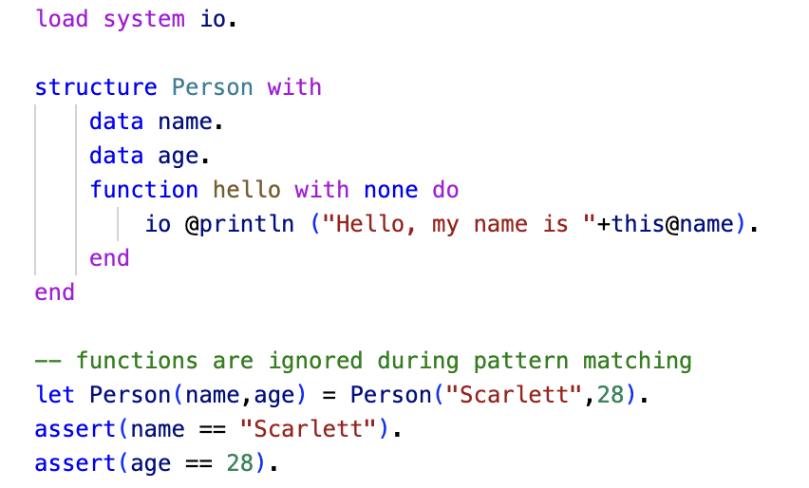
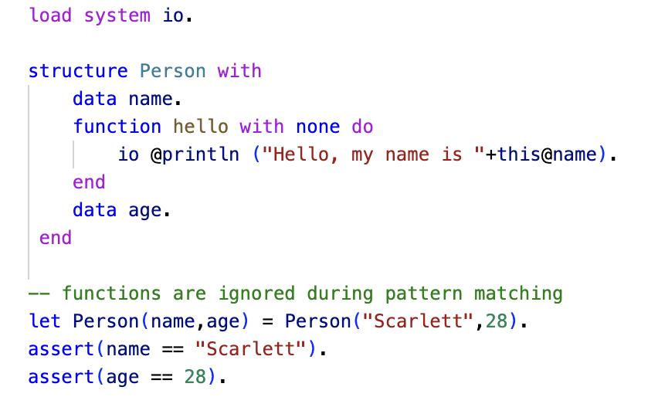
Pattern Matching on Objects
During pattern matching on objects member functions are ignored
It doesn’t matter where the functions appear.
You cannot pattern-match on functions!
You can only pattern-match on data members.

Slide 6
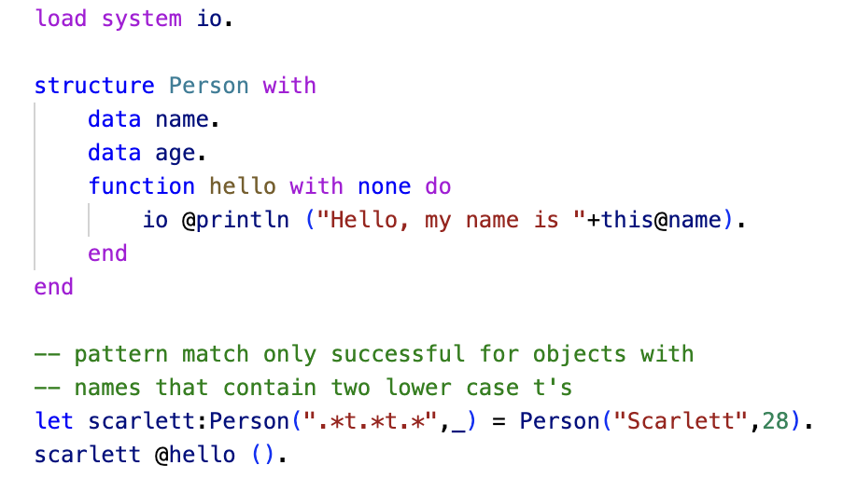
Pattern Matching on Objects
It is not a surprise that object patterns can be used as constraints.
All patterns we have looked at so far also apply to objects.

Slide 7
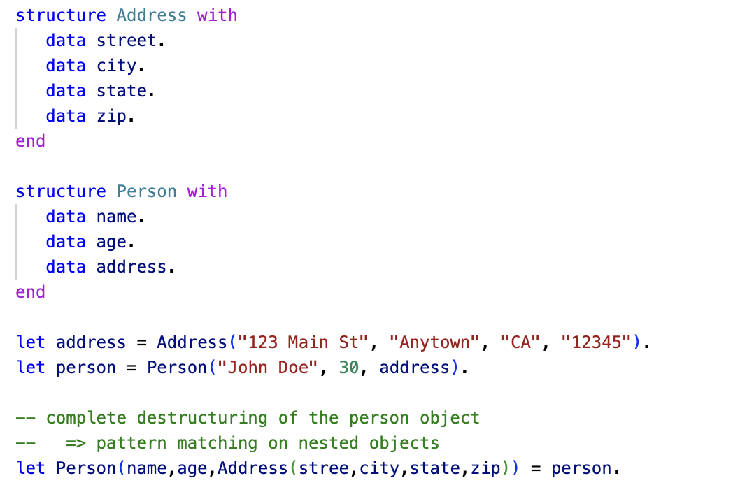
Object Composition
We already looked at object composition as a way of modeling compound objects.
Note: in Asteroid we can have nested objects but not nested structures.
ln008/objcomp.ast

Slide 8
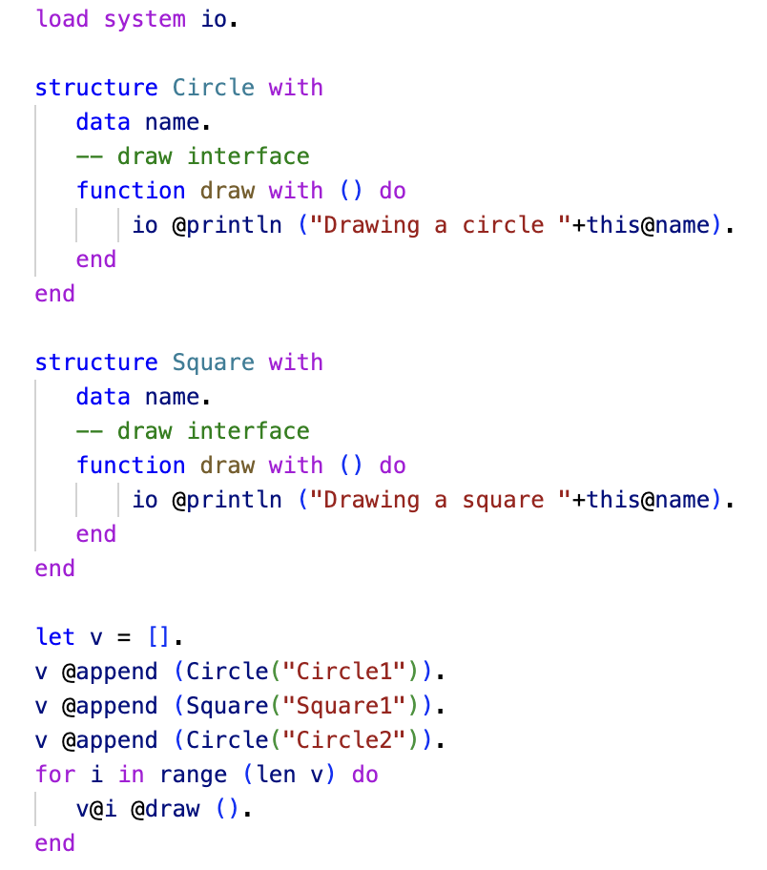
Duck Typing
As long as object have common interfaces they act as polymorphic structures – duck typing
The do not need be related via a common supertype.
ln009/subpoly.ast

Slide 9
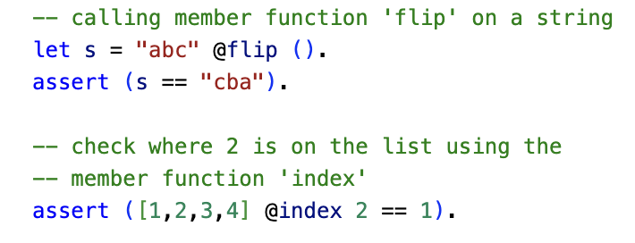
String & List Objects
In Asteroid, similar to Python, strings and lists are considered objects and have member functions.
ln009/objnstring.ast

Slide 10
Reading
https://asteroid-lang.readthedocs.io/en/latest/User%20Guide.html#structures-object-oriented-programming-and-pattern-matching
https://asteroid-lang.readthedocs.io/en/latest/Reference%20Guide.html#list-and-string-objects

