Slide 1
Imperative Programming – Foundations
The origins of imperative programming
Types

Slide 2
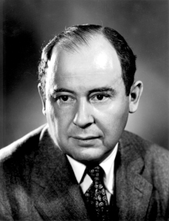
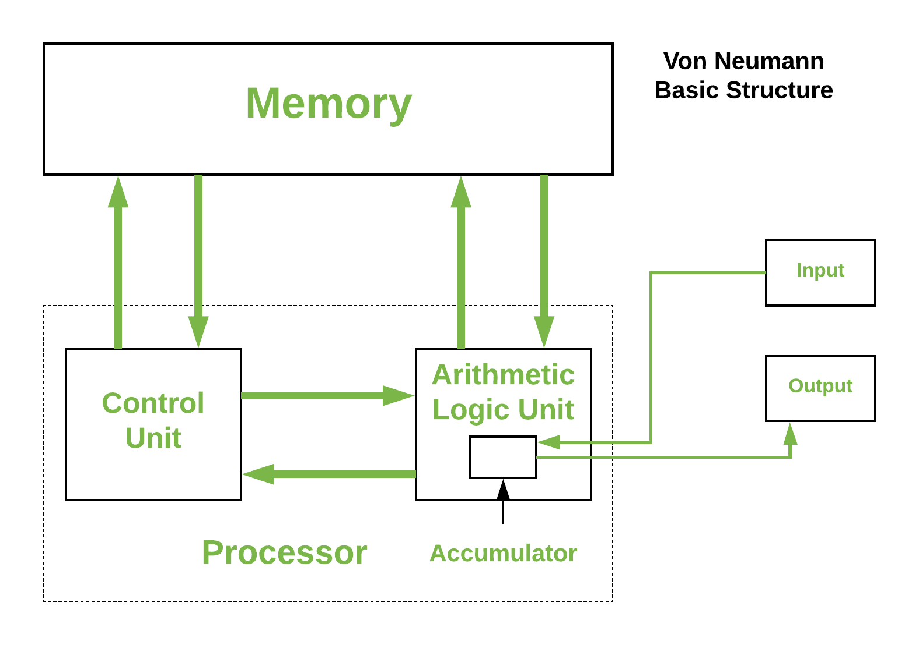
The von Newman Architecture
John von Newman, Hungarian mathematician, 1903-1957.
State
John von Newman’s computing model gave rise to the notion of imperative programming
Assembly/machine instructions directly manipulate processor memory
Imperative in the sense that each instruction states what memory will look like after it executes
The contents of the memory defines the state of the computation at any particular point in time
Image source: https://www.geeksforgeeks.org/computer-organization-von-neumann-architecture

Slide 3
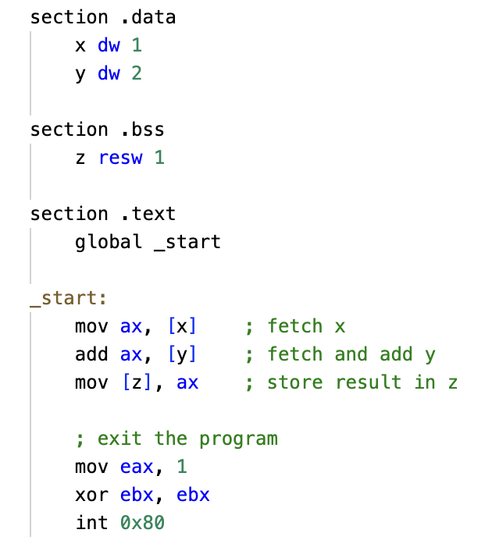
The von Newman Architecture
Memory state is defined by three three memory locations
x,y,z
The program changes the state by storing the sum of locations x and y into location z
Here [<location name>] means reading/writing the value stored at that location

Slide 4
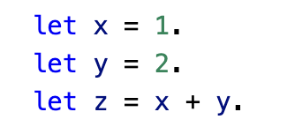
Imperative Programming – Foundations
In higher-level languages memory locations are abstracted into variables
This includes array/list variables
Assembly/machine instructions are abstracted into programming language syntax
BUT, the assignment statement is still imperative, it tells us exactly what memory looks like after it executes.

Slide 5
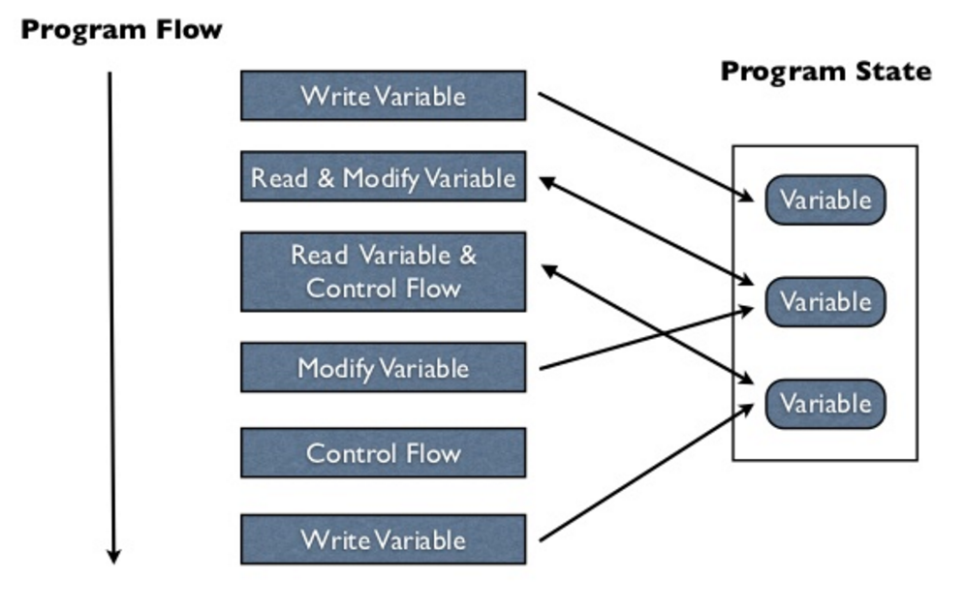
Imperative Programming – Foundations
Imperative programming –
Explicit statements that change the program state
The program state is defined by the values assigned to the variables in a program
The most common way to change the state in imperative programming is through an explicit assignment of a new value to an existing variable
Image source: https://practical.li/clojure/concepts/what-is-functional-programming.html

Slide 6
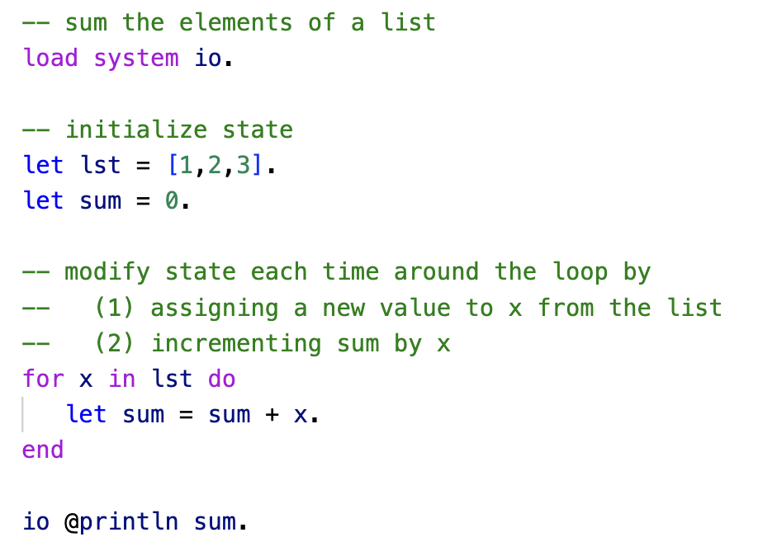
Imperative Programming – Foundations
Another example of an imperative program
ln002/sum1.ast

Slide 7
Imperative Programming – Foundations
Let’s review basic type theory for programming languages
This is important in order to understand
Type hierarchies
Type checking
Type promotion

Slide 8
Reading
Section 1 of the paper “Type Systems” by Luca Cardelli, Microsoft Research
lutzhamel.github.io/CSC493/docs/typesystems.pdf

Slide 9
Types
A Type is a Set of Values
Consider the Rust statement:
let n : i32 = 3;
Here we constrain n to take on any value from the set of all 32bit integer values.

Slide 10
Types
Def: A type is a set of values.
Def: A primitive type is a type that is built into the language, e.g., integer, string.
Def: A constructed type is a user defined type, e.g., any type introduced by the user.
In Asteroid this is done through the ‘structure’ statement.
Example: Asteroid, primitive type
q:%real = 1.1;
q is of type real, only
a value that is a member
of the set of all real
values can be assigned to q.
type real ⇒ set of all
possible real values

Slide 11
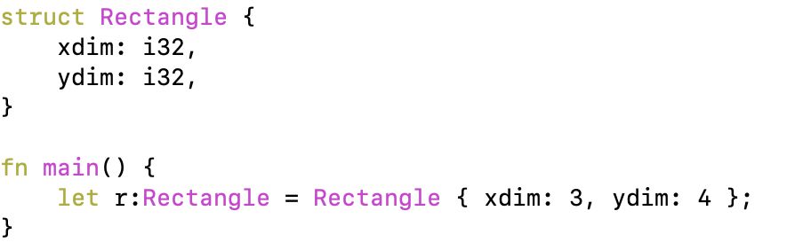
Types
Example: Rust, constructed type
Now the variable r only accepts values that are members of type Rectangle;
☞ object instantiations of struct Rectangle.

Slide 12
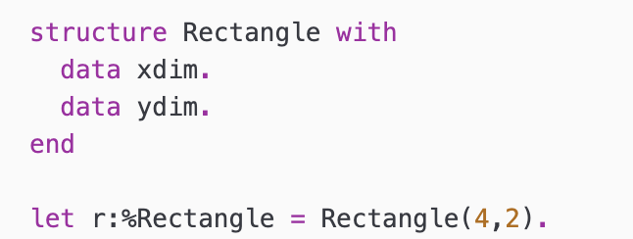
Types
Example: Asteroid, constructed type
an element of
type Rectangle.

Slide 13
Subtypes
Def: a subtype is a subset of the elements of a type.
Example: C
Short is a subtype of int: short < int
The notation A < B means
A is a subtype of B.
Observations:
converting a value of a subtype to a values of the super-type is called widening type conversion. (safe)
converting a value of a supertype to a value of a subtype is called narrowing type conversion. (not safe)
Subtypes give rise to type hierarchies and type hierarchies allow for automatic type
coercion – widening conversions!
Example: C, partial type hierarchy
char < short < int < float < double

Slide 14
Subtypes
A convenient way to visualize subtypes is using Venn diagrams
Consider, short < int
It is easy to see that the shorts are a subset of the integer values
The green arrow represents a widening type conversion is always safe
The red arrow represents a narrowing type conversion and is never safe
int
short
e.g. In Rust we have i16 < i32

Slide 15
Why do we use types?
Types allow the language system to assist the developer write better programs. Type mismatches in a program usually indicate some sort of programming error.
Static type checking – check the types of all statements and expressions at compile time.
Rust
Dynamic type checking – check the types at runtime.
Asteroid
Python

Slide 16
Type Equivalence
Fundamental to type checking is the notion of type equivalence:
Figuring out whether two type description are equivalent or not
This is trivial for primitive types
But not so straight forward for constructed types like class/struct objects.

Slide 17
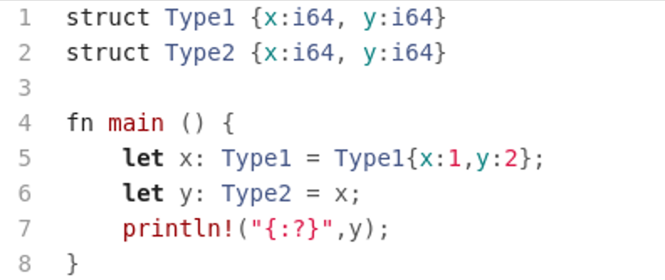
Type Equivalence
I. Name (nominal) Equivalence – two objects are of the same type if and only if they share the same type name.
Example: Rust – constructed type
Error; even though the types look the same, their names are different, therefore, Rust will not compile. Rust uses name equivalence

Slide 18
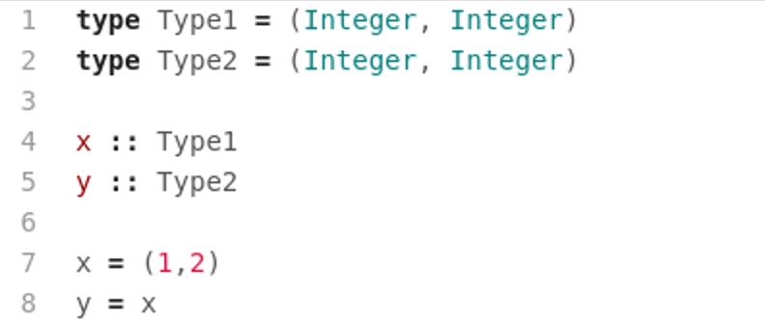
Type Equivalence
II. Structural Equivalence – two objects are of the same type if and only if they share the same type structure.
Example: Haskell
Even though the type names are different, Haskell correctly recognizes this statement.  Haskell uses structural equivalence.

Slide 19
Type checking
Type checking refers to the process of making sure that all expressions and statements are properly typed.

Slide 20
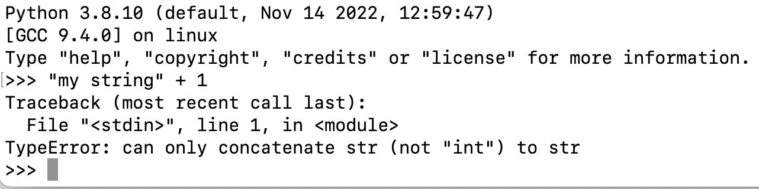
Type Checking
Here is the Python type checker in action
int and str are not part of a common type hierarchy.

Slide 21
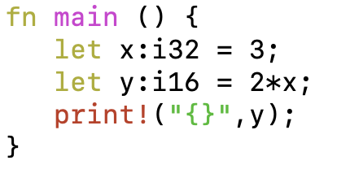
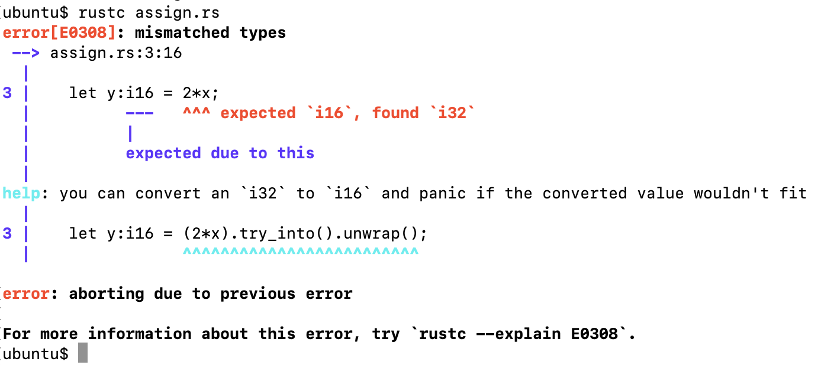
Type Checking
Here is the type checker of the Rust compiler in action
i16 < i32

Slide 22
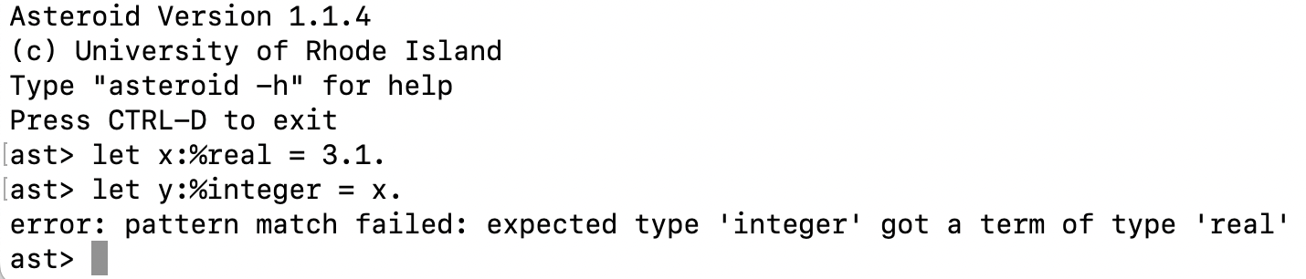
Type Checking in Asteroid
The Asteroid type checker in action
Integer < real

Slide 23
Type Promotion
Convert a subtype to a supertype (automatically)
Widening conversion
This usually happens at the operator level

Slide 24
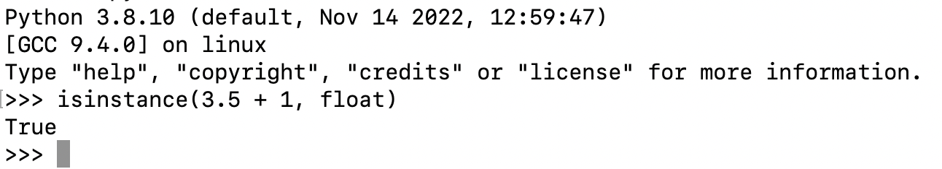
Type Promotion - Python
The addition operation is only defined for operands of the same type
In order to apply the operator in a mixed-type situation one of the operands needs to be promoted
If promotion is not possible then flag a type error
Promotion int → float

Slide 25
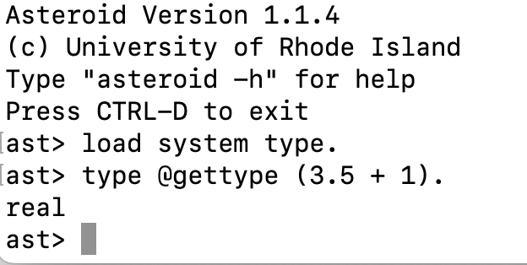
Type Promotion - Asteroid
Promotion integer → real

Slide 26
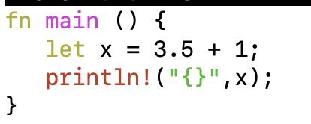
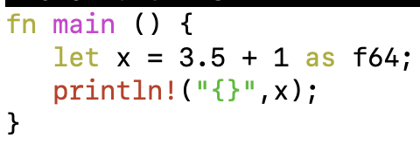
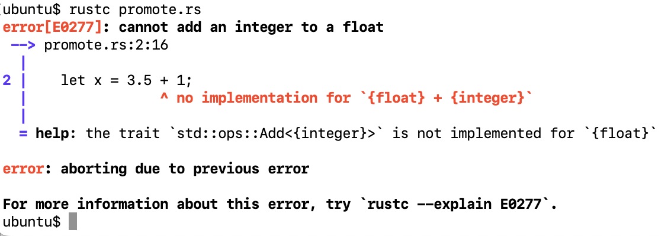
Type Promotion – Rust
Rust does not perform any automatic type promotion!
Explicit conversion

Slide 27
Imperative Programming – Asteroid
Let’s take a closer look at the imperative aspects of Asteroid
We start with the type system

Slide 28
Primitive Types & Constants in Asteroid
Constants are available for all the primitive data types,
integer, e.g. 1024
real, e.g. 1.75
string, e.g. "Hello, World!"
boolean, e.g. true

Slide 29
Type Hierarchies
Asteroid arranges primitive data types in a type hierarchy,
boolean < integer < real < string
As we have seen, type hierarchies facilitate automatic type promotion
ln002/let2.ast
Type promotion: plus as string concatenate op

Slide 30
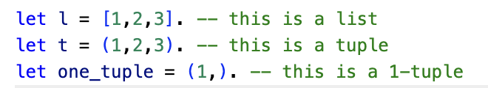
Structured Data Types
Asteroid also supports the built-in data types:
list
tuple
These are structured data types in that they can contain entities that belong to other data types.
Lists are mutable objects whereas tuples are immutable.
Some examples,
Note: (1,) ≠ (1)
ln002/let1.ast

Slide 31
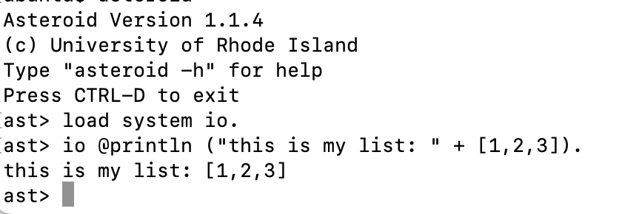
Structured Data Types
Lists and tuples themselves are also embedded in type hierarchies, although very simple ones:
list < string
tuple < string
That is, any list or tuple can be viewed as a string. This is very convenient for printing lists and tuples,

Slide 32
The None Type
Asteroid supports the none type.
The none type has only one member
A constant named none.
The empty set of parentheses () can be used as a shorthand for the none constant.
That is: none = ()

Slide 33
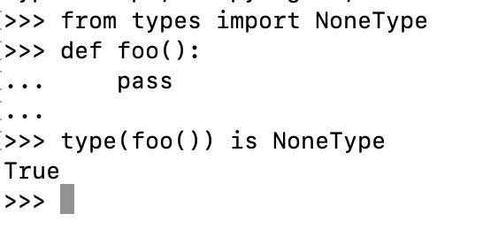
The None Type
The none type plays an important role in many modern programming languages
Python: NoneType – None
Rust: Unit – ()
Asteroid: none – none or ()
The none type is employed when something like a function needs to return a value, but no such value exists, e.g. Python
https://en.wikipedia.org/wiki/Unit_type

Slide 34
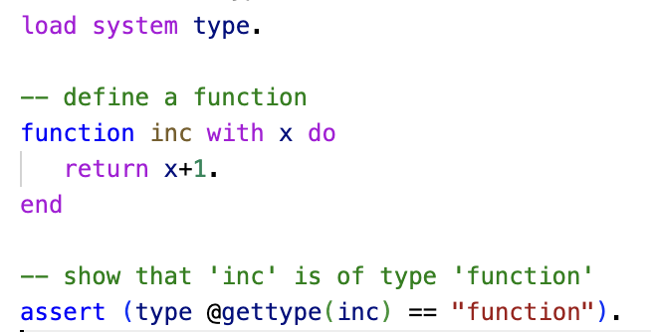
Other Data Types
In Asteroid we also have additional data types:
function
pattern
user defined data types via structures
ln002/ftype.ast

Slide 35
Reading
The Basics
asteroid-lang.readthedocs.io/en/latest/User%20Guide.html#the-basics

Slide 36
Team Exercise
Assignment #1 see BrightSpace

