Slide 1
Currying – Computing with Partially Evaluated Functions
The idea of higher-order programming and lambda functions gives rise to the idea of partially evaluated functions.
Again, we can look at the lambda calculus for foundations

Slide 2
Currying
Consider a lambda expression that takes a pair of values and adds them together.
Now assume that both arguments are not immediately available…only one at a time is available
I know, it’s a stretch but bear with me…
We can rewrite the lambda expression to deal with that situation by computing partially evaluated lambda expressions.

Slide 3
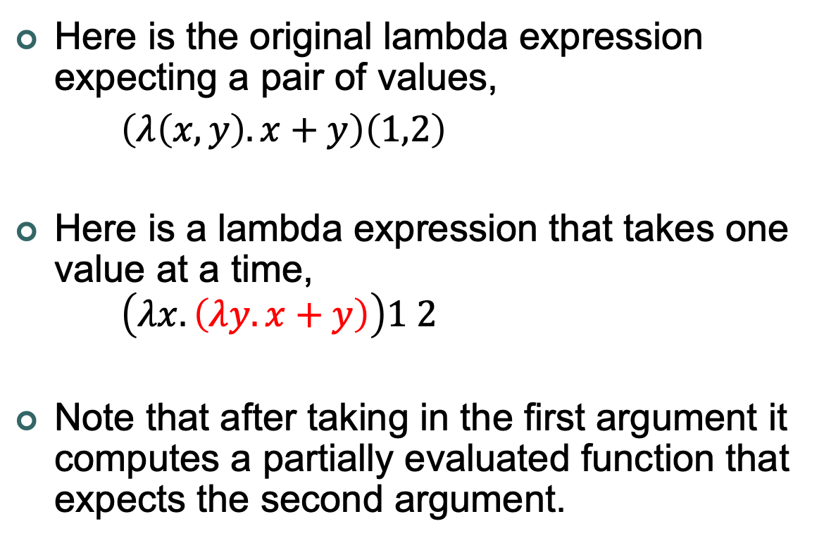
Currying
Here is the original lambda expression expecting a pair of values,
$\left(λ\left(x,y\right).x+y\right)\left(1,2\right)$
Here is a lambda expression that takes one value at a time, $\left(λx.\left(λy.x+y\right)\right)1 2$
Note that after taking in the first argument it computes a partially evaluated function that expects the second argument.
Single Value
Multiple Values

Slide 4
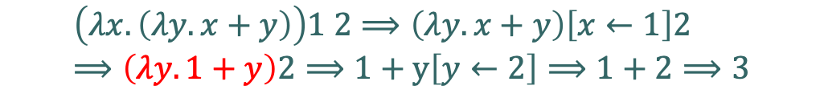

Currying
Let’s take a look how the computation of the two lambda expressions differ,
$$\left(λ\left(x,y\right).x+y\right)\left(1,2\right)⟹x+y\left[\left(x,y\right)⟵\left(1,2\right)\right]⟹x+y\left[x←1,y←2\right]⟹1+2⟹3$$
$$\left(λx.\left(λy.x+y\right)\right)1 2⟹\left(λy.x+y\right)\left[x←1\right]2⟹\left(λy.1+y\right)2⟹1+y\left[y←2\right]⟹1+2⟹3$$
Partially evaluated function

Slide 5


Currying
This technique also applies to functions that take more than two values,
$$\left(λ\left(x,y,z\right).x+y+z\right)\left(1,2,3\right)$$
$$\left(λx.\left(λy.\left(λz.x+y+z\right)\right)\right)1 2 3$$

Slide 6
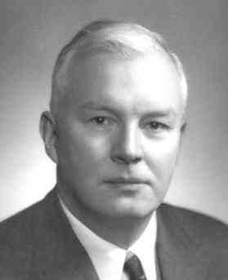
Currying
Dr Haskell Curry, mathematician
and logician, 1900-1982
This technique of turning a function expecting a tuple of values to a cascade of lambda functions is called currying.
It was invented by the mathematician and logician Haskell Curry.
He developed this technique while working combinatory logic.

Slide 7
Functional Programming
Curried functions are important in the functional programming field because they make libraries for functional languages much more flexible.
We can use partially evaluated library functions to define our own functions

Slide 8
SML
Here is an example in SML taking advantage of the curried sort function.
> sml
Standard ML of New Jersey (64-bit) v110.95 [built: Sun Nov 06 00:04:31 2022]
- val sort = ListMergeSort.sort;
val sort = fn : ('a * 'a -> bool) -> 'a list -> 'a list
- (op >);
val it = fn : int * int -> bool
- (op <);
val it = fn : int * int -> bool
-
Partially evaluated functions
- val asc_sort = sort (op >);
val asc_sort = fn : int list -> int list
- val desc_sort = sort (op <);
val desc_sort = fn : int list -> int list
- asc_sort [5, 2, 8, 3, 9, 1, 6, 7, 4];
val it = [1,2,3,4,5,6,7,8,9] : int list
- desc_sort [5, 2, 8, 3, 9, 1, 6, 7, 4];
val it = [9,8,7,6,5,4,3,2,1] : int list
-
- sort (op <) [5, 2, 8, 3, 9, 1, 6, 7, 4];
val it = [9,8,7,6,5,4,3,2,1] : int list
- sort (op >) [5, 2, 8, 3, 9, 1, 6, 7, 4];
val it = [1,2,3,4,5,6,7,8,9] : int list
-

Slide 9
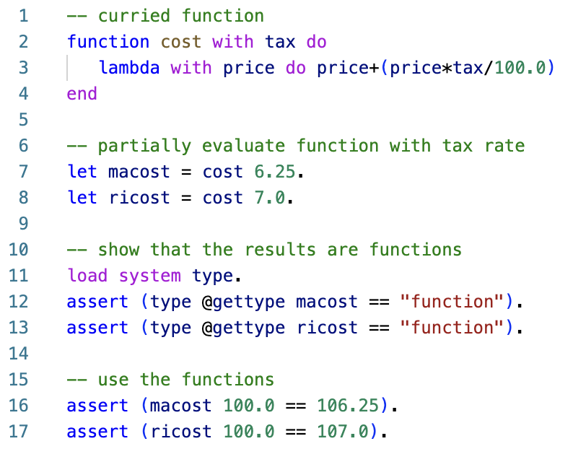
Asteroid
Even though the modules and APIs are written in a more traditional, non-curried style in most modern programming languages, currying is still a powerful programming tool
Here is a simple example written in Asteroid,
ln013/price.ast

Slide 10
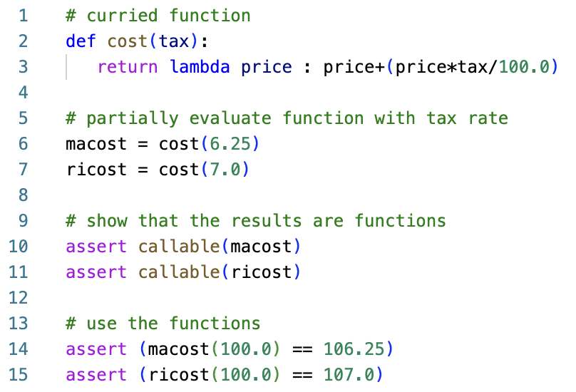
Python
Here is the same program written in Python
ln013/price.py

Slide 11
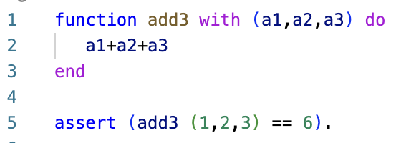
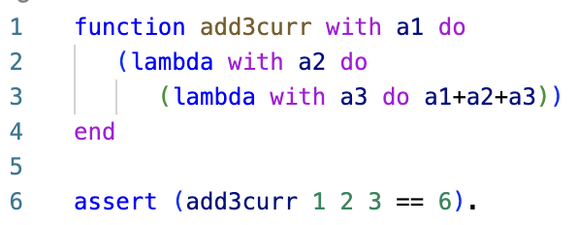
Currying of more than Two Arguments
The return value is a cascade of lambda functions
ln013/add3.ast
ln013/add3curr.ast

Slide 12
Currying Function in other Languages
Any language that supports lambda functions and static scoping supports function currying
This includes pretty much all languages designed over the last decade or two,
Python, Rust, Swift, Go, Asteroid,…

