Slide 1
A New Approach to OOP
No classes – structures with behavior instead
No (class) inheritance –traits/interfaces instead
Limited, if any, member protection to facilitate structural pattern matching on objects

Slide 2
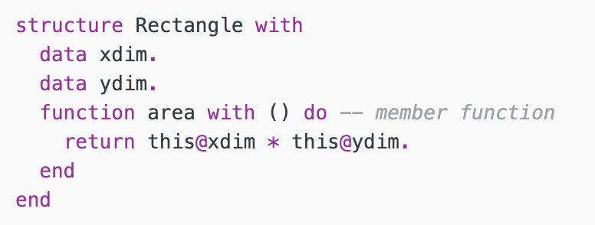
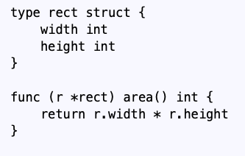
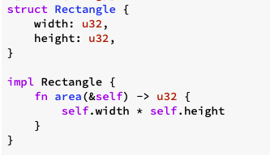
Structures with Behavior
Asteroid
Go
Rust

Slide 3
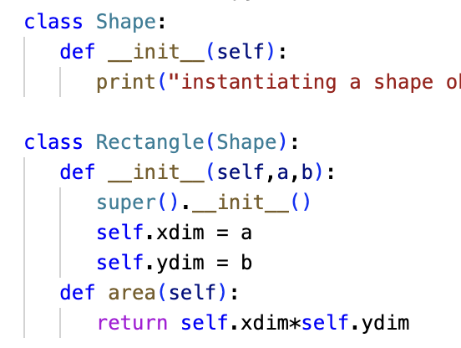
Python
Python takes a hybrid approach
Class inheritance structure but no member protection
Notice that because of duck typing we don’t need dynamic dispatching
ln008/rect.py

Slide 4
Rust
Problem: with the loss of inheritance how is subtype polymorphism supported in statically typed languages like Rust?
Answer: Traits (sometimes called interfaces) allow the developer to attach additional behavior to a class where that behavior can be shared among many classes effectively allowing polymorphic behavior with dynamic dispatching.

Slide 5
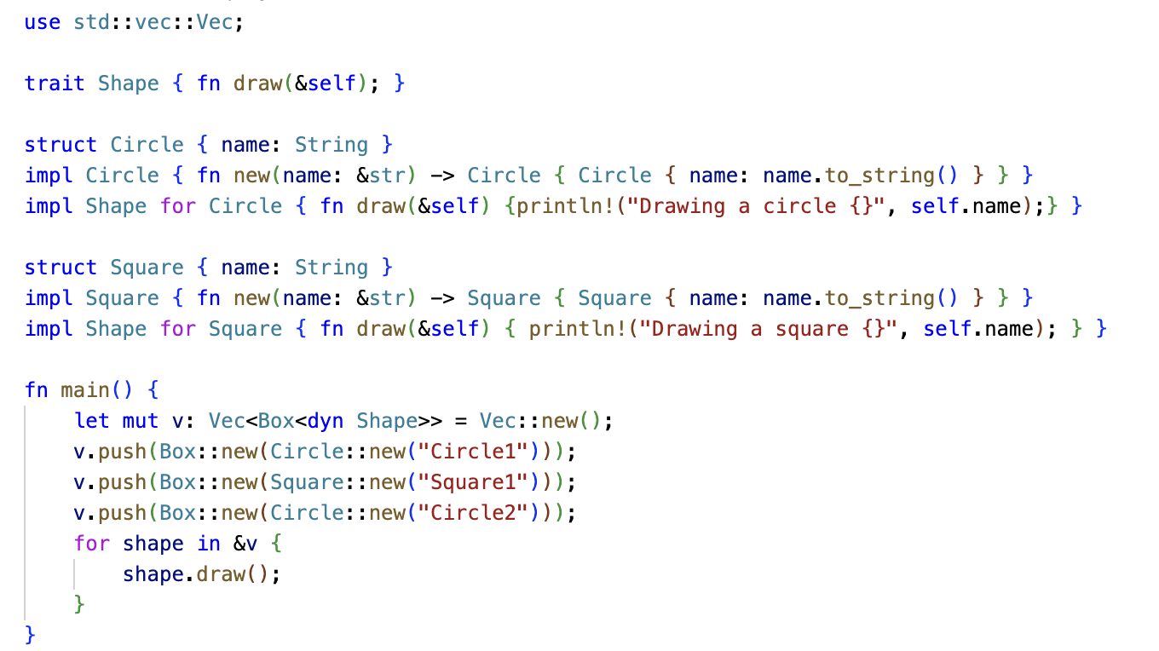
Rust
Abstract function
ln008/subpoly.rs

Slide 6
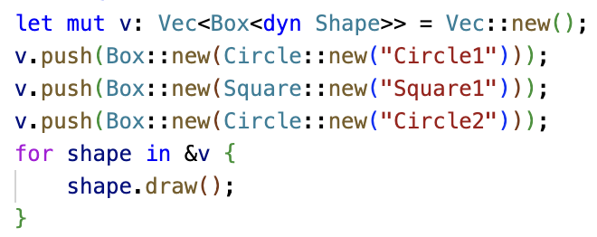
Subtype Polymorphism
let mut v: Vec<Box<dyn Shape>> =
Shape
draw()
Shape
draw()
Shape
draw()
Here Shape is
a trait not a
superclass!
Circle
“Circle1”
draw()
Square
“Square1”
draw()
Circle
“Circle2”
draw()
Dynamic dispatch realizes when calling the draw function of the trait that an implementation of that trait function exists in the structure and calls it.

Slide 7
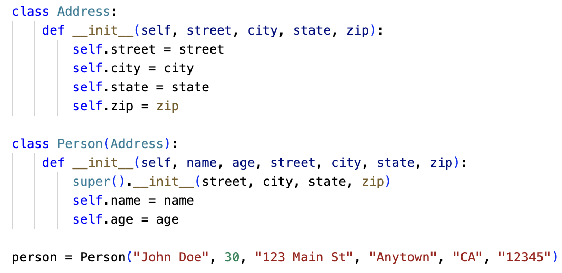
Object Composition vs Inheritance
Many modern programming languages advocate for object composition rather than inheritance, e.g. Go, Rust, Asteroid
In OOP inheritance as a subtype construction is often abused contributing to the issues mentioned earlier, consider
‘is-a’ relation
Often abused for the implementation of a ‘has-a’ relation
Person is a subtype of Address!?!
ln008/inheritance.py

Slide 8
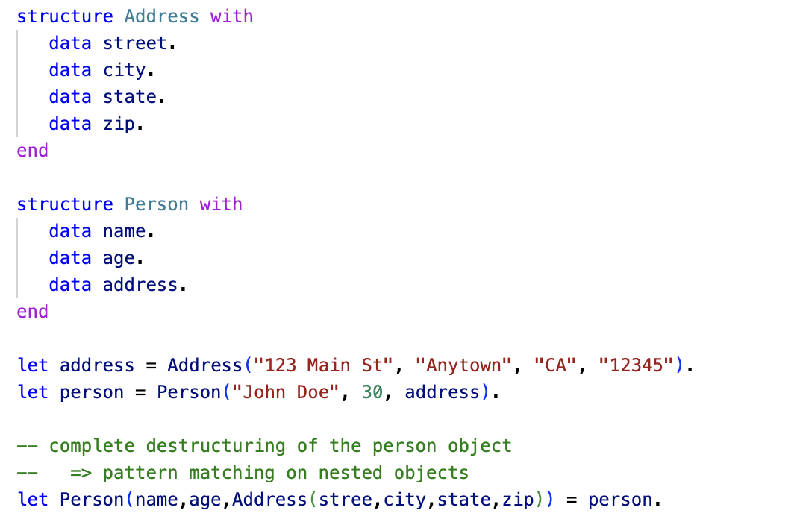
Object Composition vs Inheritance
Object composition solves this much cleaner and still enables pattern matching on objects
True ‘has-a’ relation.
ln008/objcomp.ast

