Slide 1
Object-Oriented Programming with Asteroid
Structures with behavior
No inheritance
No member protection, everything is public
Member function specification
Uses standard function syntax within structures
Internal object identity is given via the ‘this’ keyword.
Special member functions:
__init__
__str__

Slide 2
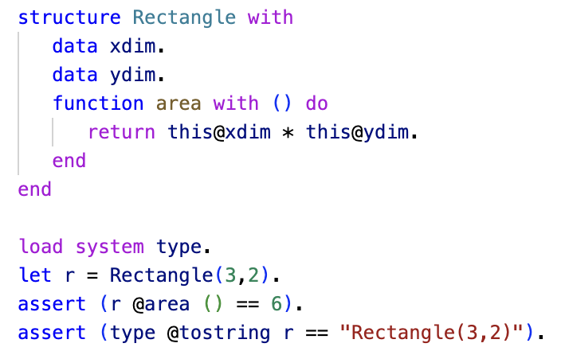
Object-Oriented Programming with Asteroid
Data and function members
Notice the use of ‘this’
We are using the default constructor that fills out the data members according to the order they appear.
Taking advantage of default behavior when mapping object to a string.
ln009/rect1.ast

Slide 3
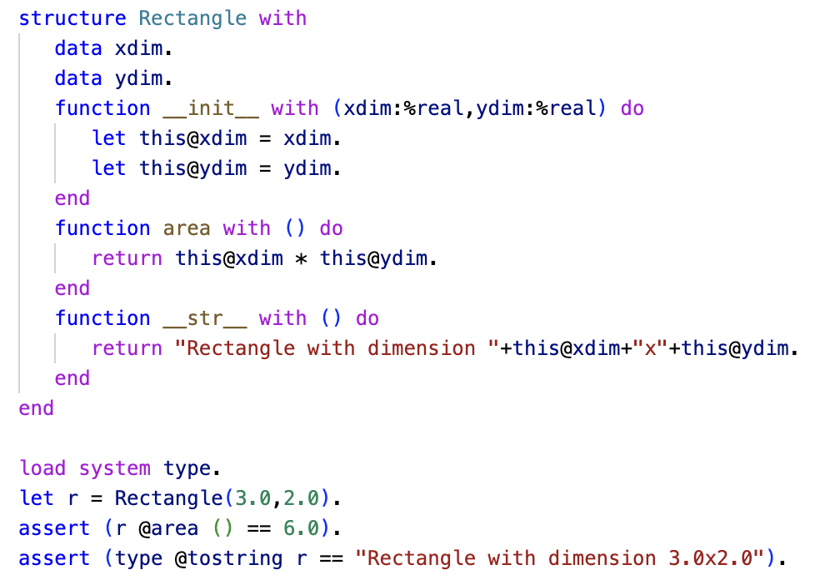
Object-Oriented Programming with Asteroid
Taking advantage of the special functions __init__ and __str__
We use the constructor __init__ to enforce that we only want real values for dimensions
The __str__ functions allows us to create a custom string representation for Rectangle objects
ln009/rect2.ast

