Slide 1
First-Class Patterns as Types
We already have seen that patterns behave like data types, consider,
let x:%integer = v.
Here the pattern %integer that matches all integer values limits what kind of values can be assigned to the variable x.
That is precisely what type declarations do!

Slide 2
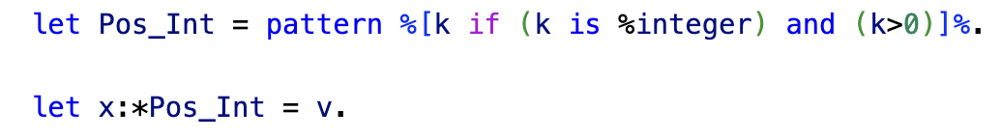
Subtypes
First-class patterns can be used to define subtypes of existing types
Consider for example,
Here we can treat the pattern Pos_Int as a subtype of the integers, in effect we have
Pos_Int < integer

Slide 3
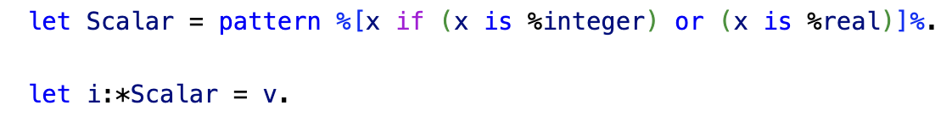
Supertypes
We can use first class patterns to also define supertypes, consider
Here the second let statement is only successful if it fulfills the requirements of the pattern Scalar.
In effect, Scalar acts like a supertype of real and integer
or more precisely it acts like an abstract base class since you since you cannot instantiate a value of type Scalar.

Slide 4
Sub- and Supertypes
We use first-class patterns to instantiate both subtypes and supertypes – how do they differ?

Slide 5
Sub- and Supertypes
Subtypes: the pattern definition adds conditions that contract a given data type
integers
positive
integers

Slide 6
Sub- and Supertypes
Supertypes: the pattern definition expands given data types so that the supertype pattern covers more objects than any given data type within the pattern definition.
scalar
reals
integers

Slide 7
Programming with Patterns as Data Types
We an impose a certain amount of type safety with patterns as data types
Specification of function domains
Type safety for objects using patterns as types in constructors
Subtype polymorphism

Slide 8
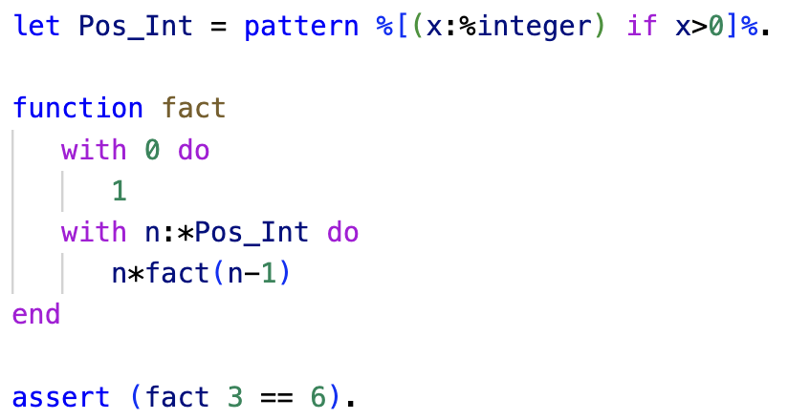
Function Domains
ln016/fact.ast

Slide 9
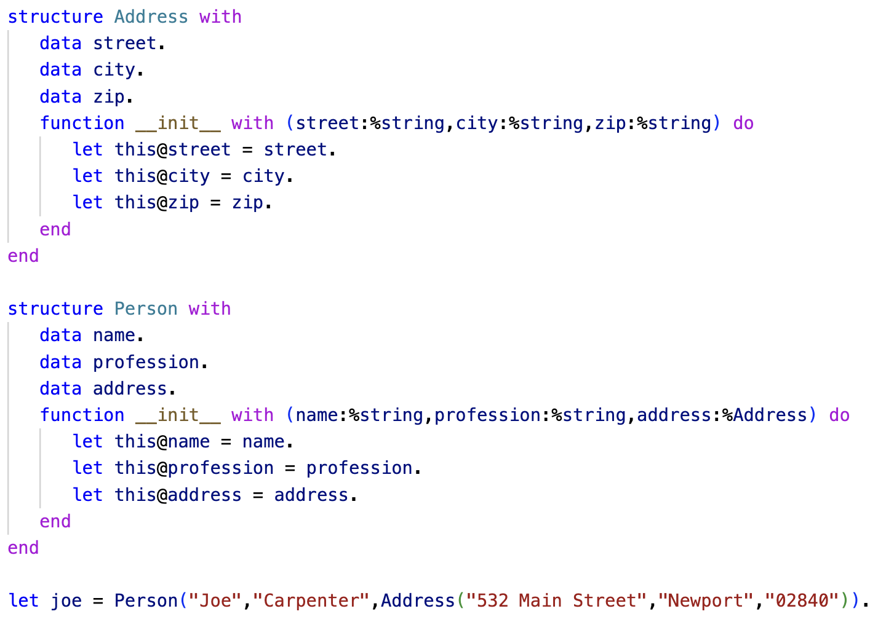
Objects

Slide 10
Subtype Polymorphism
In statically typed languages such as Java and Rust subtype polymorphism allows us to have type safe polymorphic containers
Recall our Rust Shape container ln008 slide pack slide 5

Slide 11
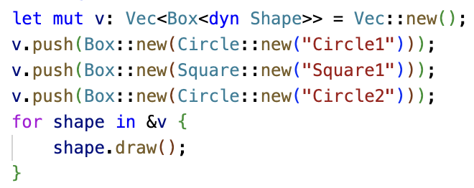
Subtype Polymorphism
let mut v: Vec<Box<dyn Shape>> =
Shape
draw()
Shape
draw()
Shape
draw()
Circle
“Circle1”
draw()
Square
“Square1”
draw()
Circle
“Circle2”
draw()
Dynamic dispatch realizes when calling the draw function of the trait that an implementation of that trait function exists in the structure and calls it.

Slide 12
Subtype Polymorphism
Dynamically typed languages like Python and Asteroid achieve polymorphic containers via Duck Typing.
However, these containers are not as type safe as subtype polymorphic containers since any object that supports the required behavior will fit into the container.

Slide 13
Subtype Polymorphism
In Asteroid we can recover a certain amount of type safety using first-class patterns
We use first-class patterns as types that allow us to define subtype-supertype relation ships
☞ subtype polymorphism

Slide 14
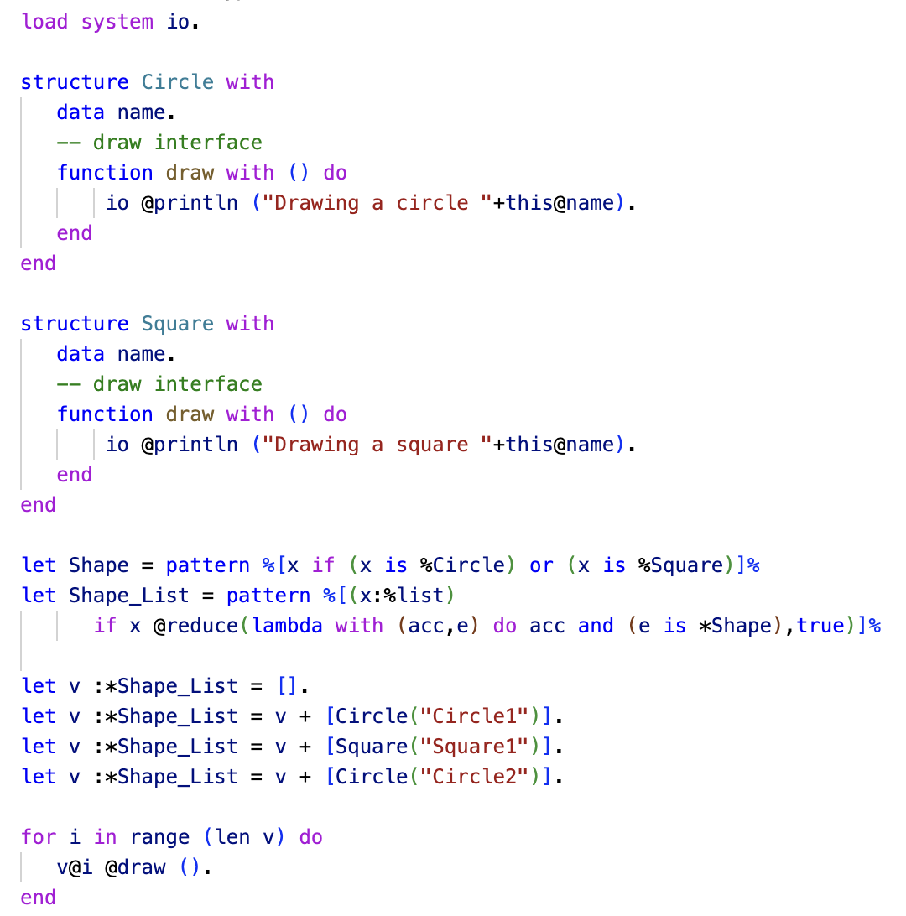
Subtype Polymorphism
Note: if we were to try to add anything but circles and squares to the list the ‘Shape_List’ pattern would fail!
ln014/subtypes.ast

Slide 15
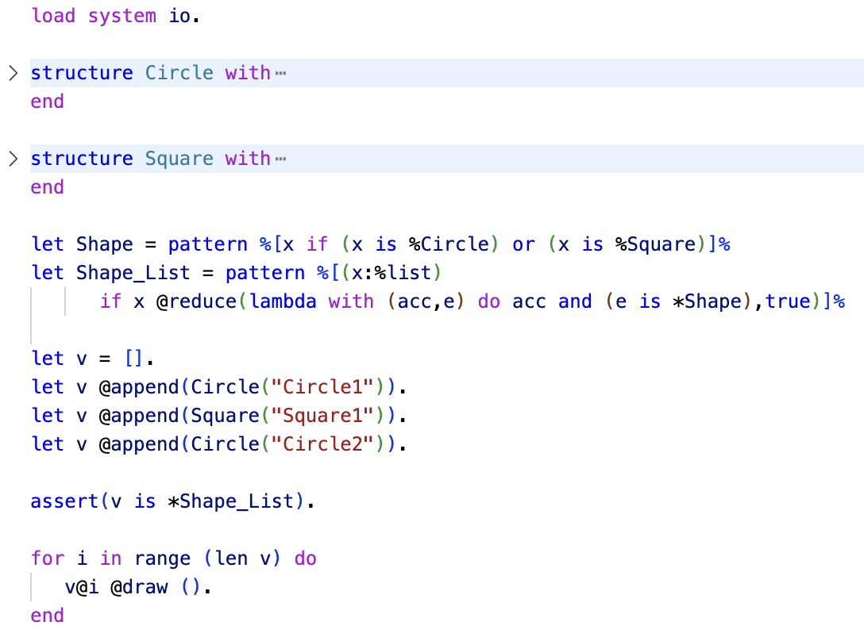
Subtype Polymorphism
Alternatively, we can construct the list in one go and then check for type safety.

Slide 16
Another Look at Multi-Dispatch
If we interpret certain patterns as types, then multi-dispatch can take on two particular forms:
Case analysis over a single type in the functional programming sense
E.g. case analysis on a list in recursive programs
Case analysis over multiple types giving rise to overloaded functions

Slide 17
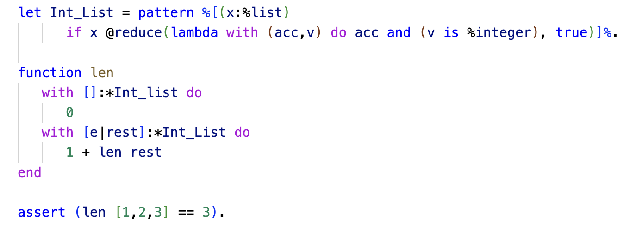
Functional Programming
In the example below we use multi-dispatch to do a case analysis on the %Int_List type
ln016/len.ast

Slide 18
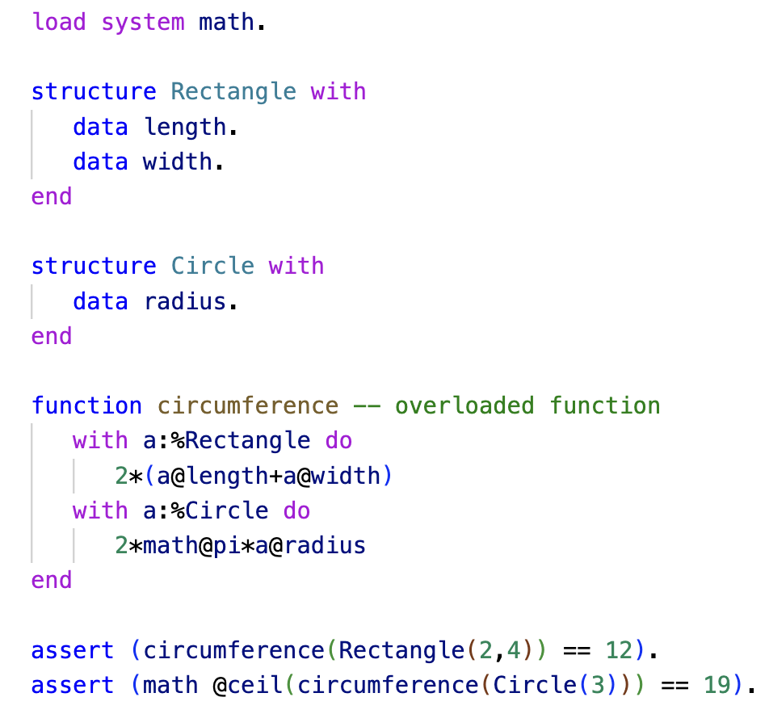
Overloaded Functions
In this example we use multi-dispatch to define an overloaded function accepting types %Rectangle and %Circle.
ln016/overload.ast

