Slide 1
First-Order Logic (FOL)
FOL consists of the following parts:
  Objects/terms
  Quantified variables
  Predicates
  Logical connectives
  Implication

Slide 2
Objects/Terms
FOL is a formal system that allows us to reason about the real world.
It is therefore no surprise that at the core of FOL we objects and terms that describe objects in the real world such as:
  phil, betty, fido -- objects
  pair(bob,susan) -- term
  [chicken,turkey,duck] -- term

Slide 3
First-Order Logic
Quantified variables allow us to talk about sets of objects/terms
  Universally quantified variables
  ∀X – for All objects X
  Existentially quantified variables
  ∃Y – there Exists an object Y

Slide 4
First-Order Logic
Predicates
  Predicates are functions that map their arguments into true/false where the domain is some universe, say U, and the co-domain is the set of Boolean values { true, false }, e.g., for the predicate p we have:
    p: U → { true, false }
  Example: human(X)
    human: U → { true, false }
    human(tree) = false
    human(paul) = true
  Example: mother(X,Y)
    mother: U × U → { true, false }
    mother(betty,paul) = true
    mother(giraffe,peter) = false
Another way of looking at predicates is as properties of objects.
Note: if we do not make another assumptions on the universe then the universe is usually taken as the set of all possible objects.

Slide 5
First-Order Logic
We can combine predicates and quantified variables to make statements on sets of objects
  ∃X[mother(X,paul)]
    there exists an object X such that X is the mother of Paul
  ∀Y[human(Y)]
    for all objects Y such that Y is human

Slide 6
First-Order Logic
Logical Connectives: and, or, not
  ∃F ∀C[parent(F,C) and male(F)]
    There exists an object F for all objects C such that F is a parent of C and F is male.
  ∀X[day(X) and (rainy(X) or snowy(X))]
    For all objects X such that X is a day and X is either rainy or snowy.

Slide 7
First-Order Logic
If-then rules: A ⇒ B
  ∀X∀Y[parent(X,Y) and female(X) ⇒ mother(X,Y)]
    For all objects X and for all objects Y such that if X is a parent of Y and X is female then X is the mother of Y.
  ∀Q[human(Q) ⇒ mortal(Q)]
    For all objects Q such that if Q is human then Q is mortal.
We can combine quantified variables, predicates, logical connectives, and implication into WFF’s (well-formed formulas)

Slide 8
First-Order Logic
Modus Ponens
human(socrates)
∀Q[human(Q) ⇒ mortal(Q)]
--------------------------------------
∴ mortal(socrates)
We reason with FOL by asserting truths and then use the implications to deduce consequences of these assertions.

Slide 9
First-Order Logic
WFFs can become very complicated, consider
∀ABCD[(p(A) ⇒ k(B)) ⇒ (q(C) ⇒ k(D))]
Very difficult to automate

Slide 10
Horn Clause Logic
In Horn clause logic the form of the WFFs is restricted:
P₁ ∧ P₂ ∧ … ∧ P_{n-1} ∧ P_{n} ⇒ P₀
Where P₀ , P₁ , P₂, … P_{n-1}, P_{n} are predicates over universally quantified variables.
Single predicate in consequent
Conjunctions only!

Slide 11
Proving things is computation!
Use resolution to reason with Horn clause expressions - resolution mimics
the modus ponens using horn clause expressions.
Advantage: this can be done mechanically (Alan Robinson, 1965)
“Deduction is Computation”
J. Alan Robinson: A Machine-Oriented Logic Based on the Resolution Principle. J. ACM 12(1): 23-41 (1965)

Slide 12
Basic Programs
Prolog programs follow the FOL style: assert truth and use the rules/implications to compute the consequences of these assertions.
Valid Horn Clause
human(socrates)
∀Q[human(Q) ⇒ mortal(Q)]
--------------------------------------
∴ mortal(socrates)

Slide 13
Basic Prolog Programs
Prolog ≡ Programming in Logic
Prolog programs consist of fact (assumptions) and inference rules.
As opposed to natural deduction, Prolog is based on FOL.
We can execute Prolog programs by trying to prove things via queries.
Example: a simple program
male(phil).
male(john).
female(betty).
Facts, Prolog will treat these as true and enters
them into its knowledgebase.
We execute Prolog programs by posing queries on its knowledgebase:
?- male(phil).
true - because Prolog can use its knowledgebase to prove true.
?- female(phil).
false - this fact is not in the knowledgebase.
Prompt

Slide 14
Prolog - Queries & Goals
A query is a way to extract information from a logic program.
Given a query, Prolog attempts to show that the query is a logical
consequence of the program; of the collection of facts.
In other words, a query is a goal that Prolog is attempting to satisfy (prove true).
When queries contain variables they are existentially quantified, consider
?- parent(X,liz).
The interpretation of this query is: prove that there is at least one object X
that can be considered a parent of liz, or formally, prove that
∃x[parent(x,liz)]
holds.
NOTE: Prolog will return all objects for which a query evaluates to true.
!!

Slide 15
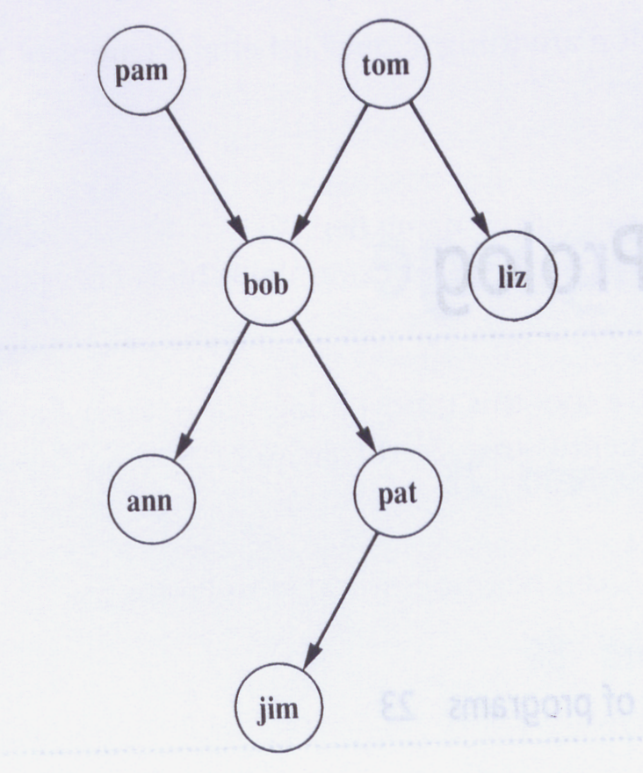
A Prolog Program
% a simple prolog program
female(pam).
female(liz).
female(ann).
female(pat).
male(tom).
male(bob).
male(jim).
parent(pam,bob).
parent(tom,bob).
parent(tom,liz).
parent(bob,ann).
parent(bob,pat).
parent(pat,jim).
Parent
Relation
Example Queries:
?- female(pam).
?- female(X). ∃X[female(X)]?
?- parent(tom,Z).
?- father(Y).
A Family Tree

Slide 16
Compound Queries
A compound query is the conjunction of individual simple queries.
Stated in terms of goals: a compound goal is the conjunction of individual
subgoals each of which needs to be satisfied in order for the compound goal
to be satisfied. Consider:
?- parent(X,Y) , parent(Y,ann).
or formally, show that the following holds,
∃X,Y[parent(X,Y) ∧ parent(Y,ann)]
When Prolog tries to satisfy this compound goal, it will make sure that the
two Y variables always have the same values.
Prolog uses unification and backtracking in order to find all the solutions
which satisfy the compound goal.

Slide 17
Prolog Rules
Prolog rules are Horn clauses, but they are written “backwards”, consider:
∀X,Y[female(X) ∧ parent(X,Y) ⇒ mother(X,Y)]
is written in Prolog as
mother(X,Y) :- female(X) , parent(X,Y) .
Implies (“think of ⇐”)
Prolog rules a implicitly
universally quantified!
!!
“and”
head
body
You can think of a rule as introducing a new “fact” (the head), but the fact is
defined in terms of a compound goal (the body). That is, predicates defined as
rules are only true if the associated compound goal can be shown to be true.

Slide 18
Prolog Rules
% a simple prolog program
female(pam).
female(liz).
female(ann).
female(pat).
male(tom).
male(bob).
male(jim).
parent(pam,bob).
parent(tom,bob).
parent(tom,liz).
parent(bob,ann).
parent(bob,pat).
parent(pat,jim).
mother(X,Y) :- female(X),parent(X,Y). _x0003_
Queries:
?- mother(pam,bob).
?- mother(Z,jim).
?- mother(P,Q).

Slide 19
Prolog Rules
The same predicate name can be defined by multiple rules:
sibling(X,Y) :- sister(X,Y) .
sibling(X,Y) :- brother(X,Y).

Slide 20
Socrates Revisited
Consider the program relating humans to mortality:
mortal(X) :- human(X).
human(socrates).
We can now pose the query:
?- mortal(socrates).
True or false?

Slide 21
Declarative vs. Procedural Meaning
When interpreting rules purely as Horn clause logic statement → declarative
When interpreting rules as “specialized queries” → procedural
Observation: We design programs with declarative meaning in our minds,
but the execution is performed in a procedural fashion.
Consider:
mother(X,Y) :- female(X),parent(X,Y).

Slide 22
Prolog Terms
A term in Prolog is anything that cannot be considered a predicate
  Simple object names, e.g. betty, john
  Simple structures, e.g. couple(betty, john), in this case the important part here is that couple does not appear as a predicate definition
  Lists

Slide 23
Lists & Pattern Matching
arity
The unification operator: =/2
  The expression A=B is true if A and B are terms and unify (look identical)
?- a = a.
true
?- a = b.
false
?- a = X.
X = a
?- X = Y.
true

Slide 24
Lists & Pattern Matching
Lists – a convenient way to represent abstract concepts
  Prolog has a special notation for lists.
[a]
[a,b,c]
[ ]
[ bmw, vw, mercedes ]
[ chicken, turkey, goose ]
Empty
List

Slide 25
Lists & Pattern Matching
Pattern Matching in Lists
?- [ a, b ] = [ a, X ].
X = b
?- [ a, b ] = X.
X = [ a, b ]
But:
?- [ a, b ] = [ X ].
no
The Head-Tail Operator: [H|T]
?- [a,b,c] = [X|Y];
X = a
Y = [b,c]
?- [a] = [Q|P];
Q = a
P = [ ]

Slide 26
Lists - the First Predicate
The predicate first/2: accept a list in the first argument and return
the first element of the list in second argument.
first(List,E) :- List = [H|T], E = H;

Slide 27
Lists - the Last Predicate
The predicate last/2: accept a list in the first argument and return
the last element of the list in second argument.
Recursion: there are always two parts to a recursive definition;
the base and the recursive step.
last([A],A).
last([A|L],E) :- last(L,E).

Slide 28
Lists - the Append Predicate
The append/3 predicate: accept two lists in the first two parameters, append
the second list to the first and return the resulting list in the third parameter.
append([ ], List, List).
append([H|T], List, [H|Result]) :- append(T, List, Result).

Slide 29
Prolog – Arithmetic
Prolog is a programming language, therefore, arithmetic is implemented as expected.
The only difference to other programming languages is that assignment is done via the predicate is rather than the equal sign, since the equal sign has been used for the unification operator.
Examples:
?- X is 10 + 5;
X = 15
?- X is 10 + 5 * 6 / 3;
X = 20
Precedence and associativity
of operators are respected.

Slide 30
Prolog – Arithmetic
Example: write a predicate definition for length/2 that takes a list
in its first argument and returns the length of the list in its second
argument.
length([ ], 0).
length(L, N) :- L = [H|T], length(T,NT), N is NT + 1.

Slide 31
Prolog – Arithmetic
Example: we can also use arithmetic in compound statements.
?- X is 5, Y is 2 * X.
X = 5
Y = 10

Slide 32
Prolog – I/O
write(term)
  is true if term is a Prolog term, writes term to the terminal.
read(X)
  is true if the user types a term followed by a period, X becomes unified to the term.
nl
  is always true and writes a newline character on the terminal.
☞ Extra-logical predicates due to the side-effect of writing/reading
to/from the terminal.

Slide 33
Prolog – I/O
?- write(tom).
tom
?- write([1,2]).
[1, 2]
?- read(X).
|: boo.
X = boo
?- read(Q).
|: [1,2,3].
Q = [1, 2, 3]
Prolog I/O Prompt

Slide 34
Prolog – I/O
Example: write a predicate definition for fadd/1 that takes a list of
integers, adds 1 to each integer in the list, and prints each integer
onto the terminal screen.
fadd([ ]).
fadd([ H | T ]) :- I is H + 1, write(I), nl, fadd(T).

Slide 35
Member Predicate
Write a predicate member/2 that takes a list as its first argument and
an element as its second element. This predicate is to return true if
the element appears in the list.
member([E|_],E).
member([_|T],E) :- member(T,E).

Slide 36
Exercises
Define a predicate max/3 that takes two numbers as its first two
arguments and unifies the last argument with the maximum
of the two.
Define a predicate maxlist/2 takes a list of numbers as its first
argument and unifies the second argument with the maximum
number in the list. The predicate should fail if the list is empty.
Define a predicate ordered/1 that takes a list of numbers as its
argument and succeeds if and only if the list is in non-decreasing
order.
Notes:
/*
max(X,Y,Z) succeeds if the max of numbers X and Y is Z.
X and Y must be instantiated.
*/
max(X,Y,X) :- X >= Y.
max(X,Y,Y) :- X < Y.
/*
maxlist(L,M) succeeds if the max in the list L of numbers
is M. L must be fully instantiated.
*/
maxlist([X],X).
maxlist([A,B|Rest],X) :-
max(A,B,C),
maxlist([C|Rest],X).
/*
ordered(L) succeeds if the list of numbers L is in non-decreasing
order. The list must be fully instantiated.
*/
ordered([]).
ordered([_]).
ordered([X,Y | Rest]) :-
X =< Y,
ordered([Y | Rest]).

Slide 37
The ‘Cut’ Predicate
The Cut predicate ‘!’ allows us to control Prolog’s backtracking behavior
The Cut predicate forces Prolog to commit to a set of choice points
Consider the following code:
different(A,B) :- A=B,!,fail.
different(_,_).
Returns true if A and B are different and false if they are equal.

Slide 38
The Cut Predicate
What would be the behavior if
  q:-fail and r:-true
  q:-true and r:-fail
a:-b,c,d.
c:-p,q,!,r,s.
c:-t.
b.
d.
p.
q:- ??.
r:- ??.
s.
t.
?- a.

