Slide 1
CSC501 Semester Review

Slide 2
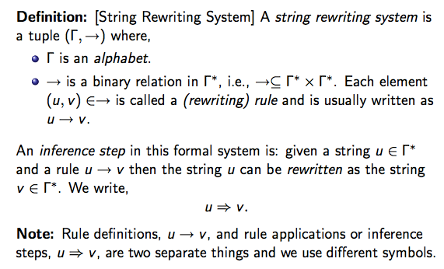
String Rewriting Systems

Slide 3
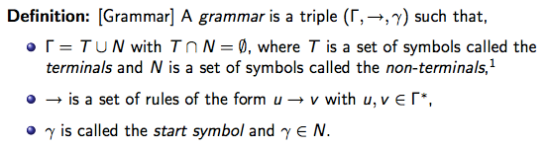
Grammars

Slide 4
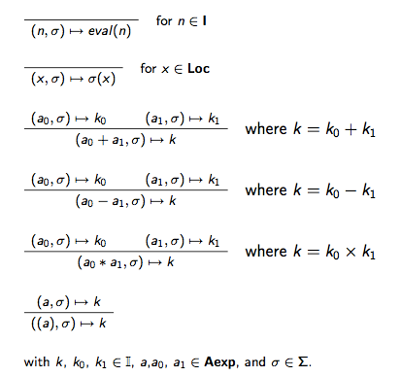
Natural Semantis
Arithmetic
Expressions:

Slide 5
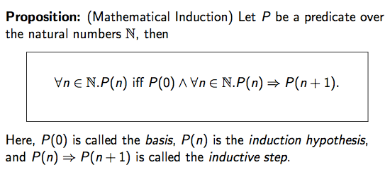
Induction

Slide 6
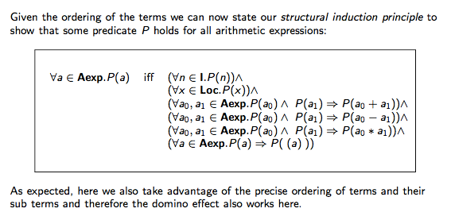
Structural Induction

Slide 7
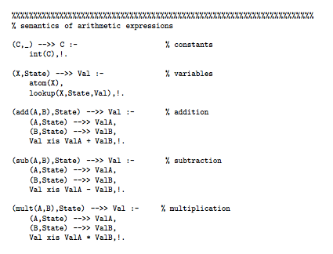
Prolog Semantics

Slide 8
Prolog Semantics
Executable Specs/Prolog Specs:
state, arithmetic expressions
boolean expressions, commands
declarations, type systems
I/O, block structured languages
functions
program correctness
pre- and postconditions
program correctness and iteration
loop invariants
program correctness and recursive functions
translational semantics
translation, source and target semantics
compiler correctness

Slide 9
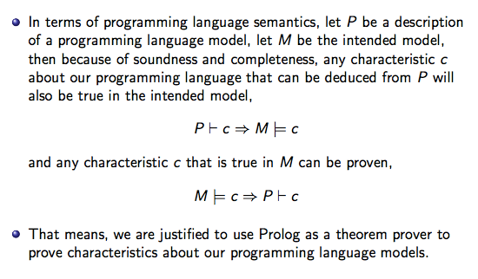
Elements of Model Theory

