Slide 1
Decision Trees
Learn from labeled observations - supervised learning
Represent the knowledge learned in form of a tree
Example: learning when to play tennis.
Examples/observations are days with their observed characteristics and whether we played tennis or not
Notes:
1

Slide 2
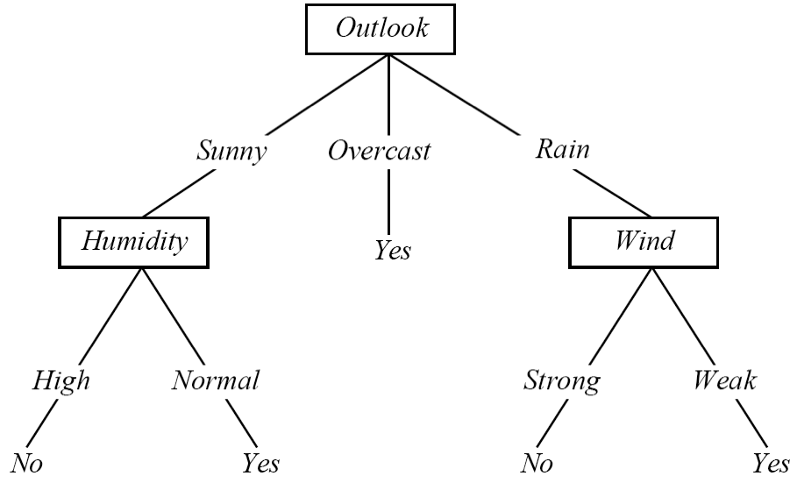
Play Tennis Example
Outlook | Temperature | Humidity | Windy | PlayTennis
Sunny | Hot | High | False | No
Sunny | Hot | High | True | No
Overcast | Hot | High | False | Yes
Rainy | Mild | High | False | Yes
Rainy | Cool | Normal | False | Yes
Rainy | Cool | Normal | True | No
Overcast | Cool | Normal | True | Yes
Sunny | Mild | High | False | No
Sunny | Cool | Normal | False | Yes
Rainy | Mild | Normal | False | Yes
Sunny | Mild | Normal | True | Yes
Overcast | Mild | High | True | Yes
Overcast | Hot | Normal | False | Yes
Rainy | Mild | High | True | No
Notes:
2

Slide 3
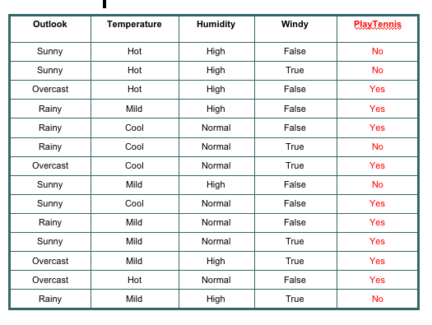
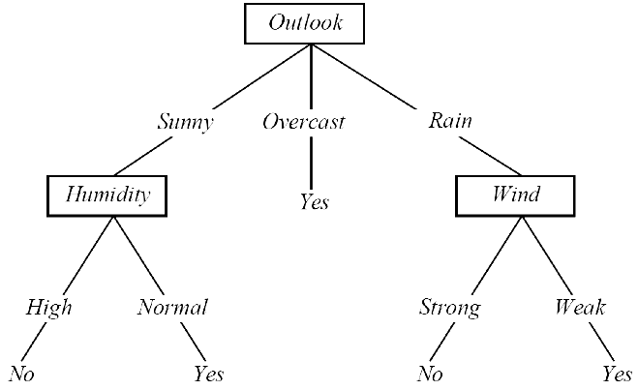
Interpreting a DT
DT ≡ Decision Tree
A DT uses the features of an observation table as nodes and the feature values as links.
All feature values of a particular feature need to be represented as links.
The target feature is special - its values show up as leaf nodes in the DT.
Notes:
3

Slide 4
Interpreting a DT
Each path from the root of
the DT to a leaf can be
interpreted as a decision rule.
IF Outlook = Sunny AND Humidity = Normal THEN Playtennis = Yes
IF Outlook = Overcast THEN Playtennis =Yes
IF Outlook = Rain AND Wind = Strong THEN Playtennis = No
Notes:
4

Slide 5
DT: Explanation & Prediction
Explanation: the DT summarizes (explains) all the observations in the table perfectly ⇒ 100% Accuracy
Prediction: once we have a DT (or model) we can use it to make predictions on observations that are not in the original training table, consider:
Outlook = Sunny, Temperature = Mild, Humidity = Normal, Windy = False, Playtennis = ?
Notes:
5

Slide 6
Constructing DTs
How do we choose the attributes and the order in which they appear in a DT?
Recursive partitioning of the original data table
Heuristic - each generated partition has to be “less random” (entropy reduction) than previously generated partitions
Notes:
6

Slide 7
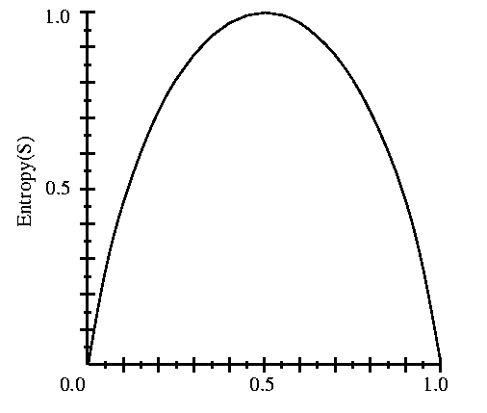
Entropy
S is a sample of training examples
p⁺ is the proportion of positive examples in S
p⁻ is the proportion of negative examples in S
Entropy measures the impurity (randomness) of S
S
p⁺
Entropy(S) ≡ - p⁺ log₂ p⁺ - p⁻ log₂ p⁻
Entropy(S) = Entropy([9+,5-]) = .94
Notes:
7

Slide 8
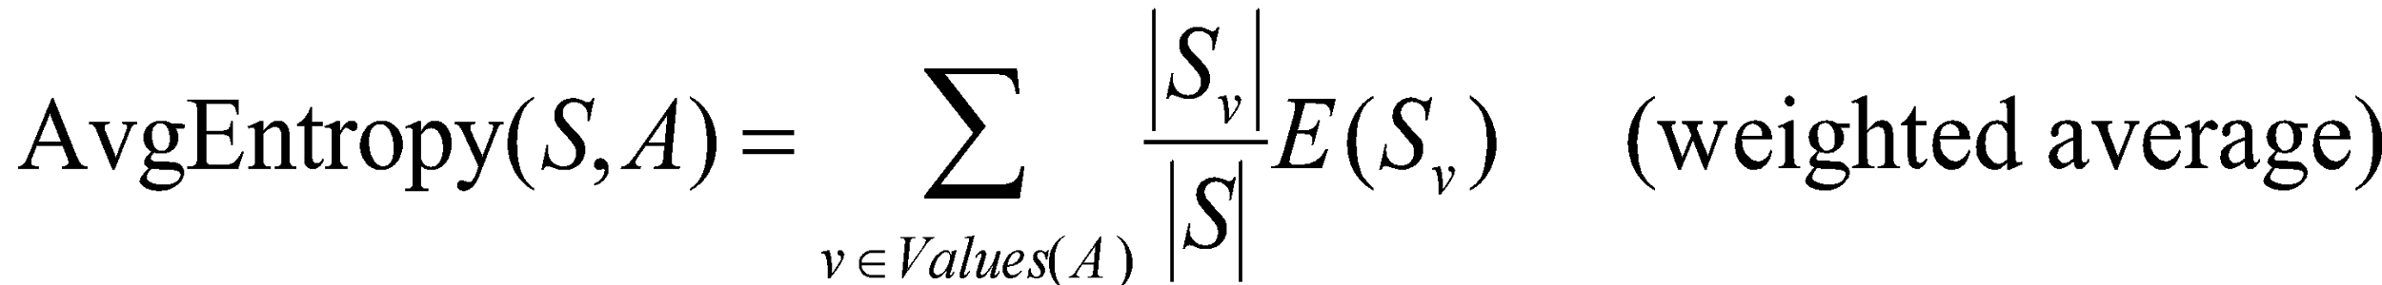
Partitioning the Data Set
Outlook | Temperature | Humidity | Windy | PlayTennis
Sunny | Hot | High | False | No
Sunny | Hot | High | True | No
Sunny | Mild | High | False | No
Sunny | Cool | Normal | False | Yes
Sunny | Mild | Normal | True | Yes
E = .97
Sunny
Outlook | Temperature | Humidity | Windy | PlayTennis
Overcast | Hot | High | False | Yes
Overcast | Cool | Normal | True | Yes
Overcast | Mild | High | True | Yes
Overcast | Hot | Normal | False | Yes
Outlook
Overcast
Average
Entropy = .64
(weighted .69)
E = 0
Rainy
Outlook | Temperature | Humidity | Windy | PlayTennis
Rainy | Mild | High | False | Yes
Rainy | Cool | Normal | False | Yes
Rainy | Cool | Normal | True | No
Rainy | Mild | Normal | False | Yes
Rainy | Mild | High | True | No
E = .97
Notes:
8

Slide 9
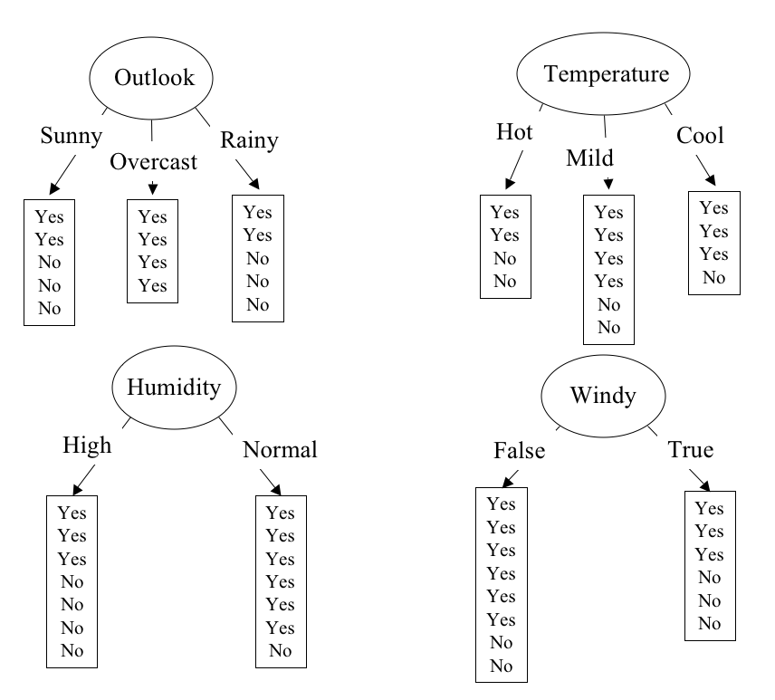
Partitioning in Action
E = .640
E = .789
E = .892
E = .911
Notes:
9

Slide 10
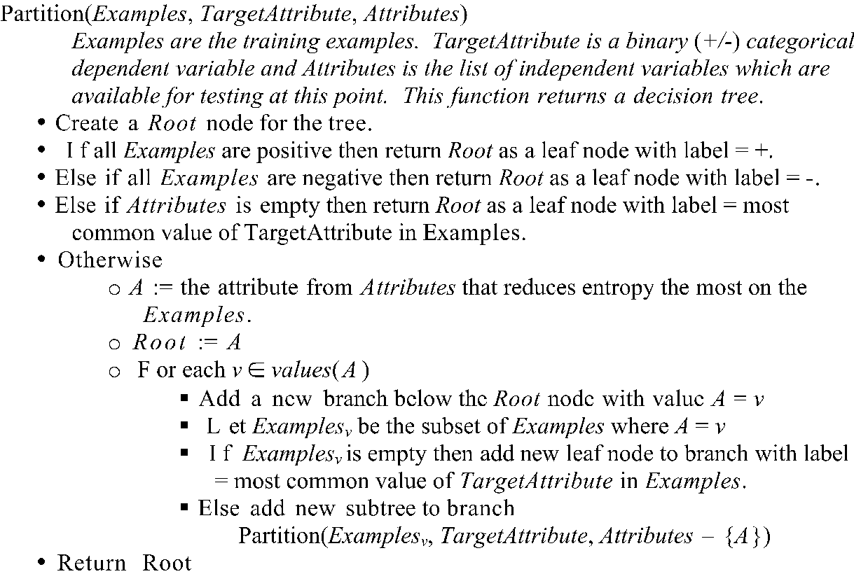
Recursive Partitioning
Based on material from the book: "Machine Learning", Tom M. Mitchell. McGraw-Hill, 1997.

Slide 11
Recursive Partitioning
Our data set:
Outlook | Temperature | Humidity | Windy | PlayTennis
Sunny | Hot | High | False | No
Sunny | Hot | High | True | No
Overcast | Hot | High | False | Yes
Rainy | Mild | High | False | Yes
Rainy | Cool | Normal | False | Yes
Rainy | Cool | Normal | True | No
Overcast | Cool | Normal | True | Yes
Sunny | Mild | High | False | No
Sunny | Cool | Normal | False | Yes
Rainy | Mild | Normal | False | Yes
Sunny | Mild | Normal | True | Yes
Overcast | Mild | High | True | Yes
Overcast | Hot | Normal | False | Yes
Rainy | Mild | High | True | No
Notes:
11

Slide 12
Recursive Partitioning
Sunny | Hot | High | False | No
Sunny | Hot | High | True | No
Overcast | Hot | High | False | Yes
Rainy | Mild | High | False | Yes
Rainy | Cool | Normal | False | Yes
Rainy | Cool | Normal | True | No
Overcast | Cool | Normal | True | Yes
Sunny | Mild | High | False | No
Sunny | Cool | Normal | False | Yes
Rainy | Mild | Normal | False | Yes
Sunny | Mild | Normal | True | Yes
Overcast | Mild | High | True | Yes
Overcast | Hot | Normal | False | Yes
Rainy | Mild | High | True | No
Outlook
Sunny | Hot | High | False | No
Sunny | Hot | High | True | No
Sunny | Mild | High | False | No
Sunny | Cool | Normal | False | Yes
Sunny | Mild | Normal | True | Yes
Rainy | Mild | High | False | Yes
Rainy | Cool | Normal | False | Yes
Rainy | Cool | Normal | True | No
Rainy | Mild | Normal | False | Yes
Rainy | Mild | High | True | No
Overcast | Hot | High | False | Yes
Overcast | Cool | Normal | True | Yes
Overcast | Mild | High | True | Yes
Overcast | Hot | Normal | False | Yes
Notes:
12

Slide 13
Recursive Partitioning
Outlook
Sunny | Hot | High | False | No
Sunny | Hot | High | True | No
Sunny | Mild | High | False | No
Sunny | Cool | Normal | False | Yes
Sunny | Mild | Normal | True | Yes
Rainy | Mild | High | False | Yes
Rainy | Cool | Normal | False | Yes
Rainy | Cool | Normal | True | No
Rainy | Mild | Normal | False | Yes
Rainy | Mild | High | True | No
Overcast | Hot | High | False | Yes
Overcast | Cool | Normal | True | Yes
Overcast | Mild | High | True | Yes
Overcast | Hot | Normal | False | Yes
Notes:
13

Slide 14
Recursive Partitioning
Outlook
Sunny | Hot | High | False | No
Sunny | Hot | High | True | No
Sunny | Mild | High | False | No
Sunny | Cool | Normal | False | Yes
Sunny | Mild | Normal | True | Yes
Rainy | Mild | High | False | Yes
Rainy | Cool | Normal | False | Yes
Rainy | Cool | Normal | True | No
Rainy | Mild | Normal | False | Yes
Rainy | Mild | High | True | No
Overcast | Hot | High | False | Yes
Overcast | Cool | Normal | True | Yes
Overcast | Mild | High | True | Yes
Overcast | Hot | Normal | False | Yes
Humidity
Sunny | Cool | Normal | False | Yes
Sunny | Mild | Normal | True | Yes
Sunny | Hot | High | False | No
Sunny | Hot | High | True | No
Sunny | Mild | High | False | No
Notes:
14

Slide 15
Recursive Partitioning
Outlook
Sunny | Hot | High | False | No
Sunny | Hot | High | True | No
Sunny | Mild | High | False | No
Sunny | Cool | Normal | False | Yes
Sunny | Mild | Normal | True | Yes
Rainy | Mild | High | False | Yes
Rainy | Cool | Normal | False | Yes
Rainy | Cool | Normal | True | No
Rainy | Mild | Normal | False | Yes
Rainy | Mild | High | True | No
Overcast | Hot | High | False | Yes
Overcast | Cool | Normal | True | Yes
Overcast | Mild | High | True | Yes
Overcast | Hot | Normal | False | Yes
Humidity
Windy
Sunny | Cool | Normal | False | Yes
Sunny | Mild | Normal | True | Yes
Sunny | Hot | High | False | No
Sunny | Hot | High | True | No
Sunny | Mild | High | False | No
Rainy | Mild | High | False | Yes
Rainy | Cool | Normal | False | Yes
Rainy | Mild | Normal | False | Yes
Rainy | Cool | Normal | True | No
Rainy | Mild | High | True | No
Notes:
15

