Slide 1
Logic as a Programming Language
Dr Lutz Hamel
Dept. of Computer Science & Statistics

Slide 2
Logic as a Programming Language
Here we take a look at First Order Logic as a computational model.
Resources:
https://github.com/lutzhamel/phl-prolog
https://www.ida.liu.se/~ulfni53/lpp/
http://www.doc.ic.ac.uk/~rak/papers/LogicForProblemSolving.pdf
http://www.swi-prolog.org

Slide 3
Logic as a Programming Language
Fundamental Question:
Can First Order Logic be considered a computational model?
Another way of asking the same question:
Is First Order Logic Turing Complete?
Turing Completeness: A system of data-manipulation
rules is said to be Turing complete if it can be used to
simulate any Turing machine (i.e. compute any algorithm).
-- Wikipedia

Slide 4
Quantification
In 1879 Gottlob Frege introduced the predicate calculus (‘Begriffsschrifft’)
Today predicate calculus is more commonly known as First Order Logic (FOL).
This logic is characterized by three structures:
predicates,
universal quantification, and
existential quantification.
Friedrich Ludwig Gottlob Frege
Philosopher and Logician

Slide 5
First-Order Logic
Quantified Variables
Universally quantified variables ∀X – for All objects X
Existentially quantified variables ∃Y – there Exists an object Y

Slide 6
First-Order Logic
Predicates
Predicates are functions that map their arguments into true/false
The signature of a predicate p(X) is
p: Objects → { true, false }
Example: human(X)
human: Objects → { true, false }
human(tree) = false
human(paul) = true
Example: mother(X,Y)
mother: Objects × Objects → { true, false }
mother(betty,paul) = true
Mother(giraffe,peter) = false

Slide 7
First-Order Logic
We can combine predicates and quantified variables to make statements on sets of objects
∃X[mother(X,paul)]
there exists an object X such that X is the mother of Paul
∀Y[human(Y)]
for all objects Y such that Y is human

Slide 8
First-Order Logic
Logical Connectives: and, or, not
∃F∀C[parent(F,C) and male(F)]
There exists an object F for all object C such that F is a parent of C and F is male.
∀X[day(X) and (wet(X) or dry(X))]
For all objects X such that X is a day and X is either wet or dry.

Slide 9
First-Order Logic
If-then rules: A → B
∀X∀Y[parent(X,Y) and female(X) → mother(X,Y)]
For all objects X and for all objects Y such that if X is a parent of Y and X is female then X is a mother.
∀Q[human(Q) → mortal(Q)]
For all objects Q such that if Q is human then Q is mortal.

Slide 10
Horn Clause Logic
In Horn clause logic the form of the WFF’s is restricted: P₁ ∧ P₂ ∧ … ∧ P_{n-1} ∧ P_{n} → P₀
Where P₀ , P₁ , P₂, … P_{n-1}, P_{n} are predicates.
Single predicate in consequent
Conjunctions only!
Horn Clause Logic is a Turing complete subset of First Order Logic.

Slide 11

Horn Clause Logic
Proof outline that Horn Clause Logic (HCL) is Turing complete:
$\text{HCL}⟺\text{μ}\text{-}\text{recursive} \text{functions}$ $⟺\text{Turing} \text{Machine}$

Slide 12
Computational Logic
Horn Clauses
Restricted FOL
Unification
Pattern matching where both pattern and subject term can have variables.
E.g. f(X,g(b)) ~ f(a,g(Y)) : { X = a, Y = b }
(SLD) Resolution
Modus Ponens kind of reasoning.
Think: search top to bottom, left to right, backtrack if you can’t find what you are looking for.
→ Prolog

Slide 13
Proving things is computation!
Advantage: All this can be done mechanically (Alan Robinson, 1965)
“Deduction is Computation”
J. Alan Robinson: A Machine-Oriented Logic Based on the Resolution Principle. J. ACM 12(1): 23-41 (1965)

Slide 14
Basic Prolog Programs
Facts - a fact constitutes a declaration of a truth; in Prolog it has to to be a positive assertion.
Prolog Programs - a Prolog program is a collection of facts (…and rules, as we will see later).
Example: a simple program
male(phil).
male(john).
female(betty).
Facts, Prolog will treat these as true and enters
them into its knowledgebase.
We execute Prolog programs by posing queries on its knowledgebase:
?- male(phil).
true - because Prolog can use its knowledgebase to prove true.
?- female(phil).
false - this fact is not in the knowledgebase.
Prompt
Prolog ≡ Programming in Logic

Slide 15
Prolog - Queries & Goals
A query is a way to extract information from a logic program.
Given a query, Prolog attempts to show that the query is a logical
consequence of the program; of the collection of facts.
In other words, a query is a goal that Prolog is attempting to satisfy (prove true).
When queries contain variables they are existentially quantified, consider
?- parent(X,liz).
The interpretation of this query is: prove that there is at least one object X
that can be considered a parent of liz, or formally, prove that
∃x[parent(x,liz)]
holds.
NOTE: Prolog will return all objects for which a query evaluates to true.

Slide 16
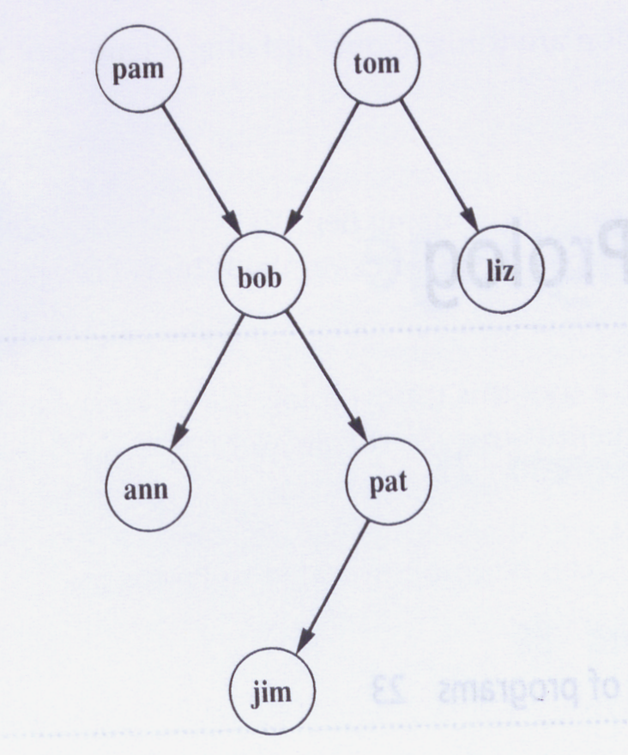
A Prolog Program
% a simple prolog program
female(pam).
female(liz).
female(ann).
female(pat).
male(tom).
male(bob).
male(jim).
parent(pam,bob).
parent(tom,bob).
parent(tom,liz).
parent(bob,ann).
parent(bob,pat).
parent(pat,jim).
Parent
Relation
Example Queries:
?- female(pam).
?- female(X). ∃X[female(X)]?
?- parent(tom,Z).
?- father(Y).
A Family Tree

Slide 17
Compound Queries
A compound query is the conjunction of individual simple queries.
Stated in terms of goals: a compound goal is the conjunction of individual
subgoals each of which needs to be satisfied in order for the compound goal
to be satisfied. Consider:
?- parent(X,Y) , parent(Y,ann).
or formally,
∃X,Y[parent(X,Y) ∧ parent(Y,ann)]
When Prolog tries to satisfy this compound goal, it will make sure that the
two Y variables always have the same values.
Prolog uses unification and backtracking in order to find all the solutions
which satisfy the compound goal.

Slide 18
Prolog Rules
Prolog rules are Horn clauses, but they are written “backwards”, consider:
∀X,Y[female(X) ∧ parent(X,Y) → mother(X,Y)]
is written in Prolog as
mother(X,Y) :- female(X) , parent(X,Y) .
Implies (“think of ←”)
Prolog rules a implicitly universally quantified!
“and”
head
body
You can think of a rule as introducing a new “fact” (the head), but the fact is defined in terms of a compound goal (the body). That is, predicates defined as
rules are only true if the associated compound goal can be shown to be true.

Slide 19
Prolog Rules
% a simple prolog program
female(pam).
female(liz).
female(ann).
female(pat).
male(tom).
male(bob).
male(jim).
parent(pam,bob).
parent(tom,bob).
parent(tom,liz).
parent(bob,ann).
parent(bob,pat).
parent(pat,jim).
mother(X,Y) :- female(X),parent(X,Y).
Queries:
?- mother(pam,bob).
?- mother(Z,jim).
?- mother(P,Q).

Slide 20
Prolog Rules
The same predicate name can be defined by multiple rules:
sibling(X,Y) :- sister(X,Y) .
sibling(X,Y) :- brother(X,Y).
Use backtracking to find alternative definitions.

Slide 21
Another Simple Prolog Program
Consider the program relating humans to mortality:
mortal(X) :- human(X).
human(socrates).
We can now pose the query:
?- mortal(socrates).
True or false?

Slide 22
Exercise
See GitHub Exercise #1

Slide 23
Declarative vs. Procedural Meaning
When interpreting rules purely as Horn clause logic statement → declarative
When interpreting rules as “specialized queries” → procedural
Observation: We design programs with declarative meaning in our minds,
but the execution is performed in a procedural fashion.
Consider:
mother(X,Y) :- female(X),parent(X,Y).

Slide 24
Lists & Pattern Matching
arity
The unification operator: =/2
The expression A=B is true if A and B are terms and unify (look identical)
?- a = a.
true
?- a = b.
false
?- a = X.
X = a
?- X = Y.
true

Slide 25
Lists & Pattern Matching
Lists – a convenient way to represent abstract concepts
Prolog has a special notation for lists.
[a]
[a,b,c]
[ ]
[ bmw, vw, mercedes ]
[ chicken, turkey, goose ]
Empty
List

Slide 26
Lists & Pattern Matching
Pattern Matching in Lists
?- [ a, b ] = [ a, X ].
X = b
?- [ a, b ] = X.
X = [ a, b ]
But:
?- [ a, b ] = [ X ].
no
The Head-Tail Operator: [H|T]
?- [a,b,c] = [X|Y]; X = a Y = [b,c] ?- [a] = [Q|P];
Q = a
P = [ ]

Slide 27
Lists - the First Predicate
The predicate first/2: accept a list in the first argument and return
the first element of the list in second argument.
first(List,E) :- List = [H|T], E = H.
or
first([H|_],H).

Slide 28
Lists - the Last Predicate
The predicate last/2: accept a list in the first argument and return
the last element of the list in second argument.
Recursion: there are always two parts to a recursive definition; the base and the recursive step.
last([A],A).
last([ _ |L],E) :- last(L,E).

Slide 29
Member Predicate
Write a predicate member/2 that takes a list as its first argument and an element as its second element. This predicate is to return true if the element appears in the list.
member([E|_],E).
member([_|T],E) :- member(T,E).

Slide 30
Exercise
Write a predicate that compares two lists and returns true if the lists are the same and false otherwise.
Notes:
Quiz #2 Friday 11/14 chapter 10-20, plus Prolog tutorial (see website)

Slide 31
Prolog – Arithmetic
Prolog is a programming language, therefore, arithmetic is implemented as expected.
The only difference to other programming languages is that assignment is done via the predicate is rather than the equal sign, since the equal sign has been used for the unification operator.
Examples:
?- X is 10 + 5;
X = 15
?- X is 10 + 5 * 6 / 3;
X = 20
Precedence and associativity of operators are respected.

Slide 32
Prolog – Arithmetic
Example: write a predicate definition for length/2 that takes
a list in its first argument and returns the length of the list
in its second argument.
length([ ], 0).
length(L, N) :- L = [H|T], length(T,NT), N is NT + 1.

Slide 33
Prolog – Arithmetic
Example: we can also use arithmetic in compound
statements.
?- X is 5, Y is 2 * X.
X = 5
Y = 10

Slide 34
Prolog – I/O
write(term)
is true if term is a Prolog term, writes term to the terminal.
read(X)
is true if the user types a term followed by a period, X becomes unified to the term.
nl
is always true and writes a newline character on the terminal.
Extra-logical predicates due to the side-effect of writing/reading to/from the terminal.

Slide 35
Prolog – I/O
?- write(tom).
tom
?- write([1,2]).
[1, 2]
?- read(X).
|: boo.
X = boo
?- read(Q).
|: [1,2,3].
Q = [1, 2, 3]
Prolog I/O Prompt

Slide 36
Prolog – I/O
Example: write a predicate definition for fadd/1 that
takes a list of integers, adds 1 to each integer in the list,
and prints each integer onto the terminal screen.
fadd([ ]).
fadd([ H | T ]) :- I is H + 1, write(I), nl, fadd(T).

Slide 37
Exercises
Define a predicate max/3 that takes two numbers as its first two arguments and unifies the last argument with the maximum of the two.
Define a predicate maxlist/2 takes a list of numbers as its first argument and unifies the second argument with the maximum number in the list. The predicate should fail if the list is empty.
Define a predicate ordered/1 that takes a list of numbers as its argument and succeeds if and only if the list is in non-decreasing order.
Notes:
/* max(X,Y,Z) succeeds if the max of numbers X and Y is Z. X and Y must be instantiated. */ max(X,Y,X) :- X >= Y. max(X,Y,Y) :- X < Y.
/* maxlist(L,M) succeeds if the max in the list L of numbers is M. L must be fully instantiated. */ maxlist([X],X). maxlist([A,B|Rest],X) :- max(A,B,C), maxlist([C|Rest],X).
/* ordered(L) succeeds if the list of numbers L is in non-decreasing order. The list must be fully instantiated. */ ordered([]). ordered([_]). ordered([X,Y | Rest]) :- X =< Y, ordered([Y | Rest]).

Slide 38
A Translation Program
Write a program that takes simple English statements and translates
them into German. The sentences are given as lists of words.
% the dictionary
lookup(logic,logik).
lookup(is,macht).
lookup(fun,spass).
% the translation procedure
translate([],[]).
translate([W|S],G):-
lookup(W,GW),
translate(S,GS),
G=[GW|GS].

Slide 39
Interaction Loops
Write a program that prompts a user for a list, then reads the list, reverses the elements of the list and then prints out the reversed list to the terminal. It then returns to prompting the user for a new list, etc.
interact:-
nl,
write('gimme a list> '),
read(X),
reverse(X,Y),
write('this is the reverse: '),
write(Y),
nl,
!,interact.
A Cut

Slide 40
Exercise
Prolog Exercise 2

