Slide 1
OpenStack
Block Storage Service
Codename: Cinder
Deepti Ramakrishna
Software Engineer, Intel

Slide 2
OpenStack storage concepts
 | Ephemeral storage | Block storage | Object storage
Used to | Run operating system and scratch space | Add additional persistent storage to a VM | VM images, disk volume snapshots etc
Accessed through | A file system | A block device that can be partitioned, formatted, and mounted (such as, /dev/vdc) | REST API
Accessible from | Within a VM | Within a VM | Anywhere
Managed by | Nova | Cinder | Swift
Persists until | VM is terminated | Deleted by user | Deleted by user
Sizing determined by | Administrator configuration of size settings, known as flavors | User specification in initial request | Amount of available physical storage
Example of typical usage | 10 GB first disk, 30 GB second disk | 1 TB disk | 10s of TBs of dataset storage
http://docs.openstack.org/ops-guide/arch_storage.html

Slide 3
What is Cinder?
Provides persistent block storage resources (volumes) to VMs
These volumes can be detached from one instance and re-attached to another, and the data remains intact
Currently a volume can be attached to only one instance at a time
Volumes have lifecycle independent of VM instance
Plugin driver architecture allows multiple choices for backend storage
Analogous to Amazon Elastic Block Store (EBS)

Slide 4
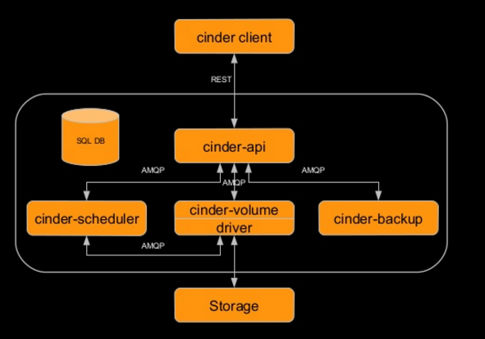
Cinder architecture
cinder-client: CLI/UI to make a request
cinder-api: Accepts and routes the requests
cinder-scheduler: Schedules and routes requests to the appropriate volume service
cinder-volume: Manages Block Storage devices
driver: Contains back-end specific code to communicate with various storage types
Storage: Different vendor’s back-end storage devices
SQL DB: Keeps track of volumes in use
cinder-backup: Provides a means to backup a volume to Swift/Ceph etc
http://www.slideshare.net/avishaytraeger/cinder-havana

Slide 5
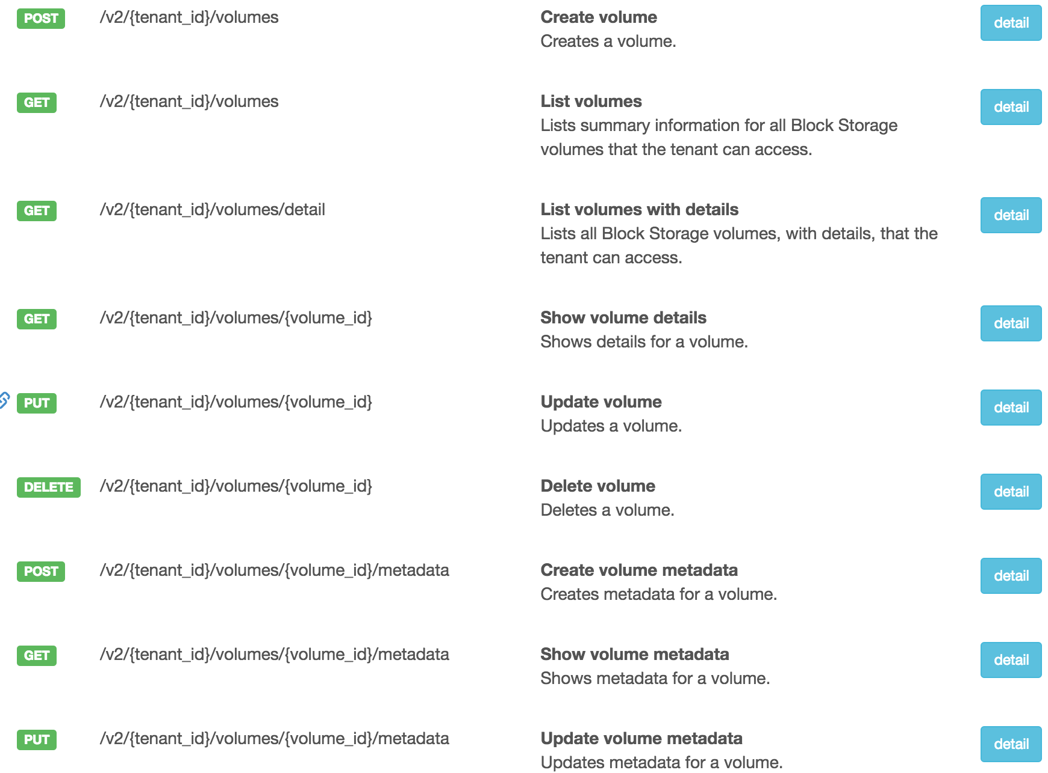
Volume API
http://developer.openstack.org/api-ref-blockstorage-v2.html

Slide 6
Cinder drivers
Cinder driver maps Cinder requests to the commands required on the external storage platform.
Linux LVM
Storage controllers from various hardware-specific vendors
Distributed file systems
Currently 50+ drivers in github
https://github.com/openstack/cinder/tree/master/cinder/volume/drivers
https://wiki.openstack.org/wiki/CinderSupportMatrix
To set a volume driver, use the volume_driver flag in cinder.conf Default is:
volume_driver = cinder.volume.drivers.lvm.LVMISCSIDriver

Slide 7
Default: LVM based implementation
Logical Volume Management (LVM)
LVM maps physical block devices onto higher-level virtual block devices
Cinder-volumes are created as Logical Volumes by using LVM
Uses iSCSI protocol to connect volumes to compute nodes
Not vendor specific

Slide 8
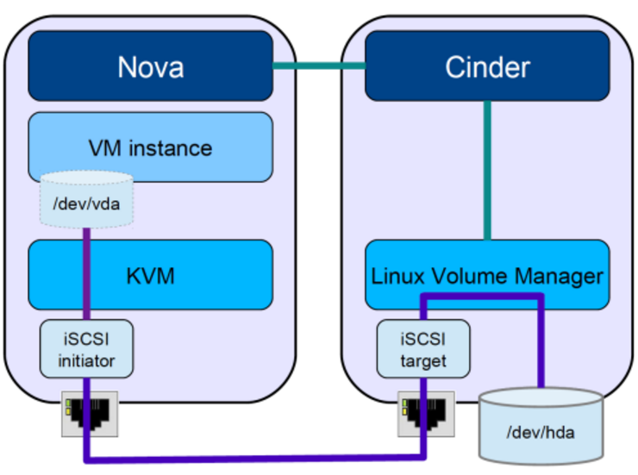
Volume attach flow
https://cloudarchitectmusings.com/2013/11/18/laying-cinder-block-volumes-in-openstack-part-1-the-basics/

Slide 9
Volume status
Status | Description
creating | The volume is being created
available | The volume is ready to attach to an instance
attaching | The volume is attaching to an instance
in-use | The volume is attached to an instance
deleting | The volume is being deleted
error | A volume creation error occurred
error_deleting | A volume deletion error occurred
backing_up | The volume is being backed up
restoring_backup | A backup is being restored to the volume
error_restoring | A backup restoration error occurred
error_extending | An error occurred while attempting to extend a volume

Slide 10
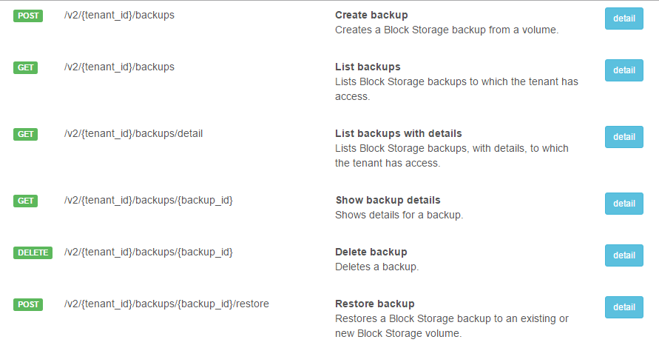
Cinder backup (c-bak)
A backup is an archived copy of a volume. Backups are stored in an object store.
cinder backup-create [--incremental] [--force] <VOLUME-ID>
incremental is a flag that indicates whether an incremental backup should be performed
force is a flag that allows or disallows backup of a volume when the volume is attached to an instance (in-use)

Slide 11
Volume types
Volume Type is an abstraction of various properties of a volume
Only admins can create tiers of storage
Differentiator based on performance, cost etc
E.g: two LVM backends - one with SSDs, one with HDDs
User can then specify a tier they want when creating a volume

Slide 12
Advanced features
Snapshot
A snapshot is a point-in-time copy of the data that a volume contains
A snapshot would live on the same storage back-end as the active volume
Quota
Admins set this limit on volume, backup and snapshot capacity depending on policy settings
Volume transfer
Transfer a volume from one user to another use
Encryption
Encryption is done by Nova using dm-crypt which is a transparent disk encryption subsystem in Linux kernel
Migration (Admin only)
Move data from the current back-end for the volume to a new one
2 main flows depending on whether the volume is attached or not to an instance

Slide 13
Useful Links
Current v2 API
http://developer.openstack.org/api-ref-blockstorage-v2.html
Source code
https://github.com/openstack/cinder
Blueprints
https://blueprints.launchpad.net/cinder
Bugs
https://bugs.launchpad.net/cinder/+bugs
Code Review
https://review.openstack.org/#/q/project:+openstack/cinder

Slide 14
Lab session

Slide 15
CLI commands
Verify all services are up and running
$ pstree
Verify Cinder service is running
$ pgrep -l cinder
Help commands
$ cinder help
$ cinder help <sub-command>
E.g: cinder help create
Source as an admin (user) of admin (project)
List cinder services
$ cinder service-list
List volume types
$ cinder type-list
Show details of the default lvm-driver 1 volume type
$ cinder type-show <TYPE-ID>
Review /etc/cinder/cinder.conf details
Source as a demo (user) of demo (project)
Create a volume with name test
$ cinder create 1 --display-name test
List volumes
$ cinder list
Place where you can find your newly created volume
$ cd /dev/stack-volumes-lvmdriver-1

Slide 16
CLI commands - continued
Extend cinder volume
$ cinder extend <VOLUME-ID> <NEW-SIZE>
This works only when volume is not attached to an instance
Create an instance
$ nova boot --image <IMAGE-NAME> --flavor m1.tiny <VM-NAME>
Attach cinder volume to this nova instance
$ nova volume-attach <INSTANCE-ID> <VOLUME-ID>
Attach cinder volume to this nova instance
$ nova volume-attach <INSTANCE-ID> <VOLUME-ID>
Show how the above volume is private by sourcing as demo (user) of invisible_to_admin (project)
$ source openrc demo invisible_to_admin
$ cinder list
Review user/project concept again
Source back as a demo (user) of demo (project)
Try deleting cinder volume - this fails
$ cinder delete <VOLUME-ID>
Detach this cinder volume from nova instance
$ nova volume-detach <INSTANCE-ID> <VOLUME-ID>
Now “Attached to” in cinder list should be empty
Now delete cinder volume
$ cinder delete <VOLUME-ID>

Slide 17
Advanced CLI
https://www.youtube.com/watch?v=DvnoCTjLuWY
Play data security video which shows
As an admin, create a new volume-type which supports encryption
As a demo user, create a volume of encrypted volume-type
Making file system and mounting the newly created volume
Create a file in that volume with some text and show how it gets encrypted.

Slide 18
Thank You!

